Slide 1
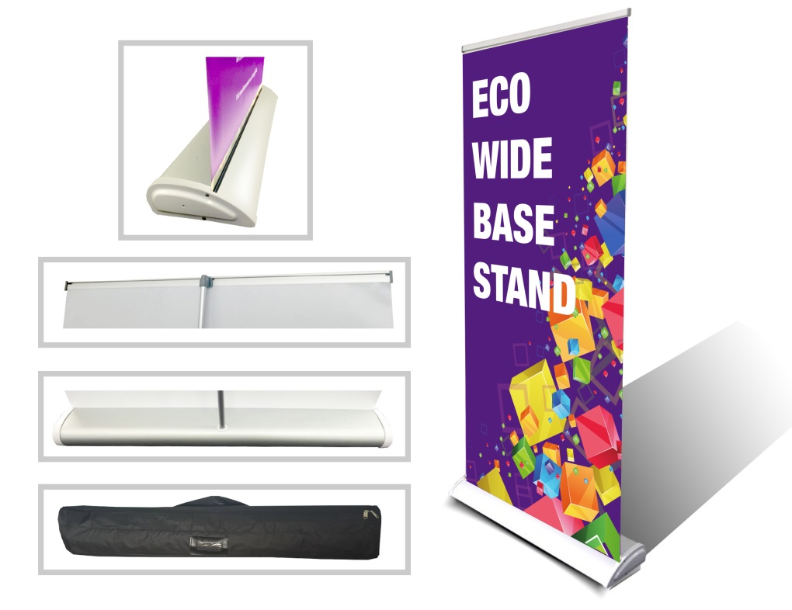
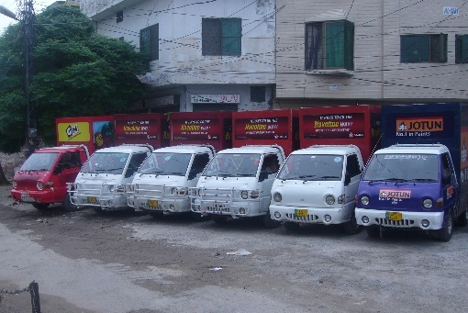
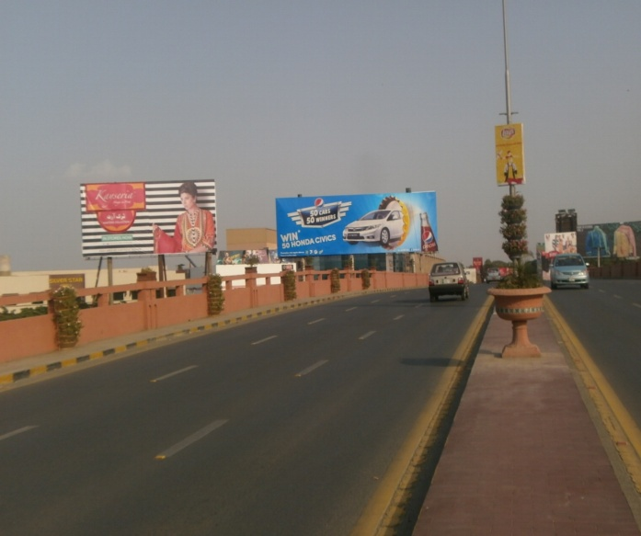
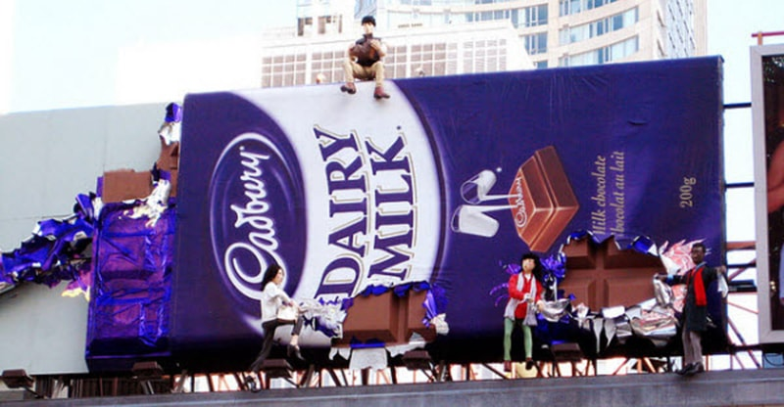
What we Do
Ad Solution
Advertising
Mobile Float
BTL Activities
Bill Boards/Hoardings
All Kinds of Pana Flex /Vinyl Printing
Offset Printing
X/Rollup Stand
Signage (New installation and Maintenance)

Slide 2
Ad Solution
Advertising
Proposal for
Billboards in Lahore

Slide 3
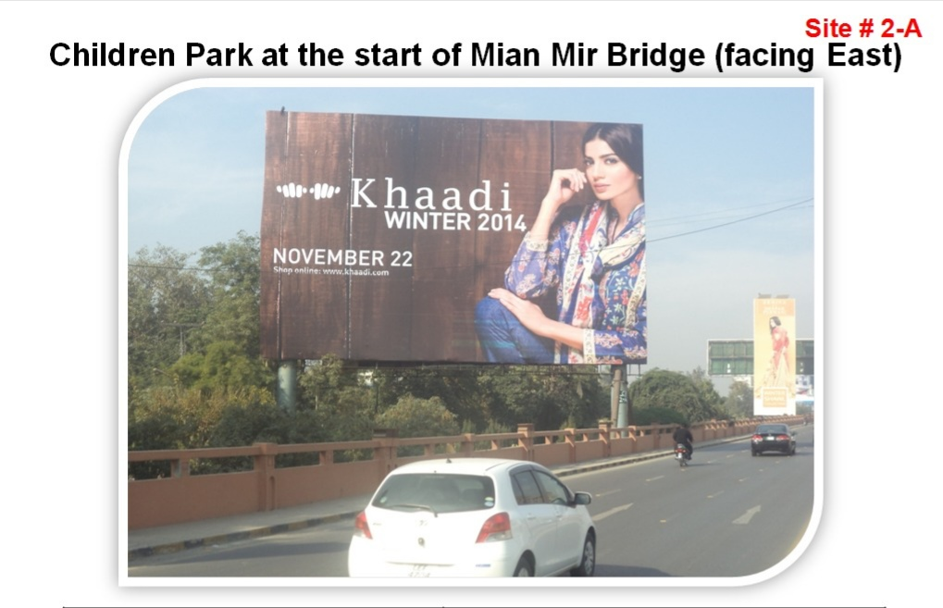
Lahore
Size | 60x40
Availability
Rate P/M | Rs: 2.5 million
Location | Direction
Mian Mir Bridge | TFCF Fortress towards Mall road

Slide 4
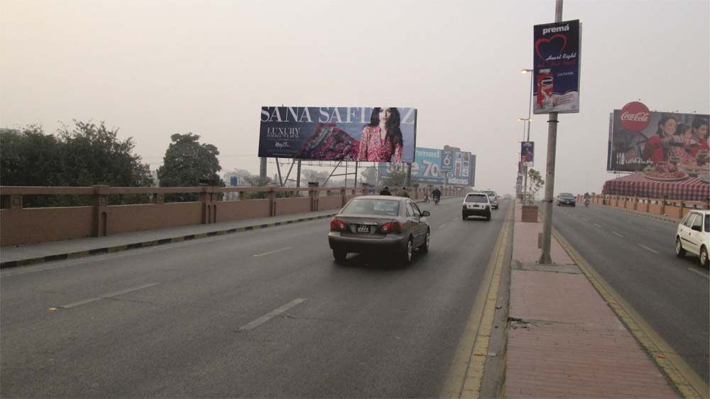
Lahore
Size | 60x20
Availability
Rate P/M | Rs: 800,000 P/M
Location | Direction
Mian Mir Bridge | TFCF Fortress towards Mall road

Slide 5
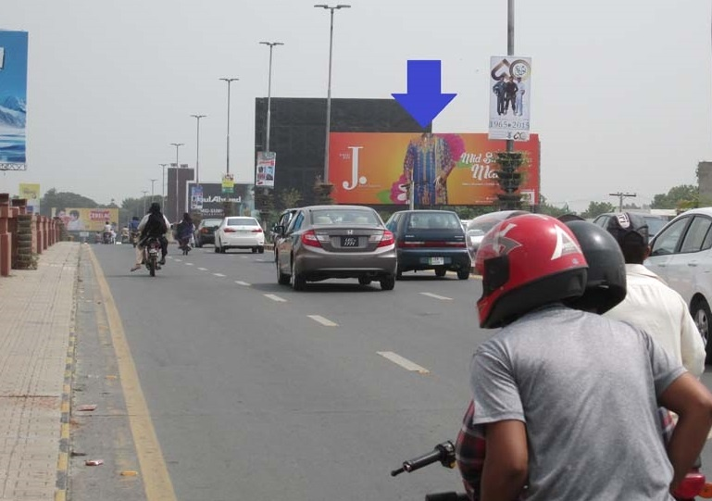
Lahore
Size | 60x20
Availability
Rate P/M | Rs: 1.3-Million P/M
Location | Direction
Mian Mir Bridge | TFCF Mall road towards Cantt and Fortress

Slide 6
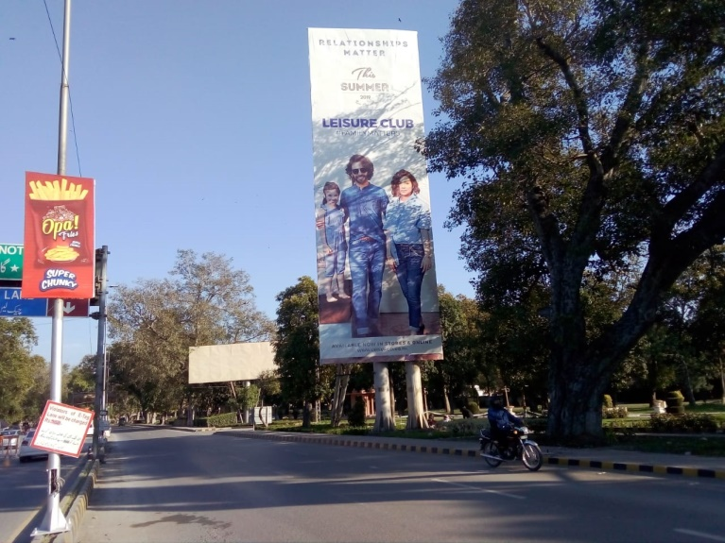
Lahore
Size | 20x60
Availability
Rate P/M | Rs: 1.4 Million
Location | Direction
Mian Mir Bridge | TFCF Mall road towards Cantt and Fortress

Slide 7
Lahore
Size | 20x60
Availability
Rate P/M | Rs:1.5 Million
Location | Direction
Mian Mir Bridge | TFCF Fortress and Cantt towards Mall road and Mian Mir bridge

Slide 8
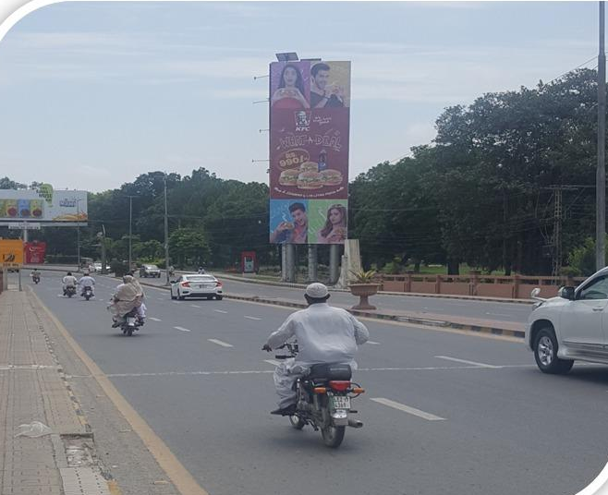
Lahore
Size | 20x60
Availability
Rate P/M | Rs: 1.6 Million
Location | Direction
Mian Mir Bridge | TFCF Mall road towards Fortress and Cantt

Slide 9
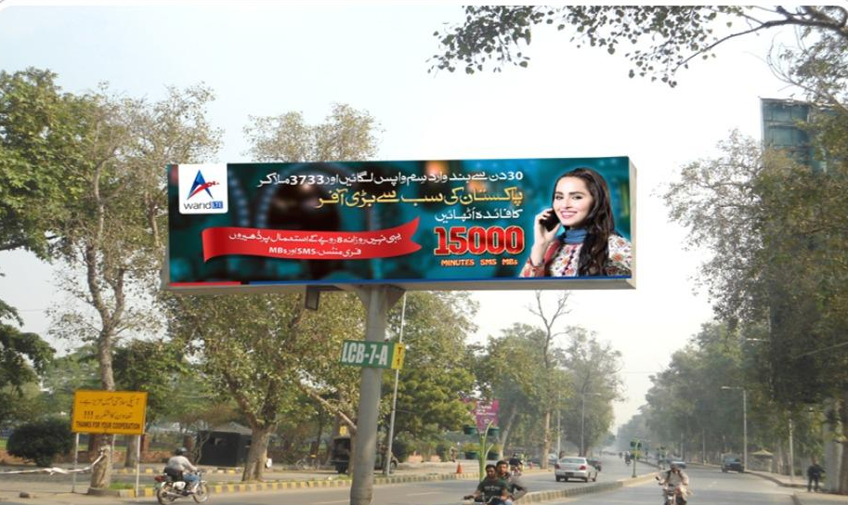
Lahore
Size | 30x8 Double sided
Availability
Rate P/M | Rs:700,000/-
Location | Direction
Fortress T- Sign | TFCF Mall Road towards Cantt and Fortress

Slide 10
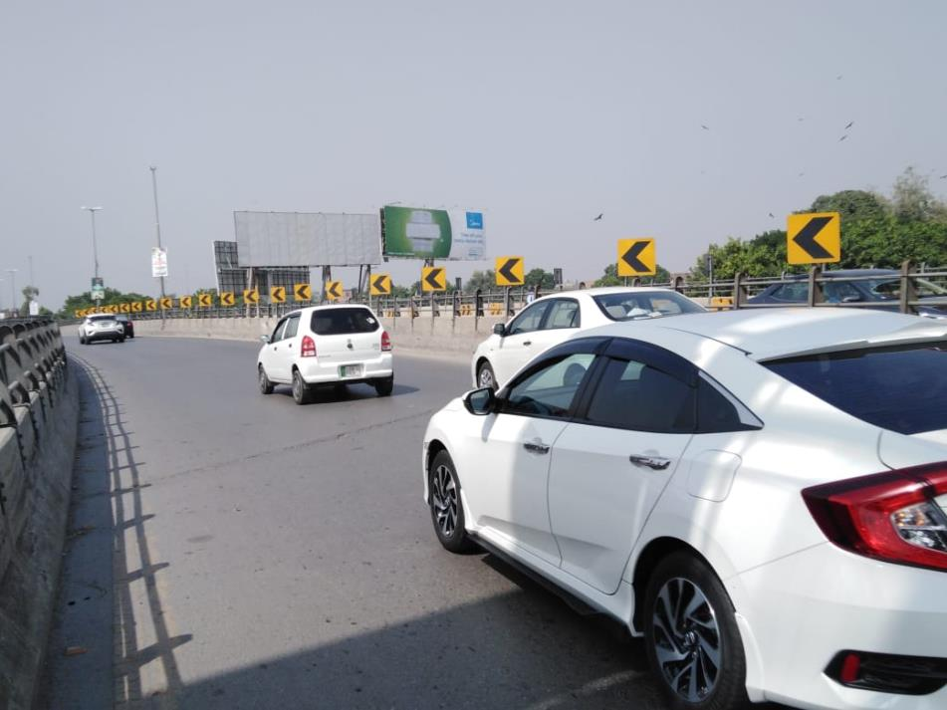
Lahore
Size | 60x20
Availability | N/A
Rate P/M | Rs: 850,000- P/M
Location | Direction
Sher Pao Bridge | FTCF: Cantt towards gulberg

Slide 11
Lahore
Size | 30x8 Double Sided
Availability
Rate P/M | Rs:700,000/-
Location | Direction
Sherpao Bridge | TFCF Sherpao Bridge towards Cantt and Girja chowk

Slide 12
Lahore
Size | 90x30
Availability
Rate P/M | Rs:2.6 Million
Location | Direction
SherPao Bridge | TFCF Jail road towards Cantt and Shami road

Slide 13
Lahore
Size | 20x60
Availability
Rate P/M | Rs:1.5 Milion
Location | Direction
Sharpao Bridge | TFCF Shami road, Cantt towards Sherpao Bridge

Slide 14
Lahore
Size | 20x60
Availability
Rate P/M | Rs:850,000 P/M
Location | Direction
Sharpao Bridge | TFCF Jail road towards Shami road and Cantt

Slide 15
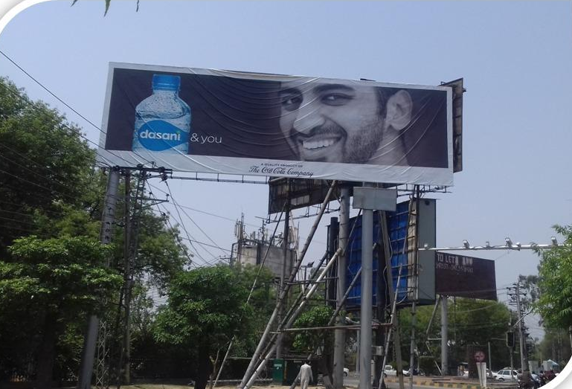
Lahore
Size | 60 x 20
Availability
Rate P/M | Rs: 850,000 P/M
Location | Direction
Shami Road | TFCF Shami road, Cantt, Girja Chowk towards Sherpao Bridge

Slide 16
Lahore
Size | 20x60
Availability
Rate P/M | Rs:1.4 Million
Location | Direction
Shami Road Near Shall Pump | TFCF Cavalry towards Cantt and SherPao Bridge

Slide 17
Lahore
Size | 20x60
Availability
Rate P/M | Rs:1.4 Million
Location | Direction
Shami Road Near Shall Pump | TFCF Cantt and Sherpao Bridge towards Cavalry and DHA

Slide 18
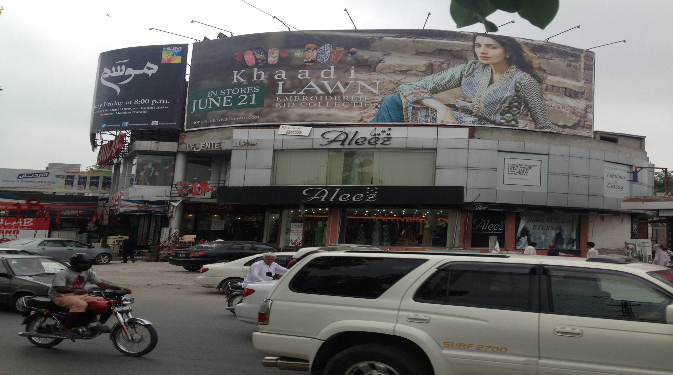
Lahore
Size | 60x20
Availability | Available
Rate P/M | Rs: 850,000- P/M with lights
Location | Direction
Hussain Chowk | FTCF:Liberty Xinua Mall /,MM Alam toward Firdous Market Signal

Slide 19
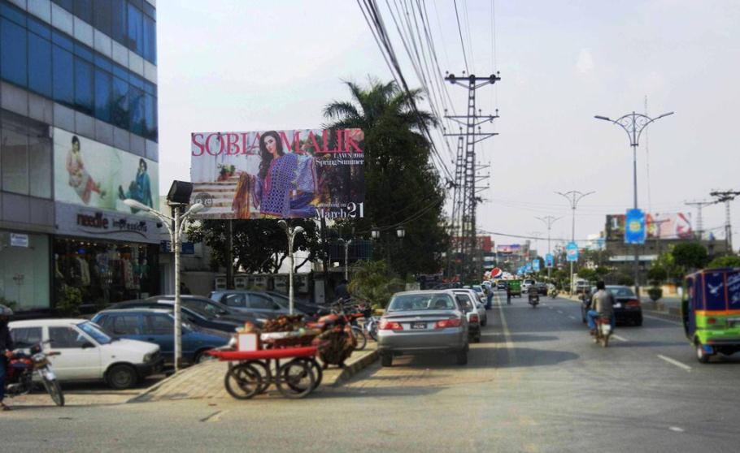
Lahore
Size | 30x15
Availability | N/A
Rate P/M | Rs: 425,000- P/M
Location | Direction
Blue Mall MM Alam road | FTCF:Hussain chowk towards mini Market roundabout

Slide 20
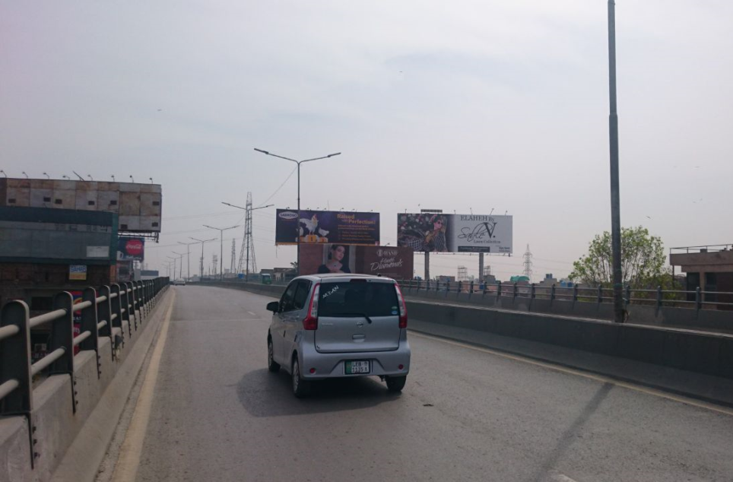
Lahore
Size | 60x20
Availability | N/A
Rate P/M | Rs: 1-Million
Location | Direction
Jinnah Bridge | FTCF:Firdous market towards cavlary signal,DHA

Slide 21
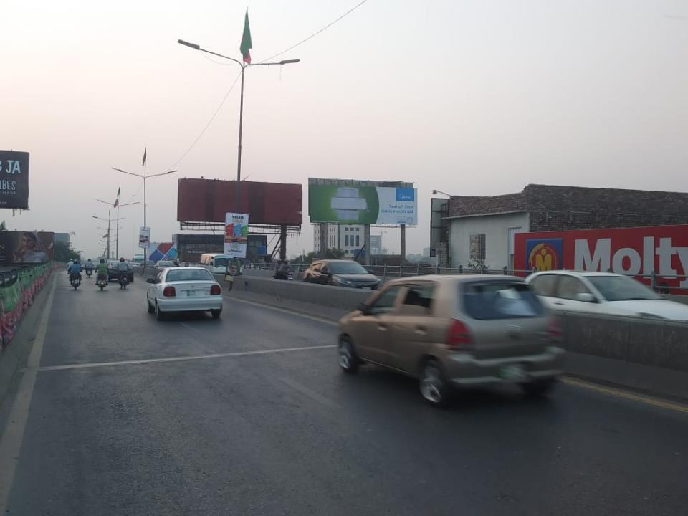
Lahore
Size | 60x20
Availability | N/A
Rate P/M | Rs: 850,000 P/M
Location | Direction
Jinnah Bridge | FTCF:Cavalary,DHA towards firdous Market

Slide 22
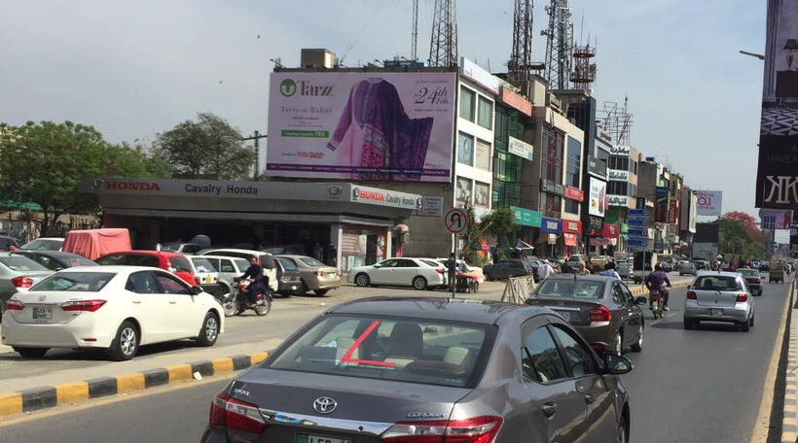
Lahore
Size | 45x24
Availability
Rate P/M | Rs:700,000-P/M
Location | Direction
Cavlary Ground | FTCF:Gulberg/Firdous market towards Khalid Butt chowk,Cantt/DHA

Slide 23
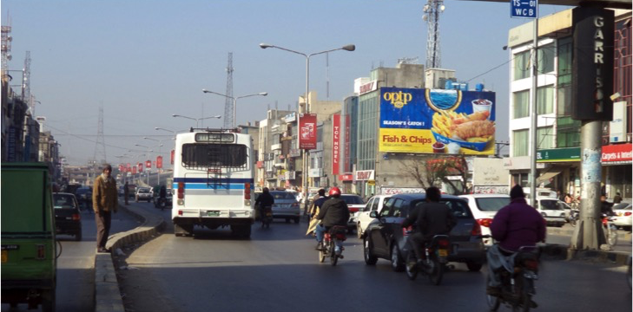
Lahore
Size | 45x25
Availability
Rate P/M | Rs: 700,000-P/M
Location | Direction
Cavlary Gruound | FTCF:Khalid but cowk/DHA towards firdous market/Gulbarg

Slide 24
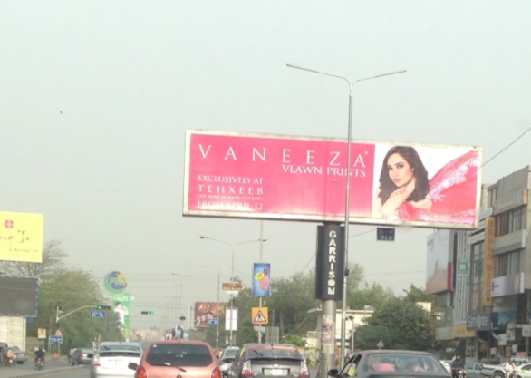
Lahore
Size | 30x8 double Sided
Availability
Rate P/M | Rs: 700,000-P/M
Location | Direction
Cavlary Ground T-Sign Double sided | FTCF:Khalid but cowk/DHA towards firdous market/Gulbarg double side view

Slide 25
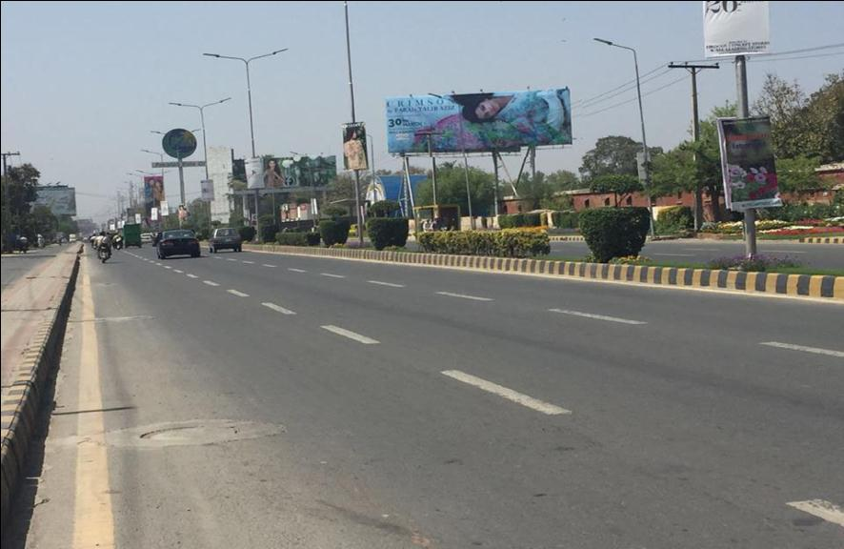
Lahore
Size | 60x20
Availability
Rate P/M | Rs: 1.3 Million- P/M
Location | Direction
Masood Anwari Road | FTCF:Chand Mari chowk/DHA towards Khalid but chowk/Jinnah Bridge

Slide 26
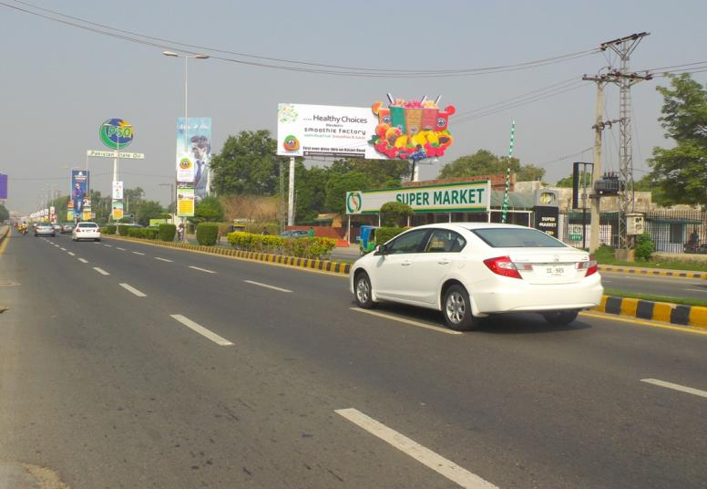
Lahore
Size | 60x20
Availability
Rate P/M | Rs: 1.4 Million- P/M
Location | Direction
Masood Anwari Road | FTCF: Chand Mari chowk/DHA towards Khalid but chowk/Jinnah Bridge

Slide 27
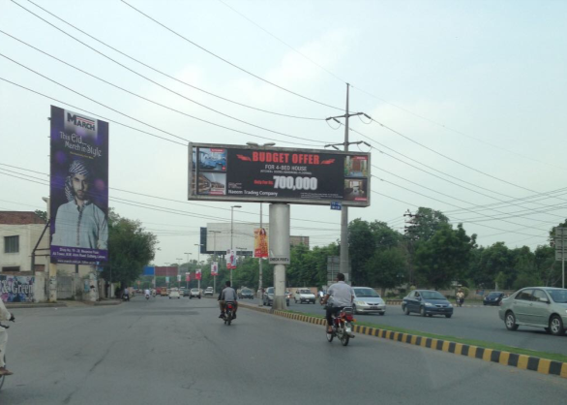
Lahore
Size | 30 x8 Double sided
Availability
Rate P/M | Rs: 700,000-P/M
Location | Direction
Defence More | FTCF:Ghora chowk towards DHA/walton packges mall

Slide 28
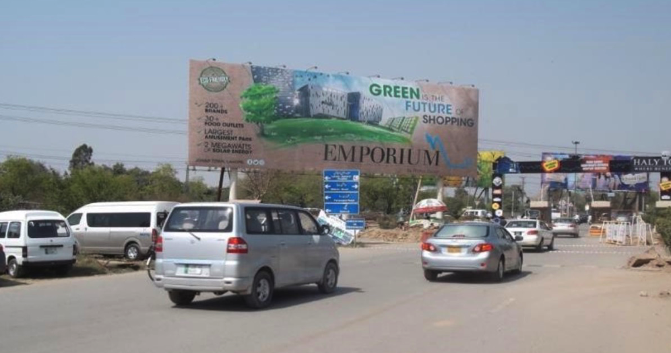
Lahore
Size | 90x30
Availability
Rate P/M | Rs: 2-Million
Location | Direction
DHA Exit Khayaban-e-Iqbal | FTCF:DHA Y& Z Block commercial towards walton road packages mall

Slide 29
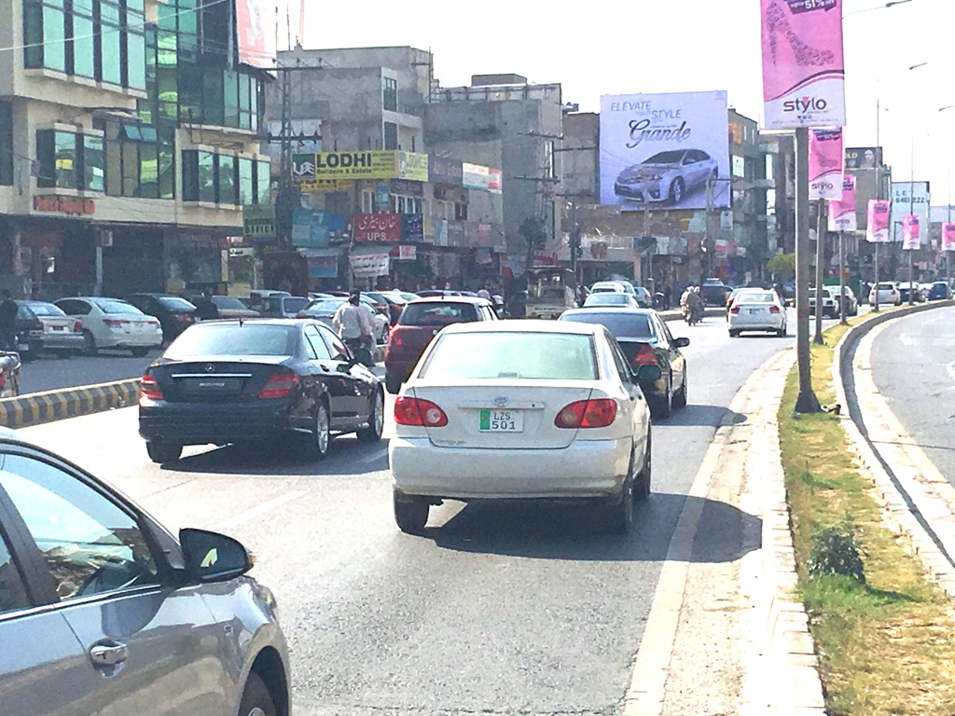
Lahore
Size | 32x34
Availability
Rate P/M | Rs: 750,000- P/M
Location | Direction
Main Bulevard DHA | FTCF:H,Block ,Masjid Chowk towards Defence More,Cahand MariChowk/Walton

Slide 30
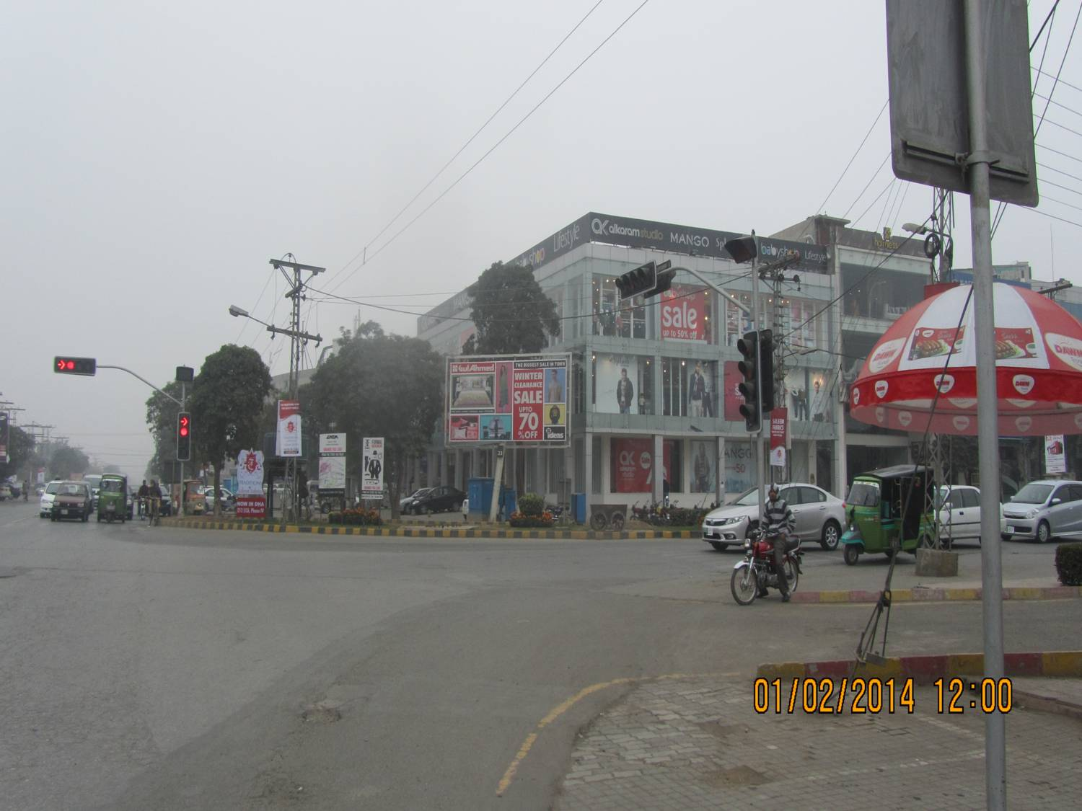
Lahore
Size | 20x10
Availability
Rate P/M | Rs: 650,000- P/M
Location | Direction
DHA Y-Block | FTCF:Ghazi chowk.W,Block going towards Y& Z Block Commercial

Slide 31
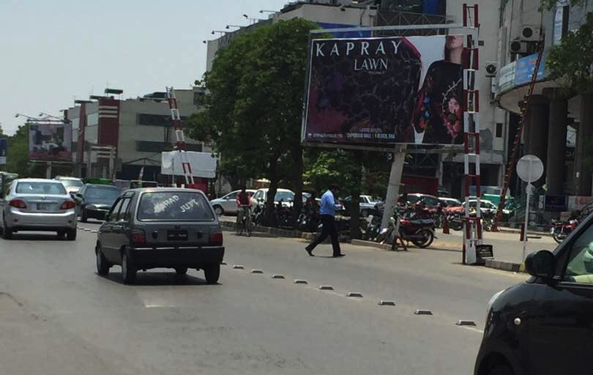
Lahore
Size | 20x10
Availability
Rate P/M | Rs: 600,000- P/M
Location | Direction
DHA Y-Block | FTCF:Ghazi chowk.W,Block going towards Y& Z Block Commercial

Slide 32
Lahore
Size | 20 x 10
Availability
Rate P/M | Rs: 575,000
Location | Direction
DHA- Y Block (HKB Store) | FTCF Ghazi Chowk, Z, W Block & going towards Y, Z Commercial Block

Slide 33
Lahore
Size | 20 x 10
Availability
Rate P/M | Rs: 500,000
Location | Direction
DHA- Y Block (InFrontPot Pori) | FTCF Ghazi Chowk, Z, W Block & going towards Y, Z Commercial Block

Slide 34
Lahore
Size | 20 x 10
Availability
Rate P/M | Rs: 600,000
Location | Direction
DHA- W Block | DHA Z Block Signal TGT from Y Block to Ghazi Chowk PSO Petrol pump

Slide 35
Lahore
Size | 20x10
Availability
Rate P/M | Rs: 600,000
Location | Direction
DHA- W Block | DHA Z Block Signal TGT from Y Block to Ghazi Chowk PSO Petrol pump

Slide 36
Lahore
Size | 20 x 10
Availability
Rate P/M | Rs: 600,000
Location | Direction
DHA-W Block | DHA W Block (Facing traffic coming from DHA Y Block and going towards Ghazi Chowk)

Slide 37
Lahore
Size | 20 x 10
Availability
Rate P/M | Rs: 600,000
Location | Direction
DHA- DD Block | DHA Phas4 Opp Bread and Beyond Bakery Traffic coming towards Y Block

Slide 38
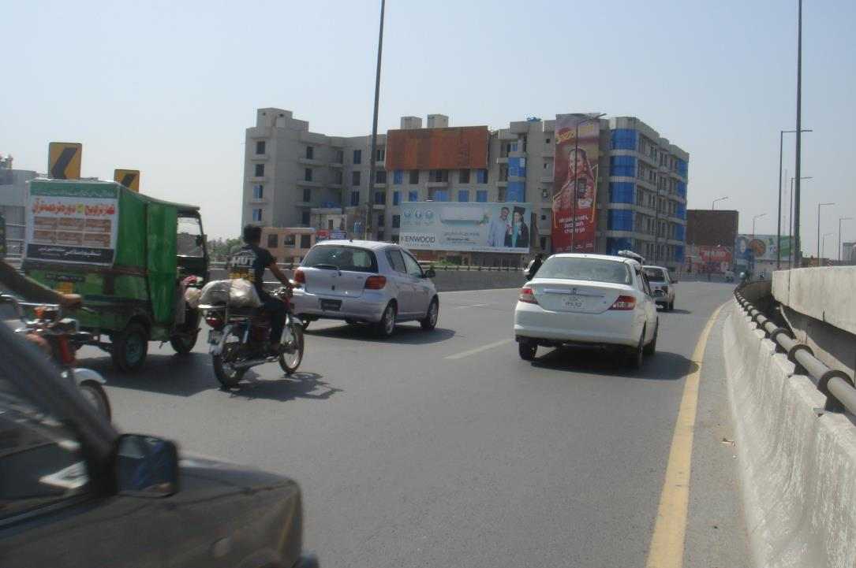
Lahore
Size | 60x20
Availability
Rate P/M | Rs: 600,000- P/M
Location | Direction
Muslim Town Fly over | FTCF:Qazafi Stadium/Kalma Chowk towards wahdat Road ,Ichra,Mazang

Slide 39
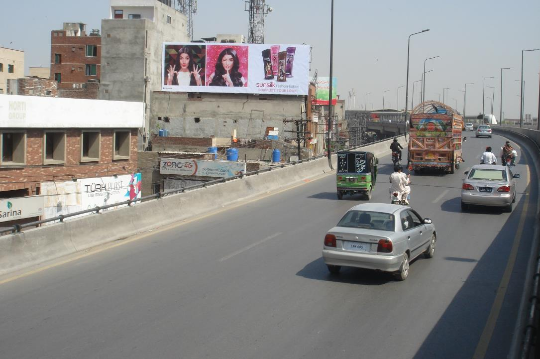
Lahore
Size | 60x20
Availability
Rate P/M | Rs:600,000- P/M
Location | Direction
Muslim Town Fly over | FTCF:Ichra towards Qazafi Stadium/Kalma Chowk

Slide 40
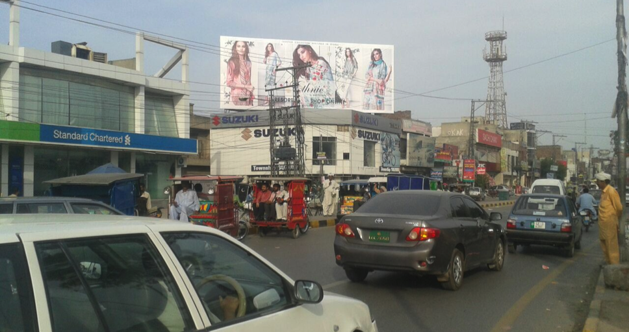
Lahore
Size | 50x20
Availability
Rate P/M | Rs: 600,000- P/M
Location | Direction
Akbar Chowk | FTCF:Jinnah Hospital/College Road, Faisal town Towards Model Town Link Road/Peco More

Slide 41
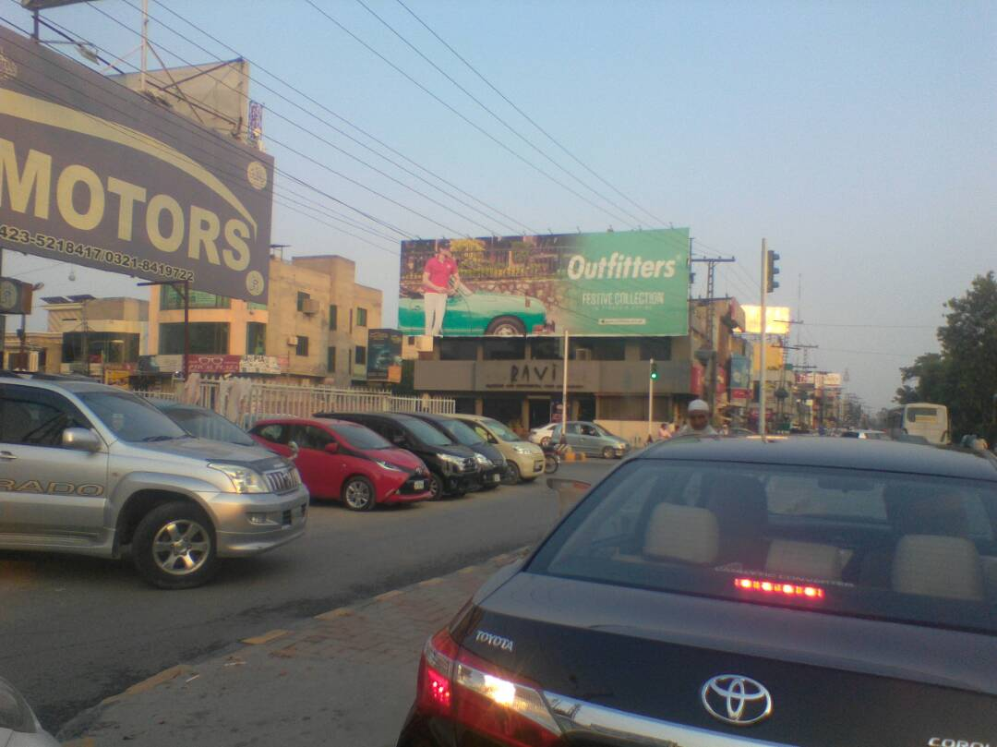
Lahore
Size | 60x20
Availability
Rate P/M | Rs: 550,000- P/M
Location | Direction
Ravi Resturant Signal Molana Shaukat Ali Road | FTCF:Canal /Jinnah Hospital Towards Akbar Chowk/Shouk Chowk Johar Town

Slide 42
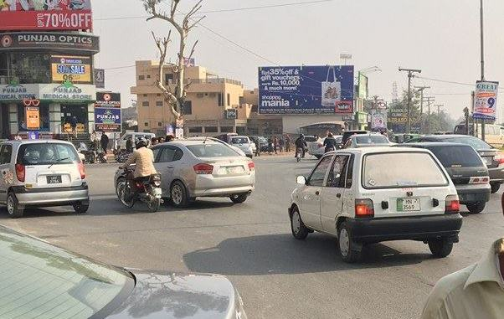
Lahore
Size | 40x20
Availability
Rate P/M | Rs: 600,000- P/M
Location | Direction
Wapda Town Roundabout | FTCF:Wapda Town Going towards Akbar Chowk/Ameer Chowk

Slide 43
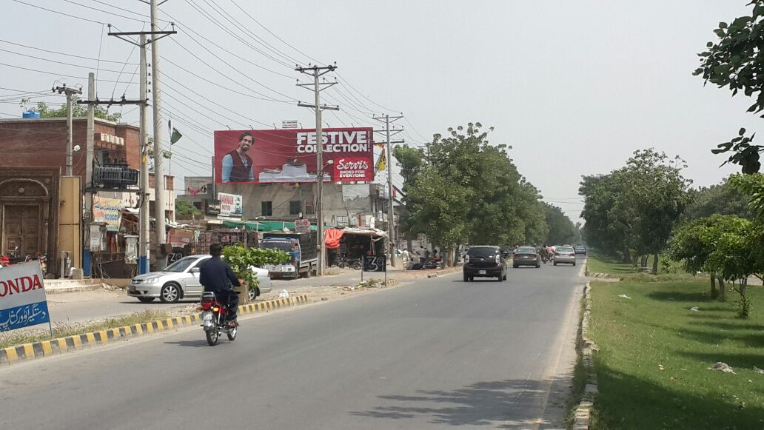
Lahore
Size | 60x20
Availability | Available
Rate P/M | Rs: 550,000- P/M
Location | Direction
Emporium Mall Johar Town | FTCF:Expo Center towards G-Block market Johar town

Slide 44
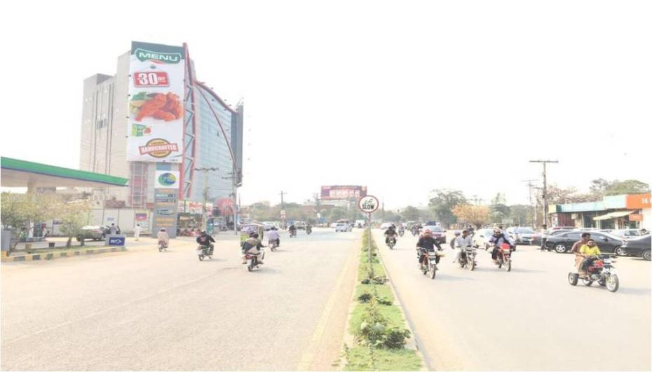
Lahore
Size | 20x60
Availability | 18 March 2019
Rate P/M | Rs: 700,000- P/M
Location | Direction
G-1 Market Johar Town | FTCF:Johar Town G-1 Market Facing traffic coming from /Doctors Hospital going towards Lahore Emporium

Slide 45
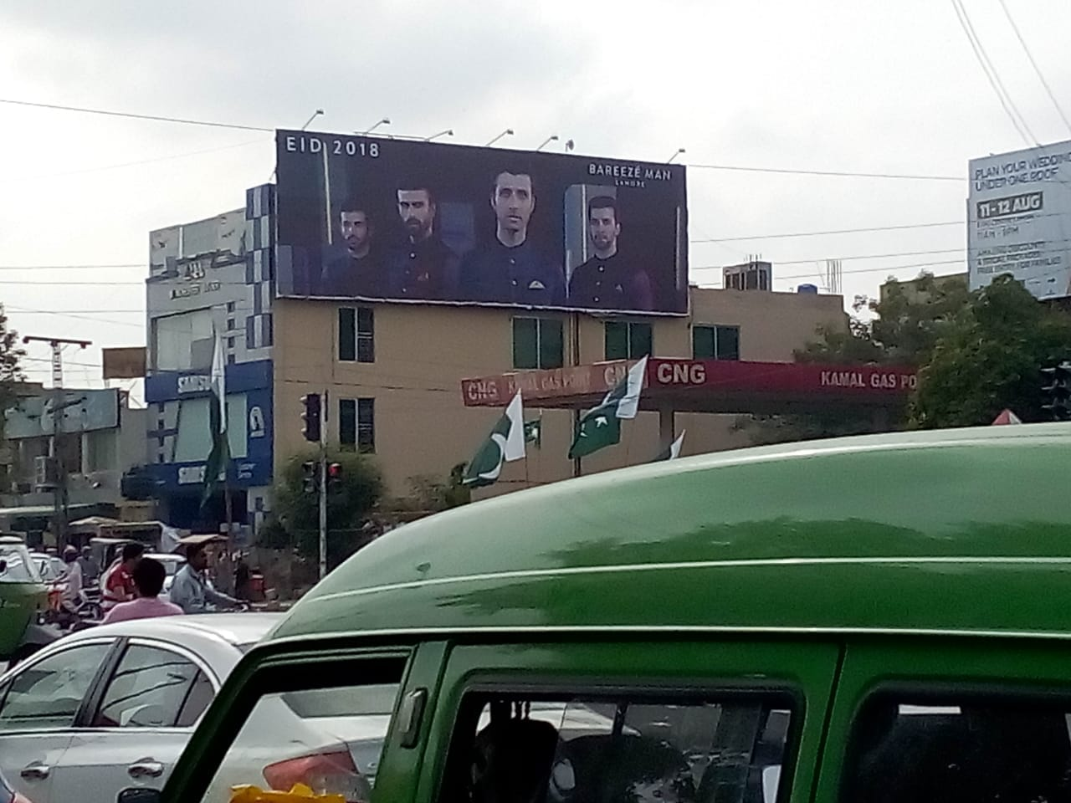
Lahore
Size | 60x20
Availability
Rate P/M | Rs: 650,000- P/M
Location | Direction
Johar town | FTCF:Lahore Emporium going towards G 1 Market/Doctors Hospital

Slide 46
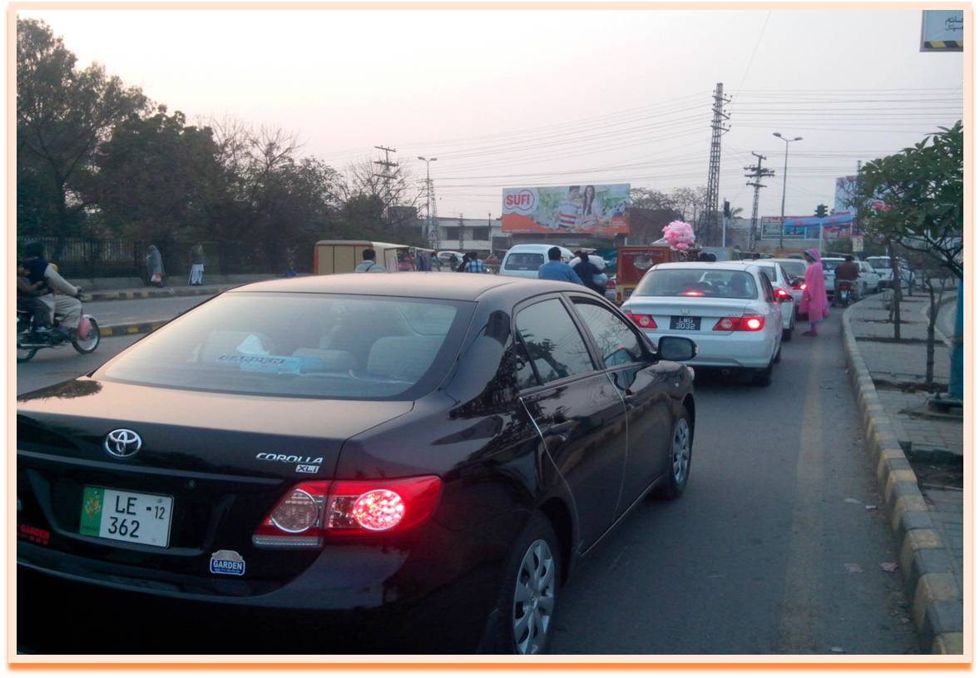
Lahore
Size | 60x20
Availability
Rate P/M | Rs: 600,000- P/M
Location | Direction
Bekhy wall More | FTCF:Punjab University campus towards Wahdat Road /Iqbal Town/Multan Road

Slide 47
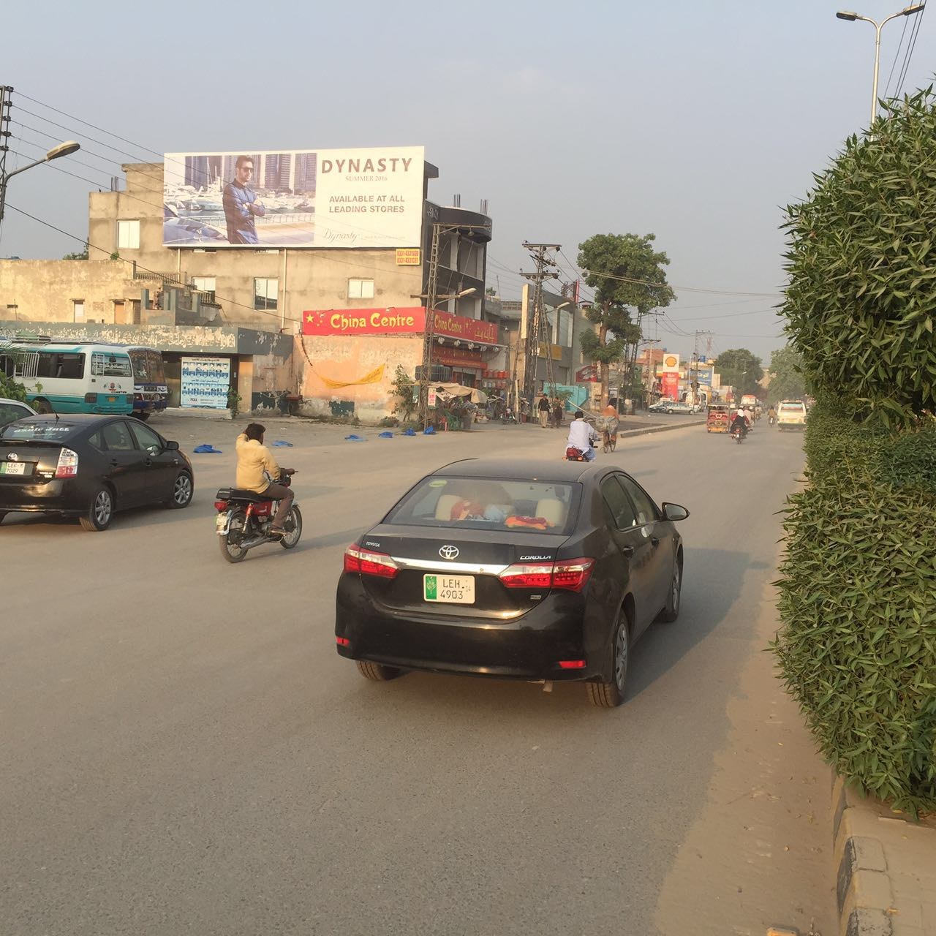
Lahore
Size | 60x20
Availability
Rate P/M | Rs: 550,000
Location | Direction
Iqbal Town Main Bulevard | FTCF:Multan Road /Scheeme More Going towards Moon Market/karim Block ,Whadat Road

Slide 48
Lahore
Size | 60 x 20
Availability
Rate P/M | Rs:350,000
Location | Direction
Canal Bahria road | TFCF Thokar towards Bahria, Shahkam Chowk

Slide 49
Lahore
Size | 60 x 20
Availability
Rate P/M | Rs:350,000
Location | Direction
Canal Bahria road | TFCF Bahria and Shahkam Chowk towards Thokar, EME

Slide 50
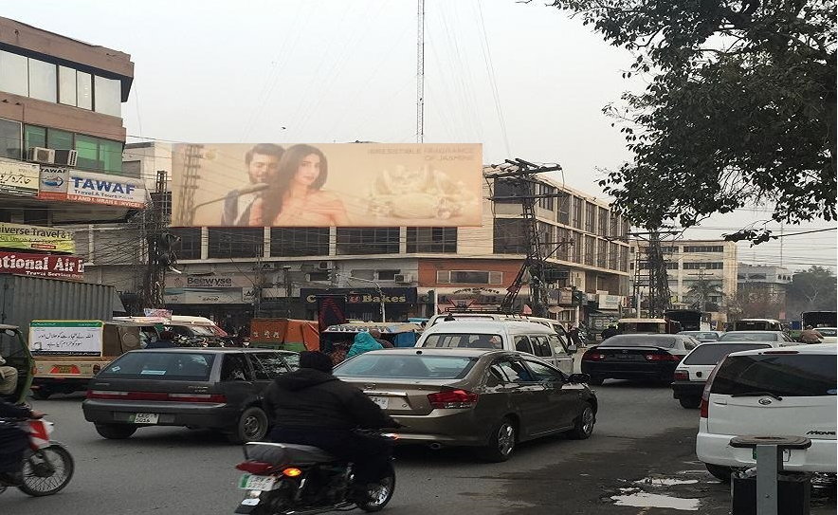
Lahore
Size | 60x20
Availability
Rate P/M | Rs:450,000- P/M
Location | Direction
Shimla Hill Signal | FTCF:Press club/ railway station going towards Ambassador Hotel & Ghari Shahu

Slide 51
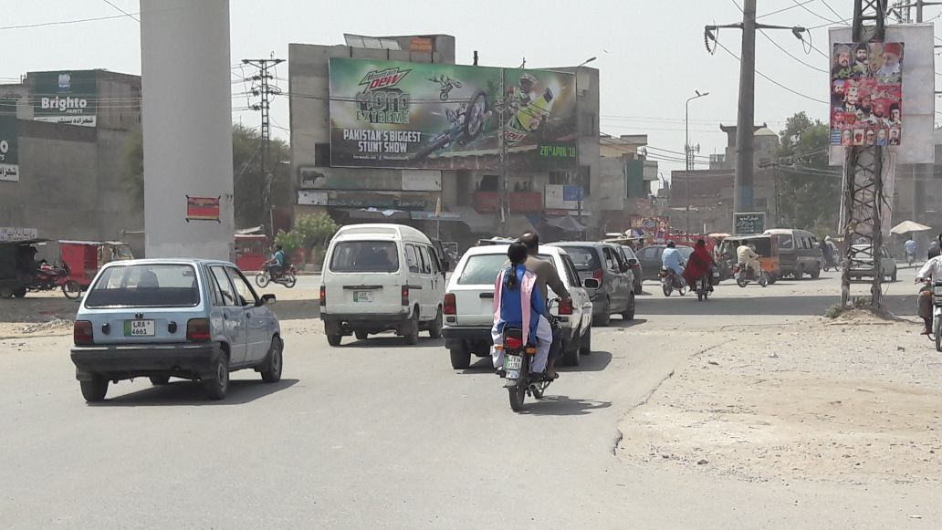
Lahore
Size | 60x20
Availability
Rate P/M | Rs: 550,000
Location | Direction
Kareem Block Iqbal Town | FTCF:Kareem Block Market,Iqbal Town,Moon Market towards Multan Road, Liaqat Chowk

Slide 52
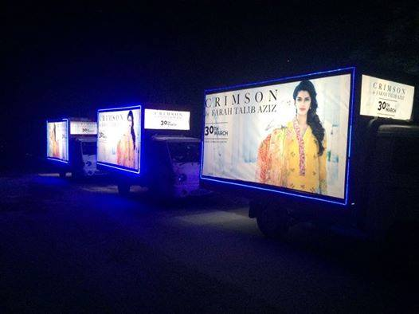
Lahore
Size | 12x6 Both Sides
Availability
Rate P/M | Rs:425,000- P/M Each
Location | Direction
Only PHA Areas | FTCF:Lahore PHA Areas only

Slide 53
Ad Solution
TERMS & CONDITIONS
First time skin installation and removing is free.
Skin printing charges are not included in the proposed rates.
These rates are exclusive of all kinds of taxes.
If skin is damaged due to weather, changing/re-printing charges will be borne by the client.
The payment will be made 50% in advance and the remaining balance will be payable through 15 days post dated cheque, from the day, the display starts.
For locking the sites please inform us within 1-3 working days.

