Slide 1
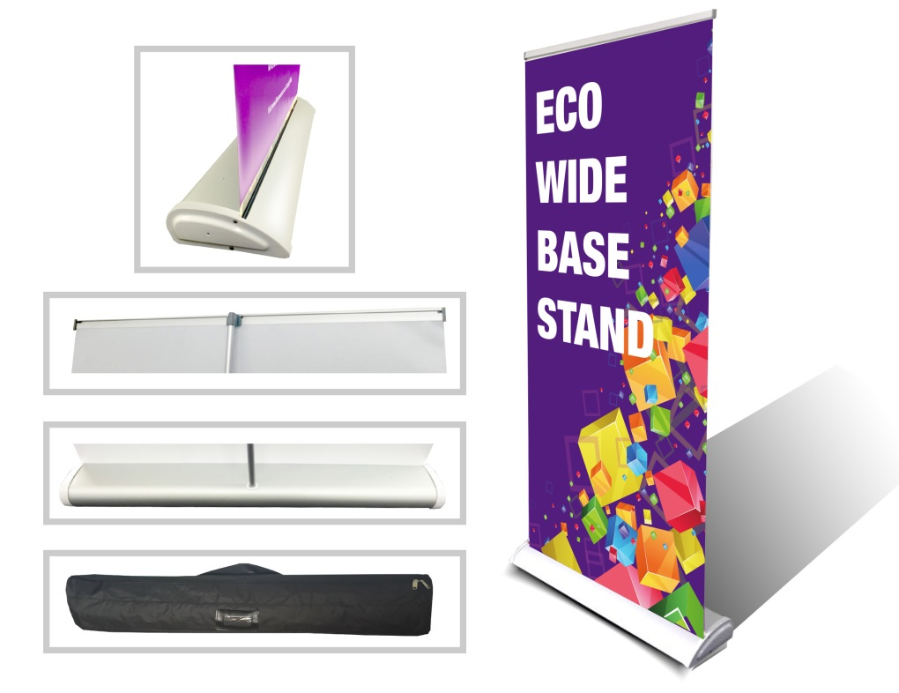
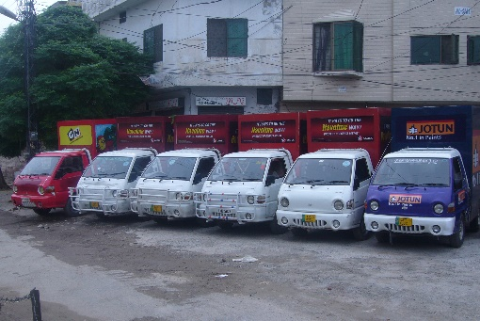
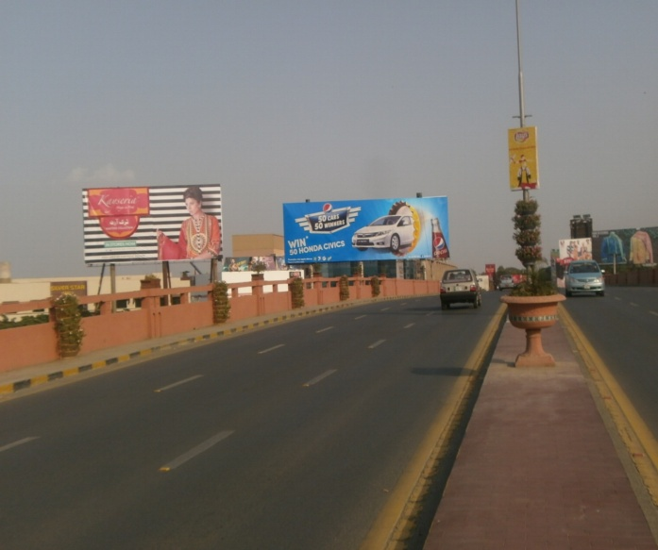
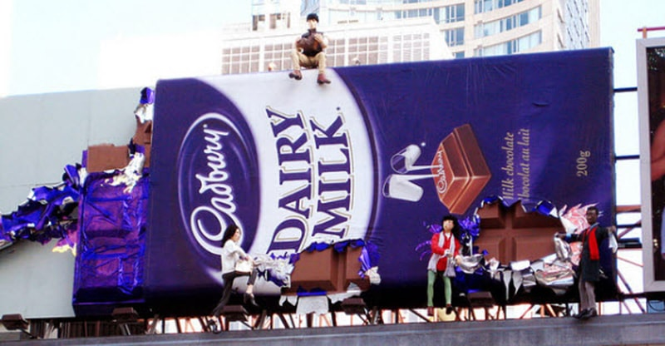
What we Do
Ad Solution
Advertising
Mobile Float
BTL Activities
Bill Boards/Hoardings
All Kinds of Pana Flex /Vinyl Printing
Offset Printing
X/Rollup Stand
Signage (New installation and Maintenance)

Slide 2
Ad Solution
Advertising
Proposal for
Billboards in Multan

Slide 3
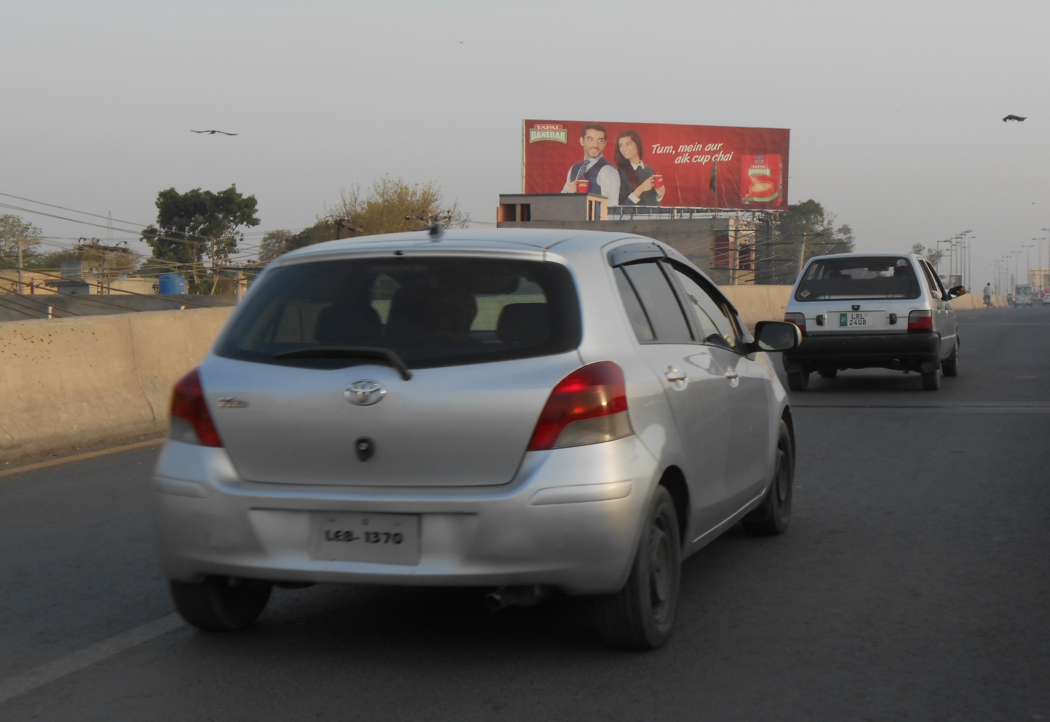
Multan
Size | 60x20
Availability | Available
Rate P/M | Rs:225,000
Location | Direction
Aziz Hotel Cantt Bridge | FTCF:SP Chowk, Mall Plaza & Railway Station towards Mumtazabad, Vehari Road & Khuraim Mandi Road

Slide 4
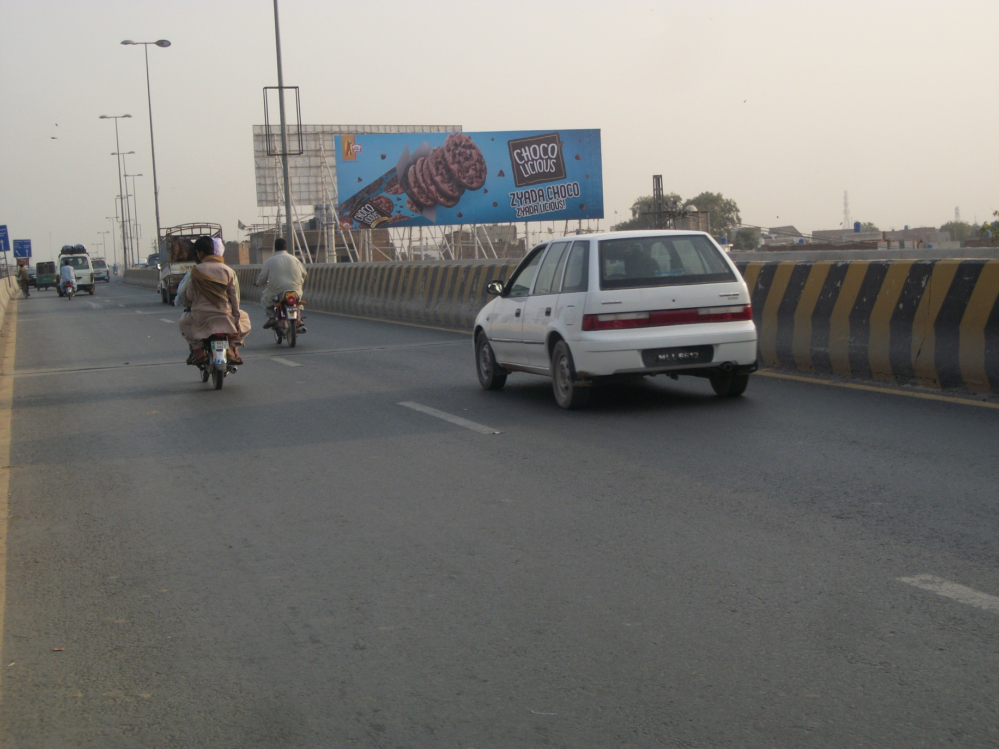
Multan
Size | 60x20
Availability | Available
Rate P/M | Rs:225,000
Location | Direction
Aziz Hotel Cantt Bridge Multan Cantt | FTCF: SP Chowk, Mall Plaza & Railway Station towards Mumtazabad, Vehari Road & Khuraim Mandi Road

Slide 5
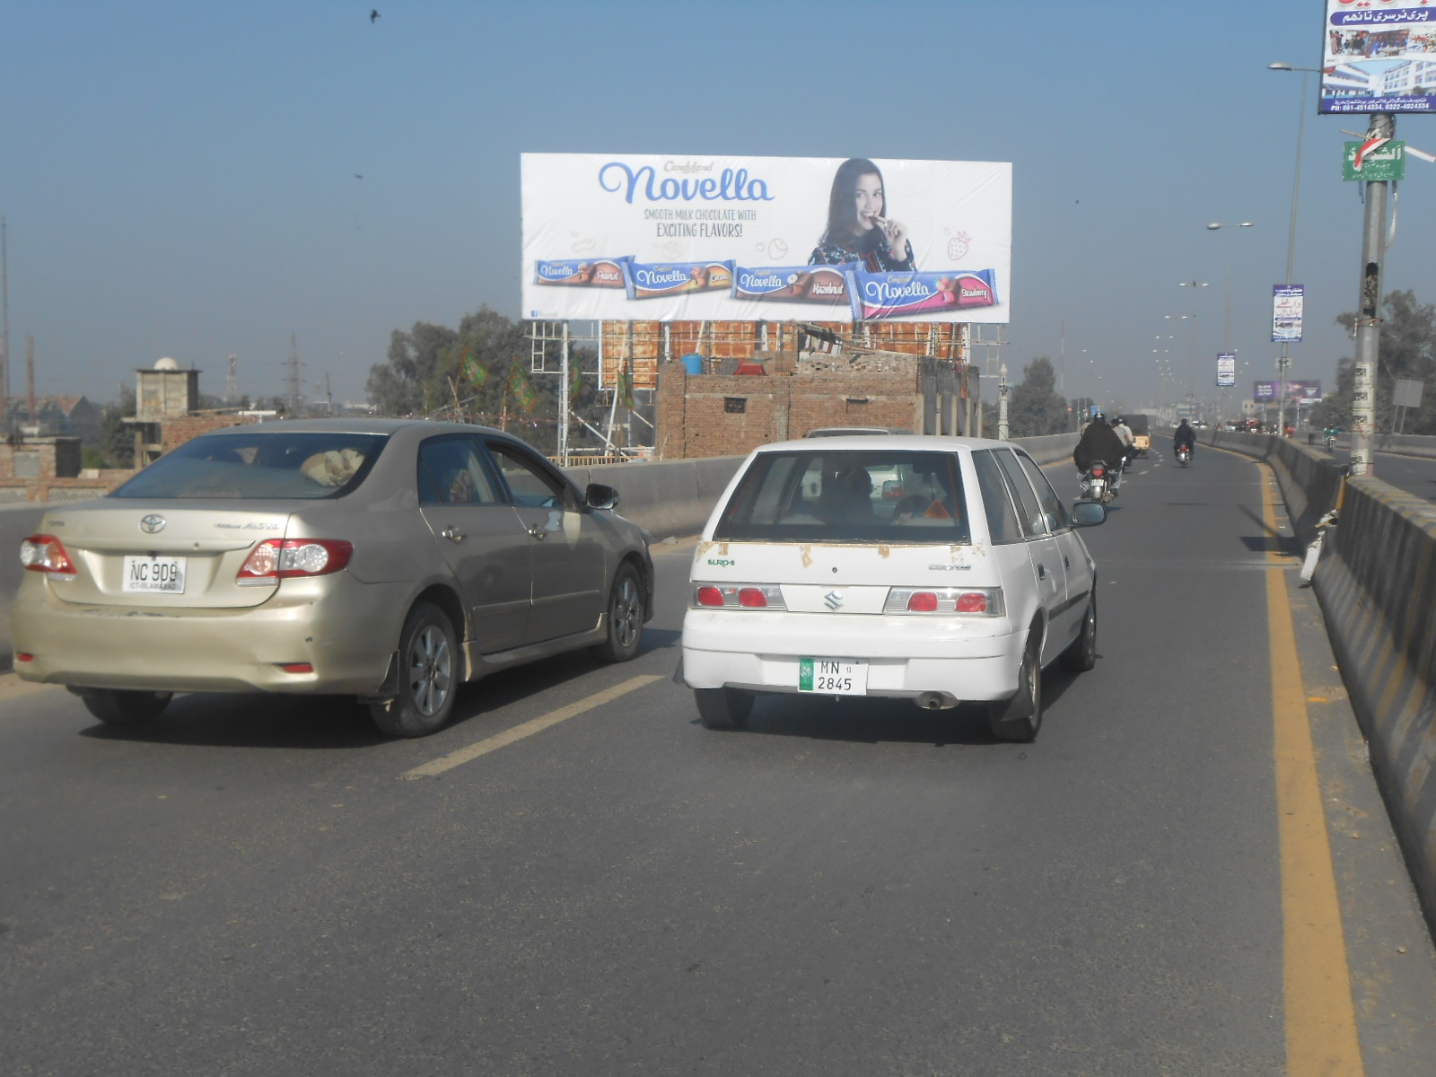
Multan
Size | 60x20
Availability | Available
Rate P/M | Rs:225,000
Location | Direction
Gilani Flyover Multan Cantt | FTCF: Askari colony cantt. Khuraim Mandi , Vehari Road towards Cantt sadder, Bomanjee Chowk , Sp Chowk , Abdali Road

Slide 6
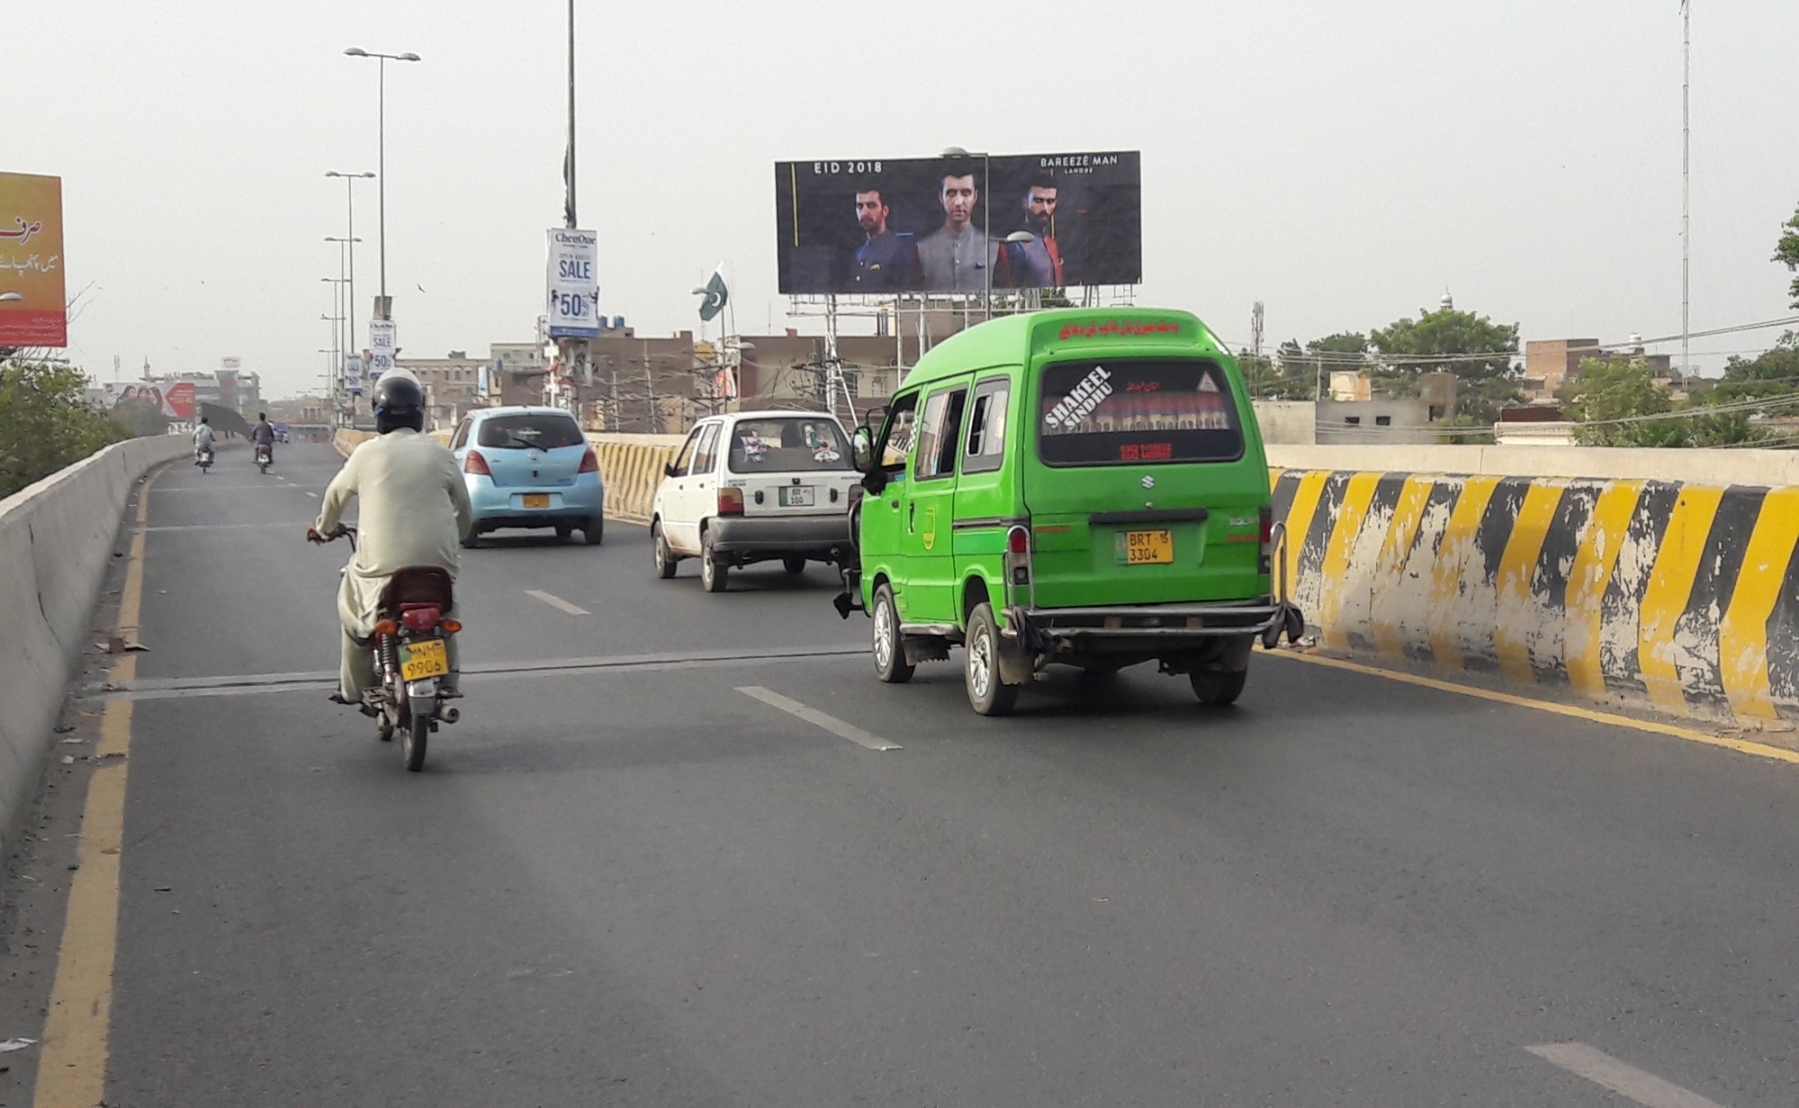
Multan
Size | 60x20
Availability | Available
Rate P/M | Rs:225,000
Location | Direction
Gilani Flyover Multan Cantt | FTCF: Askari colony cant. Khuraim Mandi , Vehari Road towards Cantt sadder, Bomanjee Chowk , Sp Chowk , Abdali Road & United mall

Slide 7
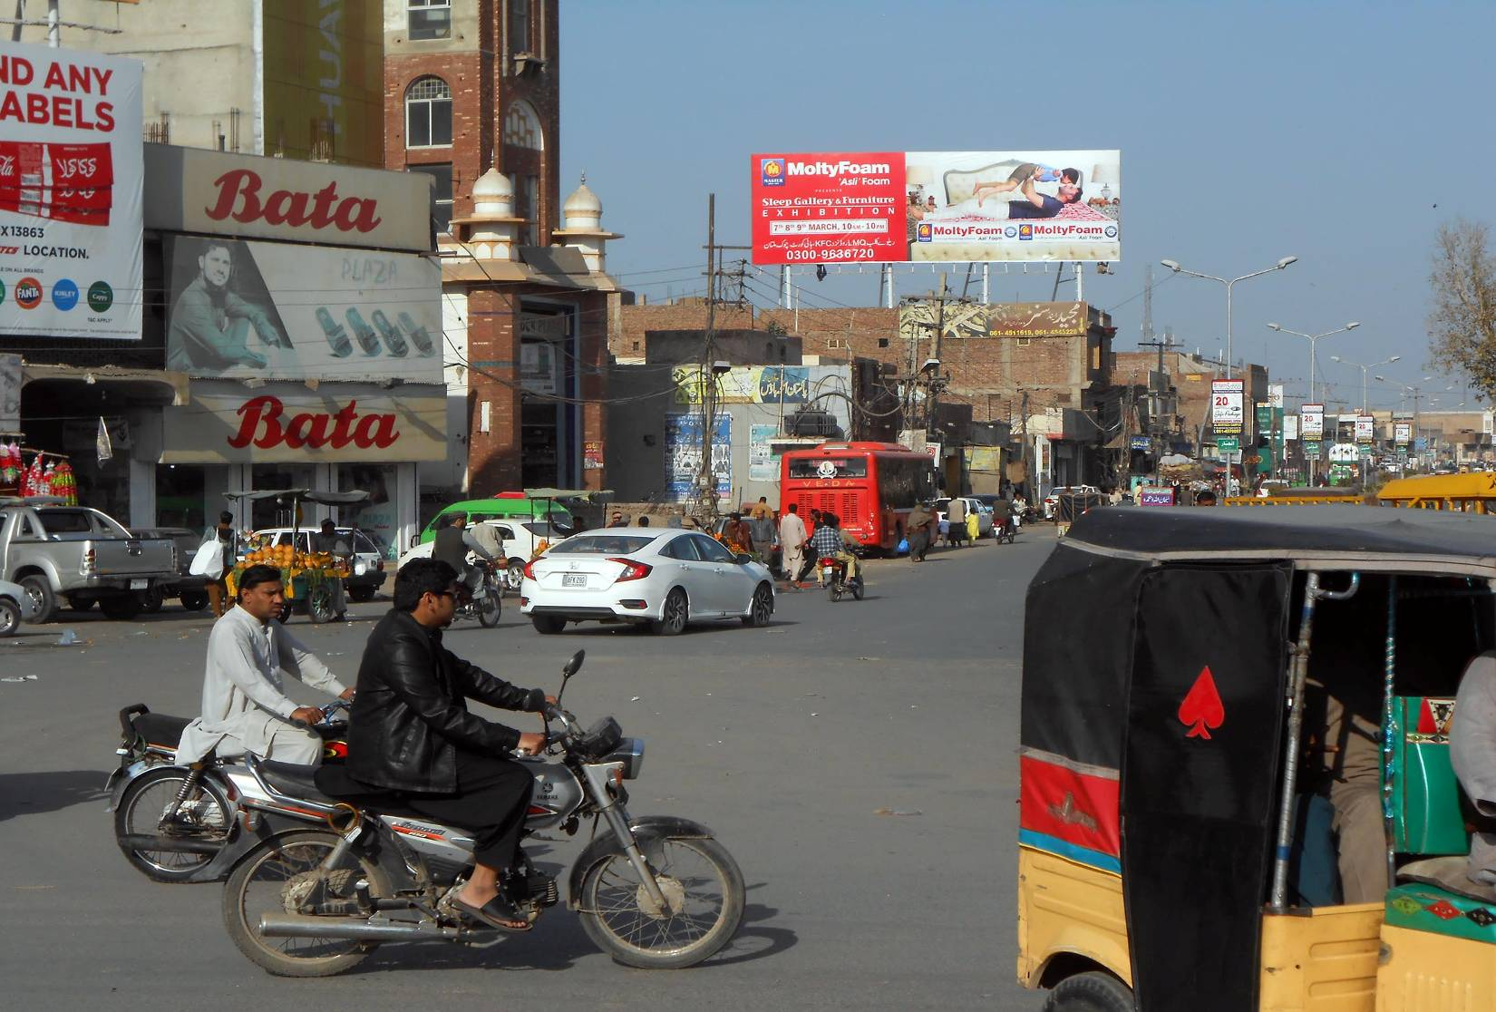
Multan
Size | 60x20
Availability | Available
Rate P/M | Rs:225,000
Location | Direction
Ghanta Ghar Chowk Multan | FTCF:Kutchery Road, Abdali road & Fawara Chowk towards Hussain Agahi, Bosan Road & Dault Gate , Chungi No.09

Slide 8
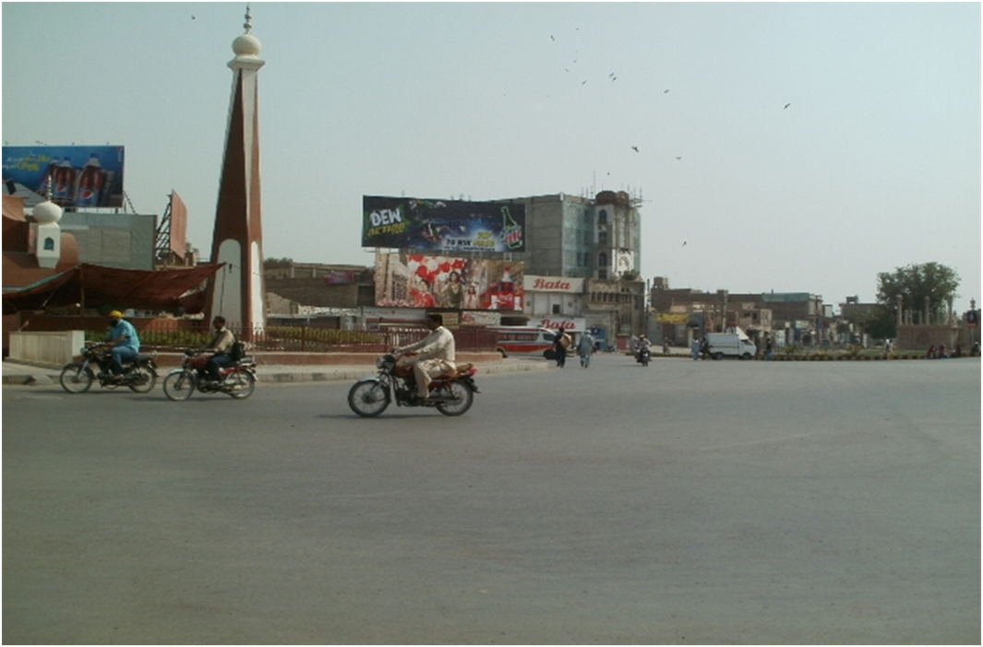
Multan
Size | 60x20
Availability | Available(Hold)
Rate P/M | Rs:225,000
Location | Direction
Ghanta Ghar Chowk Multan | FTCF: Hussain Agahi, Daulat Gate & Masoom Shah Road towards Kutchery road, Nawan Shehar & Bosan Road

Slide 9
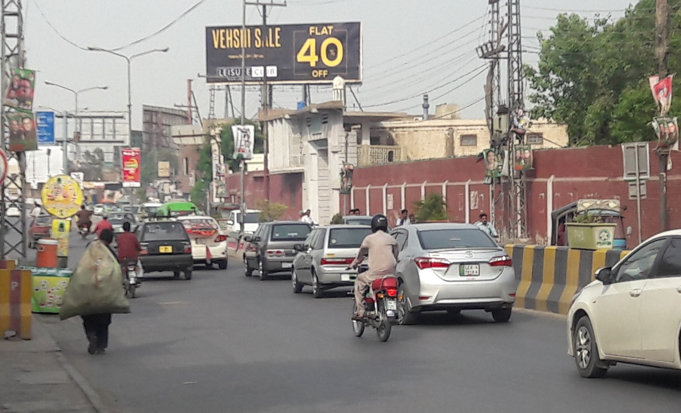
Multan
Size | 60x20
Availability | Available
Rate P/M | Rs:225,000
Location | Direction
Kalama Chowk Katchery Flyover Multan | FTCF: KFC cantt, Nishter Road, Nawan Shehar & MDA Chowk towards Gulgasht Colony, Chungi no.09 & Bosan Road, Daewoo terminal

Slide 10
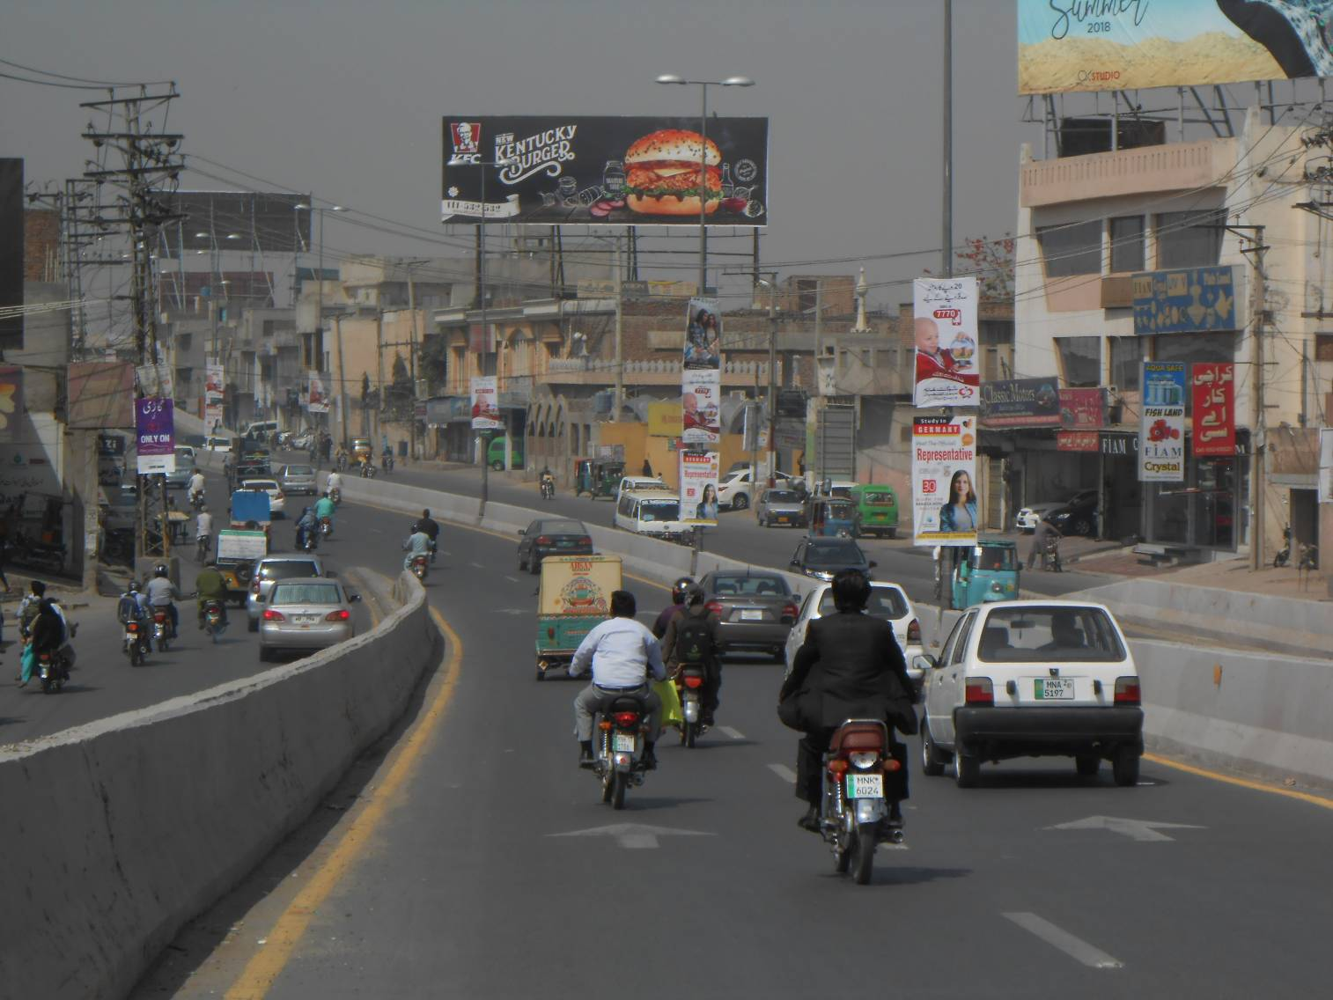
Multan
Size | 60x20
Availability | Available
Rate P/M | Rs:225,000
Location | Direction
Chungi No.09 Bridge Kutchary Fly Over Bridge Multan | FTCF: Eid Gah Road, Officer Colony Bosan Road & Ghanta Ghar towards Gulgasht Colony, MDA Chowk & Katchery Chowk, Multan Cant

Slide 11
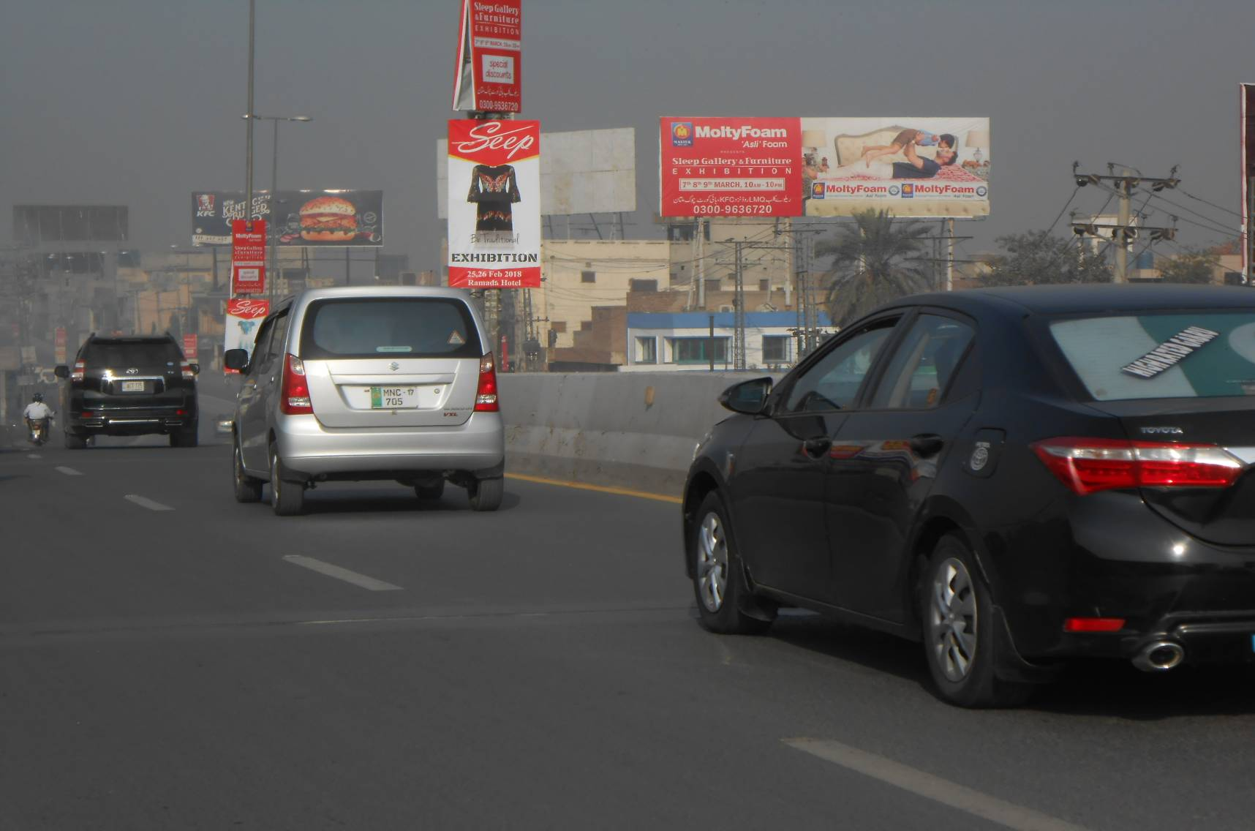
Multan
Size | 60x20
Availability | Available
Rate P/M | Rs:225,000
Location | Direction
Chungi No.09 Bridge Kutchary Fly Over Bridge Multan | FTCF: Eid Gah Road, Officer Colony Bosan Road & Ghanta Ghar towards Gulgasht Colony, MDA Chowk & Katchery Chowk, Multan Cant

Slide 12
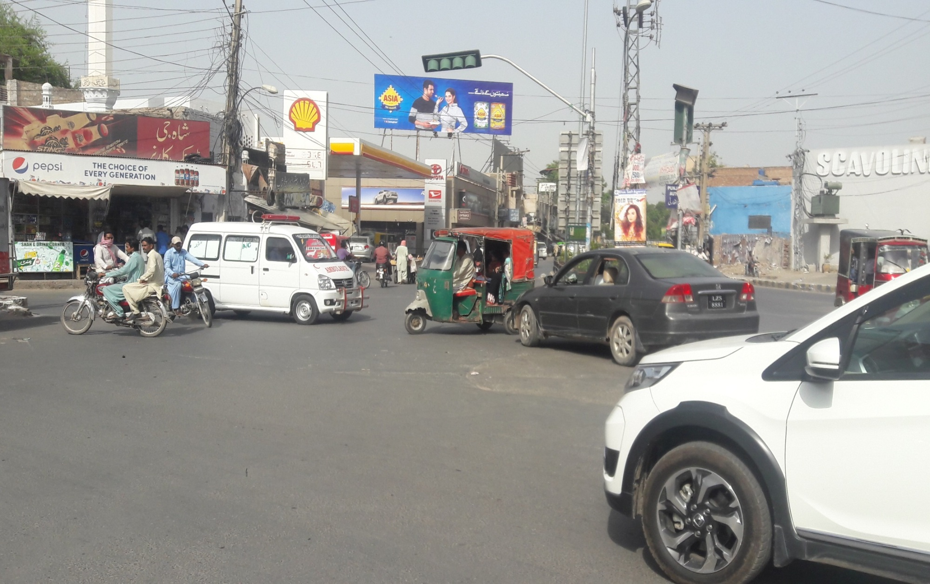
Multan
Size | 60x20
Availability | Available
Rate P/M | Rs:225,000
Location | Direction
LMQ Road Chowk Nawan Shehar Multan | FTCF: SP Chowk, Abdali road & Chowk Dera Adda, Multan Cant towards Civil hospital Road, Chowk Ghanta Ghar & Kalma Chowk

Slide 13
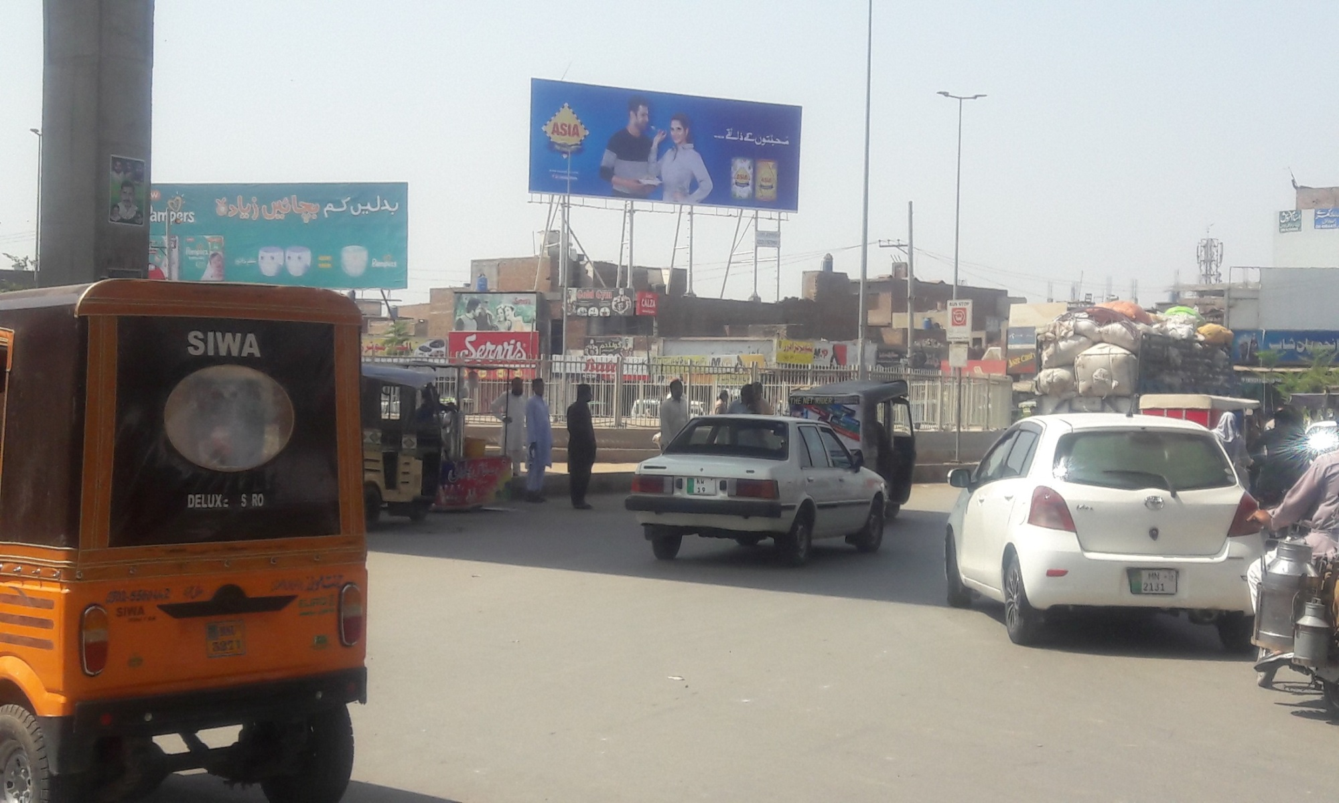
Multan
Size | 60x20
Availability | Available
Rate P/M | Rs:225,000
Location | Direction
Kazafi Chowk Multan | FTCF: NLC Chowk , Wapda Town , Khan Factory , Khanewal towards Gulshan Mkt, Masoom Shah road & Daewoo terminal

Slide 14
Ad Solution
TERMS & CONDITIONS
First time skin installation and removing is free.
Skin printing charges are not included in the proposed rates.
These rates are exclusive of all kinds of taxes.
If skin is damaged due to weather, changing/re-printing charges will be borne by the client.
The payment will be made 50% in advance and the remaining balance will be payable through 15 days post dated cheque, from the day, the display starts.
For locking the sites please inform us within 1-3 working days.

