Slide 1
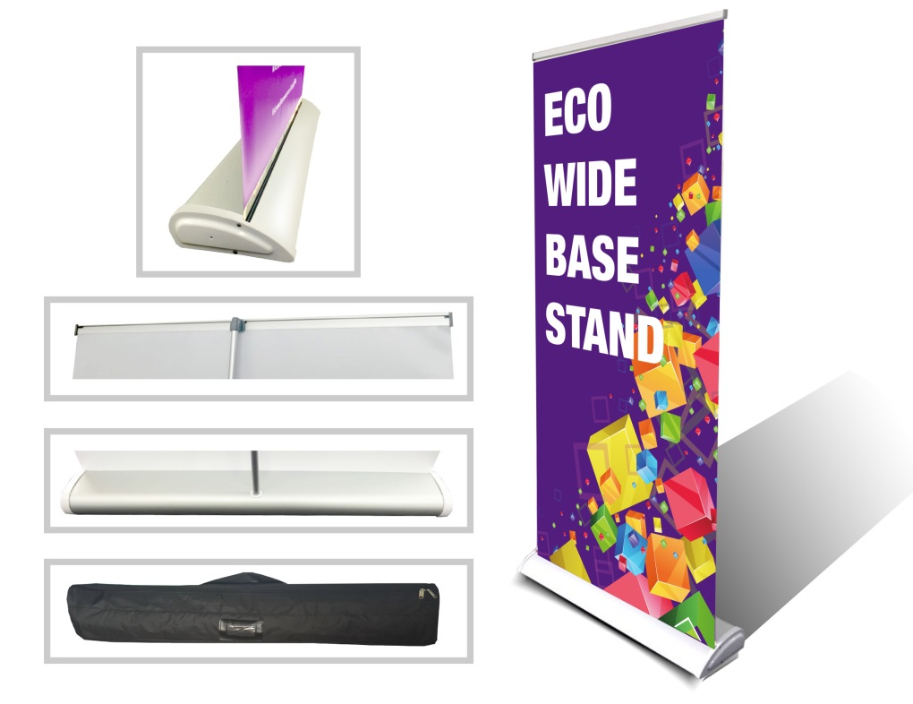
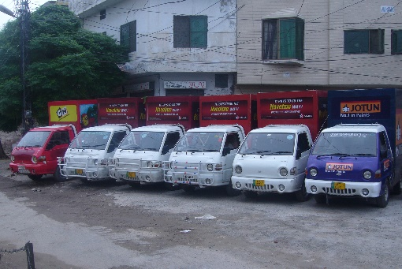
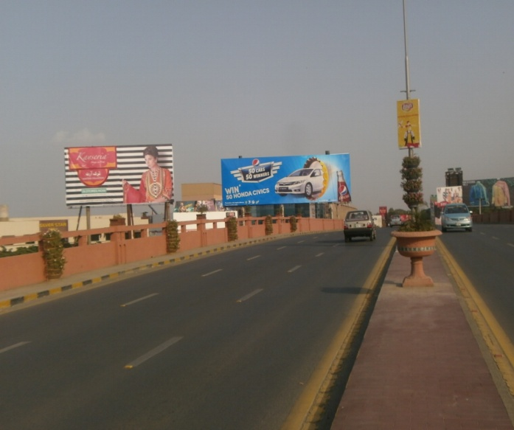
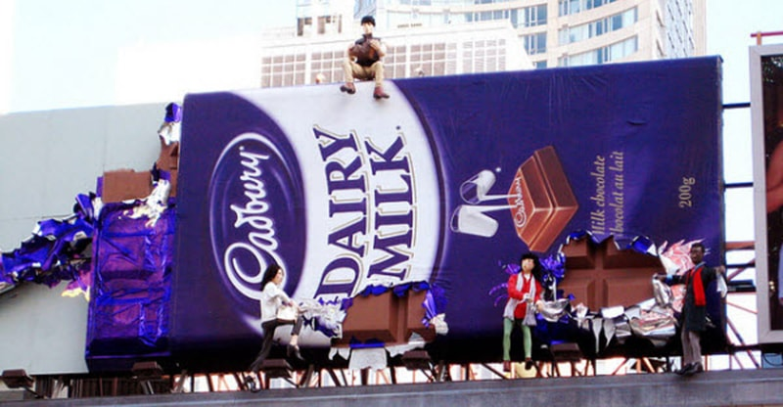
What we Do
Ad Solution
Advertising
Mobile Float
BTL Activities
Bill Boards/Hoardings
All Kinds of Pana Flex /Vinyl Printing
Offset Printing
X/Rollup Stand
Signage (New installation and Maintenance)

Slide 2
Ad Solution
Advertising
Proposal for
Billboards in Okara

Slide 3
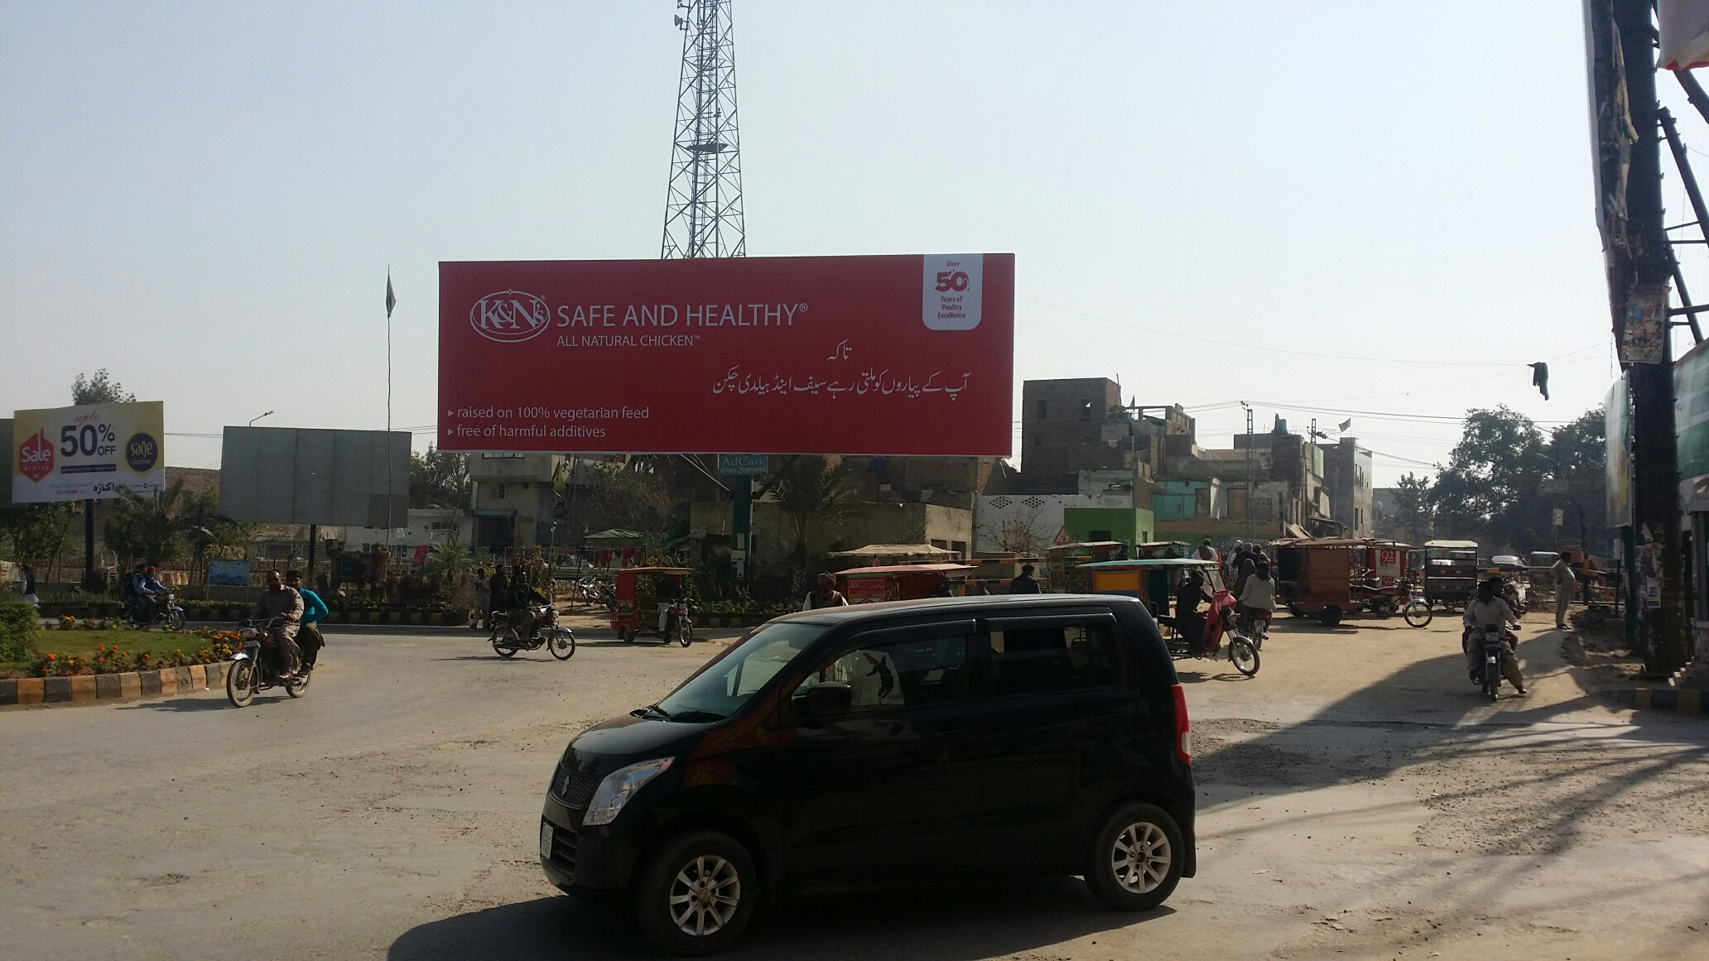
Okara
Size | 60x20
Availability | 01-02-19
Rate P/M | Rs:175,000/-
Location | Direction
Jahaz Chowk Okara | FTCF:MA Jinnah Road, Tank Chowk towards District Courts, Okara Cantt and Sahiwal

Slide 4
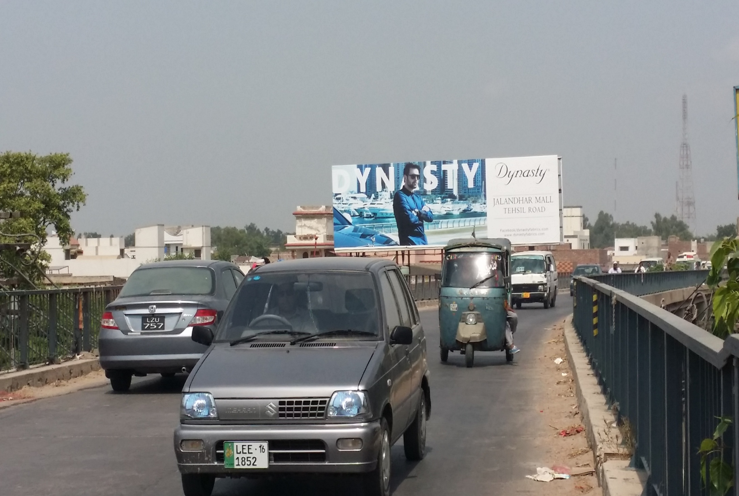
Okara
Size | 60x20
Availability | 01-03-19
Rate P/M | Rs:175,000/-
Location | Direction
Facto chowk flyover | FTCF:Depalpur Chowk towards FACTO Chowk, Katchery Chowk and Faisalabad

Slide 5
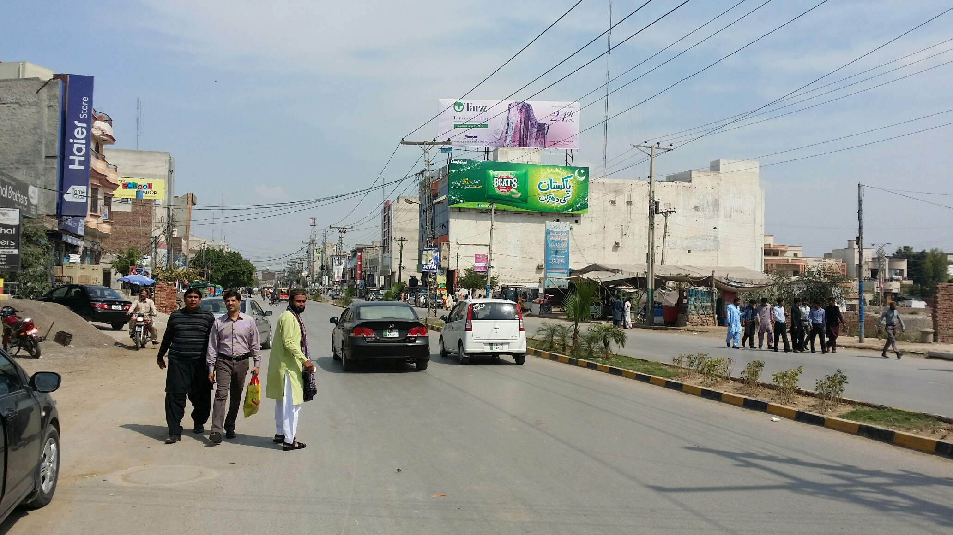
Okara
Size | 60x20
Availability | 3-month
Rate P/M | Rs:175,000/-
Location | Direction
M.A. Jinnah road okara | FTCF: Tank Chowk, Jahaz Chowk and District Complex towards Akbar Road and Gole Chowk

Slide 6
Okara
Size | 60x20
Availability
Rate P/M | Rs:175,000/-
Location | Direction
M.A. Jinnah road okara | FTCF: Tank Chowk, Jahaz Chowk and District Complex towards Akbar Road and Gole Chowk

Slide 7
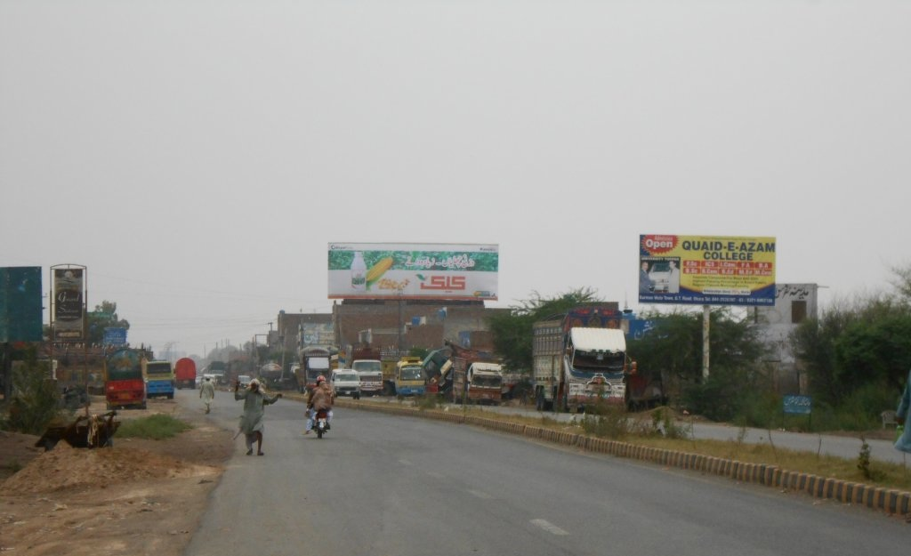
Okara
Size | 60x20
Availability | av
Rate P/M | Rs:175,000/-
Location | Direction
Jawad Avenue okara | FTCF: Lahore, Punjab College, Superior College towards Okara City

Slide 8
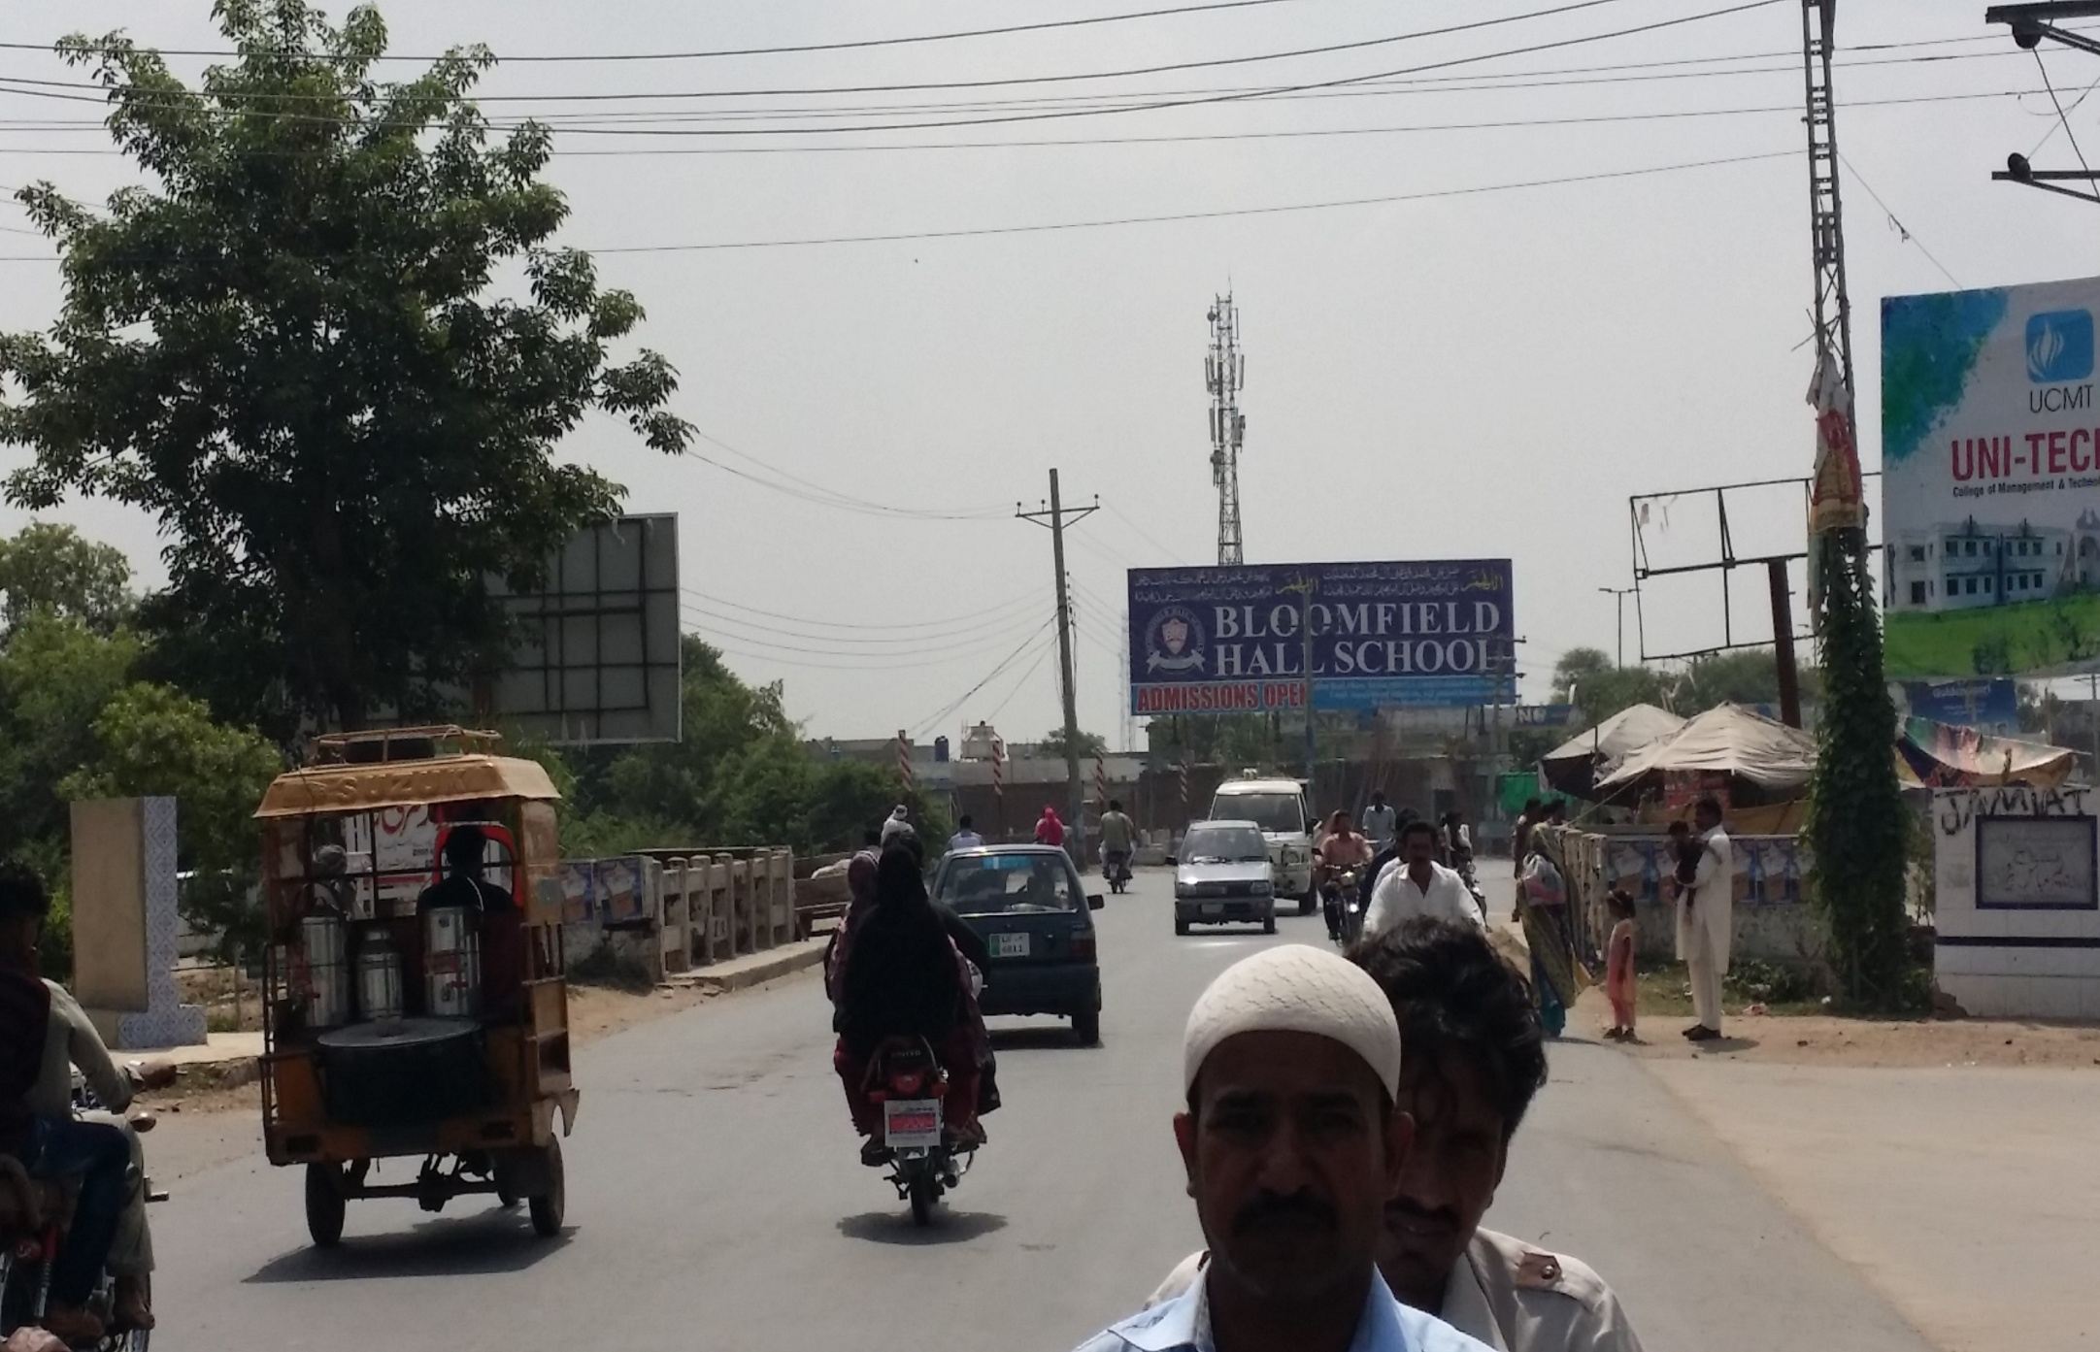
Okara
Size | 60x20
Availability | av
Rate P/M | Rs:175,000/-
Location | Direction
Sharif Hospital chowk okara | FTCF: Satgara Chowk, Cadet College towards FACTO Chowk and Depalpur Chowk

Slide 9
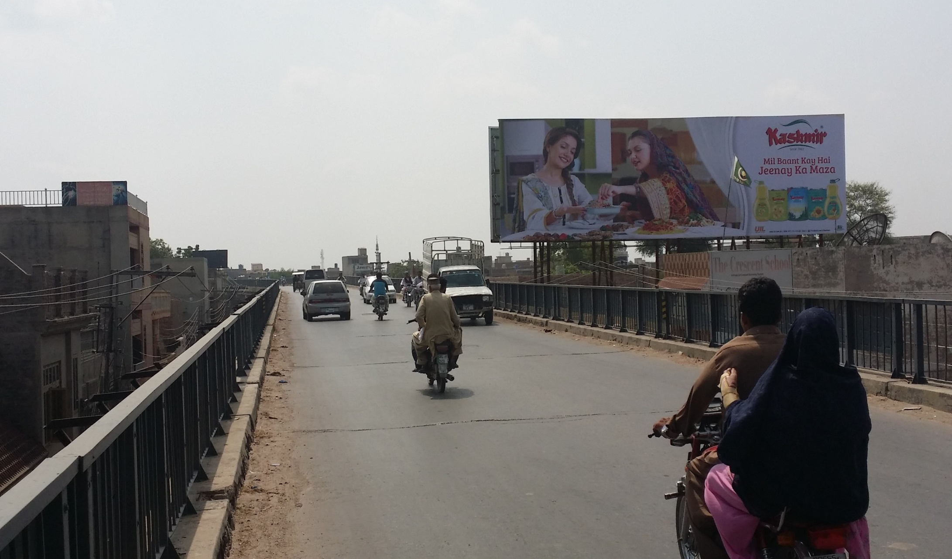
Okara
Size | 60x20
Availability | av
Rate | Rs:175,000/-
Location | Direction
Facto Chowk flyover | FTCF: FACTO Chowk, Katchery Chowk and Faisalabad towards Depalpur Chowk and Lahore

Slide 10
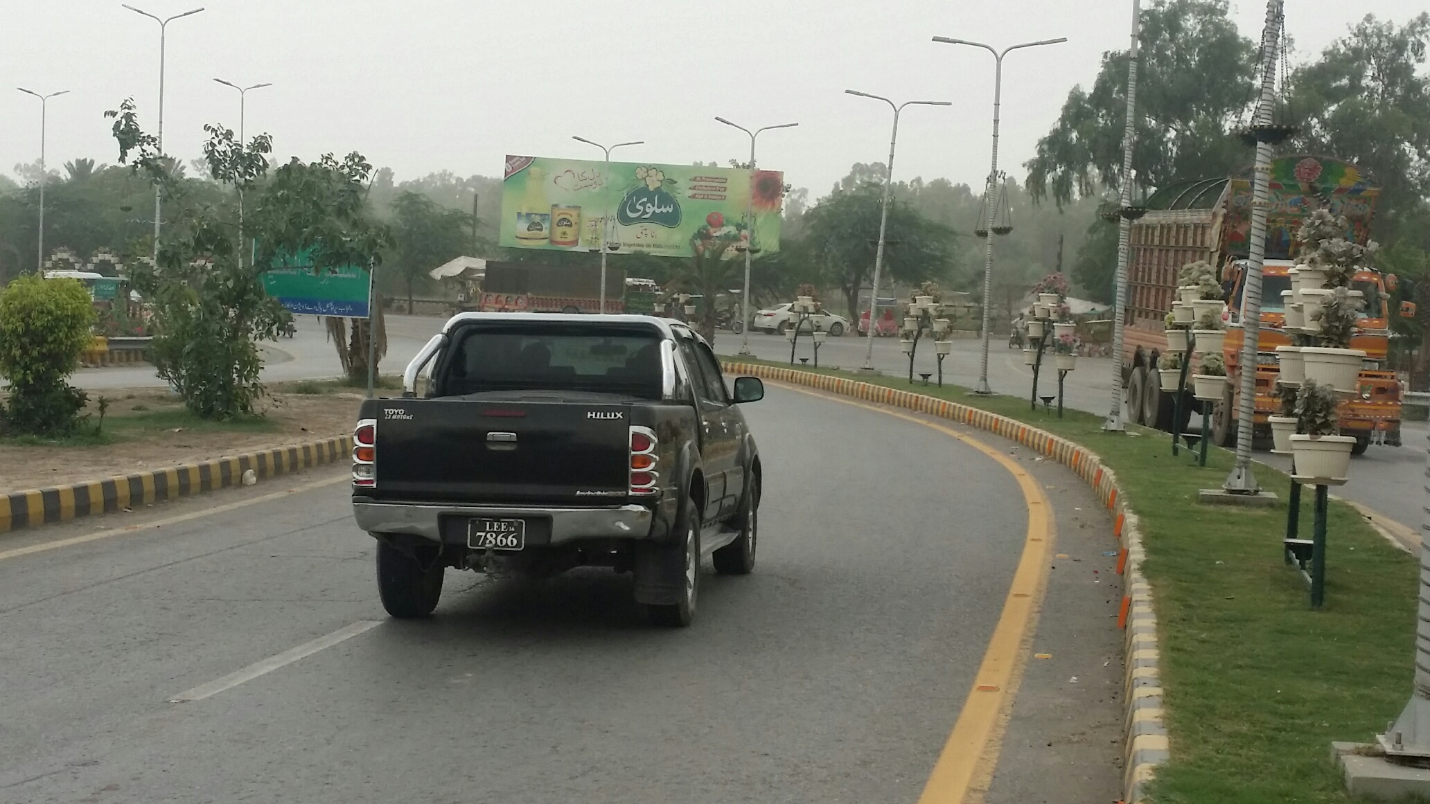
Okara
Size | 45x15
Availability | long
Rate P/M | Rs:90,000/-
Location | Direction
Gate way Mall Okara | FTCF: : Lahore, Fareedia Park towards Karmanwala, Depalpur Chowk and Sikandar Road

Slide 11
Ad Solution
TERMS & CONDITIONS
First time skin installation and removing is free.
Skin printing charges are not included in the proposed rates.
These rates are exclusive of all kinds of taxes.
If skin is damaged due to weather, changing/re-printing charges will be borne by the client.
The payment will be made 50% in advance and the remaining balance will be payable through 15 days post dated cheque, from the day, the display starts.
For locking the sites please inform us within 1-3 working days.

