Slide 1
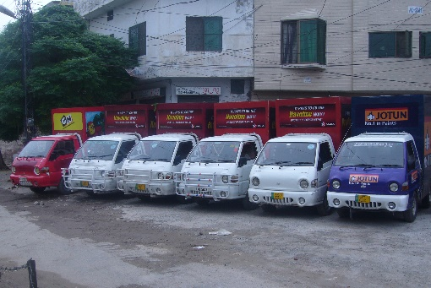
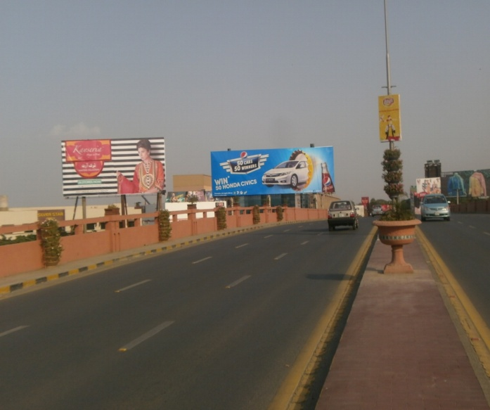
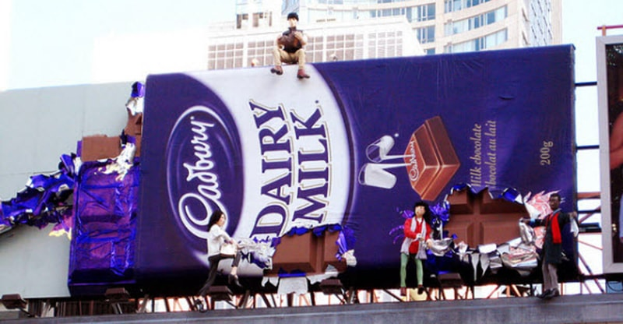
What we Do
Ad Solution
Advertising
Mobile Float
BTL Activities
Bill Boards/Hoardings
All Kinds of Pana Flex /Vinyl Printing
Offset Printing
X/Rollup Stand
Signage (New installation and Maintenance)

Slide 2
Ad Solution
Advertising
Proposal for
Raheem Yar Khan

Slide 3
Raheem Yar Khan

Slide 4
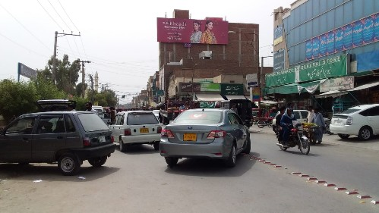
RYK
Size | 60x20
Availability | Available
Rate P/M | Rs: 150,000/=
Location | Direction
Dewan e Khas howk | FTCF: Dewan e Khas Chowk Towards Hospital and Sahi Road

Slide 5
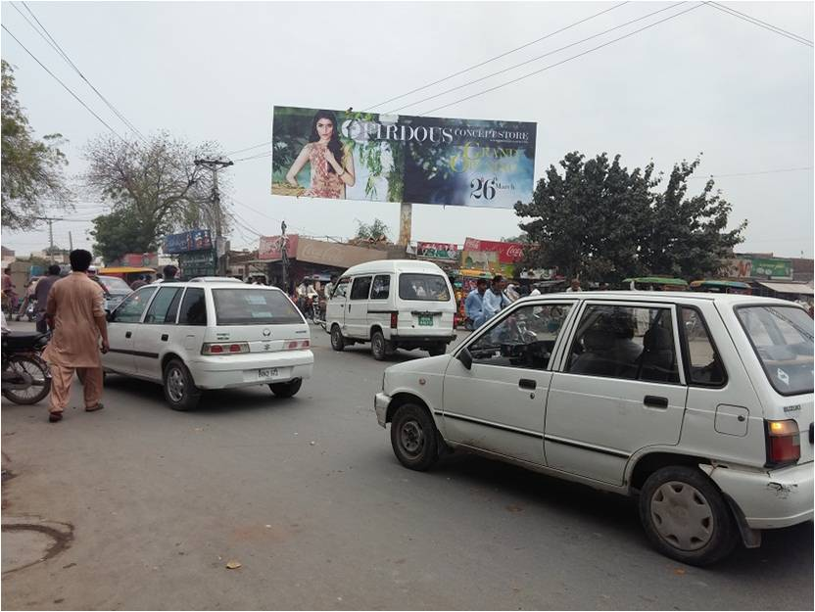
RYK
Size | 60x20
Availability | Available
Rate P/M | Rs: 150,000/=
Location | Direction
Wirless Area | FTCF: Wirless Area Belgium Chowk Towards Askri Chowk Macdonals

Slide 6
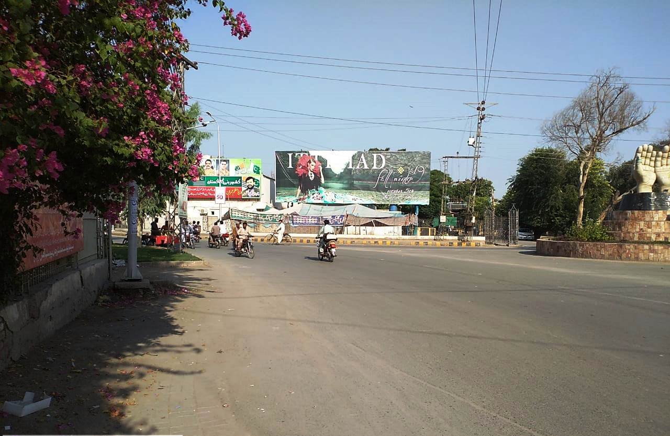
RYK
Size | 60x20
Availability | Available
Rate P/M | Rs: 150,000/=
Location | Direction
Air Port Belgium Chowk | FTCF: Air Port Belgium Chowk City Pull Shahi Road Wireless Pull Eid Gah Towards Cant Chowk DCO Office City Center Adda Khanpur UAE Palace

Slide 7
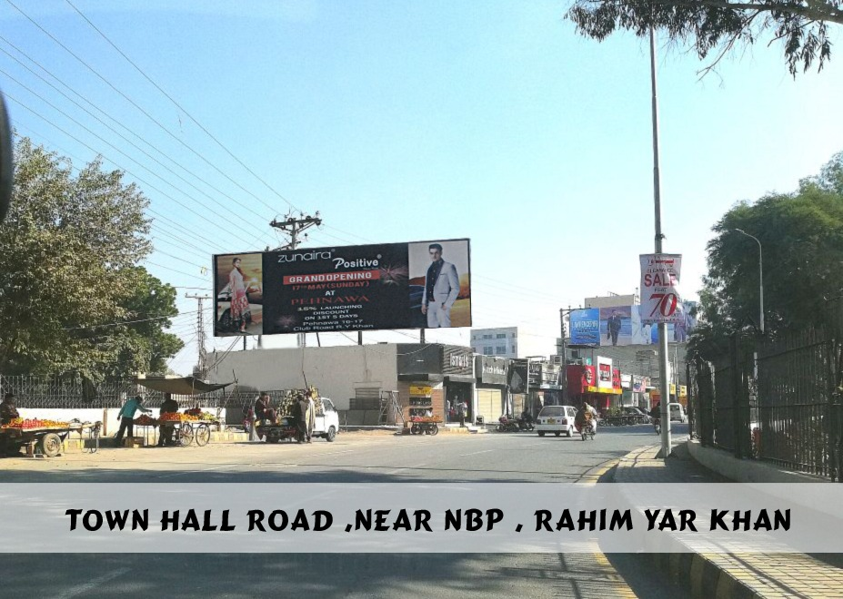
RYK
Size | 60x20
Availability | 2
Rate P/M | Rs: 150,000/=
Location | Direction
Town Hall Road | FTCF: Town Hall Belgium Chowk Towards City Center Kachehri Chowk Khanapur Add

Slide 8
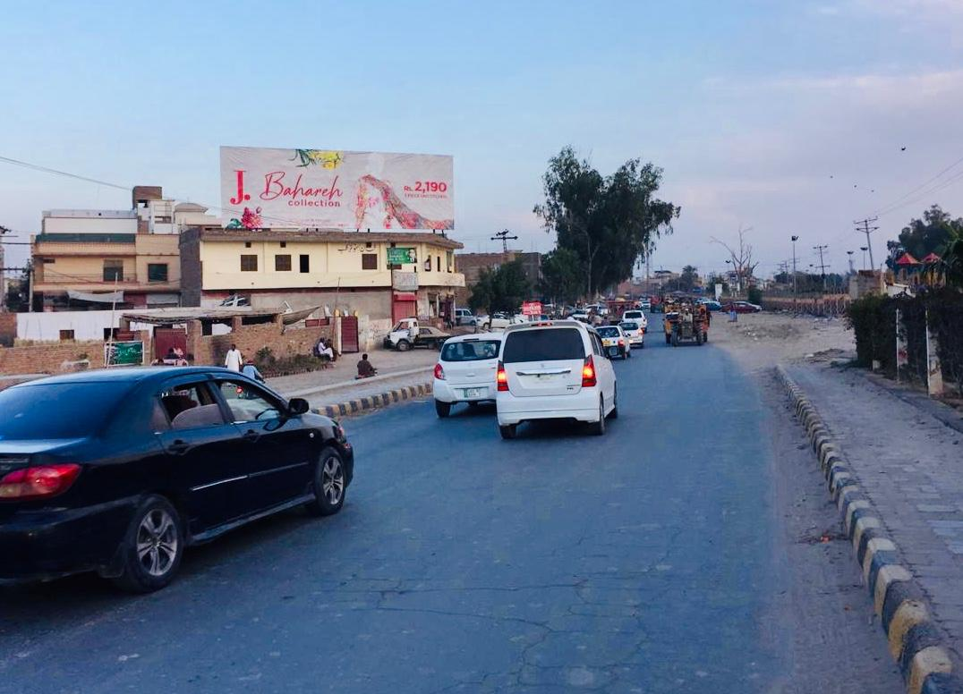
RYK
Size | 60x20
Availability
Rate P/M | Rs: 150,000/=
Location | Direction
Khanpur Add Fly Over | FTCF: Khanpur Adda Fly Over Towards Factory Area Unilever & Going to Khanpur Adda City Center Belgium Chowk

Slide 9
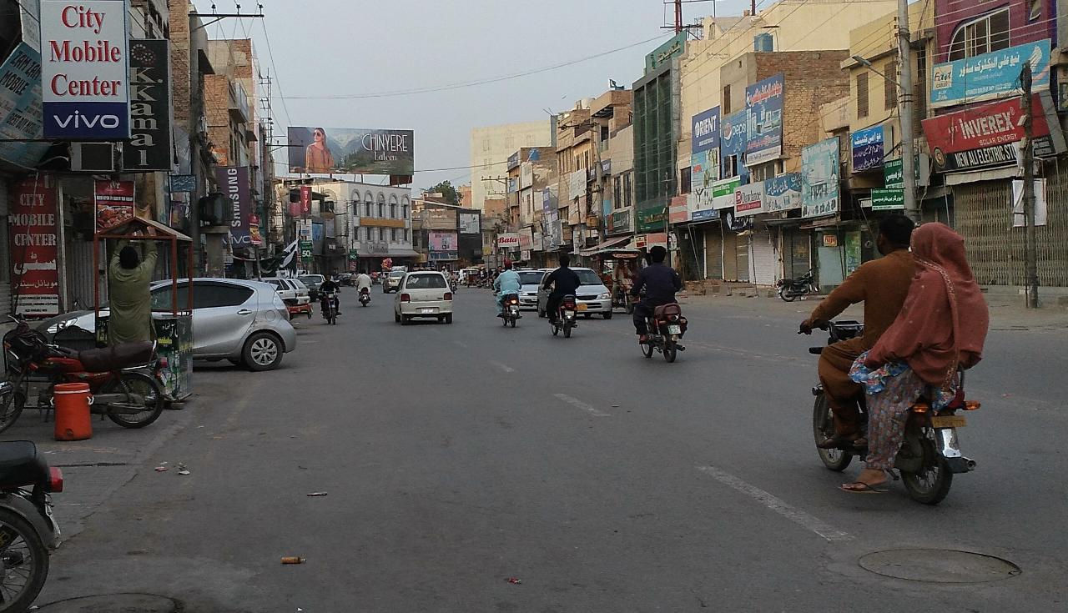
RYK
Size | 60x20
Availability
Rate P/M | Rs: 150,000/=
Location | Direction
Shahi Road | FTCF: Shahi Road Lever Belgium Chowk Towards Club Road City Center

Slide 10
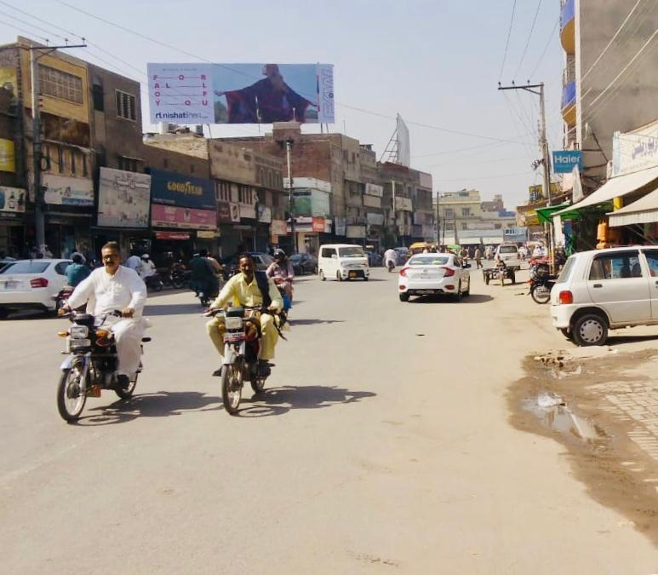
RYK
Size | 60x20
Availability
Rate P/M | Rs: 150,000/=
Location | Direction
Belgium Chowk | FTCF: Belgium Chowk City Center Dua Chowk Towards Unilever Cockacola Factory

Slide 11
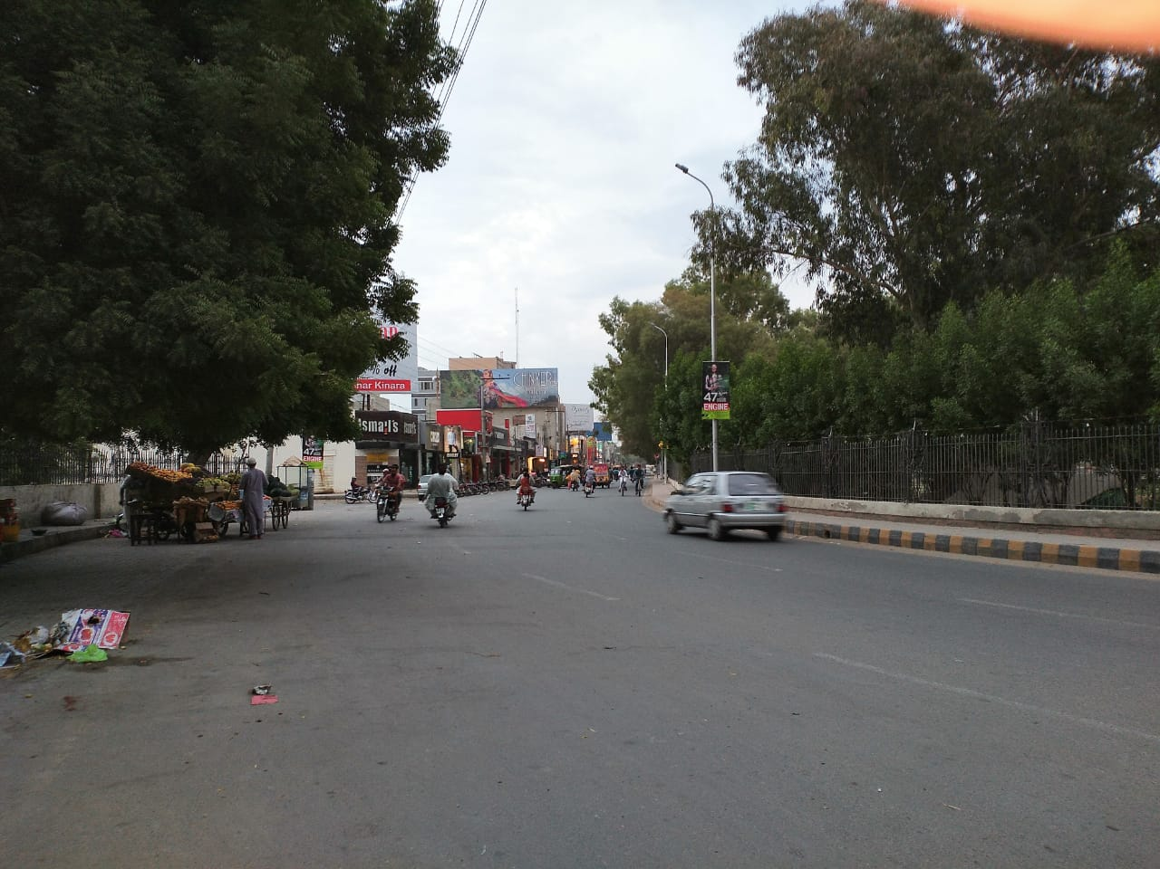
RYK
Size | 60x20
Availability
Rate P/M | Rs: 150,000/=
Location | Direction
Belgium Chowk | FTCF: Belgium Chowk Dua Chowk Towards City Center Dewan e Khas Chowk Kahanpur Adda

Slide 12
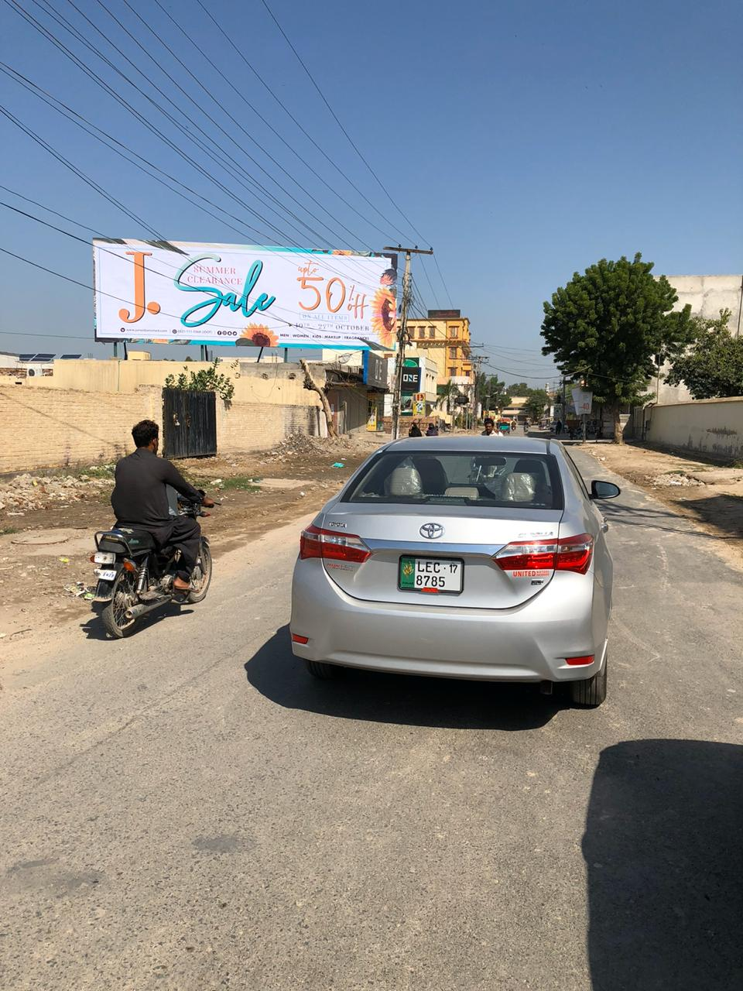
RYK
Size | 60x20
Availability
Rate P/M | Rs: 130,000/=
Location | Direction
City Center | FTCF: City Center Towards Brand Area

Slide 13
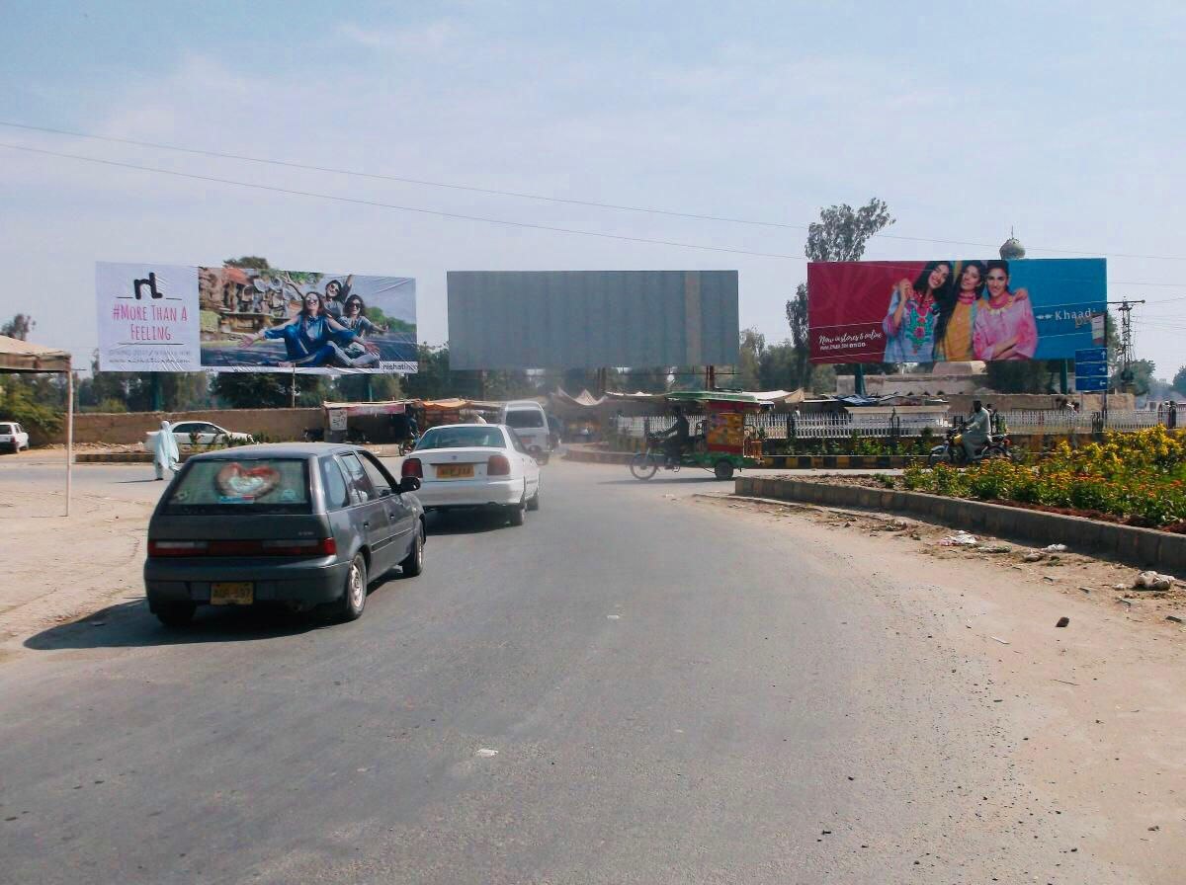
RYK
Size | 60x20
Availability
Rate P/M | Rs: 150,000/=
Location | Direction
Dewan e Khas | FTCF: Dewan e Khas Towards Macdonal up Coming KFC

Slide 14
Ad Solution
TERMS & CONDITIONS
First time skin installation and removing is free.
Skin printing charges are not included in the proposed rates.
These rates are exclusive of all kinds of taxes.
If skin is damaged due to weather, changing/re-printing charges will be borne by the client.
The payment will be made 50% in advance and the remaining balance will be payable through 15 days post dated cheque, from the day, the display starts.
For locking the sites please inform us within 1-3 working days.

