Slide 1
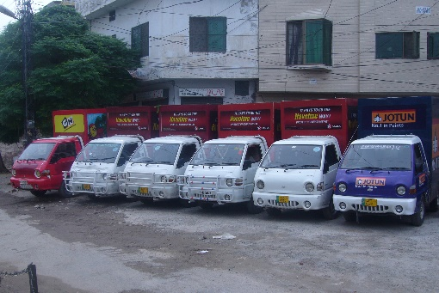
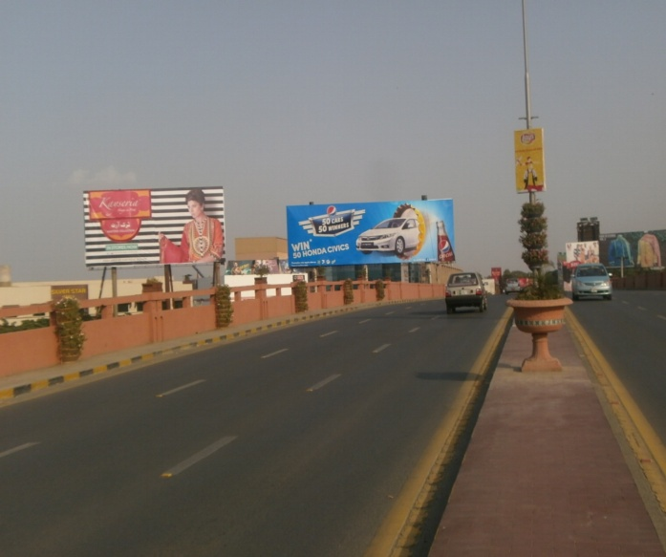
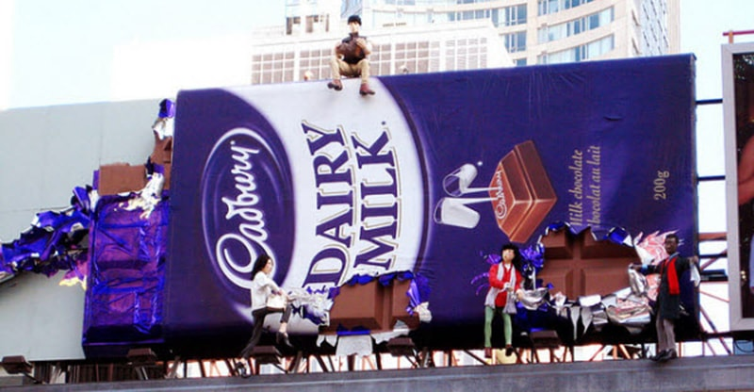
What we Do
Ad Solution
Advertising
Mobile Float
BTL Activities
Bill Boards/Hoardings
All Kinds of Pana Flex /Vinyl Printing
Offset Printing
X/Rollup Stand
Signage (New installation and Maintenance)

Slide 2
Ad Solution
Advertising
Proposal for
Billboards in Rawalpindi

Slide 3
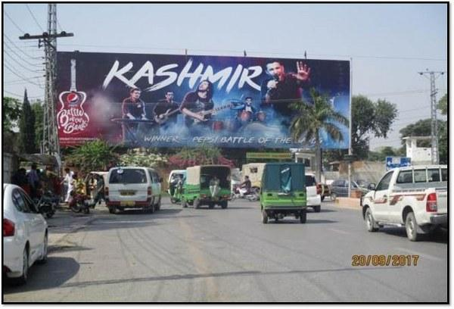
Rawalpindi
Size | 90x30
Availability
Rate P/M | Rs: 950,000
Location | Direction
Haider Road, Sadar | FTCF:Tehzeeb Bakers & GPO towards Railway Station & Mall road.

Slide 4
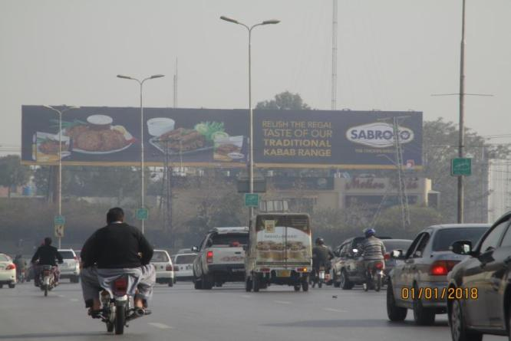
Rawalpindi
Size | 125x20
Availability
Rate P/M | Rs: 750,000
Location | Direction
Jinnah Park | FTCF:Katchehry chowk, Saddar towards Ammar chowk, Scheme # 3, Airport.

Slide 5
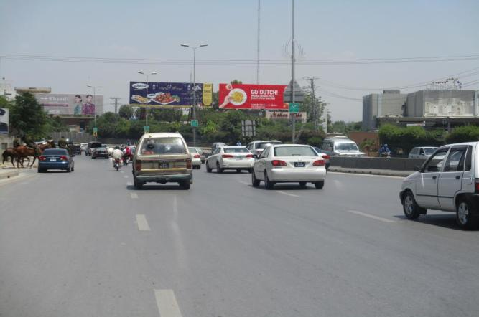
Rawalpindi
Size | 60x20
Availability
Rate P/M | Rs: 425,000
Location | Direction
Jinnah park | FTCF:Katchehry chowk, Saddar towards Ammar chowk, Scheme # 3, Airport

Slide 6
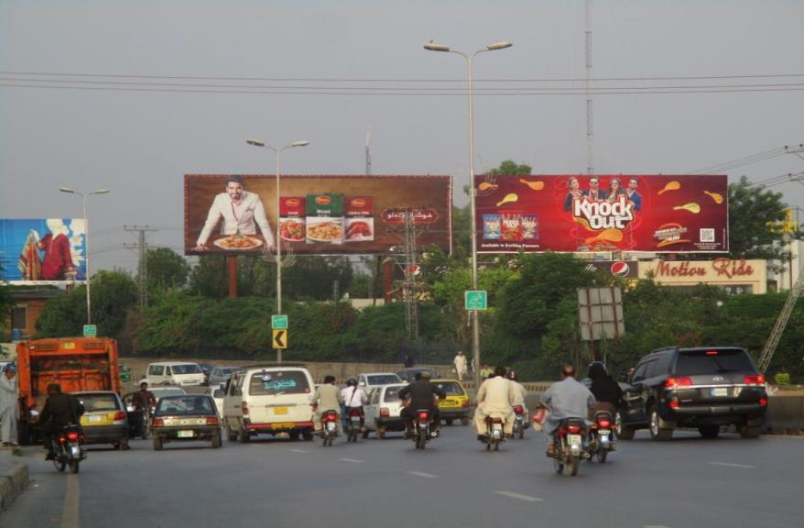
Rawalpindi
Size | 60x20
Availability
Rate P/M | Rs: 425,000
Location | Direction
Jinnah park | FTCF:Katchehry chowk, Saddar towards Ammar chowk, Scheme # 3, Airport

Slide 7
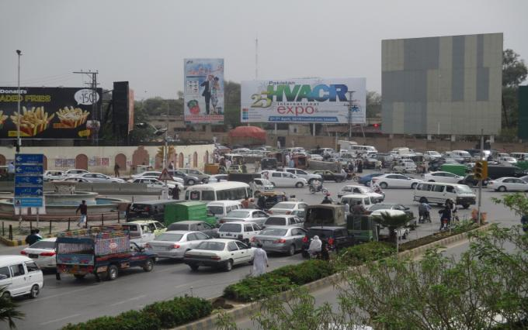
Rawalpindi
Size | 90x30
Availability
Rate P/M | Rs:950,000
Location | Direction
Main kachery Chowk | FTCF Airport,Amar Chowk,Chaklala SchemeIII To Mall Road FTCF Murree Roadand Mareer Chowk towards DHA and Bahria

Slide 8
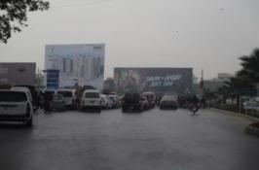
Rawalpindi
Size | 90x30
Availability
Rate P/M | Rs: 2-Million
Location | Direction
Main kachery ChowkAirport | FTCF:Airport,Amar Chowk,Chaklala SchemeIII To Mall Road/DHA (Double View)

Slide 9
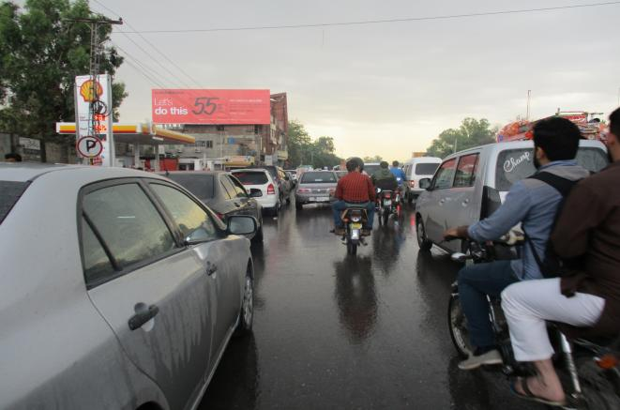
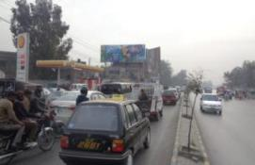
Rawalpindi
Size | 60x20
Availability
Rate P/M | Rs: 400,000
Location | Direction
Main Kachery chowk | FTCF:Mall road, Airport road , Rashid Minhas Road & MT DHA and Bahria Town

Slide 10
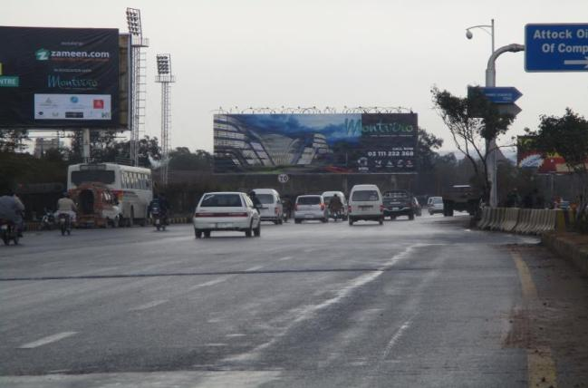
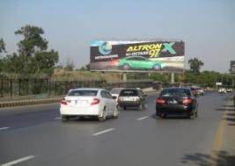
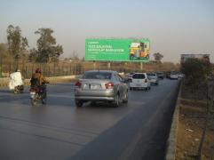
Rawalpindi
Size | 105x35
Availability
Rate P/M | Rs: 650,000
Location | Direction
Ayub Park | FTCF:DHA & Bahria town towards katchery chowk

Slide 11
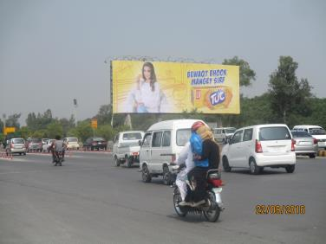
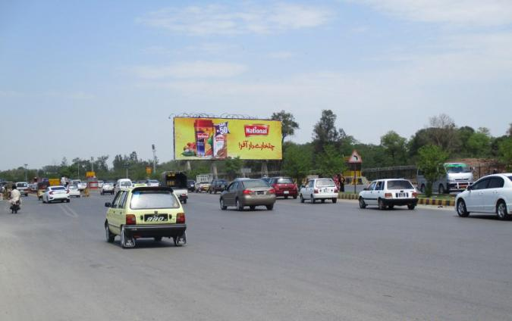
Rawalpindi
Size | 105x35
Availability
Rate P/M | Rs: 650,000
Location | Direction
Ayub Park | FTCF:DHA & Bahria town towards katchery chowk

Slide 12
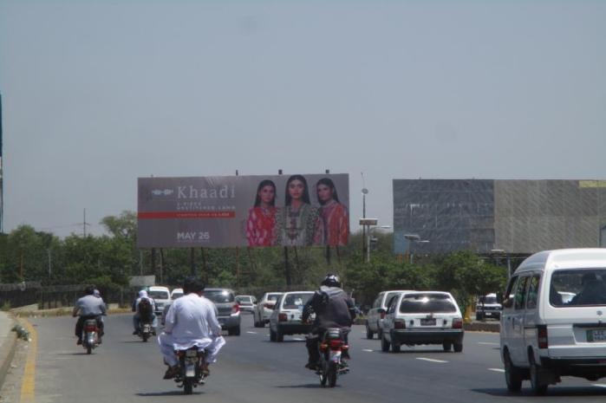
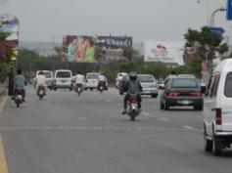
Rawalpindi
Size | 90x30
Availability
Rate P/M | Rs: 750,000
Location | Direction
Ayub Park near Defence 1 | FTCF:Katchery Chowk Towards DHA, Bahria Town, Sawan

Slide 13
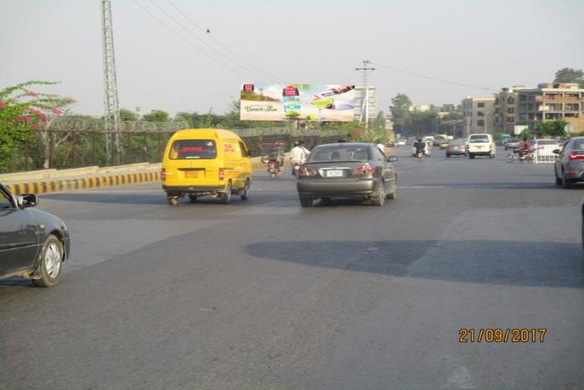
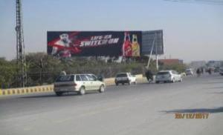
Rawalpindi
Size | 60x20
Availability
Rate P/M | Rs: 350,000
Location | Direction
Ayub Park(Jhelum Road) | FTCF:Katchery Chowk towards DHA & Bahria town

Slide 14
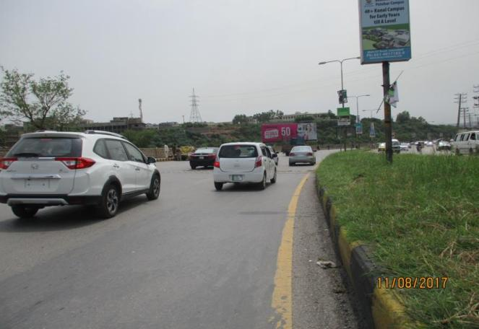
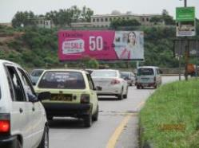
Rawalpindi
Size | 60x20
Availability
Rate P/M | Rs: 450,000
Location | Direction
DHA Round about | FTCF:Kachery , Jhelum road and moving towards G.T road DHA, Bahria town

Slide 15
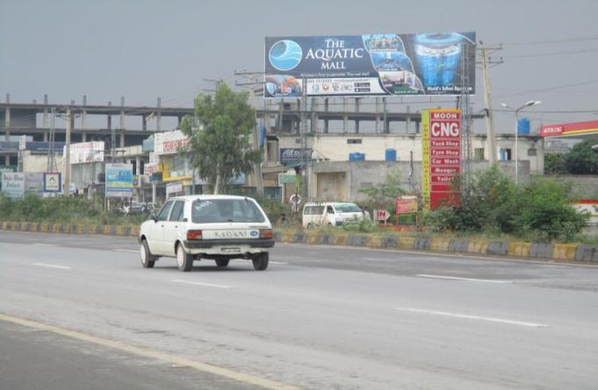
Rawalpindi
Size | 60x20
Availability
Rate P/M | Rs: 350,000
Location | Direction
Defense 2 (Gigga Mall) | FTCF: Bahria town, DHA1,2 going towards WTC, Gigga Mall

Slide 16
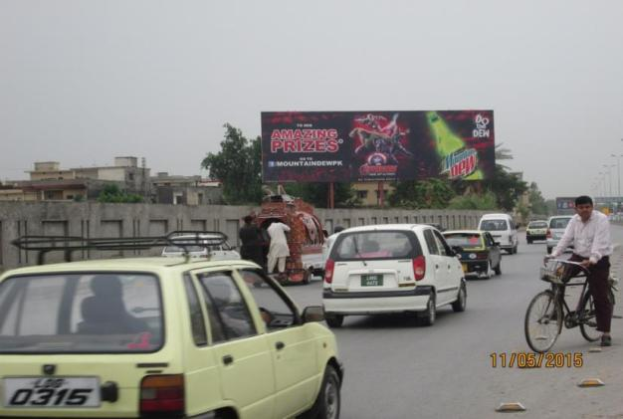
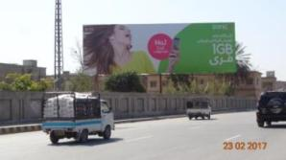
Rawalpindi
Size | 90x30
Availability
Rate P/M | Rs: 700,000
Location | Direction
Airport opposite Askari 9 | FTCF:Islamabad and moving towards Ammar Chowk.

Slide 17
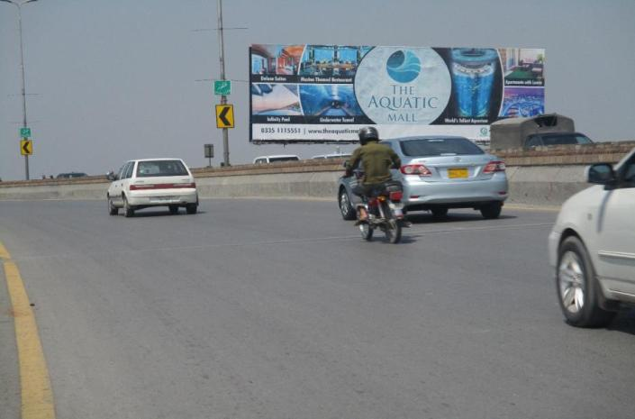
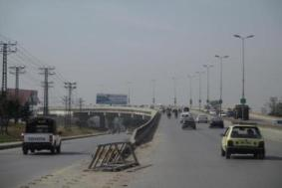
Rawalpindi
Size | 60x20
Availability
Rate P/M | Rs: 500,000
Location | Direction
Rahimabad Fly over | FTCF:Chaklala Cantt FTCF Airport Towards Ammar chowk Scheme 3 &Kachery chowk

Slide 18
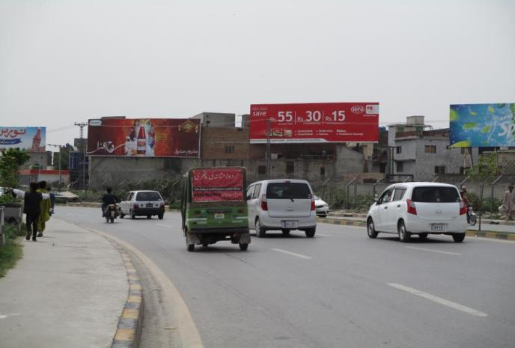
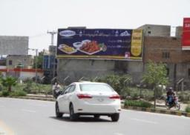
Rawalpindi
Size | 60x20
Availability
Rate P/M | Rs: 250,000
Location | Direction
Rawal Road | FTCF:Chandni Chowk,Murree Road MT Foji Tower

Slide 19
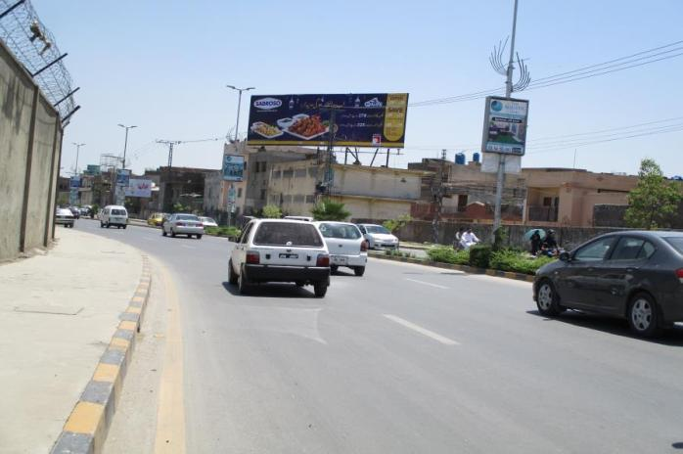
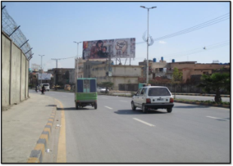
Rawalpindi
Size | 60x20
Availability
Rate P/M | Rs:250,000
Location | Direction
Rawal Road | FTCF:Rawal chowk towards PAF Chowk.

Slide 20
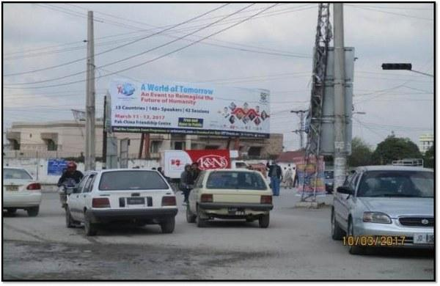
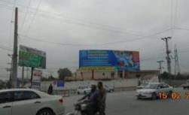
Rawalpindi
Size | 45X15
Availability
Rate P/M | Rs: 400,000
Location | Direction
Khawaja Corporation Chowk | FTCF: Lalazar Askari 14 towards Khawaja Corporation Chowk, Adyala to Katchehry Chowk

Slide 21
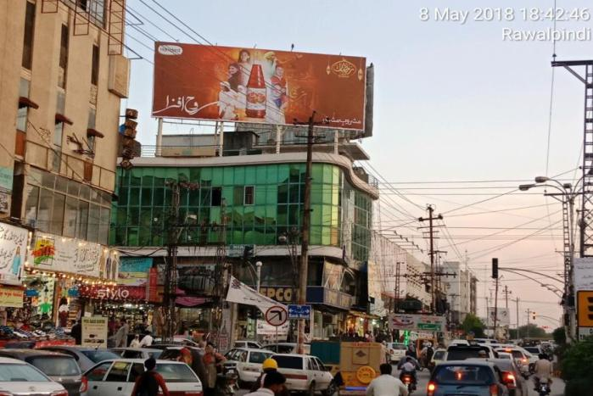
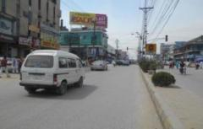
Rawalpindi
Size | 50x20
Availability
Rate P/M | Rs: 450,000
Location | Direction
Bank Road Saddar RWP Cantt | FTCF:Adamjee road towards GPO

Slide 22
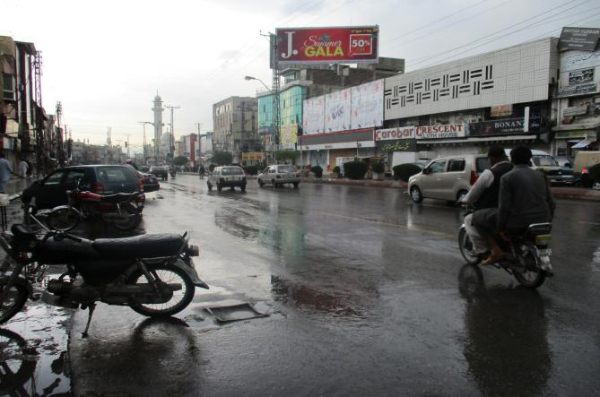
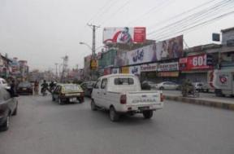
Rawalpindi
Size | 50x20
Availability | Available
Rate P/M | Rs: 450,000
Location | Direction
Main saddar GPO Chowkn Cantt | FTCF:Mall Road Towards Bank Road

Slide 23
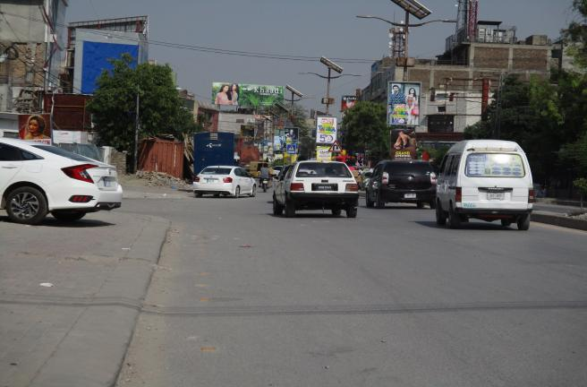
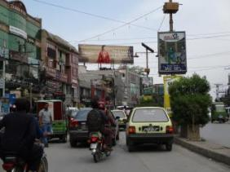
Rawalpindi
Size | 60x20
Availability | N/A
Rate P/M | Rs: 350,000
Location | Direction
Commercial Market At Khaadi | FTCF:Refreshment Center and going towards Murree road Double road

Slide 24
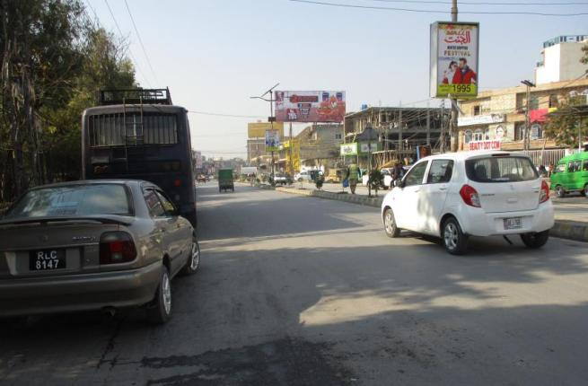
Rawalpindi
Size | 50x20
Availability
Rate P/M | Rs: 350,000
Location | Direction
Commercial Market | FTCF: Murree Road and moving towards Tehzeeb Baker and Said pur Road

Slide 25
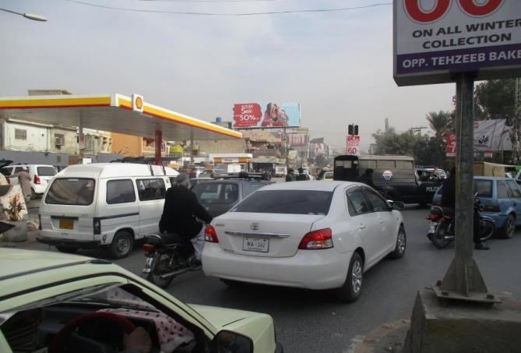
Rawalpindi
Size | 50x20
Availability
Rate P/M | Rs: 350,000
Location | Direction
Commercial Market | FTCF:Tehzeeb Bakers , Refreshment center & said purr road TMT Murree Road

Slide 26
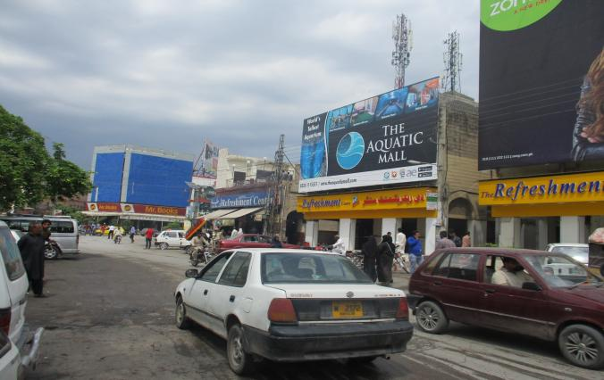
Rawalpindi
Size | 20x40
Availability
Rate P/M | Rs: 300,000
Location | Direction
Commercial Market | FTCF: Chandni Chowk, Shaheen Chemist moving towards 5th road.

Slide 27
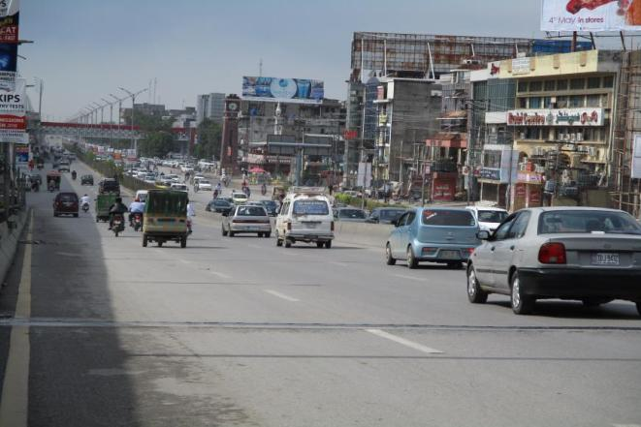
Rawalpindi
Size | 60x20
Availability
Rate P/M | Rs: 250,000
Location | Direction
Rehmanabad Main Enterance to Commerical Market | FTCF: Faizabad,Islamabad and Moving towards Murree Road & Saddar

Slide 28
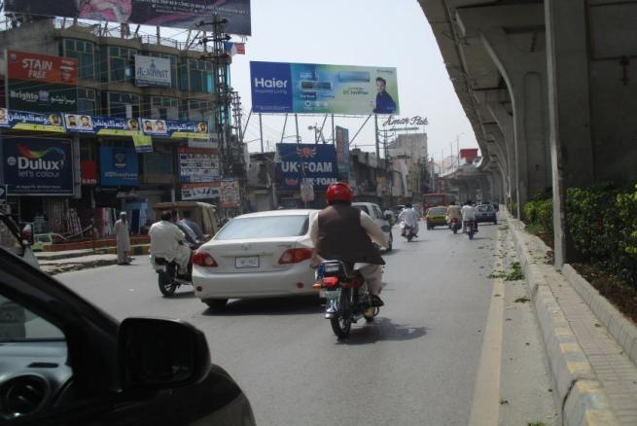
Rawalpindi
Size | 60x20
Availability
Rate P/M | Rs: 350,000
Location | Direction
Naaz Cinema Main Murree Road | FTCF: Fazabad & Commerical and going towards Saddar

Slide 29
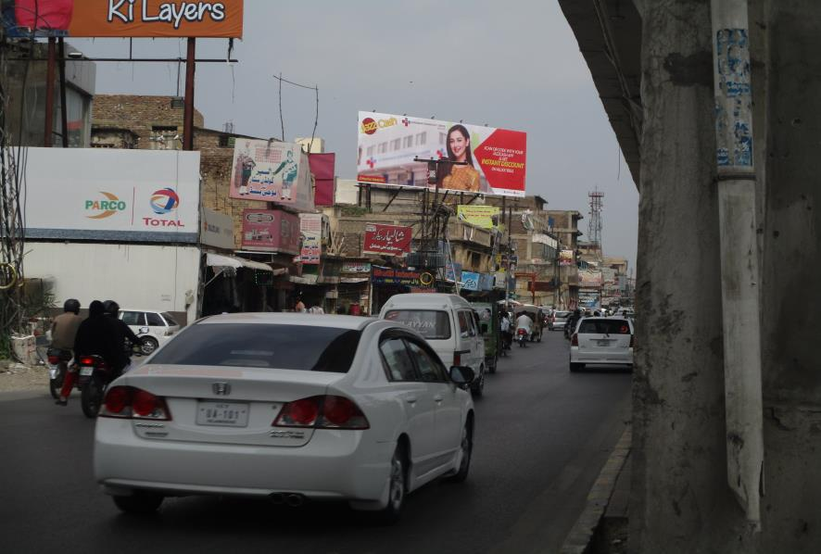
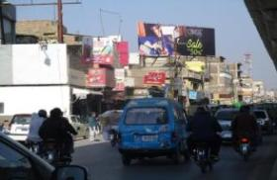
Rawalpindi
Size | 60x20
Availability
Rate P/M | Rs: 350,000
Location | Direction
Naaz Cinema | FTCF: Road FTCF Commettie Chowk Towards Waris Khan Stop,Chandni Chowk

Slide 30
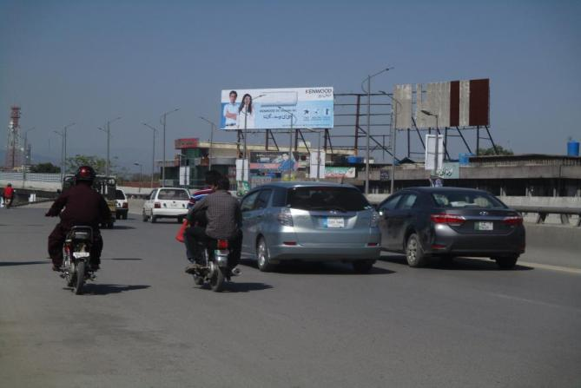
Rawalpindi
Size | 60x20
Availability
Rate P/M | Rs: 250,000
Location | Direction
Chandani Chowk Flyover | FTCF: Liaquat Bagh And Saddar going toward Fazabad & Islamabad Expressway

Slide 31
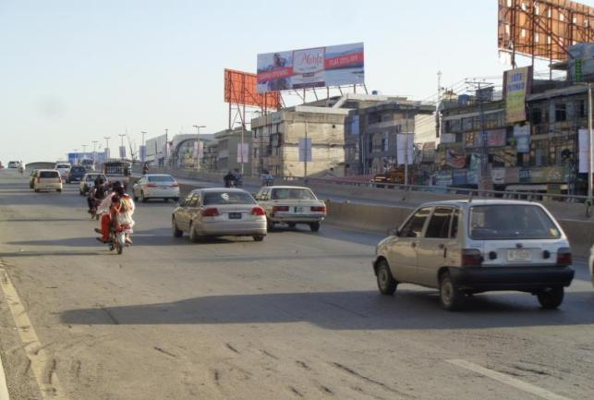
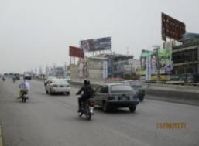
Rawalpindi
Size | 60x20
Availability
Rate P/M | Rs: 250,000
Location | Direction
6th Road Flyover | FTCF: Faizabad and moving towards Chandni chowk and Saddar

Slide 32
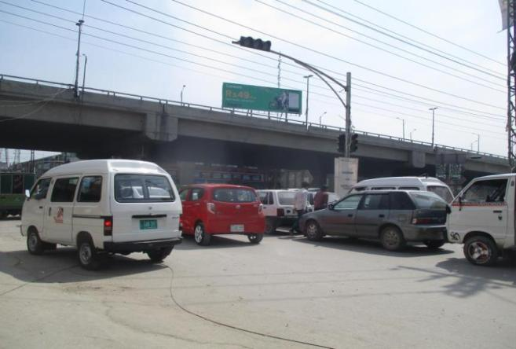
Rawalpindi
Size | 60x20
Availability
Rate P/M | Rs: 250,000
Location | Direction
6th Road Chowk Murree Road | FTCF:Faizabad and going towards Commercial Market & Chandani Chowk

Slide 33
Rawalpindi
Size | 60x20
Availability
Rate P/M | Rs: 350,000
Location | Direction
Liaquat Bagh Signal, Murree Road | FTCF:chandani chowk towards Liaquat Bagh ,Saddar & katchery chowk

Slide 34
Rawalpindi
Size | 60x20
Availability
Rate P/M | Rs: 350,000
Location | Direction
Moti Mahal Main Murree Road | FTCF:View from Faizabad towards Saddar & Rawalpindi Medical College

Slide 35
Rawalpindi
Size | 60x20
Availability
Rate P/M | Rs: 400,000
Location | Direction
Tehzeeb Bakers | FTCF:Haider Road FTCF GPO Stop Kashmir Road Towards Station More Stop Mehfooz Road

Slide 36
Rawalpindi
Size | 60x20
Availability
Rate P/M | Rs: 350,000
Location | Direction
DHA Gate 2 | FTCF: -Chowk and Moving towards Bahria Town Phase 7.

Slide 37
Rawalpindi
Size | 60x20
Availability
Rate P/M | Rs: 250,000
Location | Direction
Airport Road Rawalpindi | FTCF:Airport to Expressway Korral Chowk.

Slide 38
Rawalpindi
Size | 60x20
Availability
Rate P/M | Rs: 250,000
Location | Direction
Airport Road Rawalpindi | FTCF: Airport to Expressway Korral Chowk, Gulzar e Quaid.

Slide 39
Rawalpindi
Size | 60x20
Availability
Rate P/M | Rs: 250,000
Location | Direction
Airport Road Rawalpindi | FTCF:Expressway to Airport, Gulzar e Quaid

Slide 40
Rawalpindi
Size | 60x42
Availability
Rate P/M | Rs: 800,000
Location | Direction
Race Course Ground | FTCF:Westridge ,Peshawar Road Moving towards MH Chowk, GHQ Saddar.

Slide 41
Rawalpindi
Size | 60x20
Availability
Rate P/M | Rs: 400,000
Location | Direction
Race Course Ground | FTCF:Westridge ,Peshawar Road Moving towards MH Chowk, GHQ Saddar.

Slide 42
Rawalpindi
Size | 60x20
Availability
Rate P/M | Rs: 400,000
Location | Direction
Race Course Ground | FTCF:Westridge ,Peshawar Road Moving towards MH Chowk, GHQ Saddar.

Slide 43
Ad Solution
TERMS & CONDITIONS
First time skin installation and removing is free.
Skin printing charges are not included in the proposed rates.
These rates are exclusive of all kinds of taxes.
If skin is damaged due to weather, changing/re-printing charges will be borne by the client.
The payment will be made 50% in advance and the remaining balance will be payable through 15 days post dated cheque, from the day, the display starts.
For locking the sites please inform us within 1-3 working days.

