Slide 1
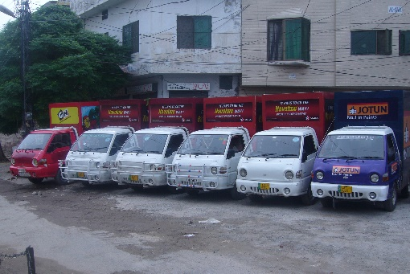
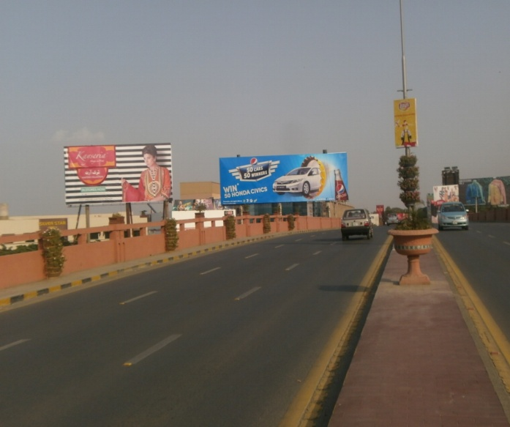
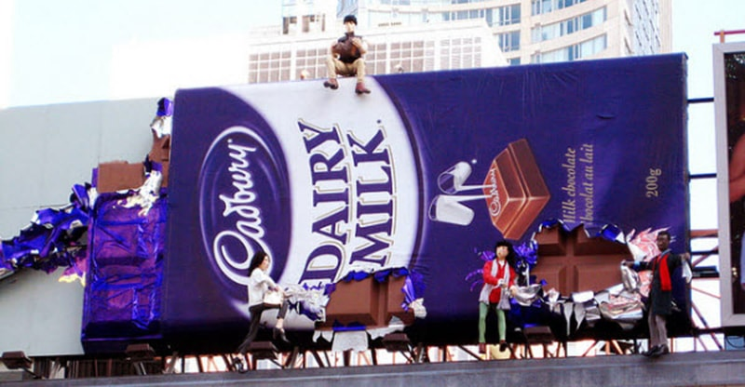
What we Do
Ad Solution
Advertising
Mobile Float
BTL Activities
Bill Boards/Hoardings
All Kinds of Pana Flex /Vinyl Printing
Offset Printing
X/Rollup Stand
Signage (New installation and Maintenance)

Slide 2
SAHIWAL

Slide 3
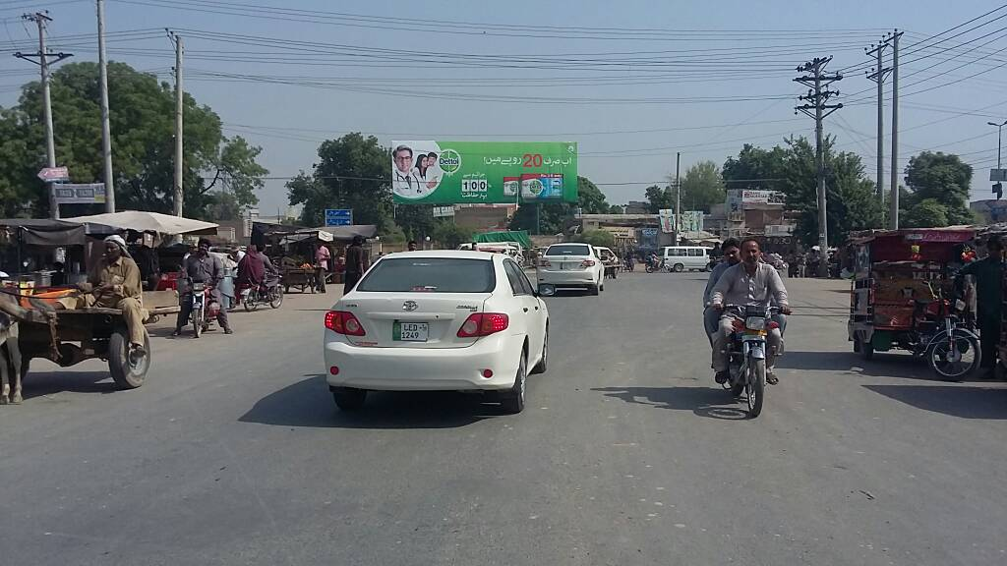
Sahiwal
Size | 60x20
Availability
Rate P/M | Rs: 150,000/=
Location | Direction
Arif Chowk | FTCF: Ghulam Fareed Town, Daewoo Terminal and Arifwala Towards Pakpatan Chowk, Jahaz Chowk and City

Slide 4
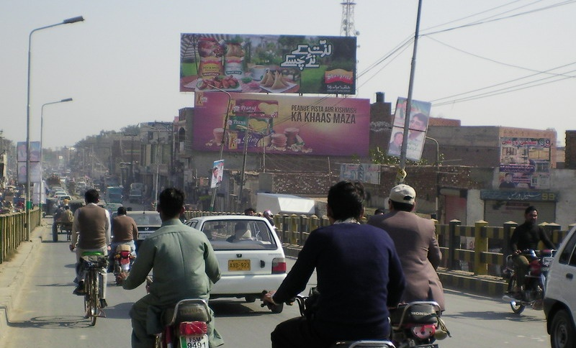
Sahiwal
Size | 60x20
Availability
Rate P/M | Rs: 175,000/=
Location | Direction
Niazi Flyover Pakpatan Chowk | FTCF: Jogi Chowk Towards Pakpatan Chowk

Slide 5
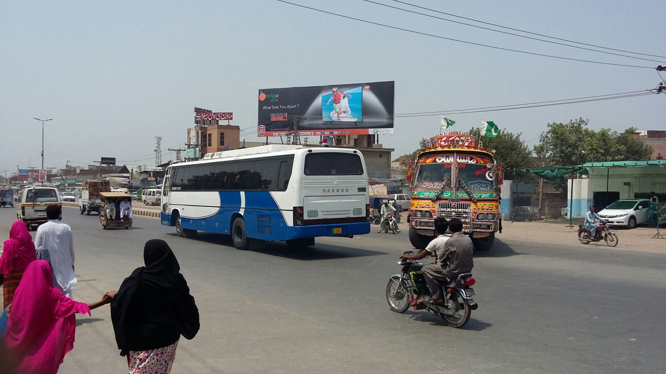
Sahiwal
Size | 60x20
Availability
Rate P/M | Rs: 150,000/=
Location | Direction
Mintgomery Biscuits Factory Chowk | FTCF: Pakpatan Chowk Towards Jahaz Chowk, Multan and Arifwala

Slide 6
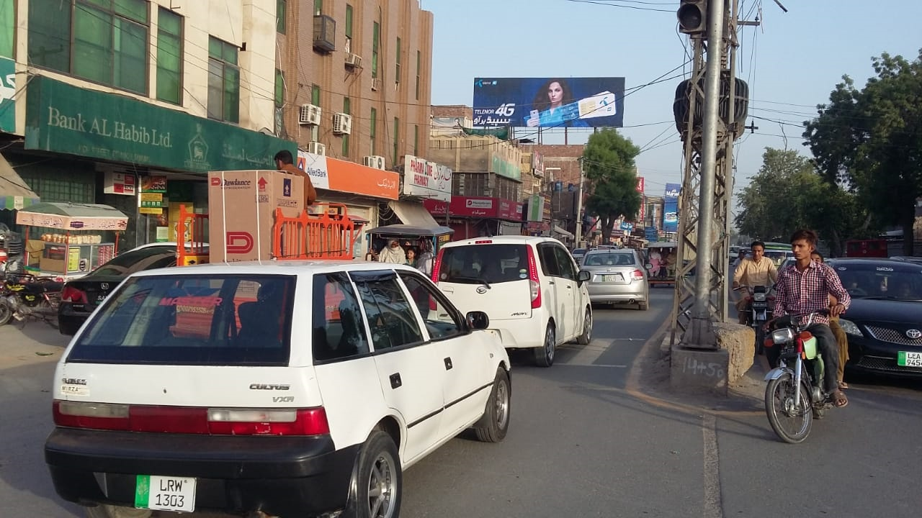
Sahiwal
Size | 60x20
Availability
Rate P/M | Rs: 150,000/=
Location | Direction
Tanki Chowk | FTCF: Mission Chowk Towards Jogi Chowk

Slide 7
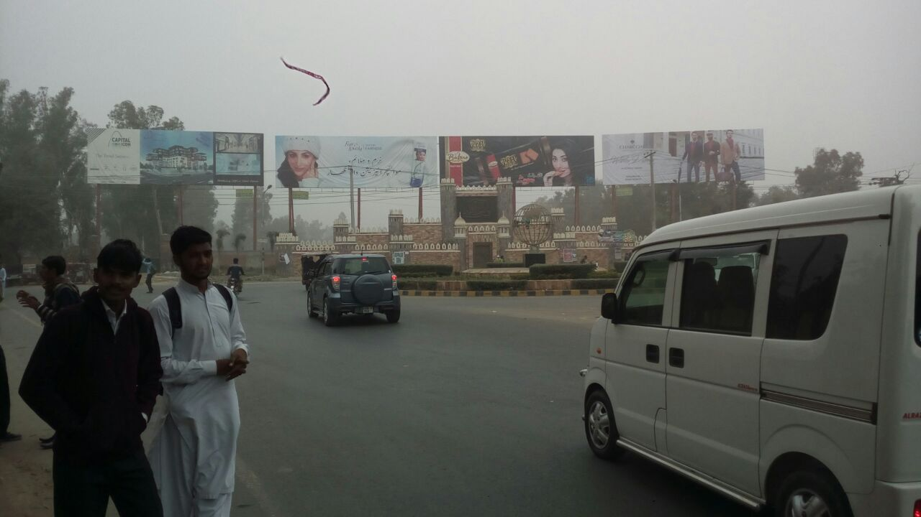
Sahiwal
Size | 60x20
Availability
Rate P/M | Rs: 200,000/=
Location | Direction
Jahaz Chowk | FTCF: General Bus Stand and Arif Chowk Towards Jahaz Chowk, Azan Heights and College Chowk

Slide 8
Sahiwal
Size | 60x20 Qty_2
Availability
Rate P/M | Rs: 200,000/=
Location | Direction
Jahaz Chowk | FTCF: General Bus Stand and Arif Chowk Towards Jahaz Chowk, Azan Heights and College Chowk

Slide 9
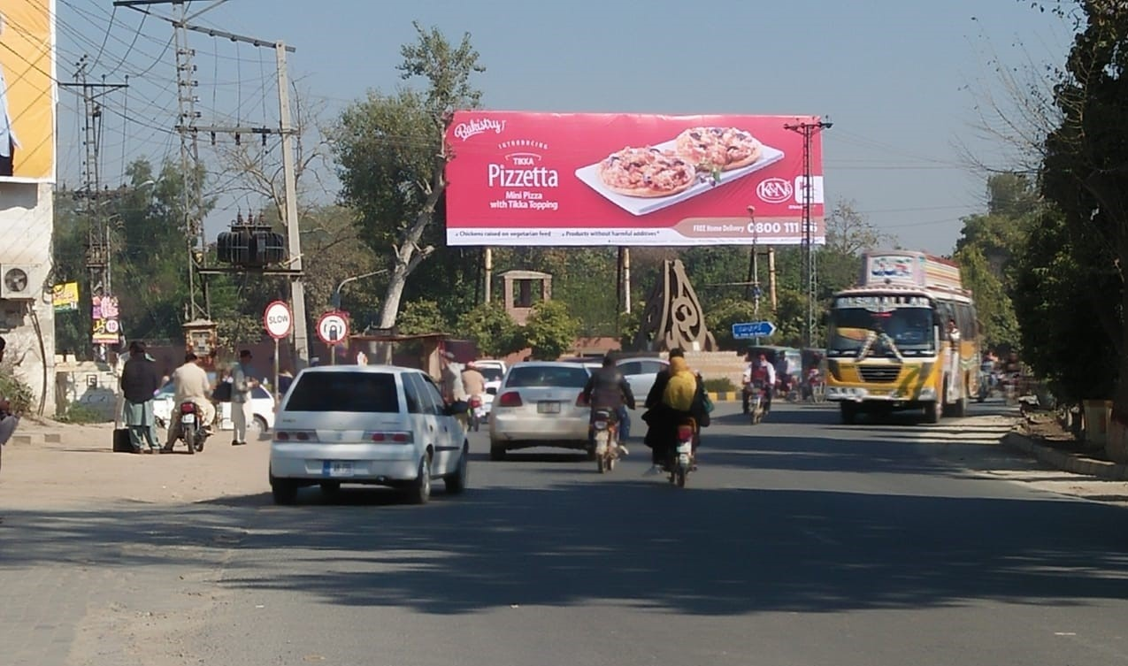
Sahiwal
Size | 60x20
Availability
Rate P/M | Rs: 150,000/=
Location | Direction
Jinnah Hall Chowk (Katchery Chowk) | FTCF: Jahaz Chowk anprild GPO Chowk Towards College Chowk and High Street

Slide 10
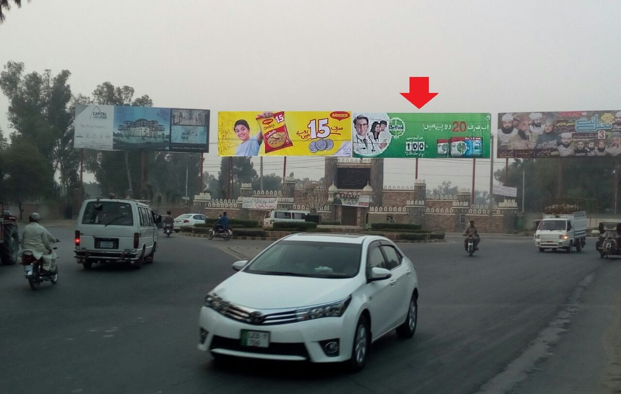
Sahiwal
Size | 60x20
Availability
Rate P/M | Rs: 200,000/=
Location | Direction
Jahaz Chowk | FTCF: General Bus Stand and Arif Chowk to Jahaz Chowk, Azan Heights and College Chowk

Slide 11
BUREWALA

Slide 12
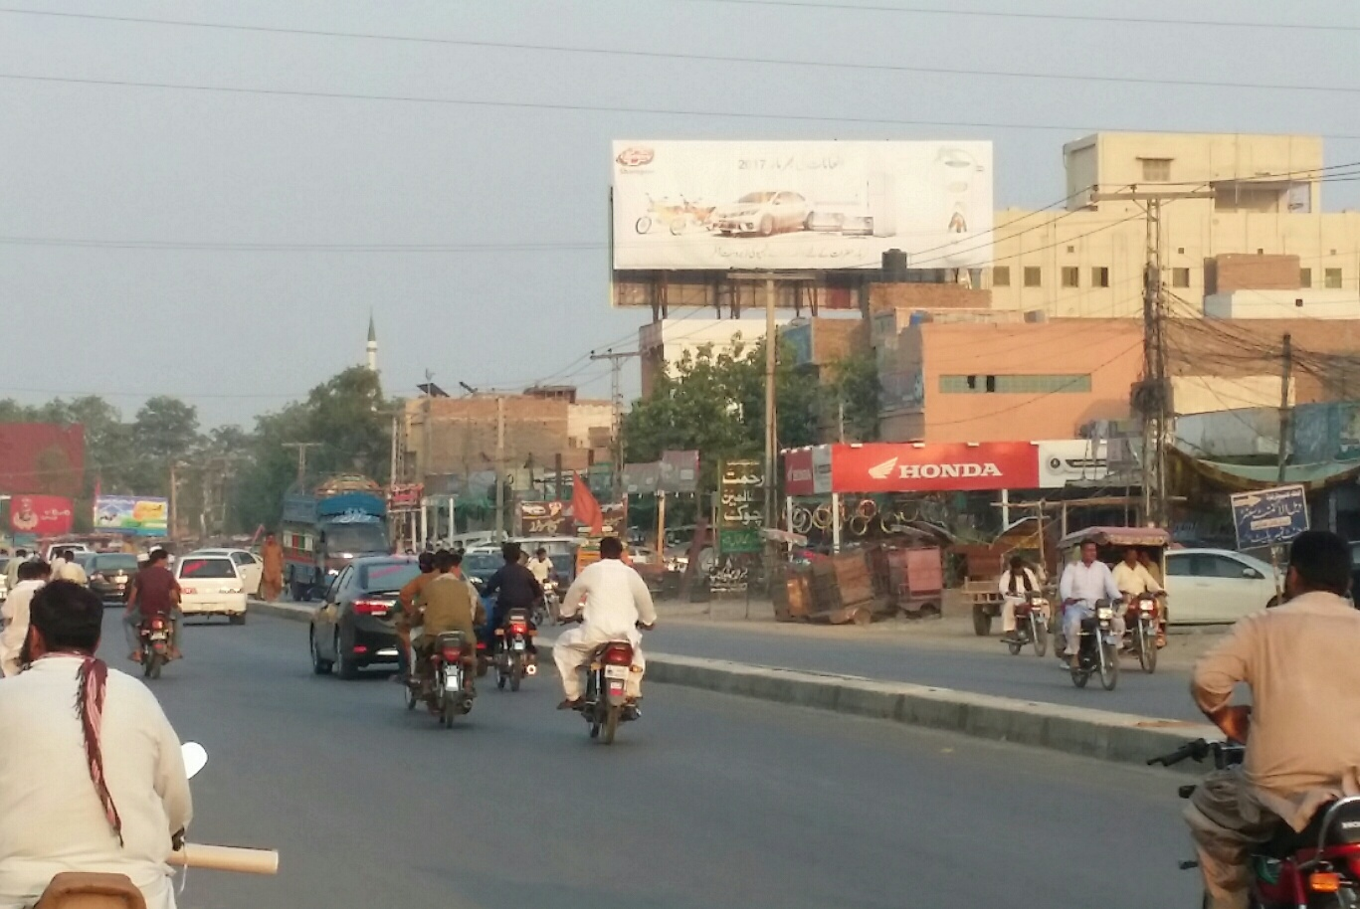
Burewala
Size | 60x20
Availability
Rate P/M | Rs: 150,000
Location | Direction
Fawara Chowk | FTCF: Hussaini Chowk and General Bus Stand Towards BTM and Arifwala

Slide 13
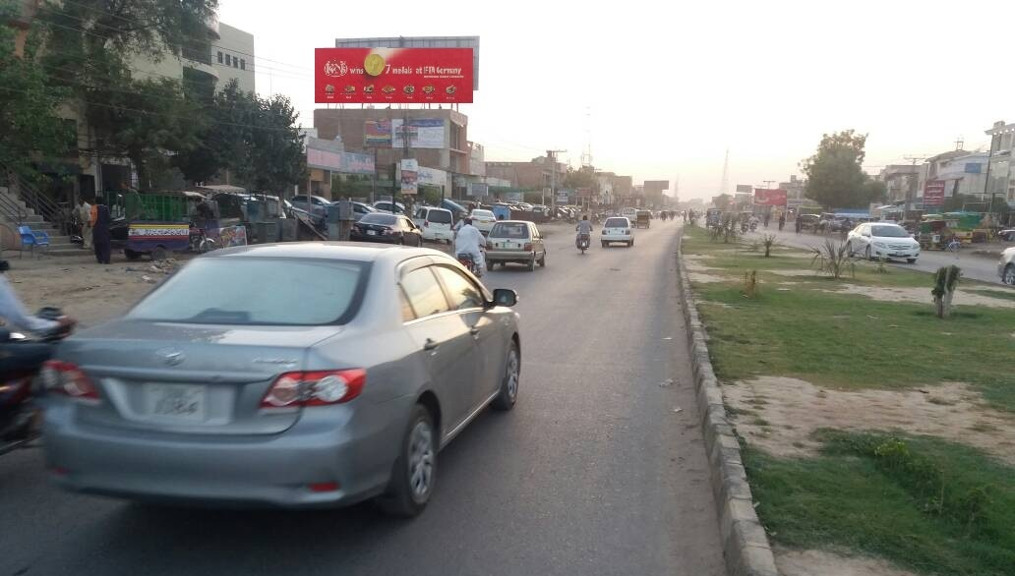
Burewala
Size | 60x20
Availability | Available
Rate P/M | Rs: 150,000
Location | Direction
Fawara Chowk | FTCF: BTM and Arifwala Towards Hussaini Chowk and General Bus Stand

Slide 14
KHANEWAL

Slide 15
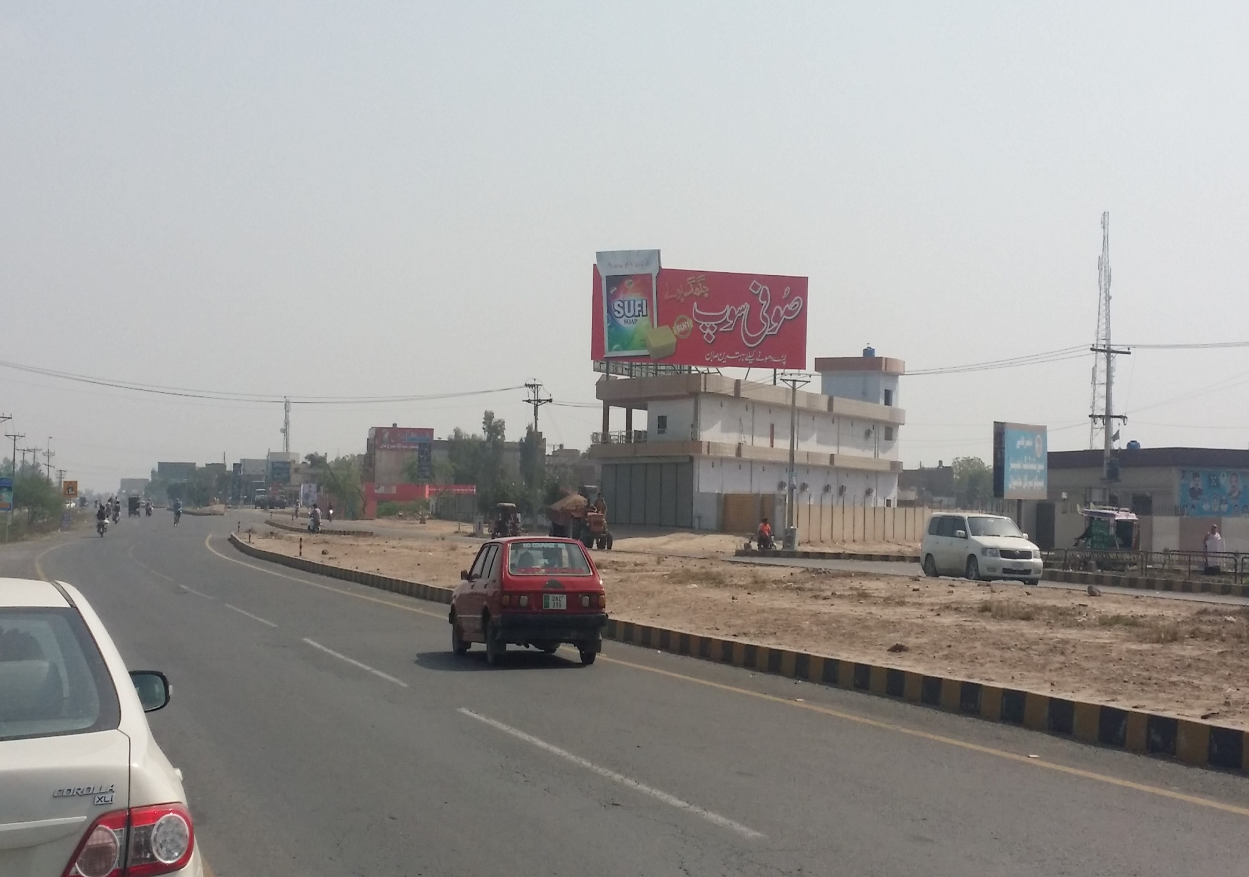
Khanewal
Size | 60x20
Availability | Available
Rate P/M | Rs: 140,000
Location | Direction
Unilever Chowk | FTCF: Kabirwala Chowk, Multan and City Towards Niazi Chowk and Lahore (Double View)

Slide 16
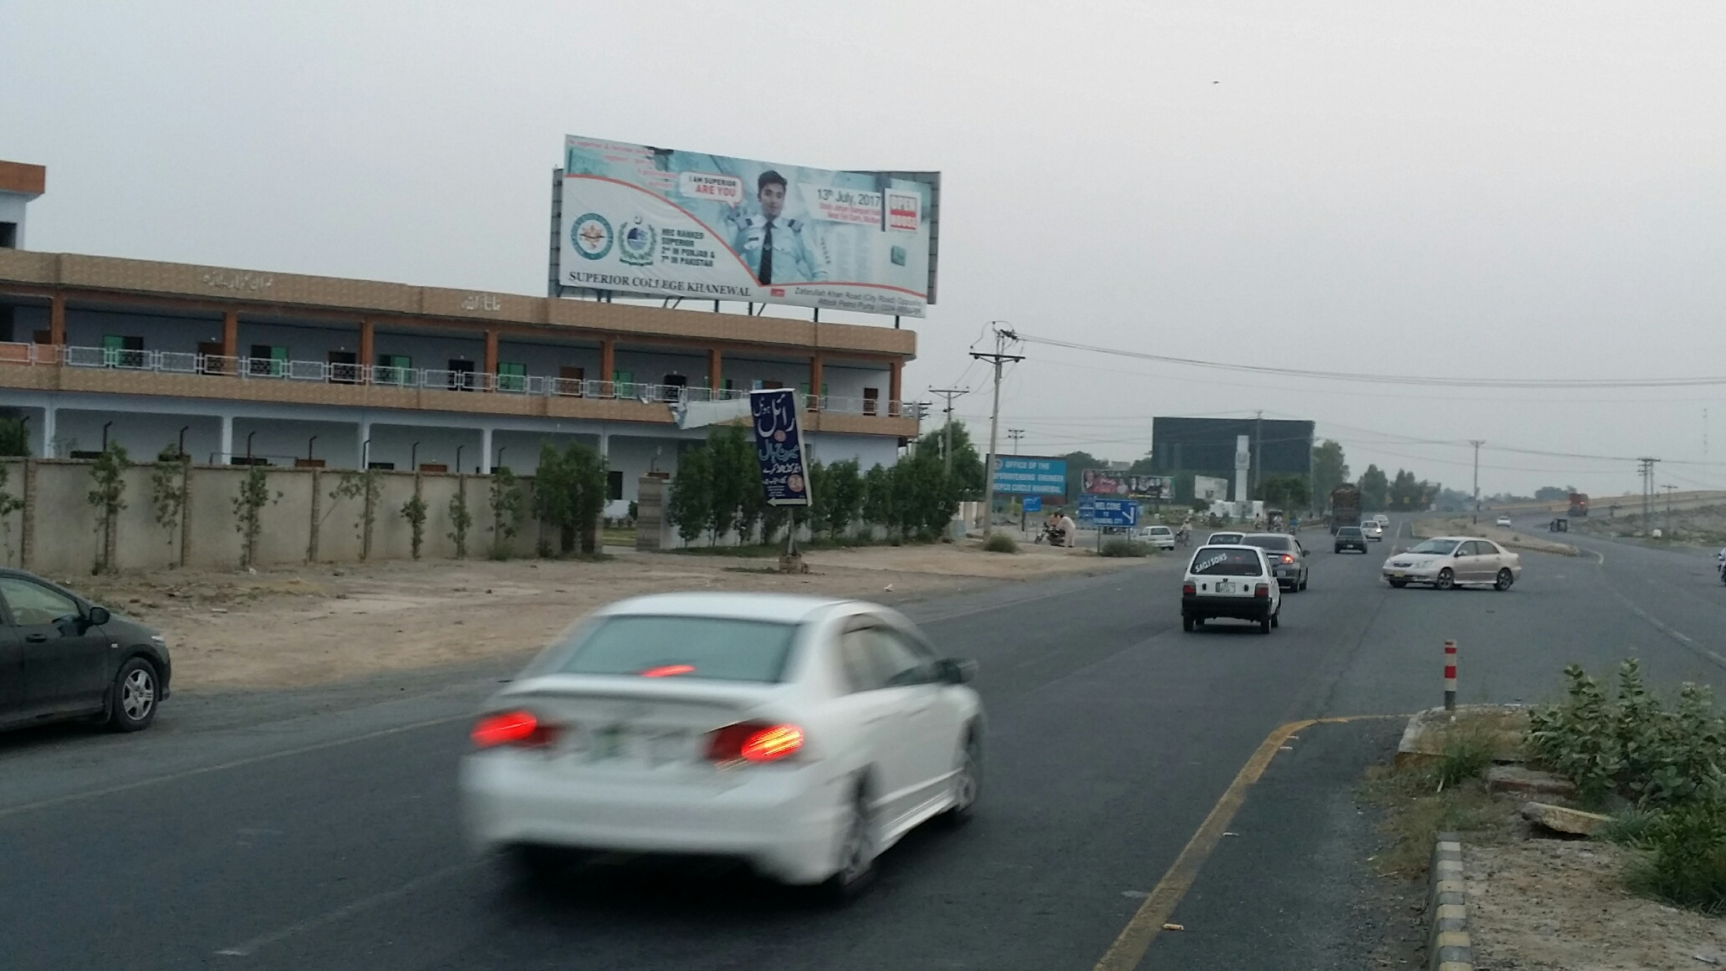
Khanewal
Size | 60x20
Availability | Available
Rate P/M | Rs: 140,000
Location | Direction
Unilever Chowk | FTCF: Niazi Chowk and Lahore Towards Khanewal City, Kabirwala Chowk and Multan

Slide 17
MIANWALI

Slide 18
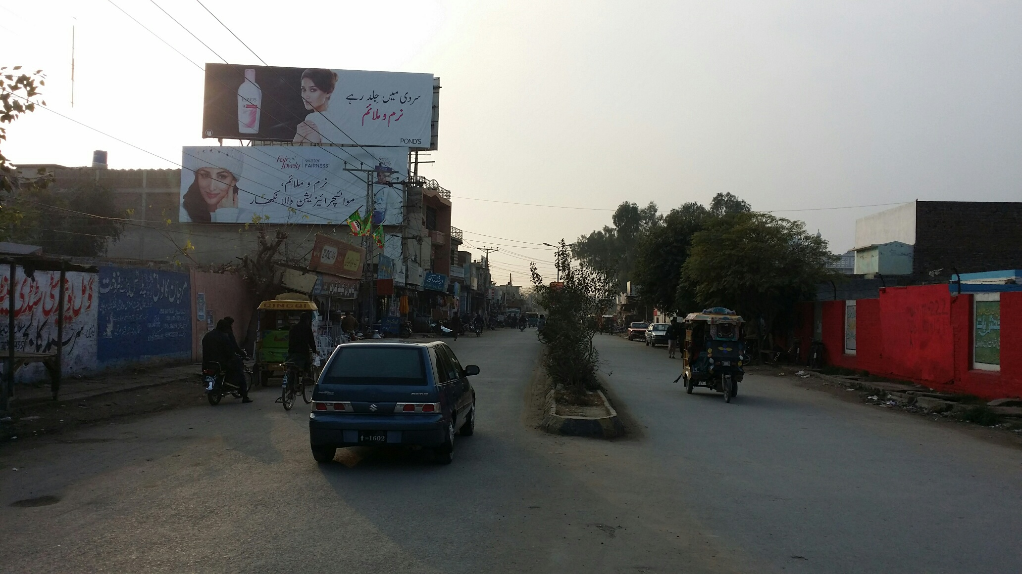
Mianwali
Size | 60x20
Availability
Rate P/M | Rs: 125,000/=
Location | Direction
Awami Chowk | FTCF: Watta Khail Chowk, Gulberg Chowk Towards Main Bazar and Railway Station

Slide 19
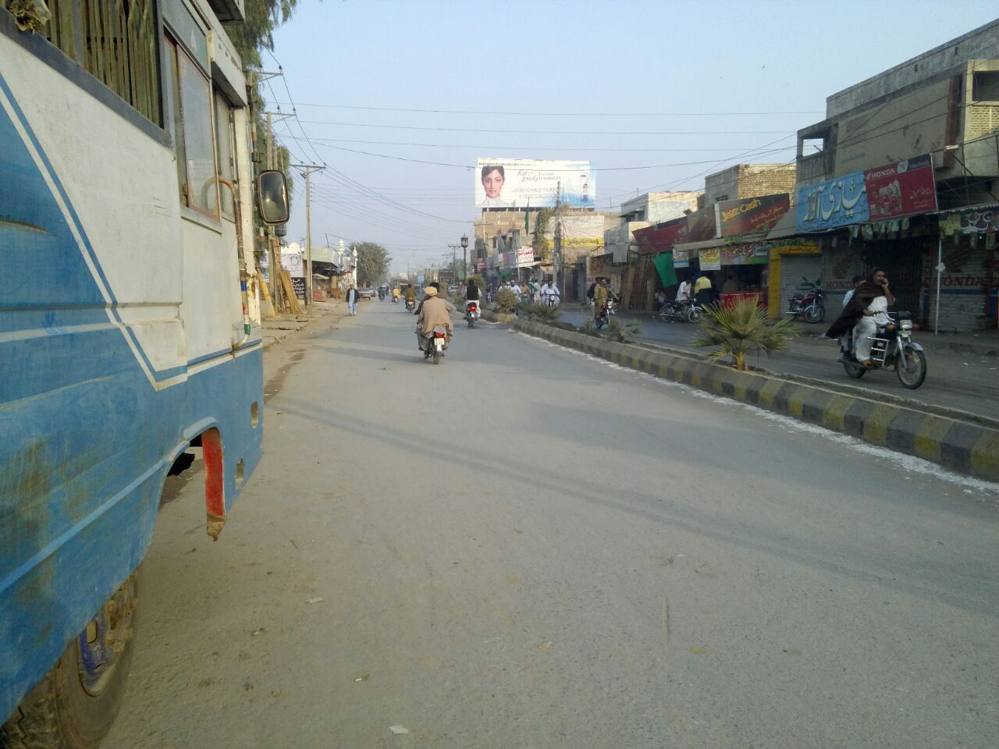
Mianwali
Size | 60x20
Availability
Rate P/M | Rs: 125,000/=
Location | Direction
Awami Chowk | FTCF: Main Bazar and Railway Station Towards Watta Khail Chowk, Gulberg Chowk

Slide 20
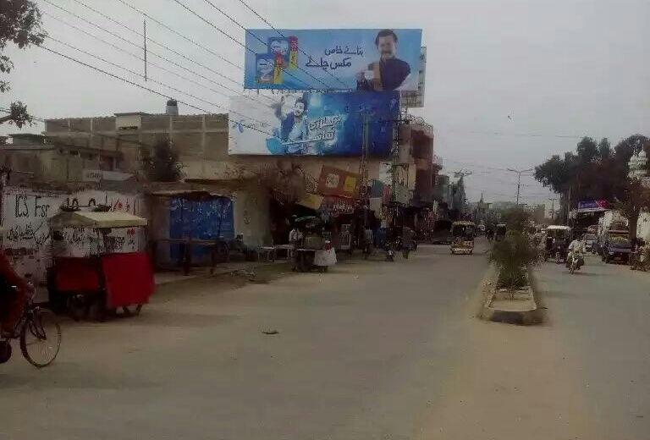
Mianwali
Size | 60x20
Availability
Rate P/M | Rs: 125,000/=
Location | Direction
Awami Chowk | FTCF: Watta Khail Chowk, Gulberg Chowk to Main Bazar and Railway Station

Slide 21
CHINIOT

Slide 22
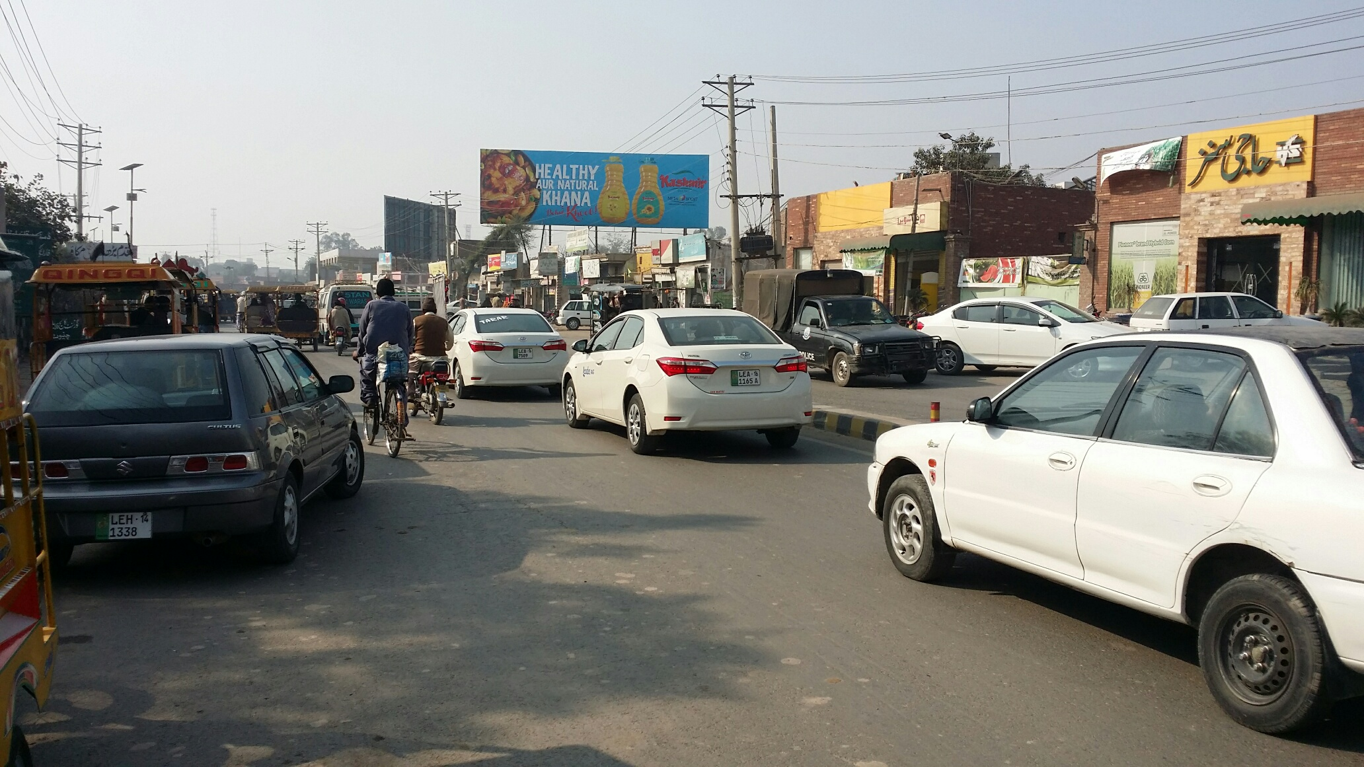
Chiniot
Size | 60x20
Availability
Rate P/M | Rs: 125,000/=
Location | Direction
Tehsil Chowk | FTCF: Model Town, Police Line and Lahore Towards Katchery Chowk Jhang & General Bus Stand

Slide 23
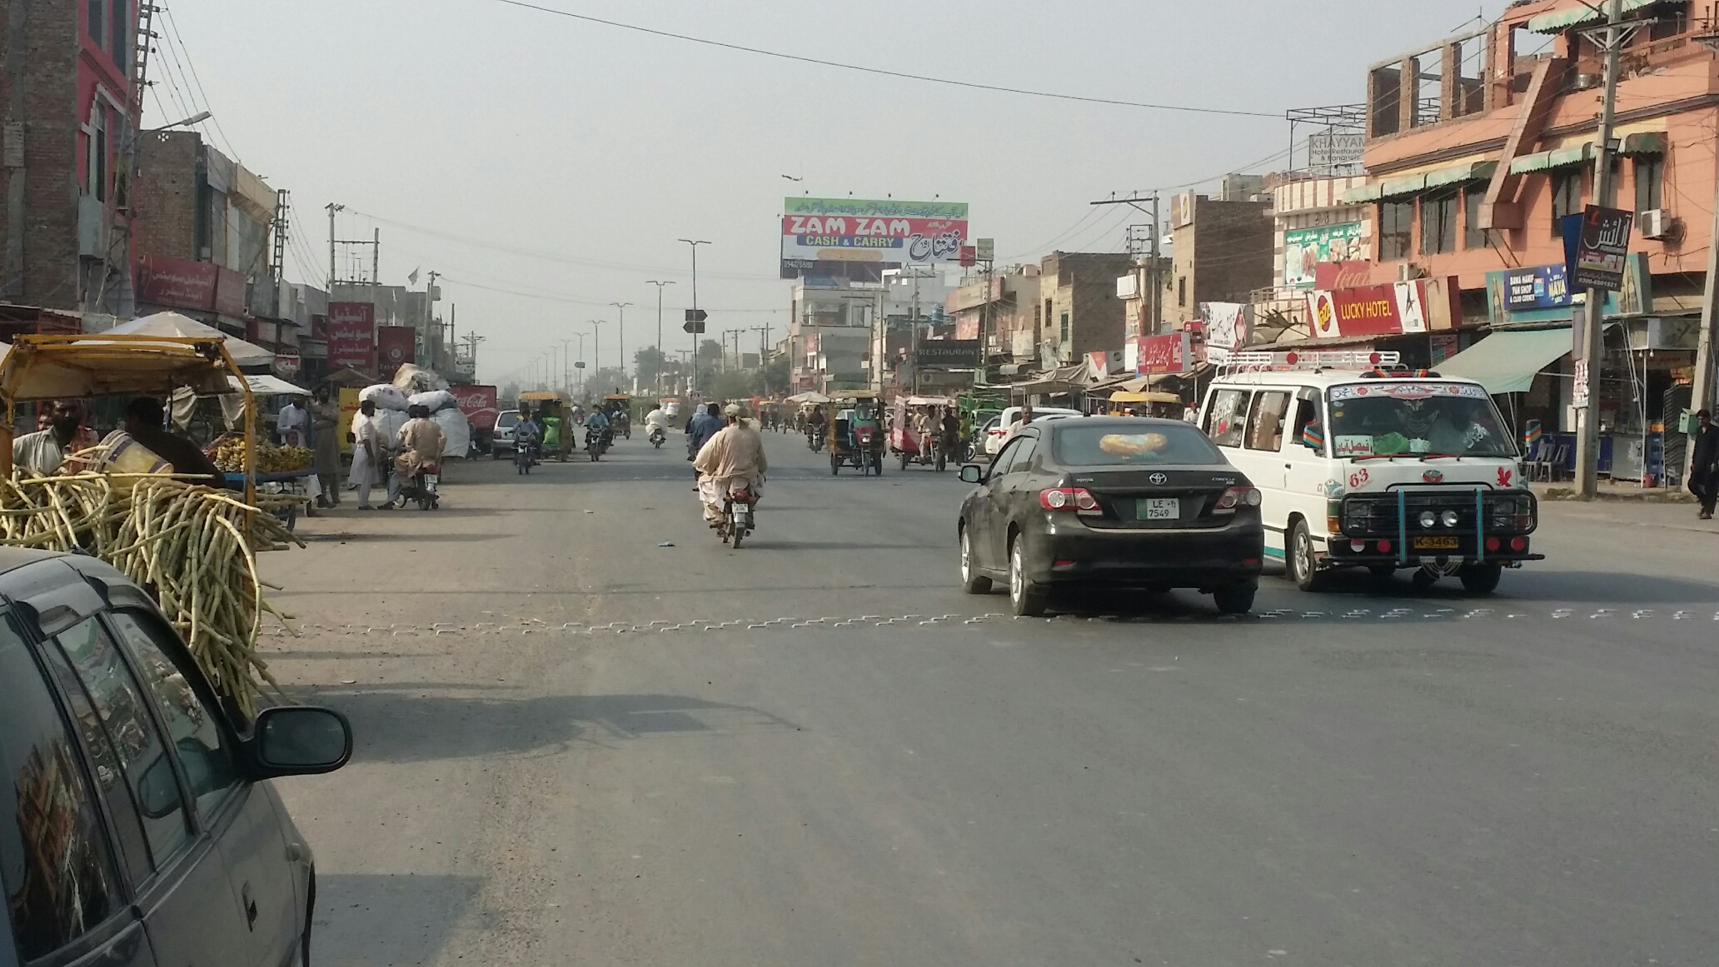
Chiniot
Size | 60x20
Availability
Rate P/M | Rs: 125,000/=
Location | Direction
Railway Station Chowk | FTCF: Tehsil Chowk and General Bus Stand Towards Chanab Nagar and Sargodha

Slide 24
PATTOKI

Slide 25
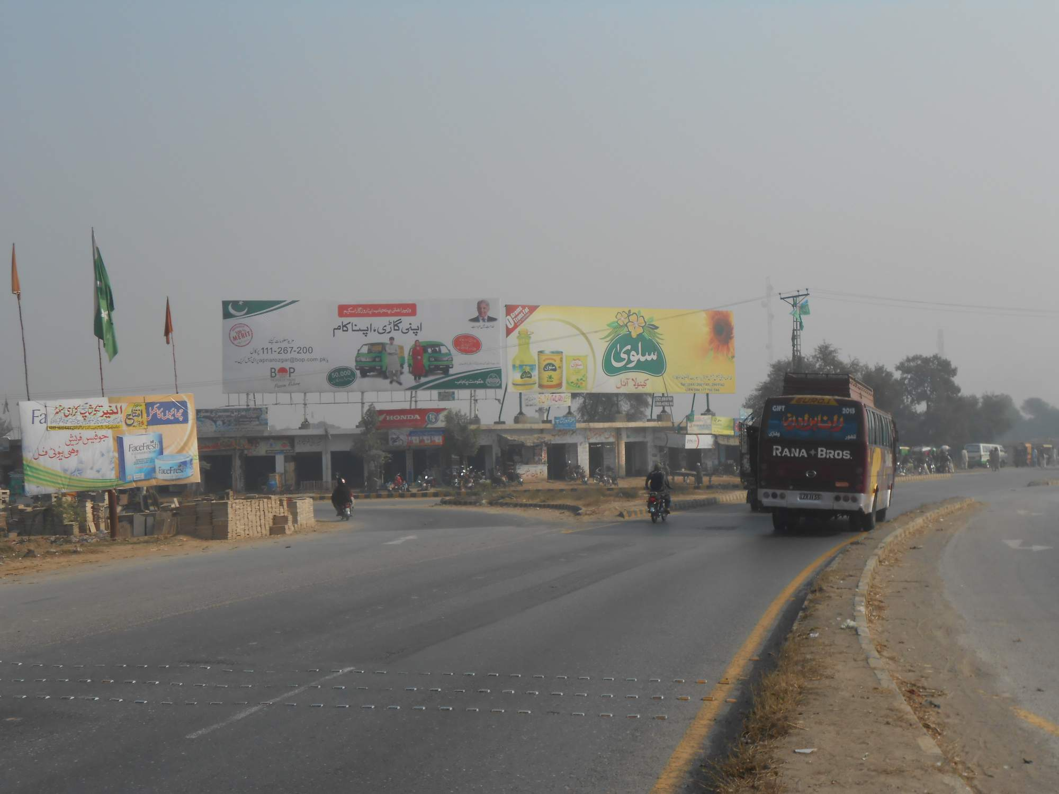
Pattoki
Size | 60x20
Availability
Rate P/M | Rs: 125,000/=
Location | Direction
Habibabad Bypass Near | FTCF: Multan Towards Lahore

Slide 26
NAROWAL

Slide 27
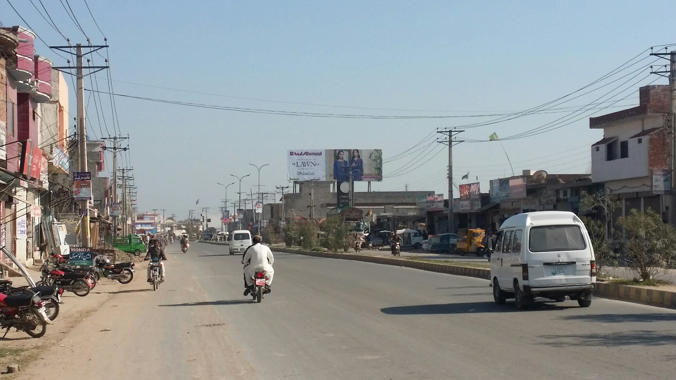
Narowal
Size | 60x20
Availability | Available
Rate P/M | Rs: 125,000
Location | Direction
Bijli Ghar Chowk | FTCF: Lahore, Sialkot and Grid Station Chowk Towards General Bus Stand, Main Bazar and Circular Road

Slide 28
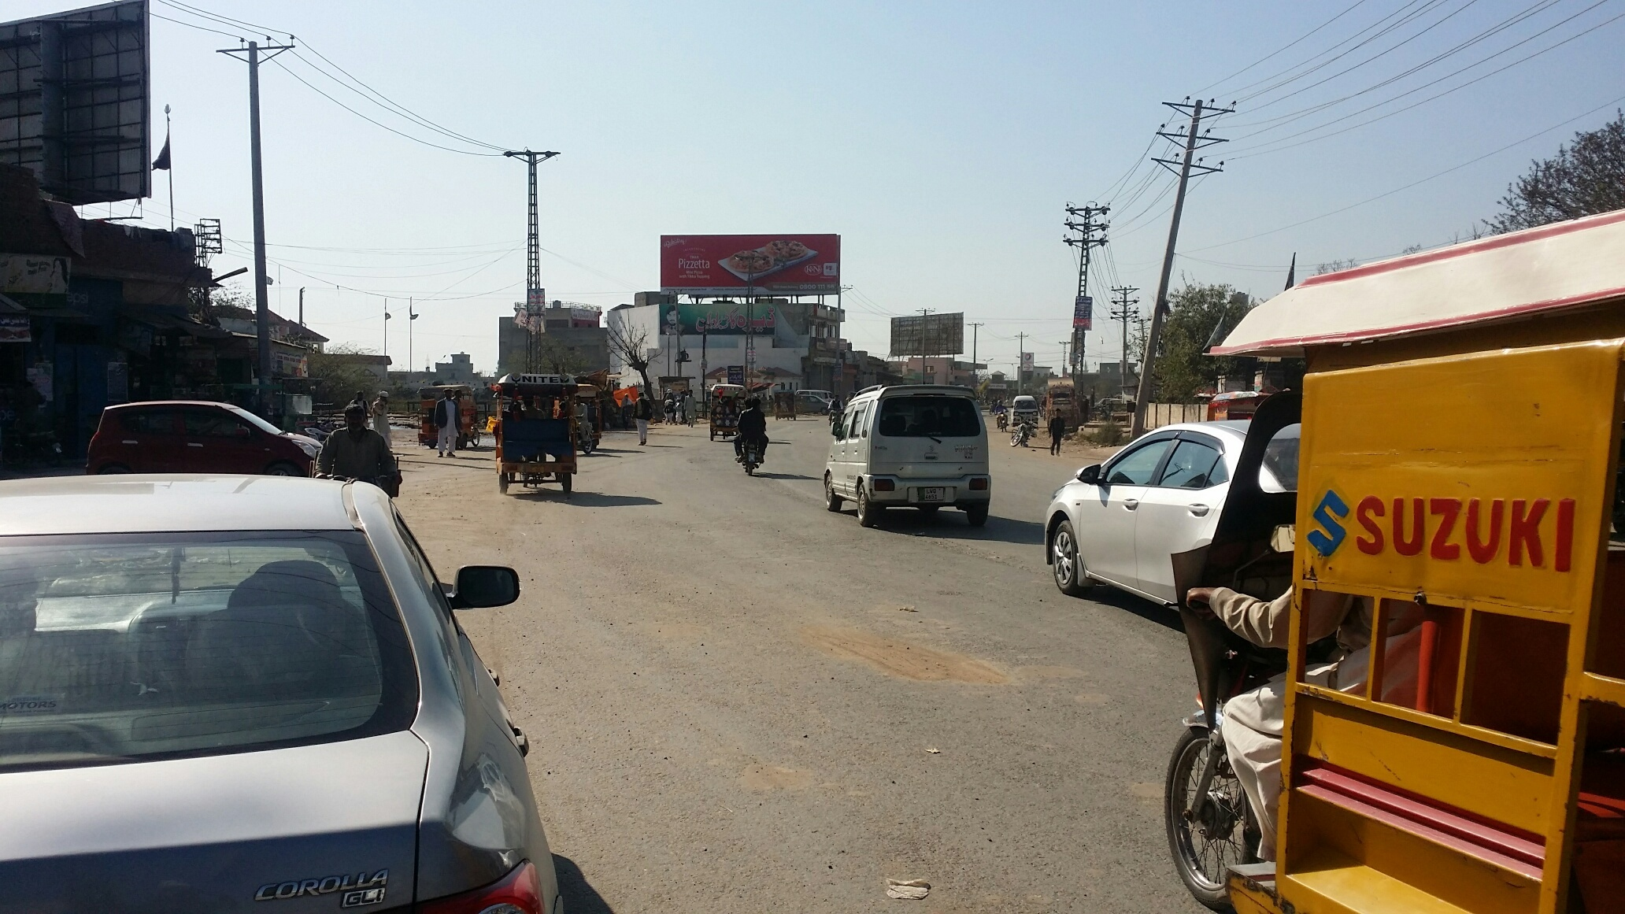
Narowal
Size | 60x20
Availability
Rate P/M | Rs: 125,000
Location | Direction
Butt Motors | FTCF: General Bus Stand, Main Bazar and Circular Road Towareds Sabzi Mandi, Sialkot and Grid Station Chowk

Slide 29
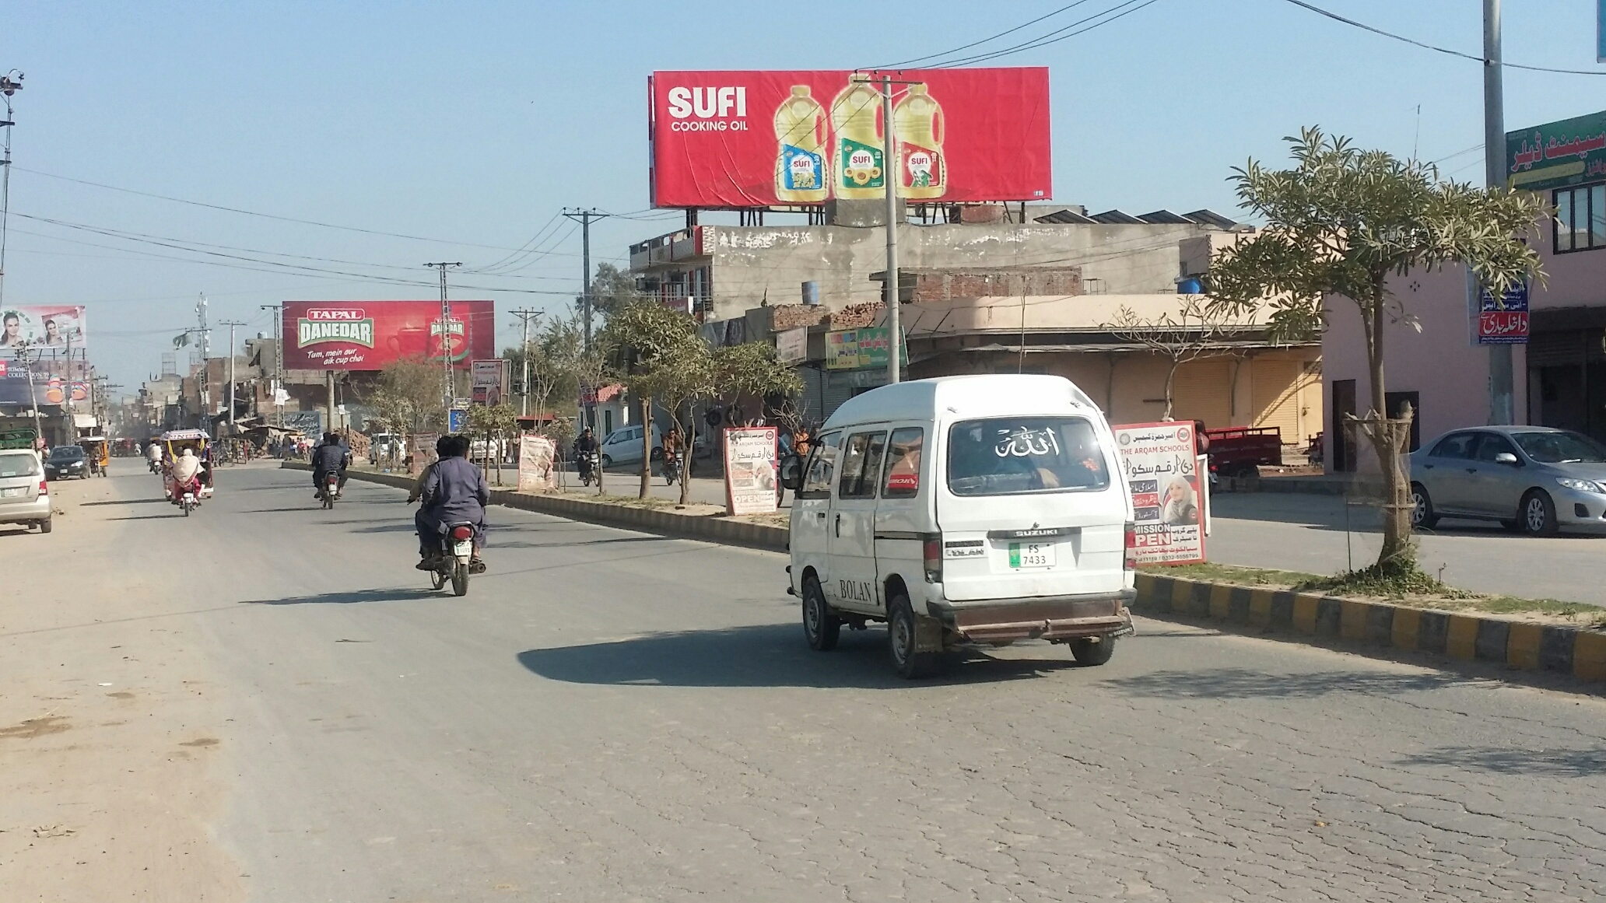
Narowal
Size | 60x20
Availability
Rate P/M | Rs: 125,000
Location | Direction
Butt Motors | FTCF: Lahore, Sialkot and Grid Station Chowk Towards General Bus Stand, Main Bazar and Circular Road

Slide 30
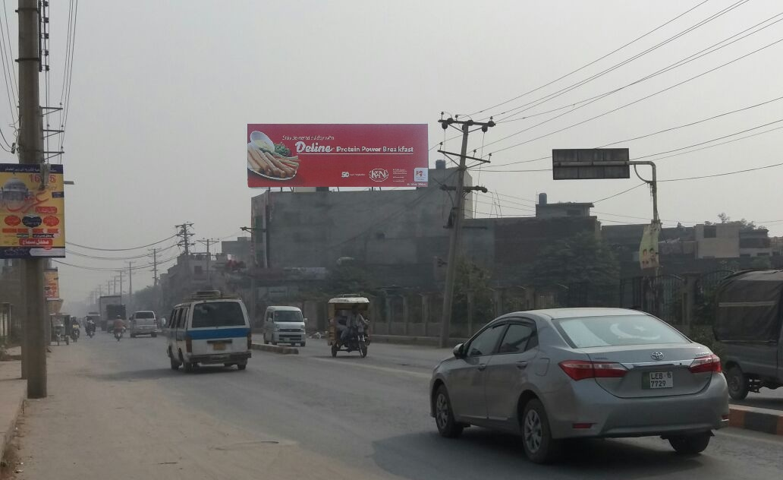
Sialkot
Size | 60x20
Availability
Rate P/M | Rs: 175,000
Location | Direction
Defence Road | FTCF: Sublime Chowk and Shahab Phatak Towards Haji Pura and Pull Aik

Slide 31
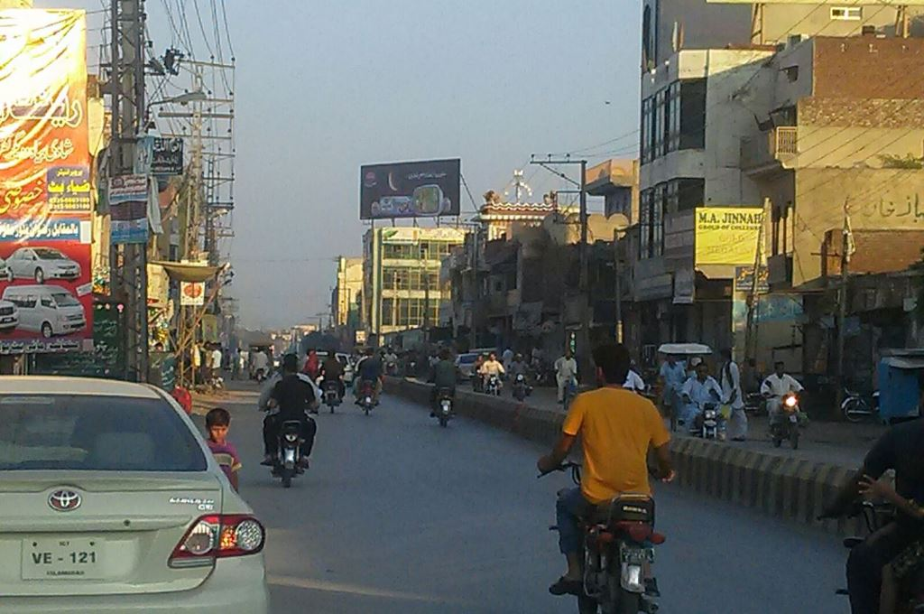
Jehlum
Size | 60x20
Availability | Available
Rate P/M | Rs: 175,000/=
Location | Direction
Shandar Chowk | FTCF: Jada Chowk Towards Sadar Bazar and Shandar Chowk

Slide 32
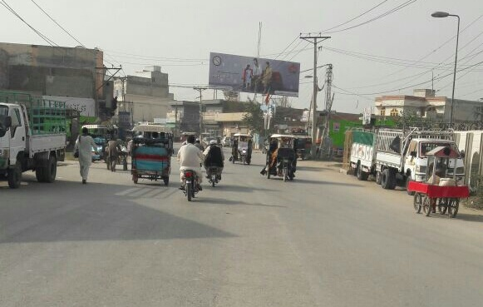
DI Khan
Size | 60x20
Availability | Available
Rate P/M | Rs: 175,000/=
Location | Direction
Circular Road | FTCF: Fawara Chowk Towards Ghora Chowk and GPO Chowk

Slide 33
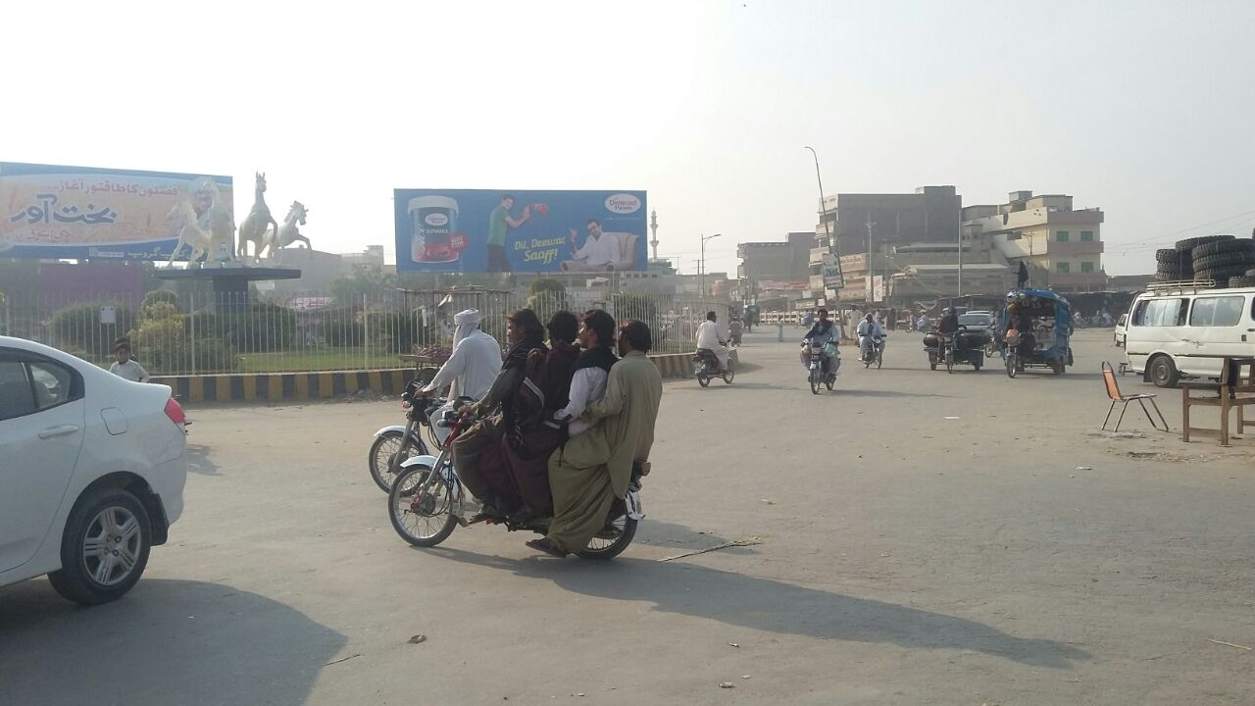
DG Khan
Size | 60x20
Availability | Available
Rate P/M | Rs: 150,000/=
Location | Direction
Chorata Chowk | FTCF: Mutlan, Tonsa Towards Pull Dot Chowk, traffic Chowk and TMA Chowk

Slide 34
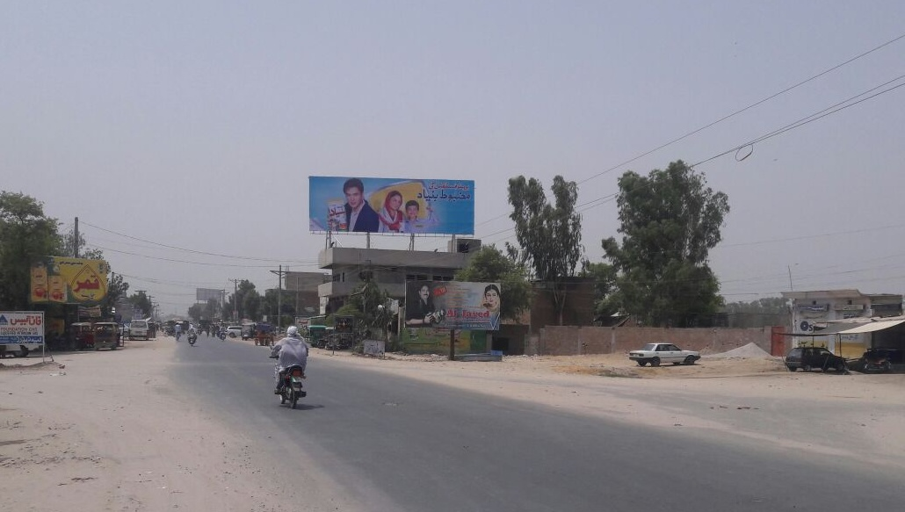
Layyah
Size | 60x20
Availability
Rate P/M | Rs: 110,000/=
Location | Direction
Employees Chowk | FTCF: District Courts Towards DHQ Hospital and General Bus Stand

Slide 35
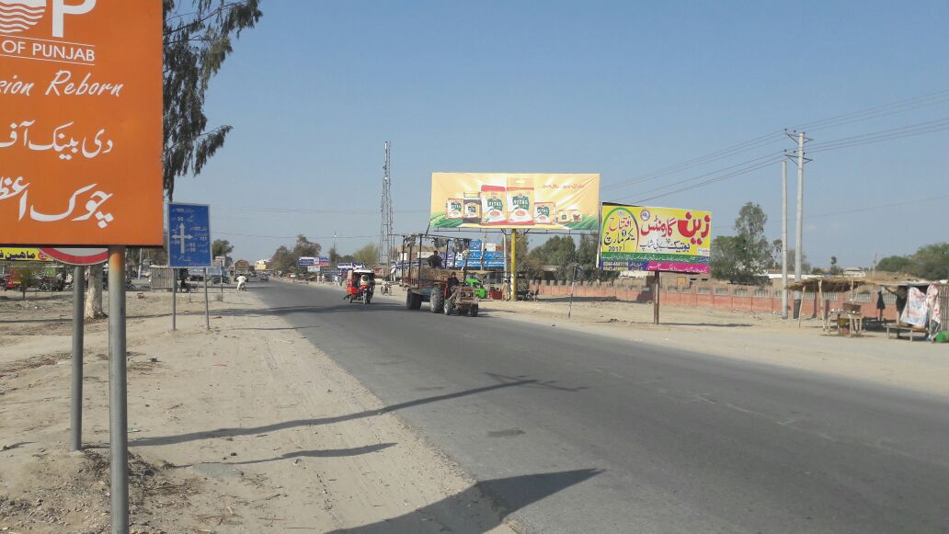
Chowk Azam
Size | 45x15
Availability
Rate P/M | Rs: 50,000/=
Location | Direction
THQ Hospital | FTCF: Chowk Munda and Multan Towards Layyah, Chobara and Mianwali

Slide 36
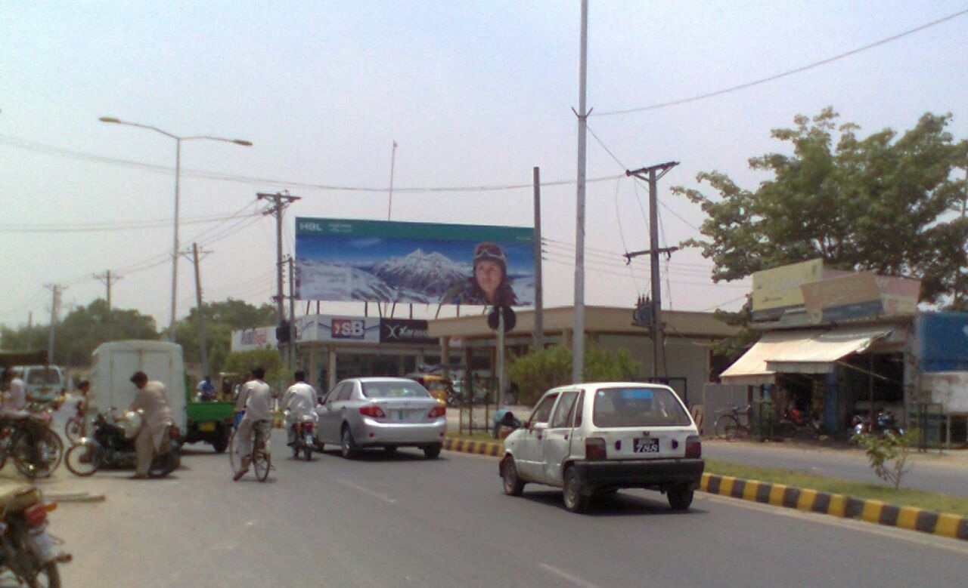
Bahawalpur
Size | 60x20
Availability
Rate P/M | Rs: 150,000/=
Location | Direction
Airport Road | FTCF: Library Chowk and Bahawal Club Towards Airport, DHA and Yazman

Slide 37
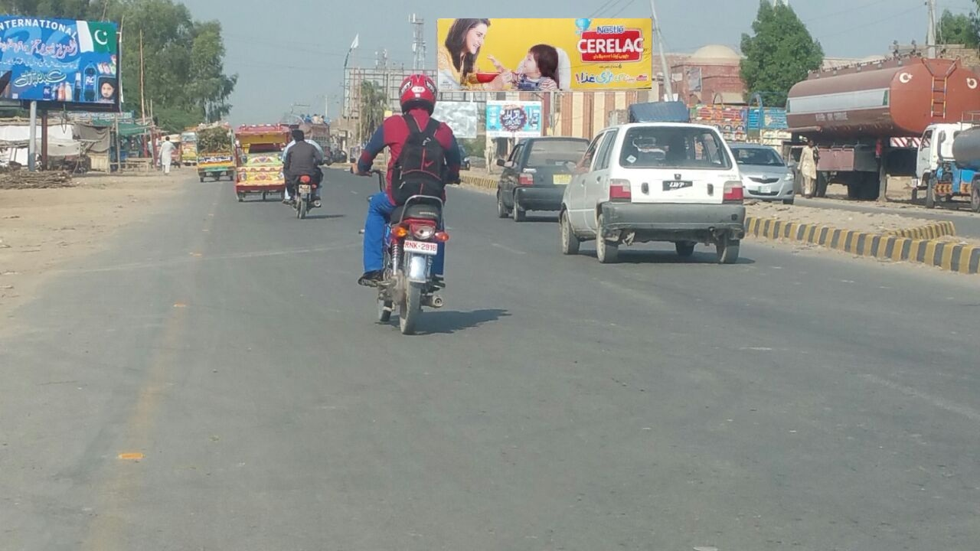
Chishtian
Size | 60x20
Availability | Available
Rate P/M | Rs:120,000
Location | Direction
General Bus Stand | FTCF: Hasilpur, Daharanwala Chowk Towards Fawara Chowk and Gulzar Chowk

Slide 38
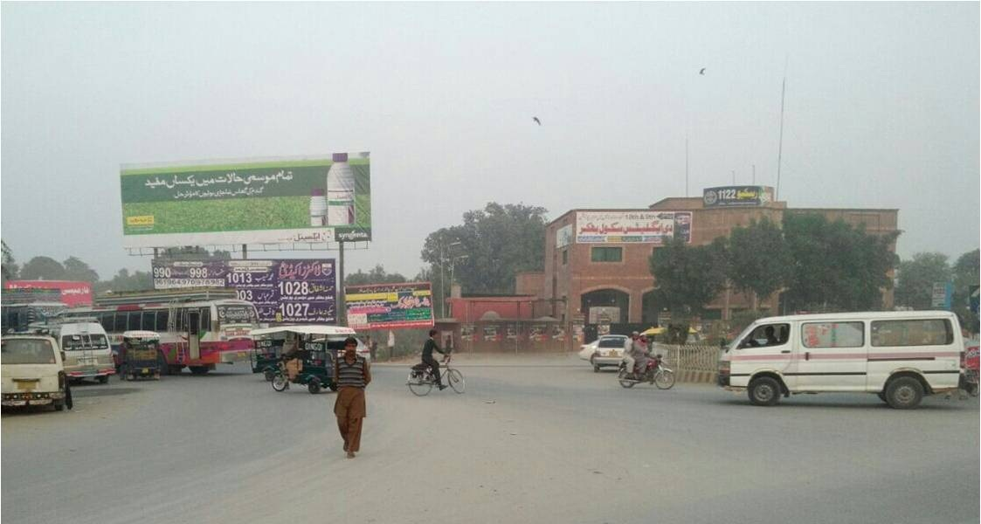
Bhakkar
Size | 60x20
Availability
Rate P/M | Rs: 110,000/=
Location | Direction
Jhang Morr (Chowk) | FTCF: Chishti Chowk and Abbas Chowk Towards General Bus Stand and City

Slide 39
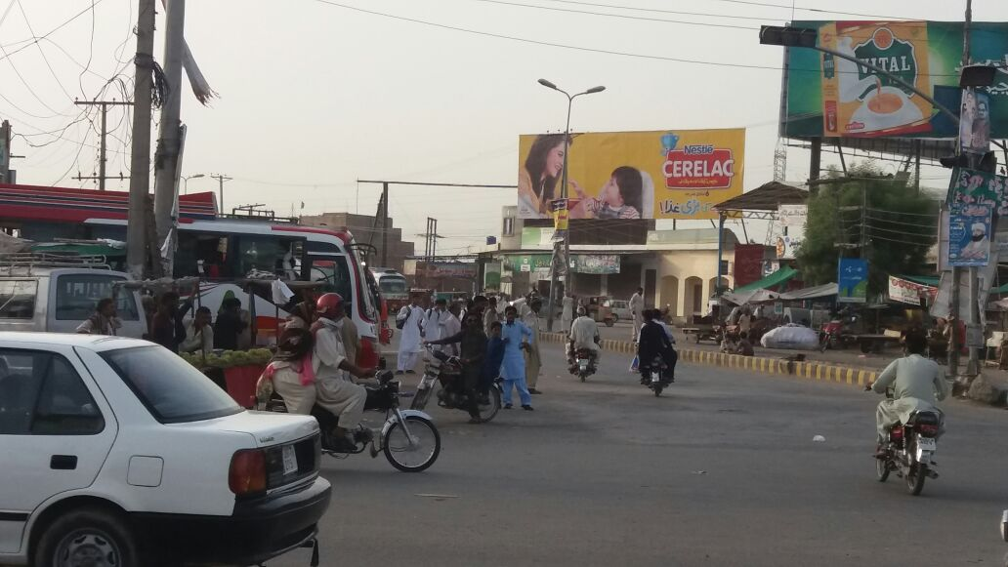
Arifwala
Size | 60x20
Availability | Available
Rate P/M | Rs: 75,000/=
Location | Direction
Larri Adda Chowk | FTCF: Tarikhni Chowk and Sahiwal Towards Arif wala City, Burewala and Pakpatan

Slide 40
Ad Solution
TERMS & CONDITIONS
First time skin installation and removing is free.
Skin printing charges are not included in the proposed rates.
These rates are exclusive of all kinds of taxes.
If skin is damaged due to weather, changing/re-printing charges will be borne by the client.
The payment will be made 50% in advance and the remaining balance will be payable through 15 days post dated cheque, from the day, the display starts.
For locking the sites please inform us within 1-3 working days.

