Slide 1
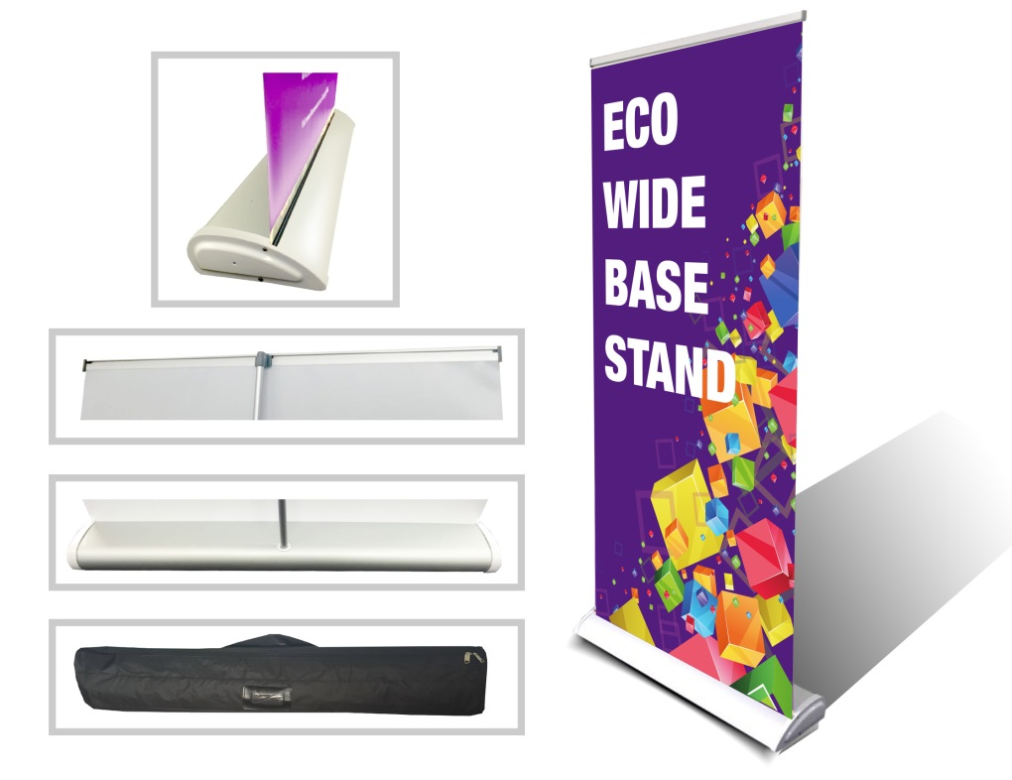
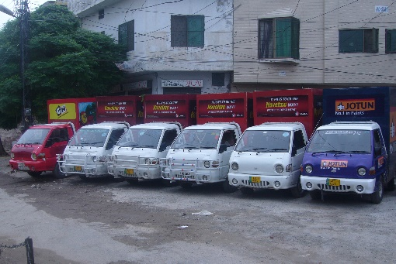
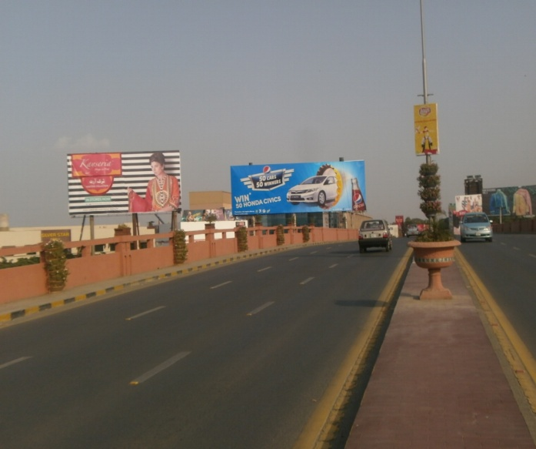
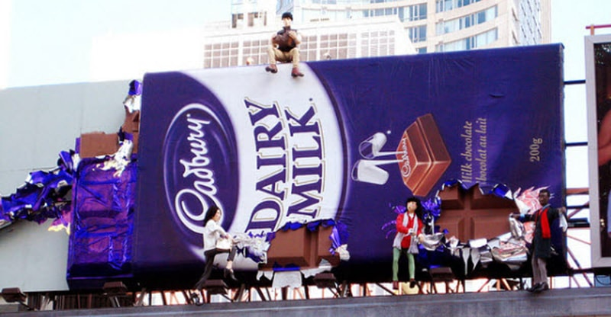
What we Do
Ad Solution
Advertising
Mobile Float
BTL Activities
Bill Boards/Hoardings
All Kinds of Pana Flex /Vinyl Printing
Offset Printing
X/Rollup Stand
Signage (New installation and Maintenance)

Slide 2
Ad Solution
Advertising
Proposal for
Billboards in Sukur

Slide 3
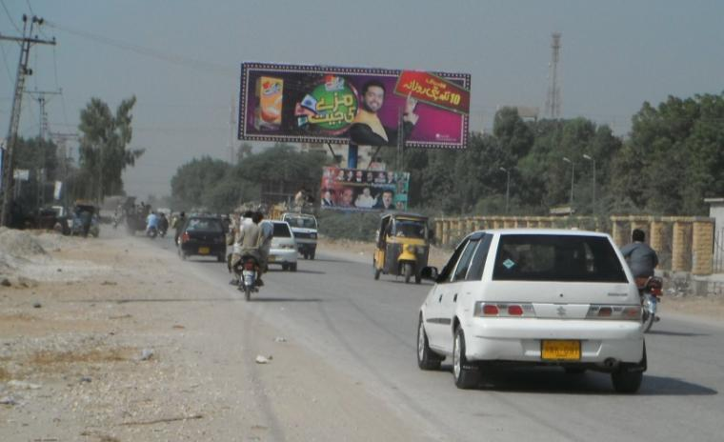
Sukur
Size | 60’x20’
Availability
Rate P/M | Rs: 225,000
Location | Direction
BOARD OFFICE | FTCF: MILETRY ROAD TOWARDS SOCIETY & AIRPORT ROAD

Slide 4
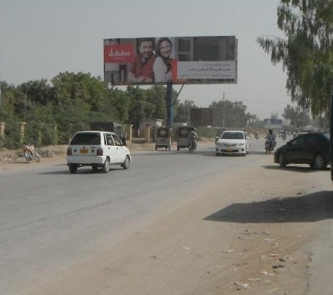
Sukur
Size | 60’x20’
Availability
Rate P/M | Rs: 225,000
Location | Direction
BOARD OFFICE | FTCF: AIRPORT ROAD TOWARDS MILETRY ROAD

Slide 5
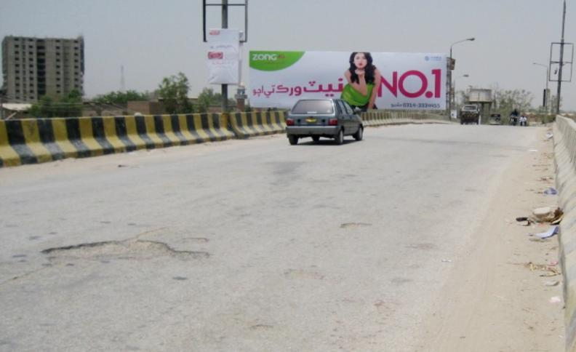
Sukur
Size | 60’x20’
Availability
Rate P/M | Rs: 225,000
Location | Direction
Miltry road flyover | FTCF:MILETRY ROAD & CITY POINT TOWARDS DEGREECOLLEGE

Slide 6
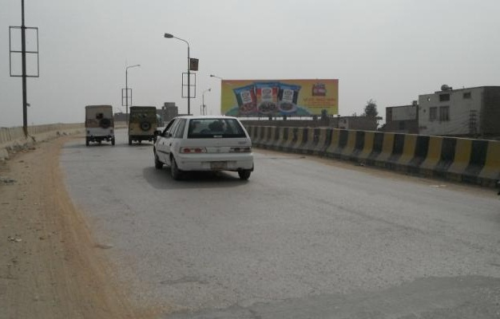
Sukur
Size | 60’x20’
Availability
Rate P/M | Rs: 225,000
Location | Direction
Miltry road flyover | FTCF:DEGREE COLLEGE TOWARDS MILETRY ROAD & CITY POINT

Slide 7
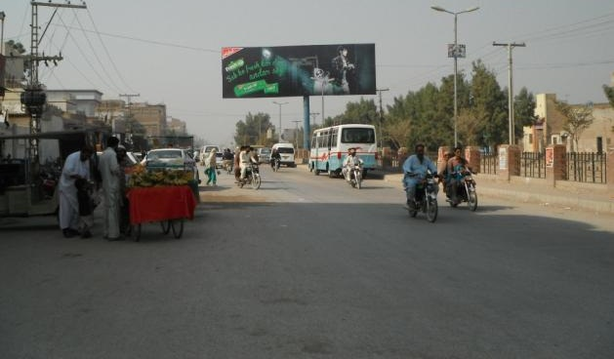
Sukur
Size | 60’x20’
Availability
Rate P/M | Rs: 225,000
Location | Direction
Airport road | FTCF:CLOCK TOWER TOWARDS CITY POINT & LAB-E-MEHRAN

Slide 8
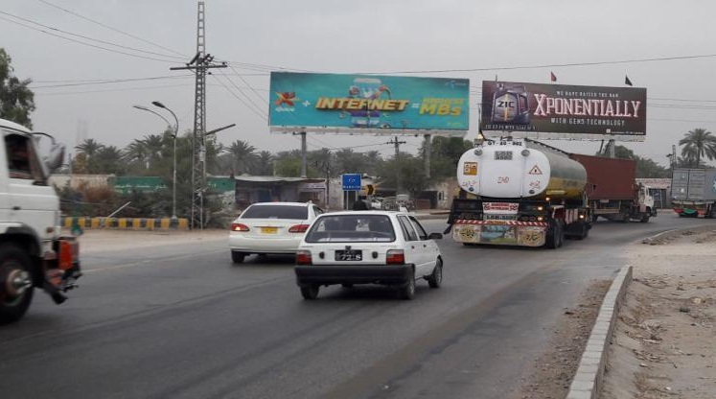
Sukur
Size | 60’x20’
Availability
Rate P/M | Rs: 225,000
Location | Direction
BUS TERMINAL , | FTCF:BABARLO TOWARDS CITY ENTERANCE & DAEWOO Bus stop

Slide 9
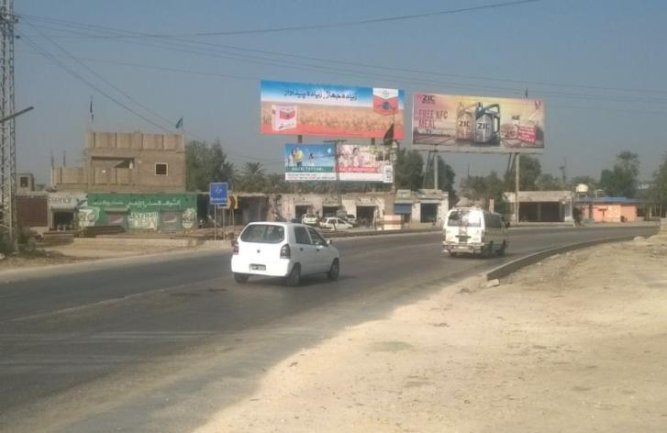
Sukur
Size | 45’x15’
Availability
Rate P/M | Rs: 125,000
Location | Direction
BUS TERMINAL , | FTCF:BABARLO TOWARDS CITY ENTERANCE & DAEWOO Bus stop

Slide 10
Ad Solution
TERMS & CONDITIONS
First time skin installation and removing is free.
Skin printing charges are not included in the proposed rates.
These rates are exclusive of all kinds of taxes.
If skin is damaged due to weather, changing/re-printing charges will be borne by the client.
The payment will be made 50% in advance and the remaining balance will be payable through 15 days post dated cheque, from the day, the display starts.
For locking the sites please inform us within 1-3 working days.

