Slide 1
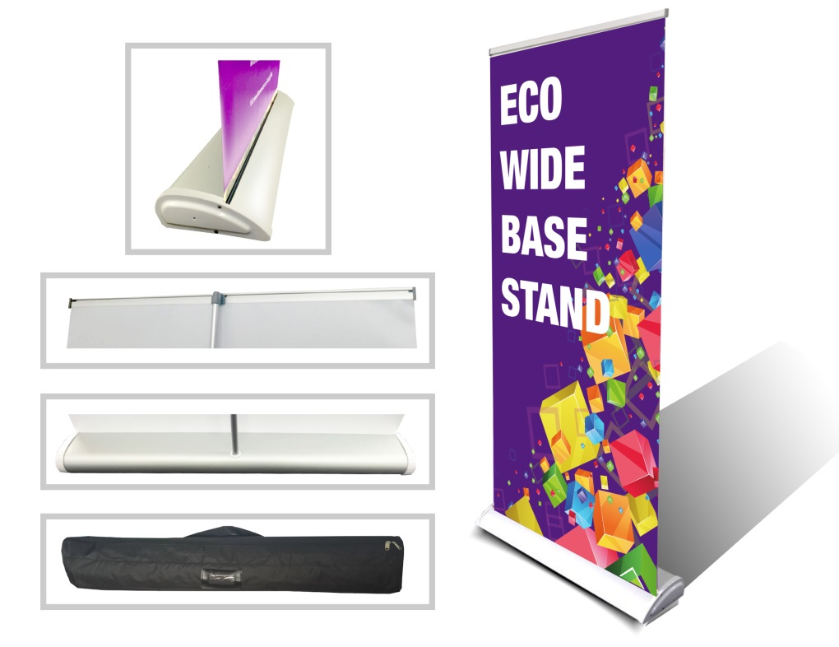
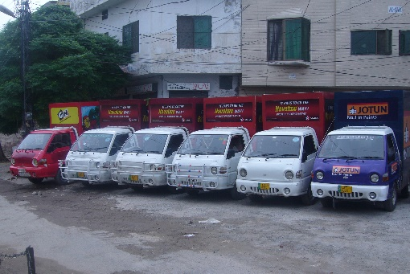
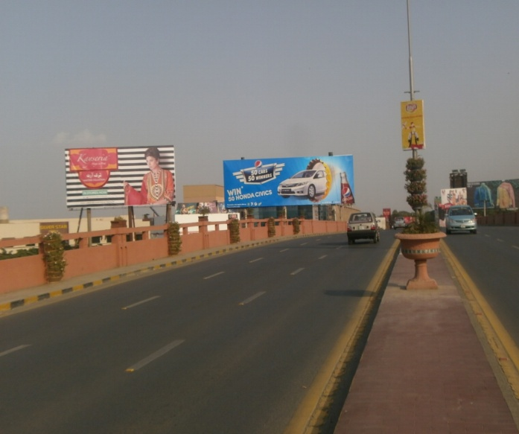
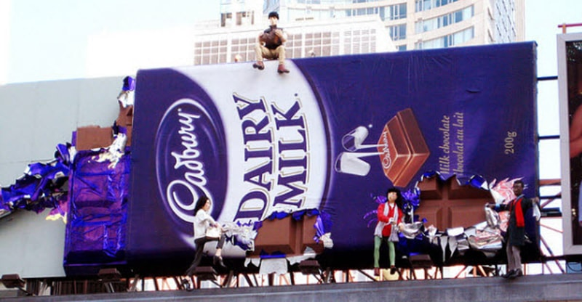
What we Do
Ad Solution
Advertising
Mobile Float
BTL Activities
Bill Boards/Hoardings
All Kinds of Pana Flex /Vinyl Printing
Offset Printing
X/Rollup Stand
Signage (New installation and Maintenance)

Slide 2
Ad Solution
Advertising
Proposal for
Billboards in Bahawalpur

Slide 3
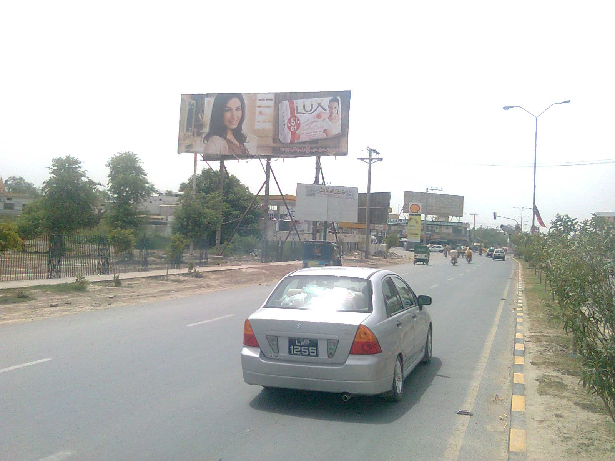
Bahawalpur
Size | 60x20
Availability
Rate P/M | Rs:225,000/-
Location | Direction
Bahawalpur cantt | FTCF: Saraiky chowk Railway road BWP cant facing traffic coming from Chowk Fawara towards Melad chowk

Slide 4
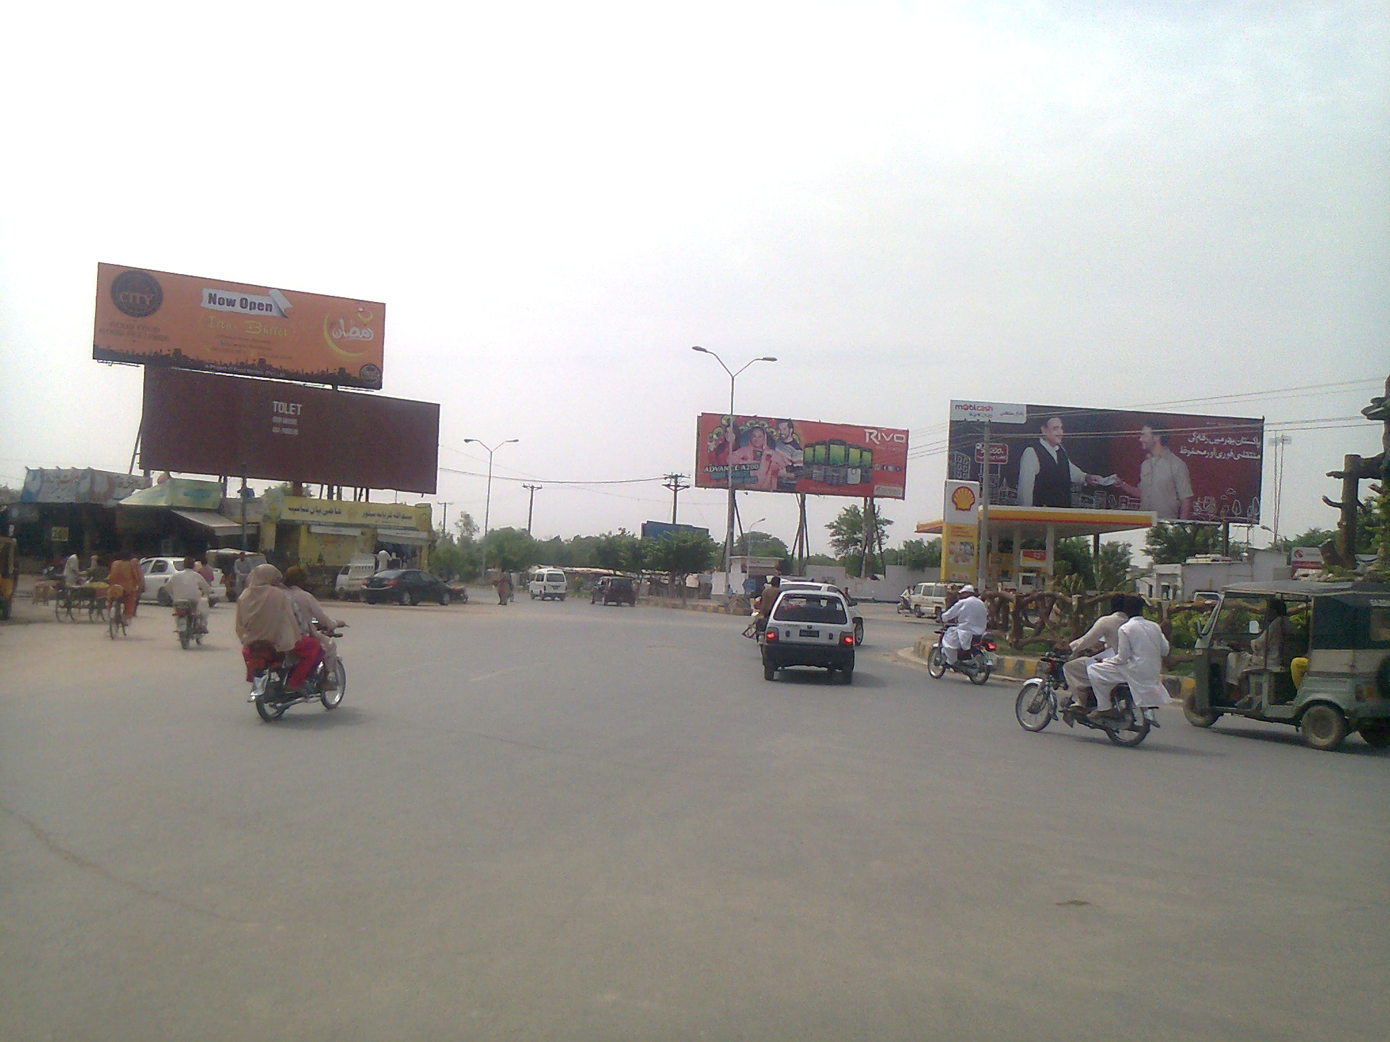
Bahawalpur
Size | 60x20
Availability
Rate P/M | Rs: 250,000/-
Location | Direction
Bahawalpur cant | FTCF: Saraiki chowk Bwp cantt facing Traffic coming from welcome chowk to fawara chowk

Slide 5
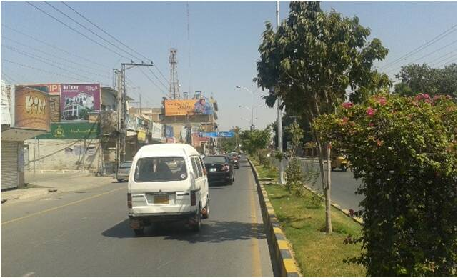
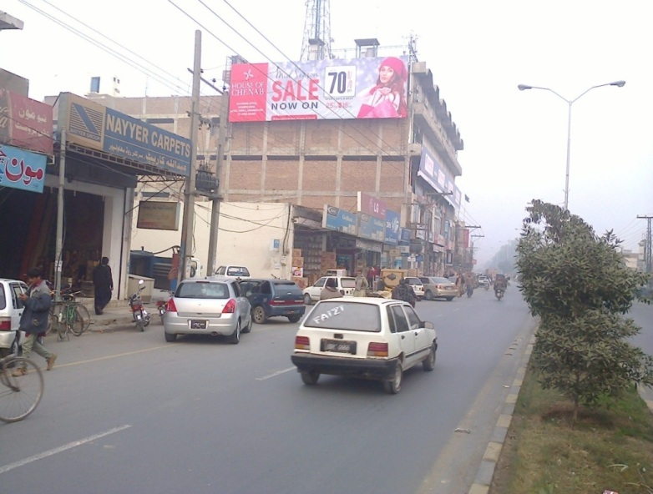
Bahawalpur
Size | 60x20
Availability
Rate P/M | Rs: 225,000/-
Location | Direction
Bahawalpur Al karim plaza | FTCF: Al karim plaza facing fawara chowk to fareed gate

Slide 6
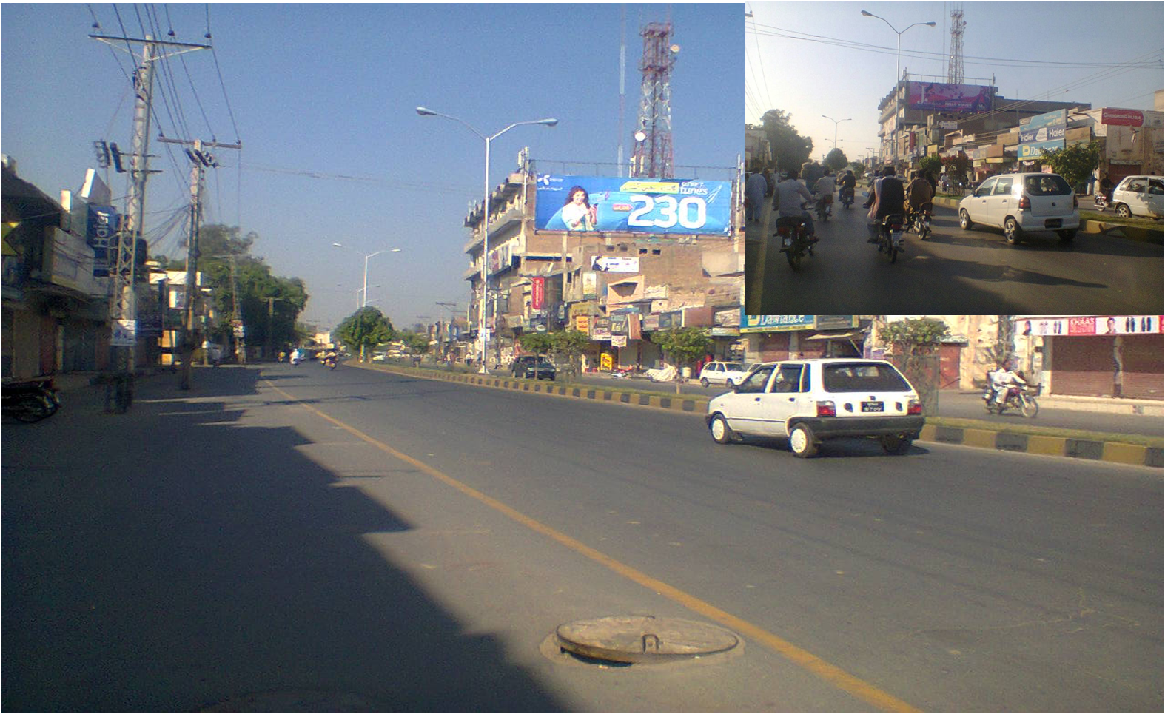
Bahawalpur
Size | 60x20
Availability
Rate P/M | Rs: 215,000/-
Location | Direction
Bahawalpur | FTCF: AL karim plaza facing fared gate to fawara chowk

Slide 7
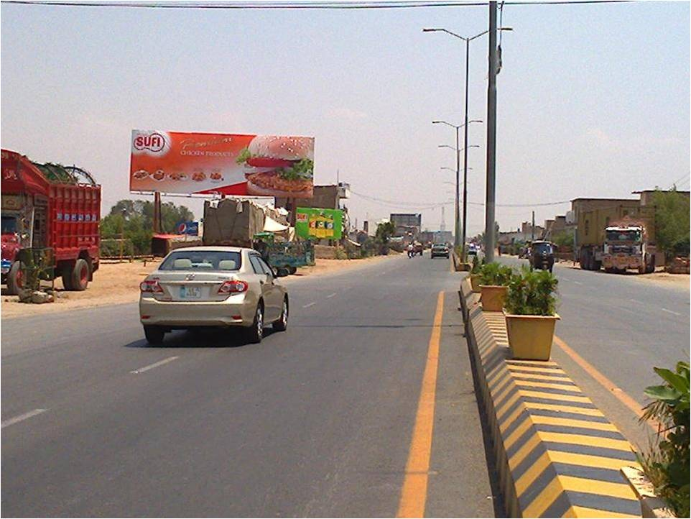
Bahawalpur
Size | 60x20
Availability
Rate P/M | Rs: 225,000/-
Location | Direction
Industrial Area Multan Road | FTCF: from karacy by pass,Toll plaza to Genral bus stand bwp

Slide 8
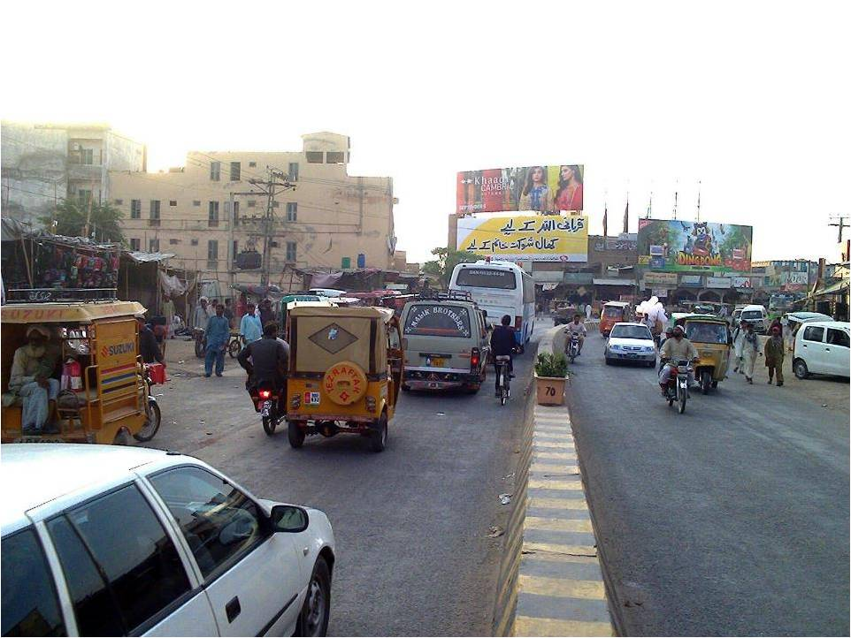
Bahawalpur
Size | 60x20
Availability
Rate P/M | Rs: 200,000/-
Location | Direction
City Hotel Chowk | FTCF: Bus stand to multan road

Slide 9
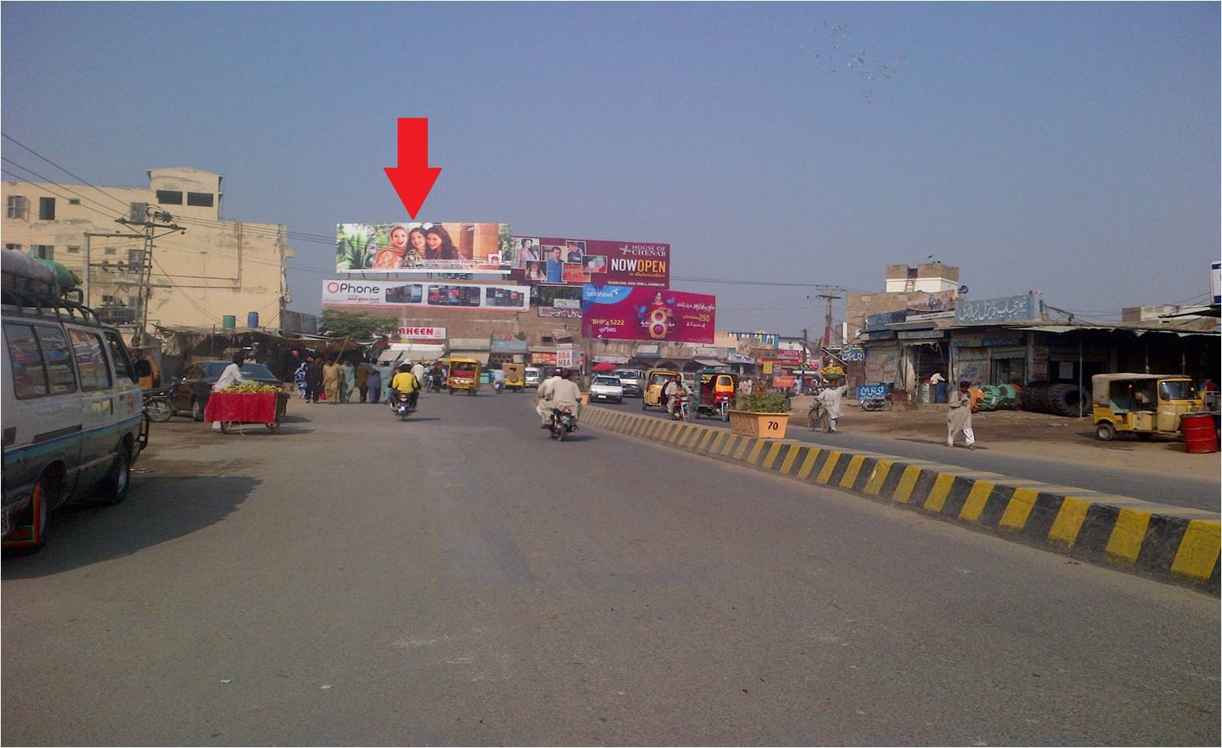
Bahawalpur
Size | 60x20
Availability
Rate P/M | Rs: 220,000/-
Location | Direction
City Hotel Chowk | FTCF: Bus stand to multan road

Slide 10
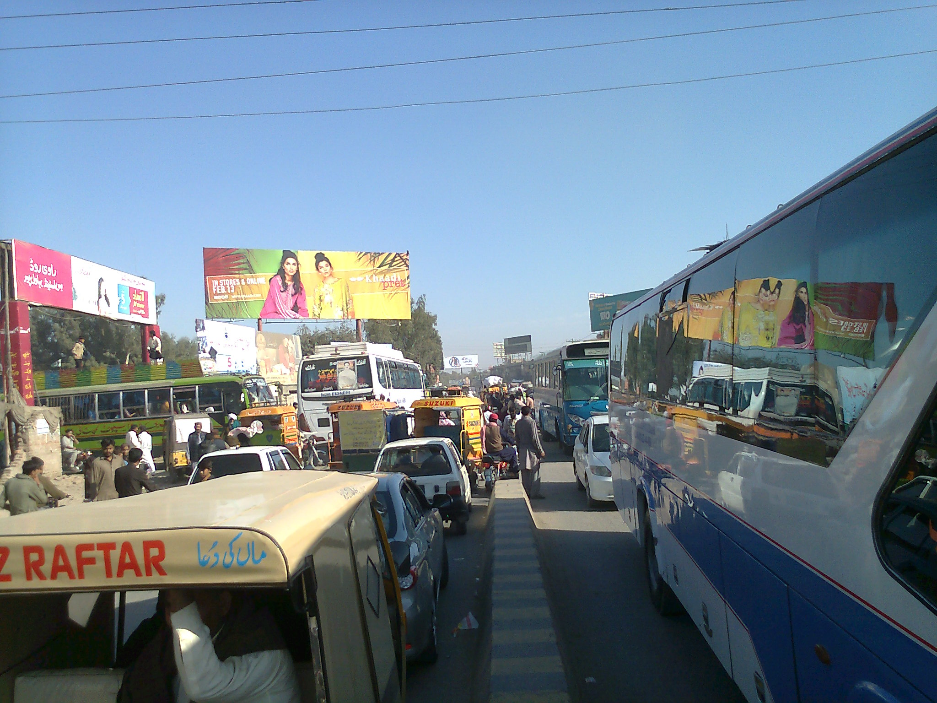
Bahawalpur
Size | 60x20
Availability
Rate P/M | Rs: 200,000/-
Location | Direction
Bus stand | FTCF: Multan Road to Niaazy terminal and stadium road

Slide 11
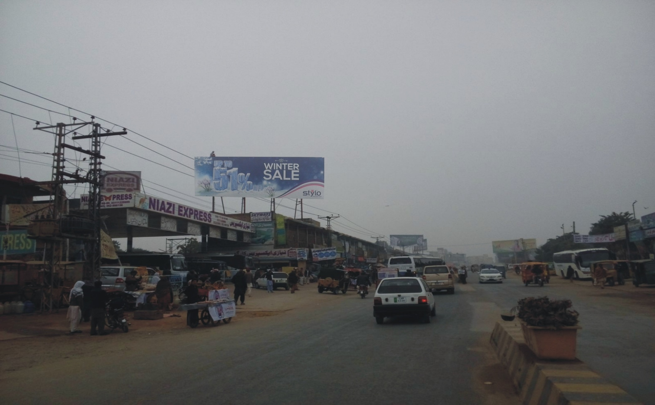
Bahawalpur
Size | 60x20
Availability
Rate P/M | Rs: 200,000/-
Location | Direction
Bahawalpur | FTCF: Niaazi terminal bwp trafic coming from stadium Road to Multan Road

Slide 12
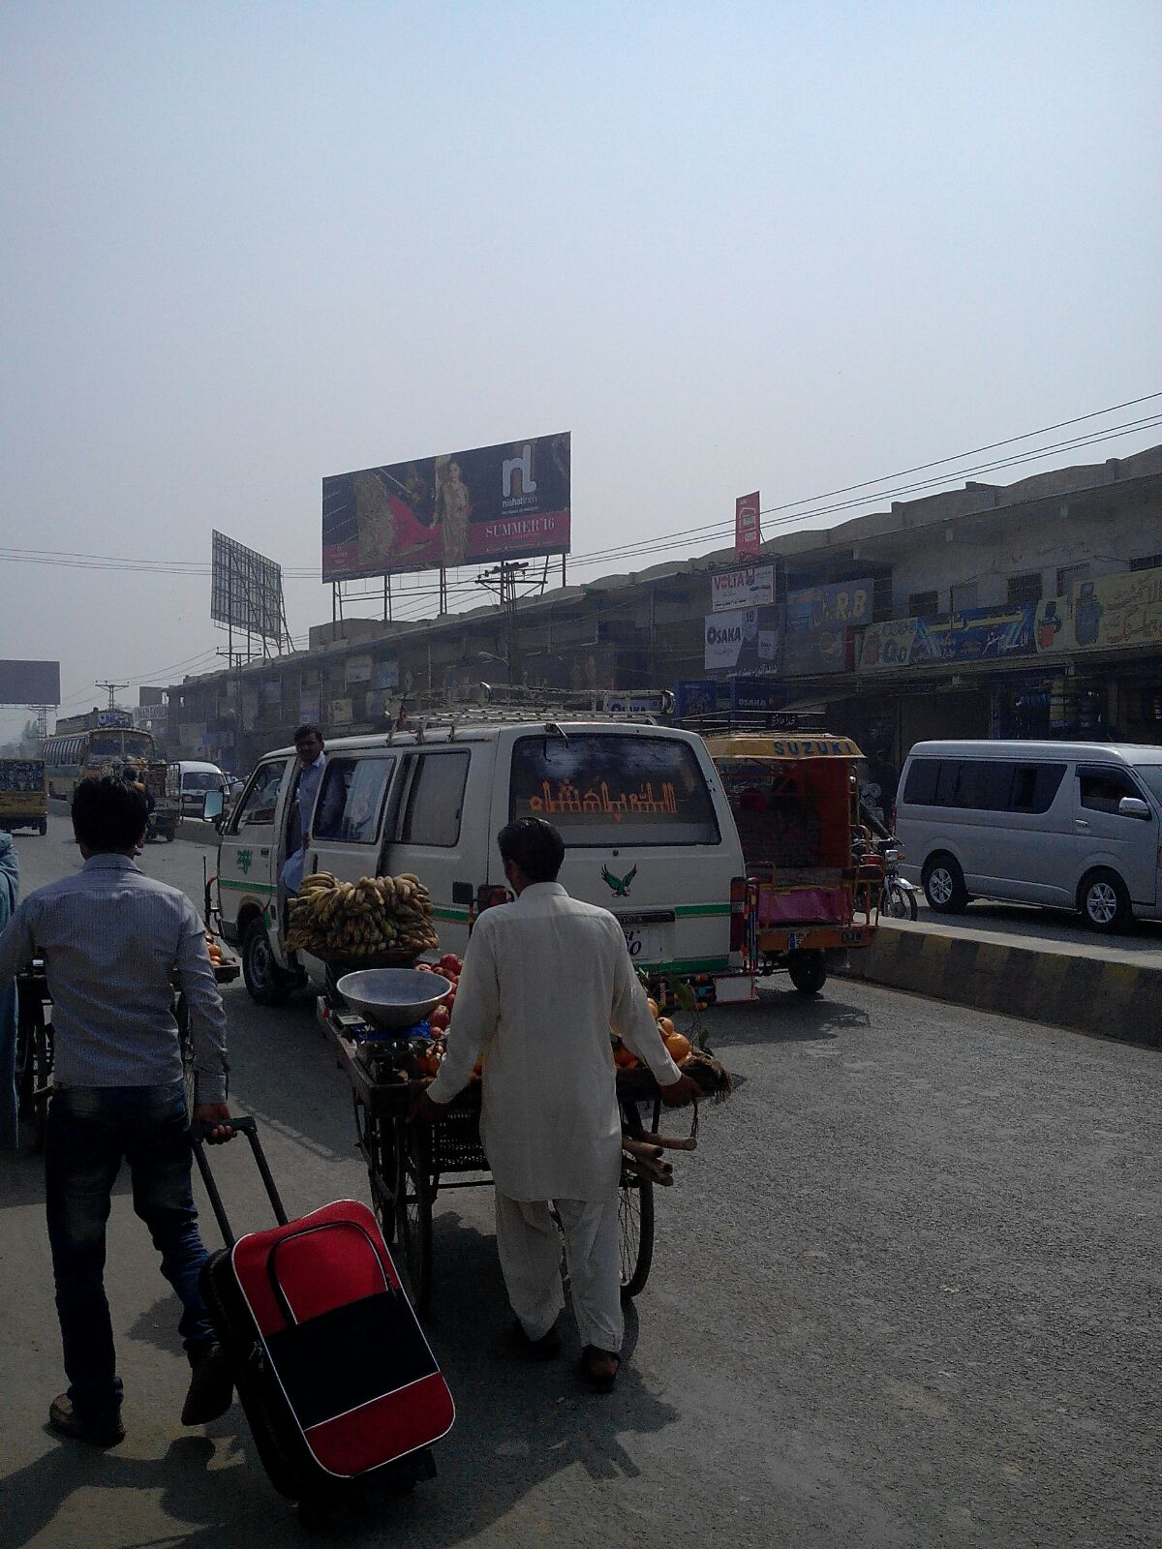
Bahawalpur
Size | 60x20
Availability
Rate P/M | Rs: 200,000/-
Location | Direction
Bahawalpur | FTCF: Bus stand trafic coming from Multan Road to Stadium Road (newly installed)

Slide 13
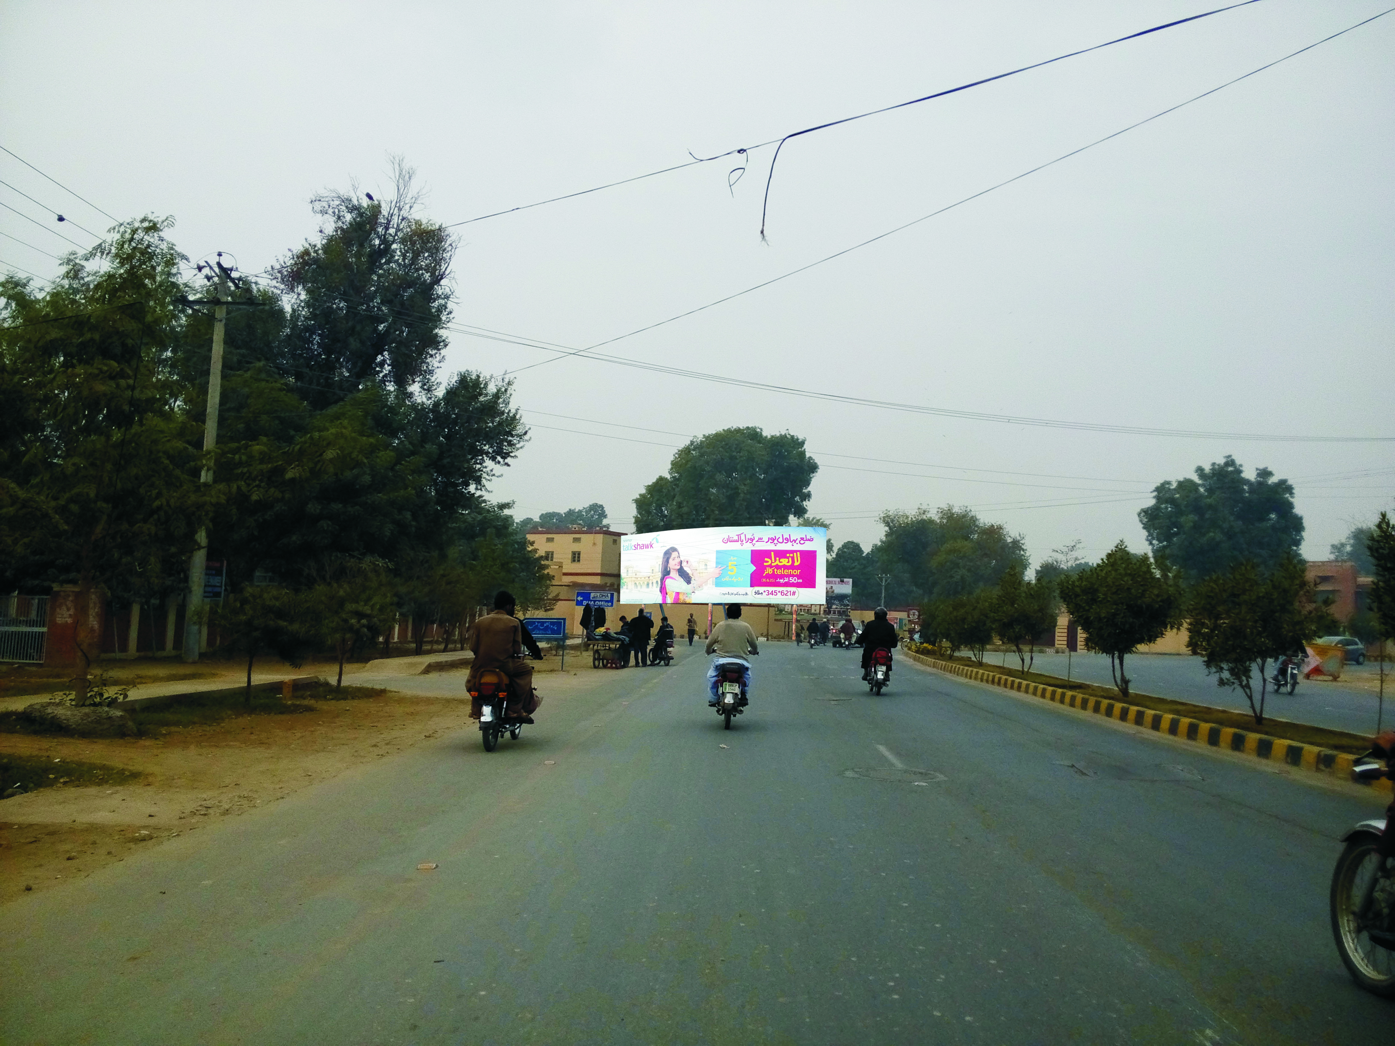
Bahawalpur
Size | 60x20
Availability
Rate P/M | Rs: 225,000/-
Location | Direction
Bahawalpur Cantt | FTCF: CMH chowk cantt. Trafic coming from University road & Airport & going towards circular road

Slide 14
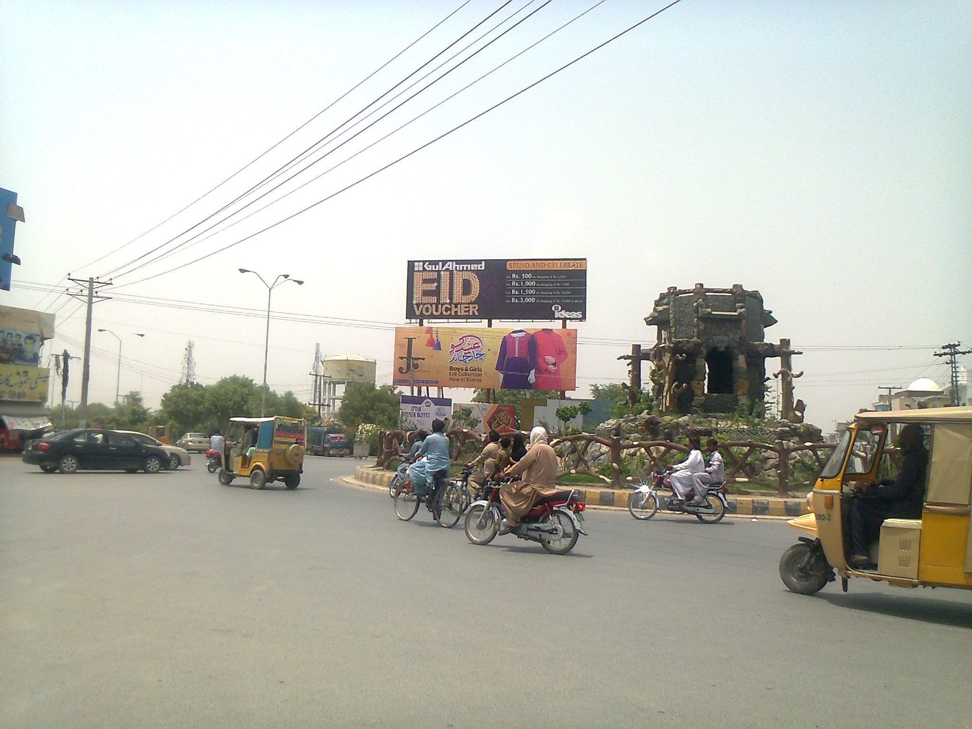
Bahawalpur
Size | 60x20
Availability
Rate P/M | Rs: 275,000/-
Location | Direction
Bahawalpur | FTCF: Saraiki Chowk fared Park

Slide 15
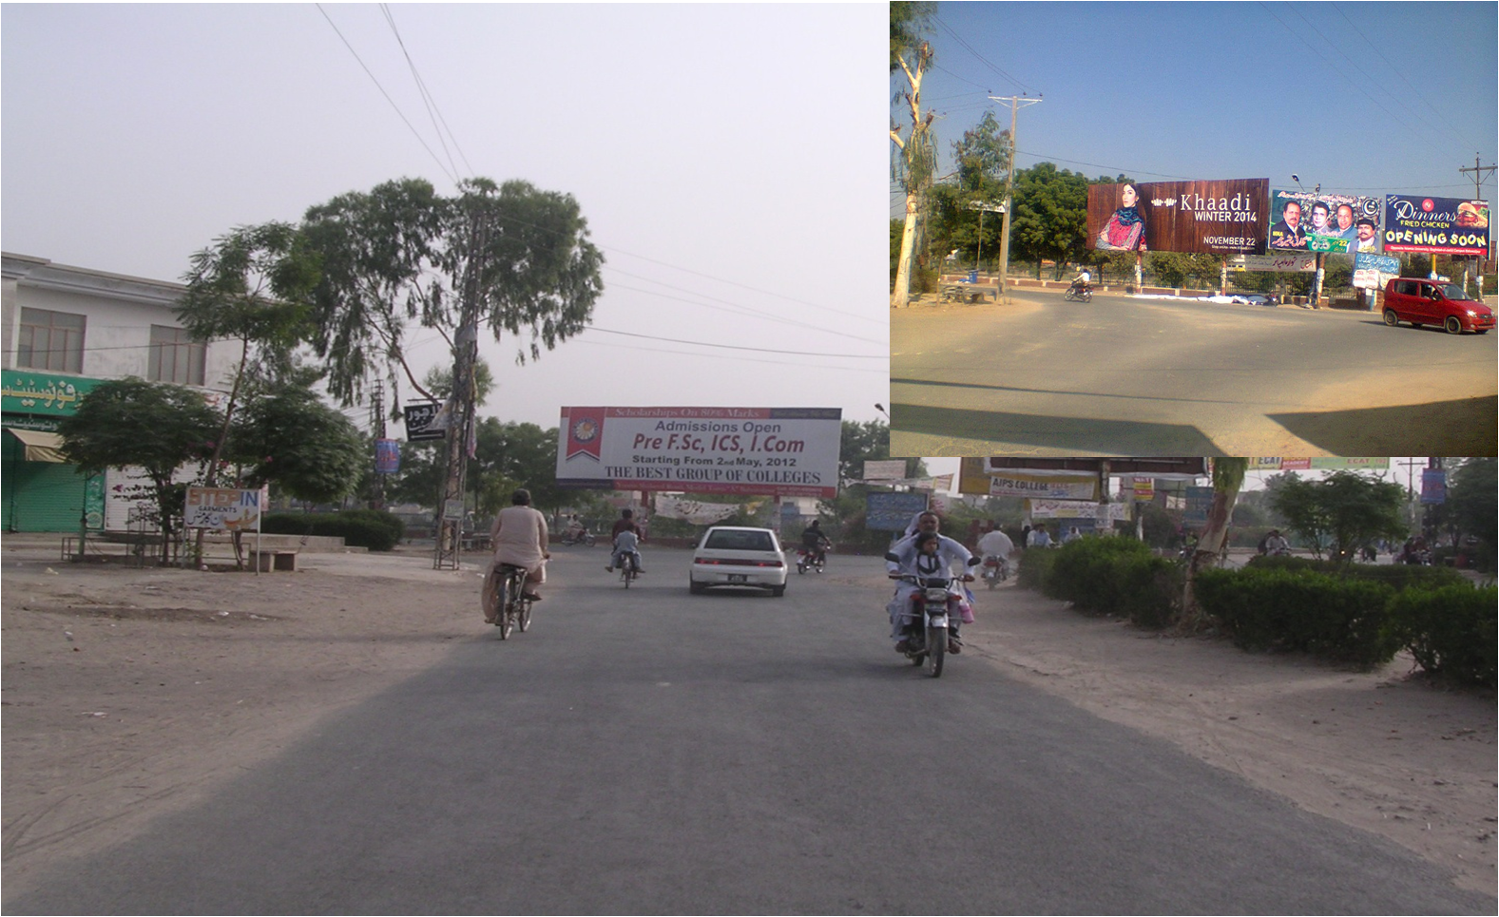
Bahawalpur
Size | 15x45
Availability
Rate P/M | Rs: 175,000/-
Location | Direction
Bahawalpur | FTCF: Commercial Area

Slide 16
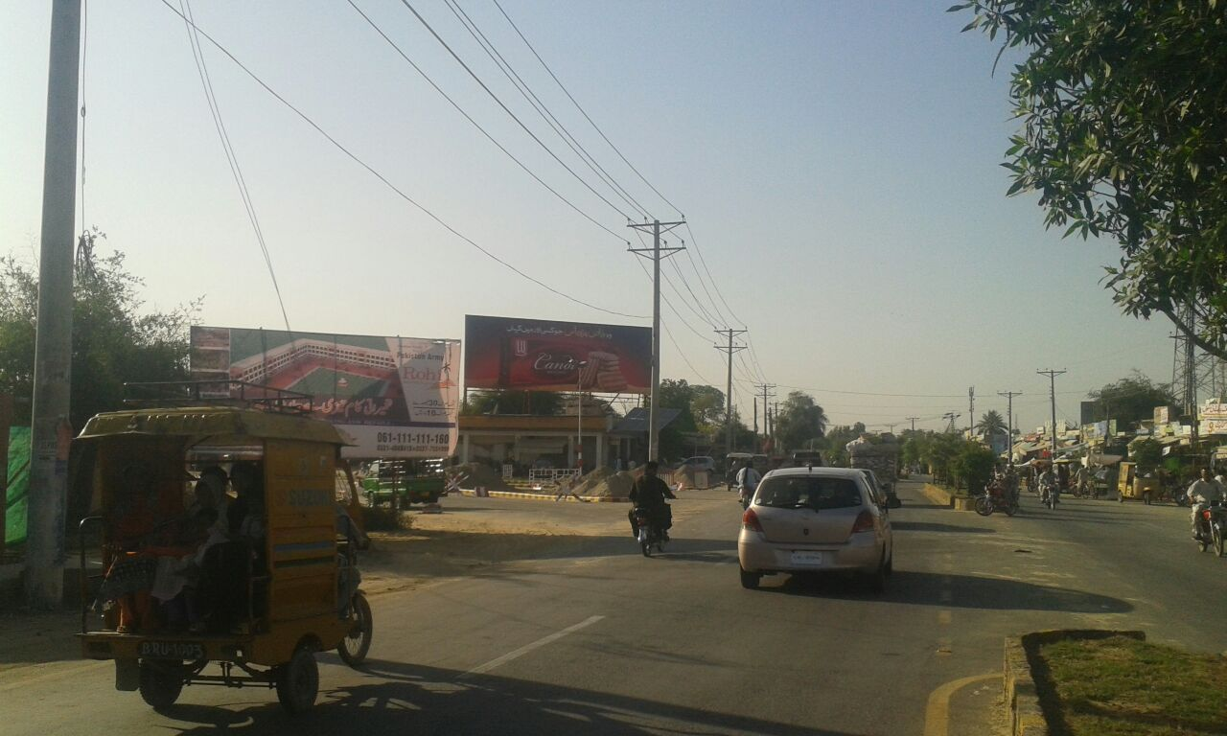
Bahawalpur
Size | 60x20
Availability
Rate P/M | Rs:250,000/-
Location | Direction
Bahawalpur | FTCF: New CMH Chowk Islamia Colony Cant Airport Road to University Road

Slide 17
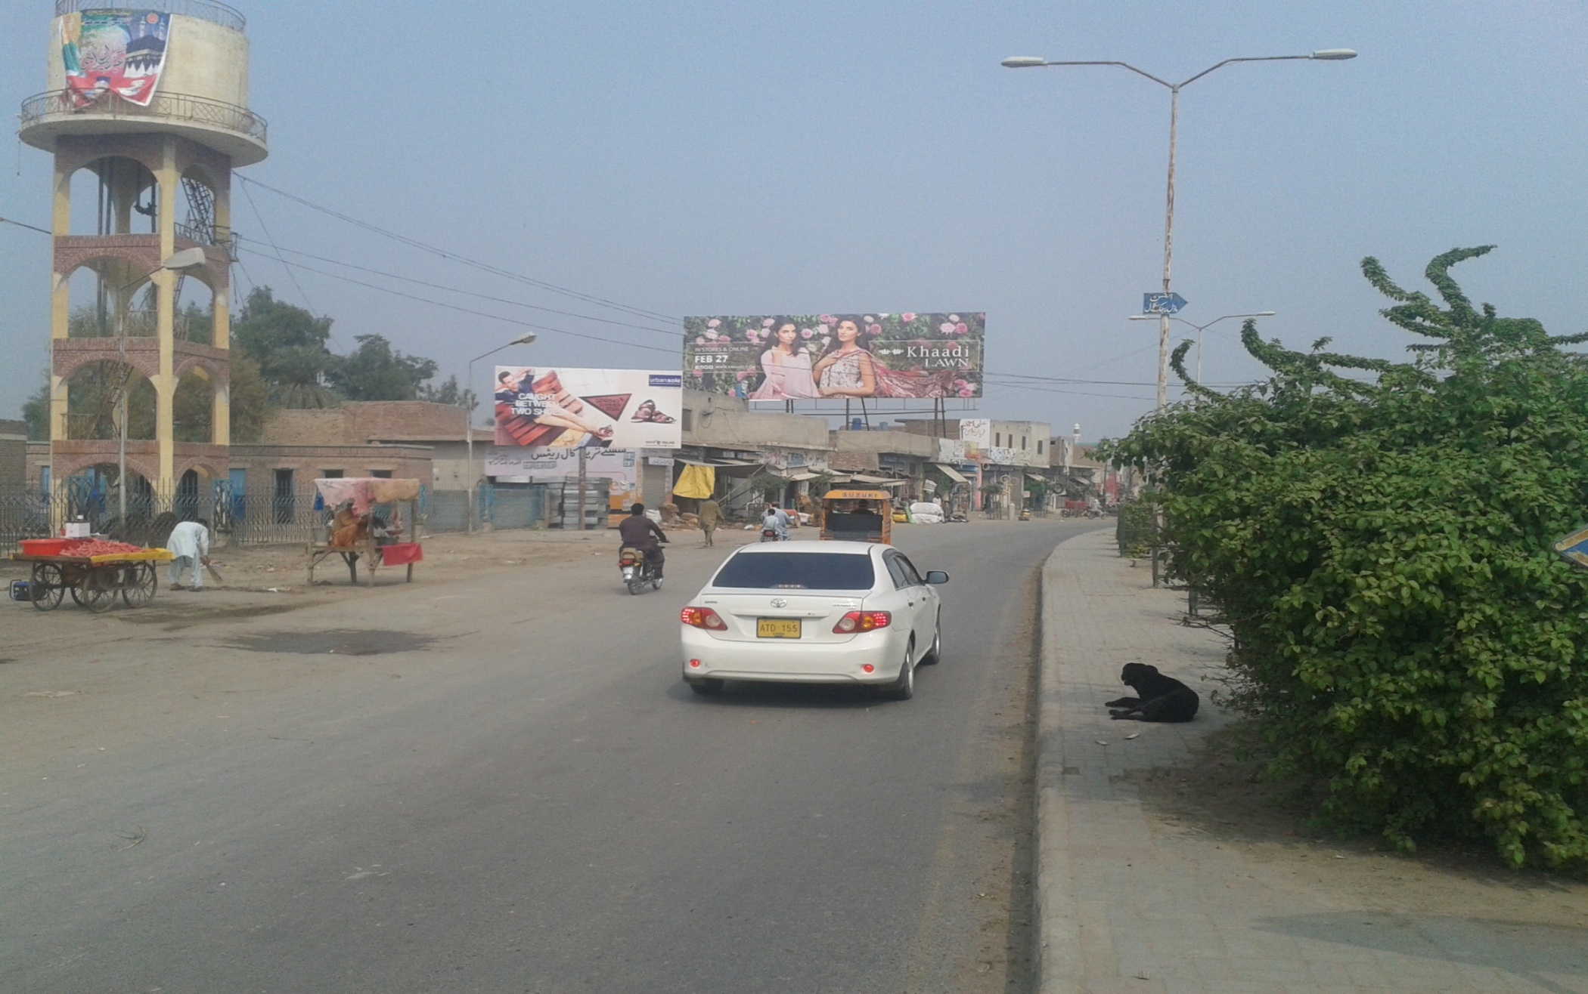
Bahawalpur
Size | 60x20
Availability
Rate P/M | Rs:225,000/-
Location | Direction
Bahawalpur | FTCF: Ahmed Pur road near Sammi Daewoo Bus termina

Slide 18
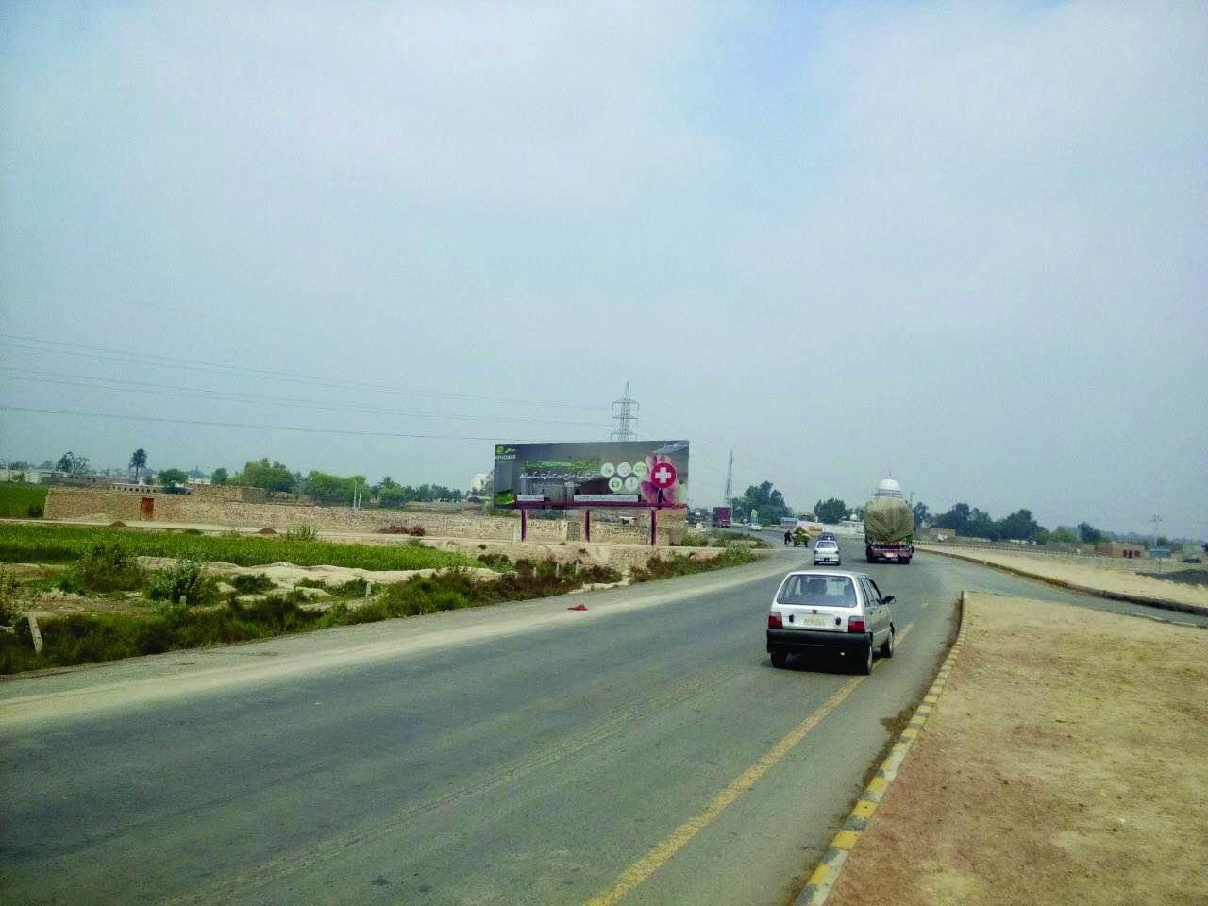
Bahawalpur
Size | 60x20
Availability
Rate P/M | Rs:200,000/-
Location | Direction
Bahawalpur | FTCF: By Pass Road Azam Chowk Karachi RYK to Bahawalpur, Multan, Lahore

Slide 19
Ad Solution
TERMS & CONDITIONS
First time skin installation and removing is free.
Skin printing charges are not included in the proposed rates.
These rates are exclusive of all kinds of taxes.
If skin is damaged due to weather, changing/re-printing charges will be borne by the client.
The payment will be made 50% in advance and the remaining balance will be payable through 15 days post dated cheque, from the day, the display starts.
For locking the sites please inform us within 1-3 working days.

