Slide 1
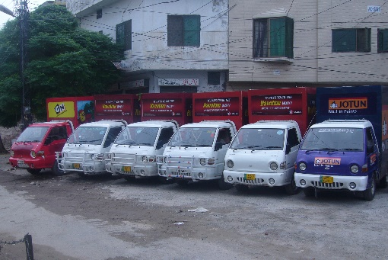
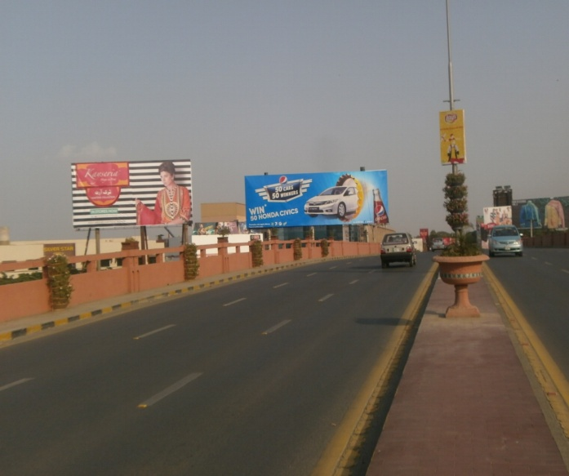
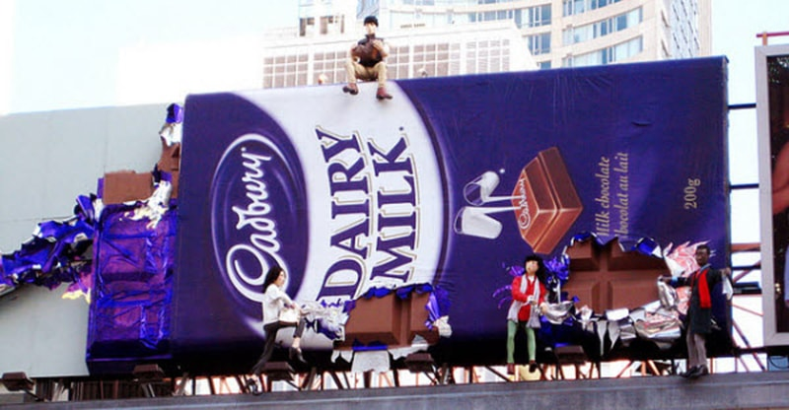
What we Do
Ad Solution
Advertising
Mobile Float
BTL Activities
Bill Boards/Hoardings
All Kinds of Pana Flex /Vinyl Printing
Offset Printing
X/Rollup Stand
Signage (New installation and Maintenance)

Slide 2
Ad Solution
Advertising
Proposal for
Billboards in Faisalabad

Slide 3
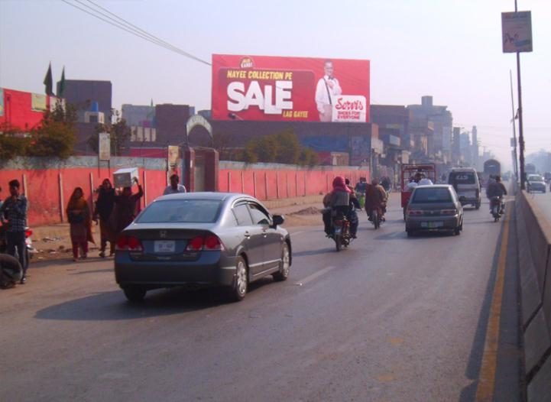
Faisalabad
Size | 60x20
Availability
Rate P/M | Rs:300,000/-
Location | Direction
Main Sargodha Road | FTCF: Moterway & Chiniot Towards Allied More & Chenab club

Slide 4
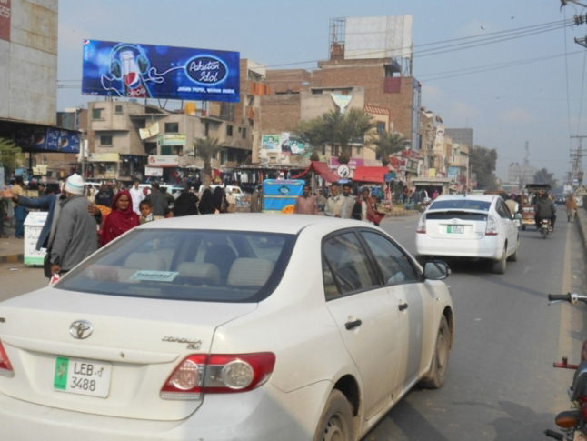
Faisalabad
Size | 60x20
Availability
Rate P/M | Rs: 300,000/-
Location | Direction
Main Narrwala Chowk | FTCF:G.C Univercity, Jhang Road Towards Jinah Colony Aminpur Bazar, Chiniot Bazar

Slide 5
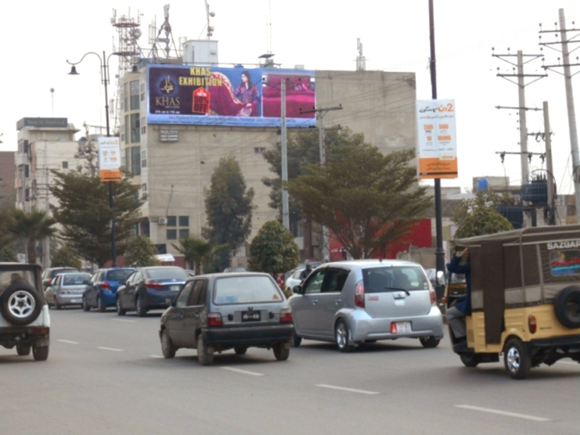
Faisalabad
Size | 60x20
Availability
Rate P/M | Rs:300,000/-
Location | Direction
Civil Lines Faisal Complex | FTCF: Jail Road Agry University Towards Iqbal Stadium Serena Hotel

Slide 6
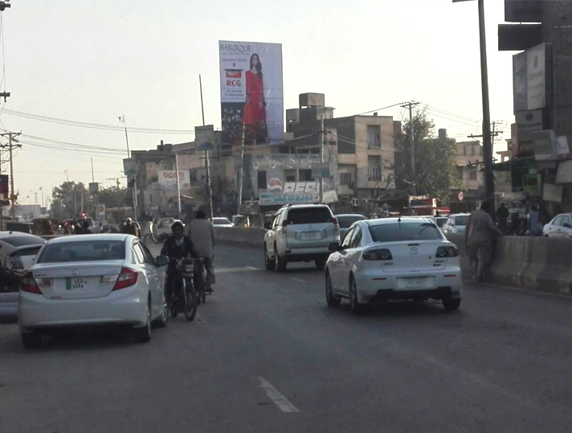
Faisalabad
Size | 30x40
Availability
Rate P/M | Rs:250,000/-
Location | Direction
Sargodha Road Faisal Complex | FTCF: Motorway, Metro, Chiniot Towards Allide More, Clock Tower

Slide 7
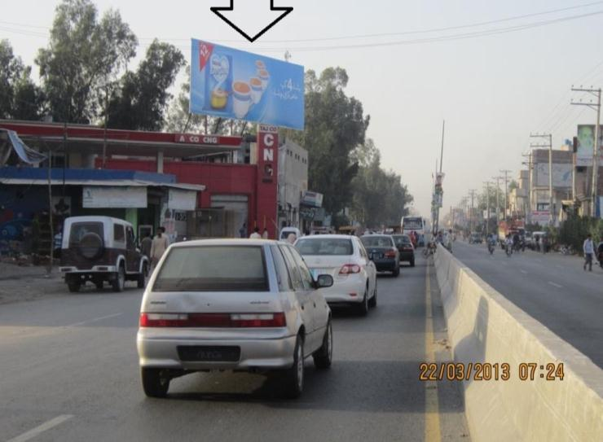
Faisalabad
Size | 60x20
Availability
Rate P/M | Rs:250,000/-
Location | Direction
Sargodha Road | FTCF: Allide More, Jail Road Towards Motorway, Metro, Chiniot

Slide 8
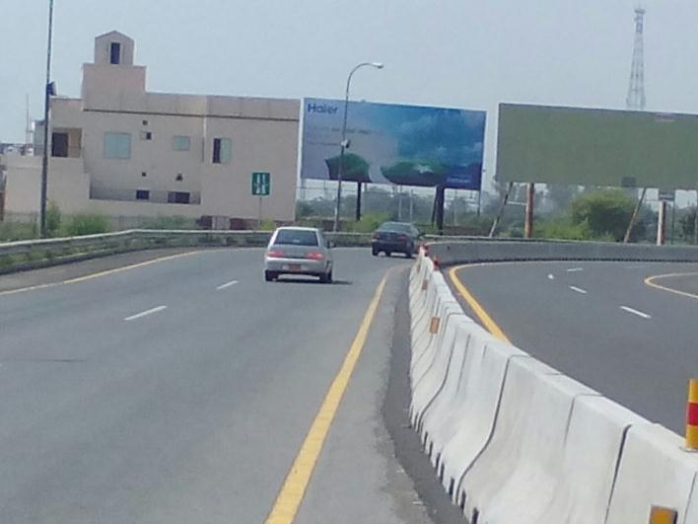
Faisalabad
Size | 45x20
Availability
Rate P/M | Rs:250,000/-
Location | Direction
Faisalabad Inter Change | FTCF: Lahore & Islamabad Towards Metro store Alliede more

Slide 9
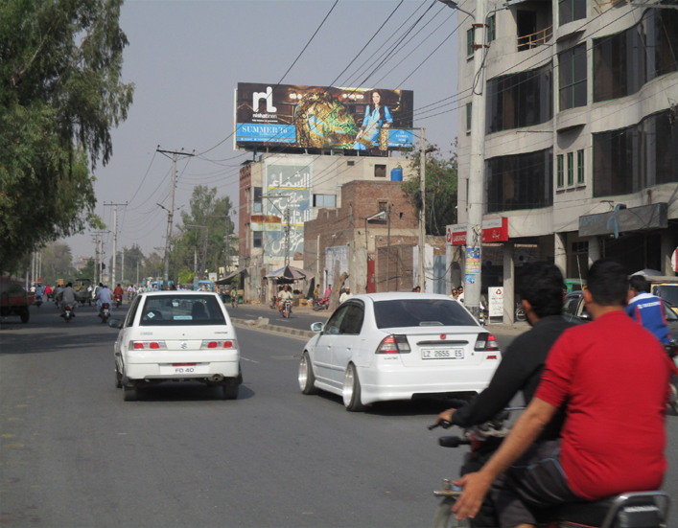
Faisalabad
Size | 60x20
Availability
Rate P/M | Rs:300,000/-
Location | Direction
Jail Road Al-shifa Lab | FTCF: Jinnah Colony, Gulbarge Towards Agry Uni, Serena Allied More

Slide 10
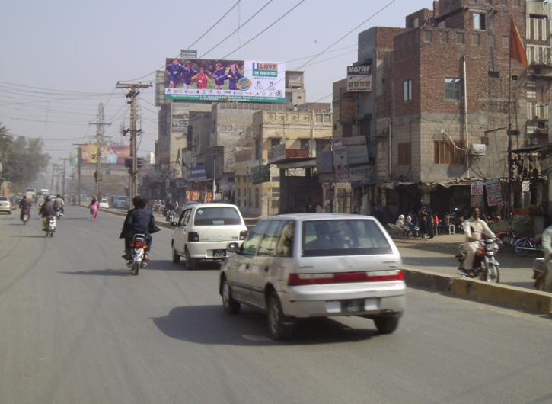
Faisalabad
Size | 60x20
Availability
Rate P/M | Rs:300,000/-
Location | Direction
Jail Road City Car | FTCF: Jinnah Colony, Gulbarge Towards Agri Uni, Serena Allied More

Slide 11
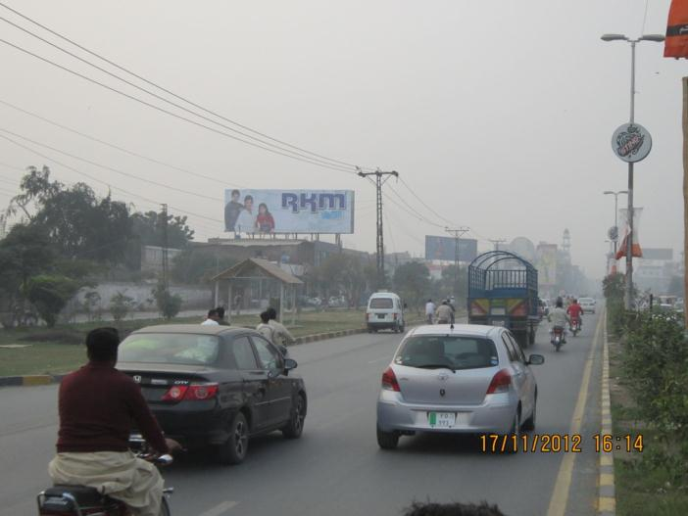
Faisalabad
Size | 60x20
Availability
Rate P/M | Rs:300,000/-
Location | Direction
Satyana road | FTCF: McDonnald’s Towards Saleemi Chowk

Slide 12
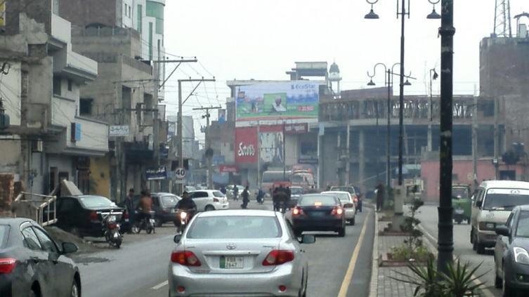
Faisalabad
Size | 45x15
Availability
Rate P/M | Rs:200,000/-
Location | Direction
Chen 1 Road, Saleemi Chowk | FTCF:D-Ground, Kohinoor Chowk Towards Saleemi Chowk Satyana Road

Slide 13
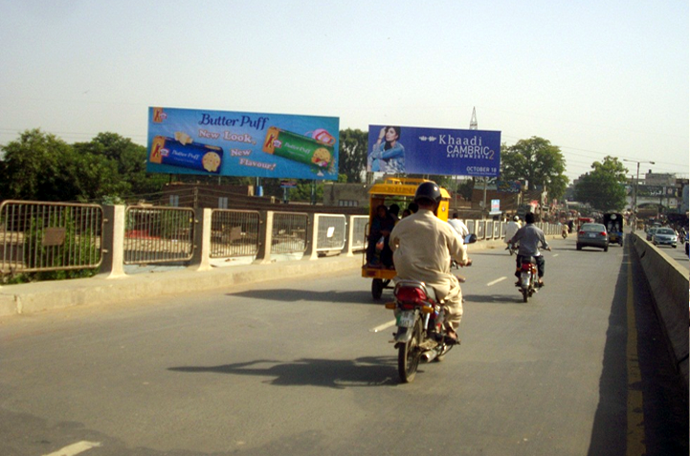
Faisalabad
Size | 60x20
Availability
Rate P/M | Rs:300,000/-
Location | Direction
Novelty Bridge | FTCF: Jhang Bazar Clowk Tower Towards Sumndri Rd Jhall Underpass

Slide 14
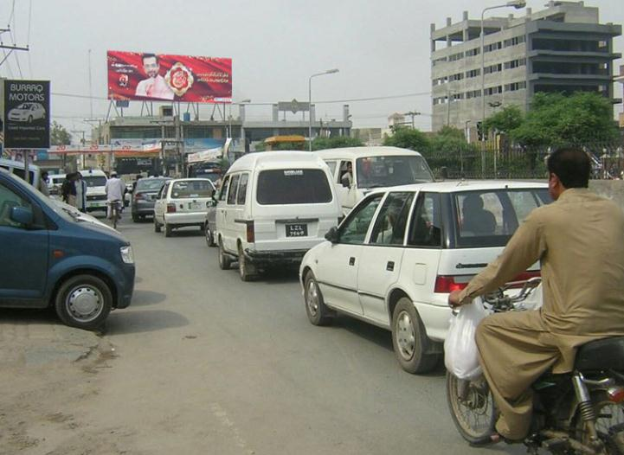
Faisalabad
Size | 60x20
Availability
Rate P/M | Rs:300,000/-
Location | Direction
E-Mart Susan Road Madina Town | FTCF: Girls College, D-Ground, Kohinoor Towards Susan chowk Abdullah pur

Slide 15
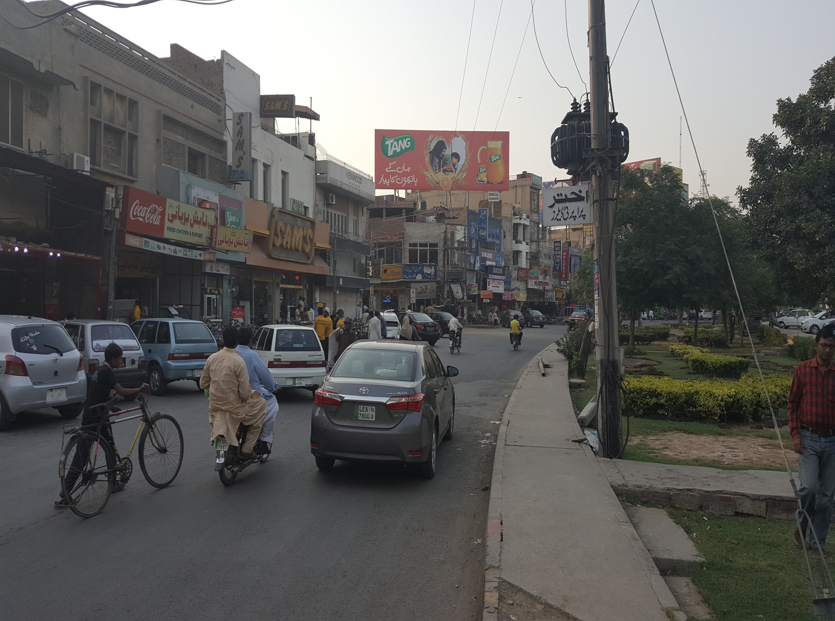
Faisalabad
Size | 60x20
Availability
Rate P/M | Rs:350,000/-
Location | Direction
D-Ground | FTCF: Satyana Road Towards Ripple Plaza /Chowk Chen one Road

Slide 16
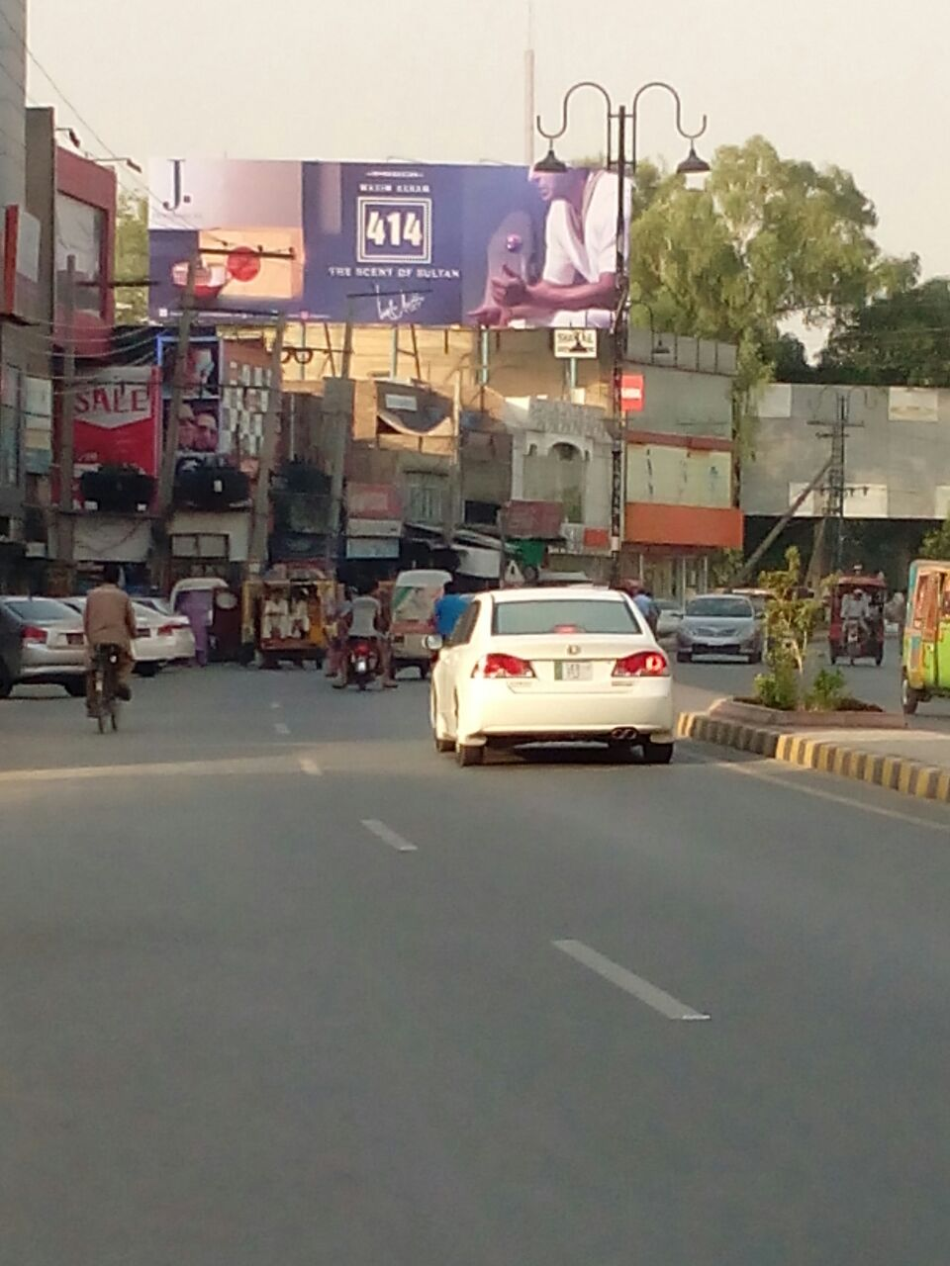
Faisalabad
Size | 60x20
Availability
Rate P/M | Rs: 350,000/-
Location | Direction
Chen one Road | FTCF: Sleemi Chowk/Satyana Road Towards Ripple Plaza /D-Ground

Slide 17
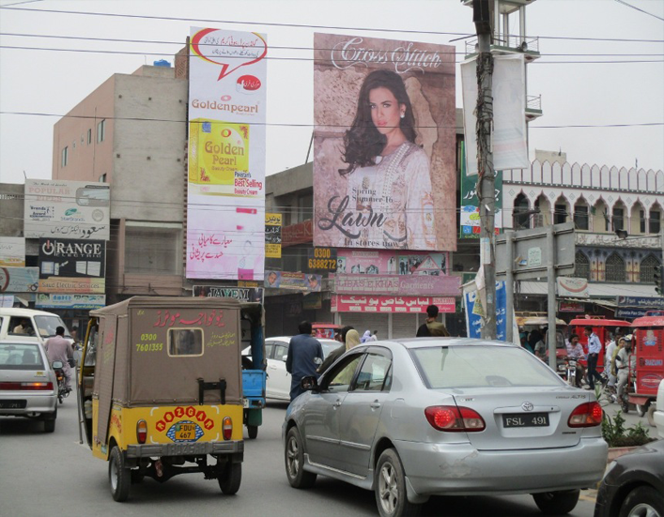
Faisalabad
Size | 30x40
Availability
Rate P/M | Rs: 350,000/-
Location | Direction
Saleemi Chowk | FTCF:D-Ground Towards Jhaal & GTS Chowk

Slide 18
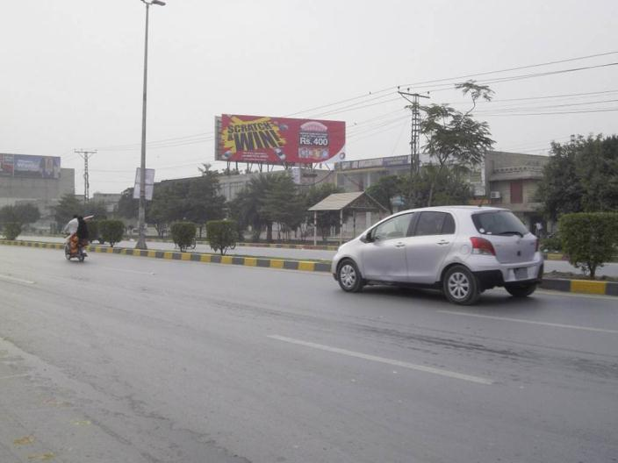
Faisalabad
Size | 60x20
Availability
Rate P/M | Rs: 300,000/-
Location | Direction
Satyana road | FTCF: Saleemi Chowk Towards Mc Donnald’s

Slide 19
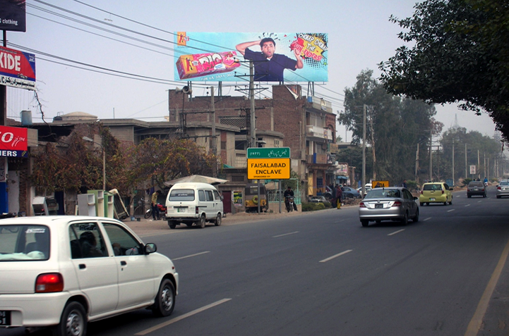
Faisalabad
Size | 60x20
Availability
Rate P/M | Rs: 350,000/-
Location | Direction
Main Canal Road | FTCF: Abdullahpur, Station, Kohinoor Towards Lahore Road, Gatt Wala

Slide 20
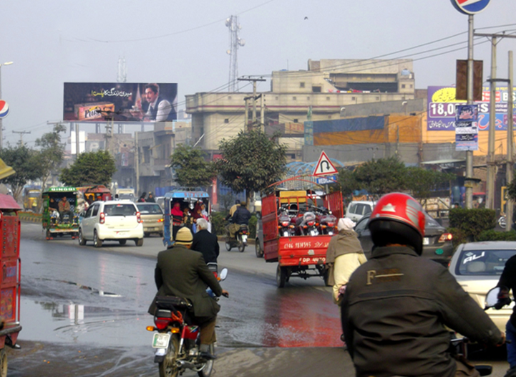
Faisalabad
Size | 60x20
Availability
Rate P/M | Rs: 300,000/-
Location | Direction
Novelty Chowk | FTCF: Novelty Bridge, Sumundry Road Towards Jhaal Chowk, GTS, Saleemi chowk

Slide 21
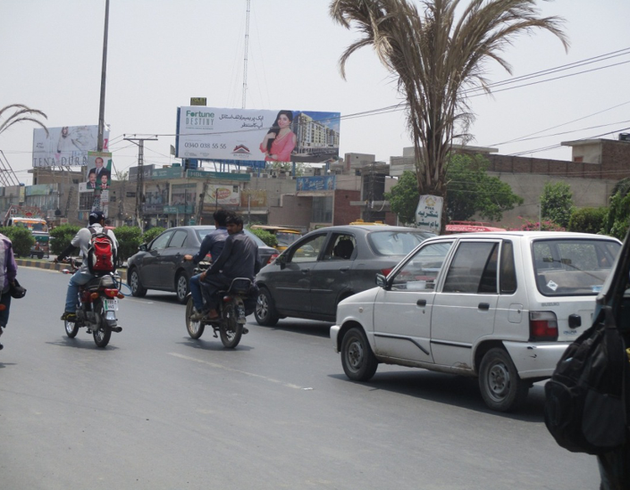
Faisalabad
Size | 60x20
Availability
Rate P/M | Rs: 300,000/-
Location | Direction
MC Donnal’s Chowk | FTCF: Saleemi chowk,Jhaal,Chen,1 Towards D-Ground, Peoples colony

Slide 22
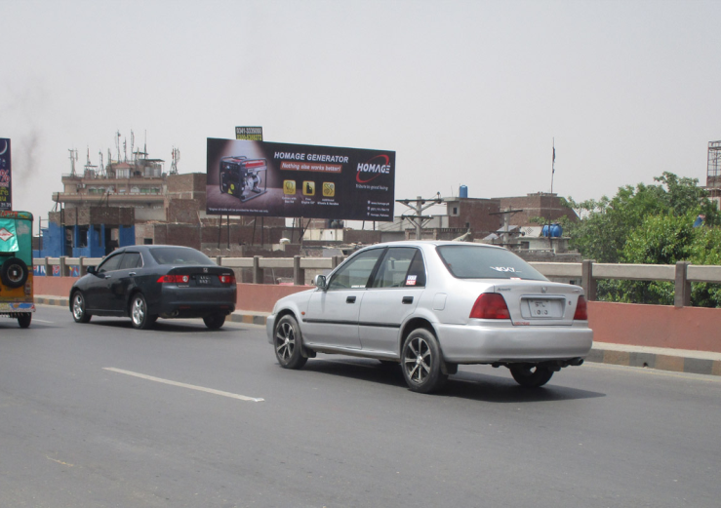
Faisalabad
Size | 60x20
Availability
Rate P/M | Rs: 300,000/-
Location | Direction
Abdullahpur Bridge | FTCF: Abdullahpur Chowk Towards Station Chowk

Slide 23
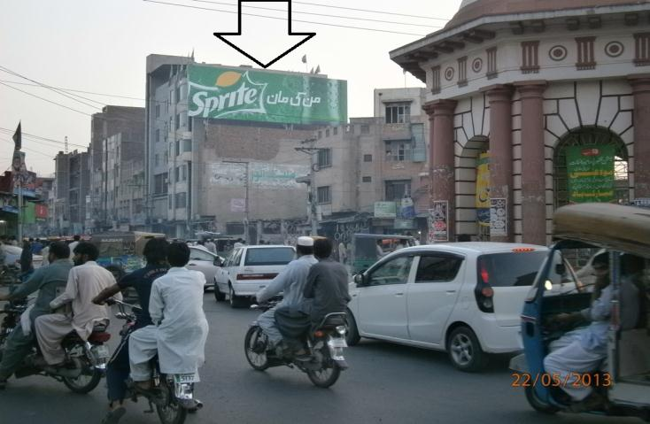
Faisalabad
Size | 60x20
Availability
Rate P/M | Rs: 300,000/-
Location | Direction
Ghumti Chowk | FTCF: Chenab club Towards Kechery Bazar

Slide 24
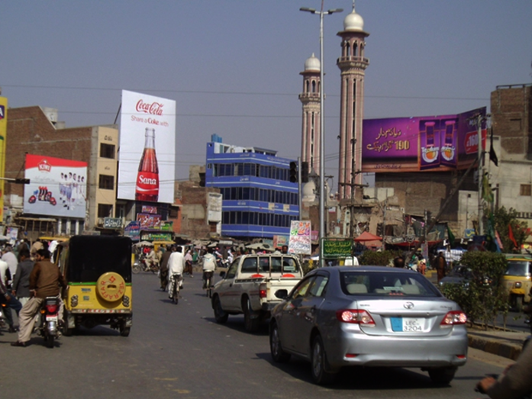
Faisalabad
Size | 30x40
Availability
Rate P/M | Rs:275,000/-
Location | Direction
Jhang Bazar Chowk | FTCF: Station, GTS, Dijkot Road Towards Jinah Colony GC University

Slide 25
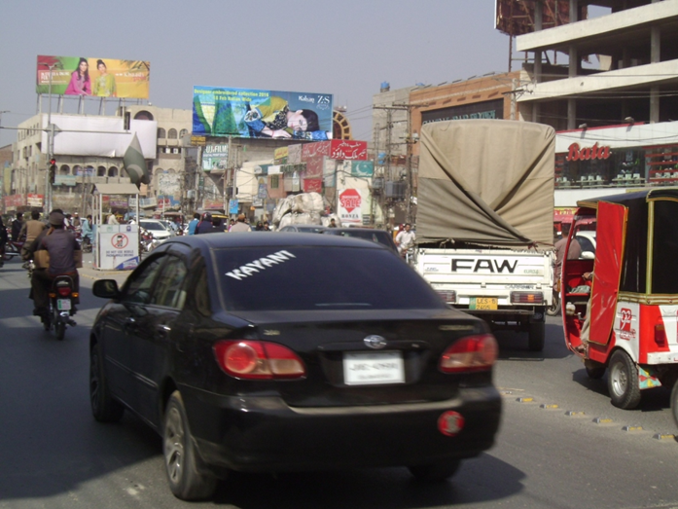
Faisalabad
Size | 60x20
Availability
Rate P/M | Rs: 350,000/-
Location | Direction
Saleemi Chowk Fsd | FTCF: Mc Donalds chowk, D-Ground Towards Chen 1 & Jhaal chowk

Slide 26
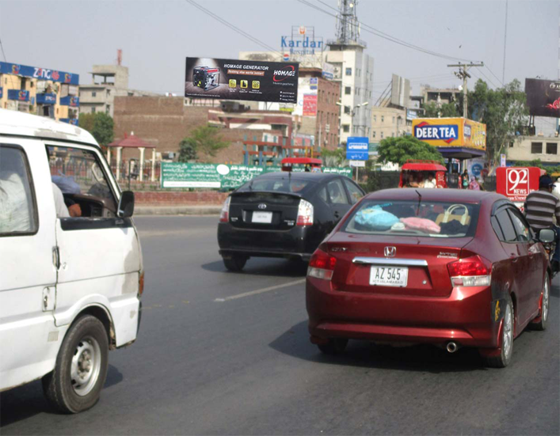
Faisalabad
Size | 60x20
Availability
Rate P/M | Rs: 300,000/-
Location | Direction
Susan Chowk Jaranwala Road | FTCF: Abdullah pur Canal Road, GTS Towards Kohinoor & D Ground

Slide 27
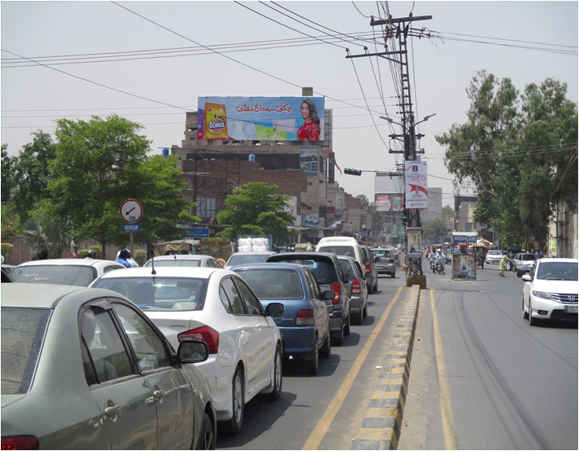
Faisalabad
Size | 60x20
Availability
Rate P/M | Rs: 300,000/-
Location | Direction
Jail Road Signal Chowk | FTCF: Agri Uni, Serena Allied More Towards Jinnah Colony, Gulbarge

Slide 28
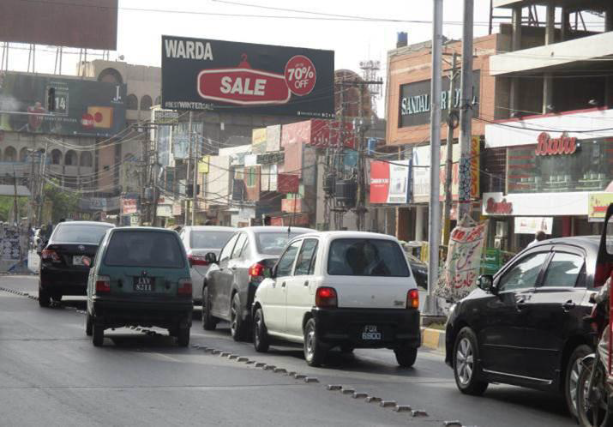
Faisalabad
Size | 60x20
Availability
Rate P/M | Rs: 350,000/-
Location | Direction
Saleemi Chowk | FTCF: Mcdonald Chowk/D-Ground Towards Chen one/Jhal Chowk

Slide 29
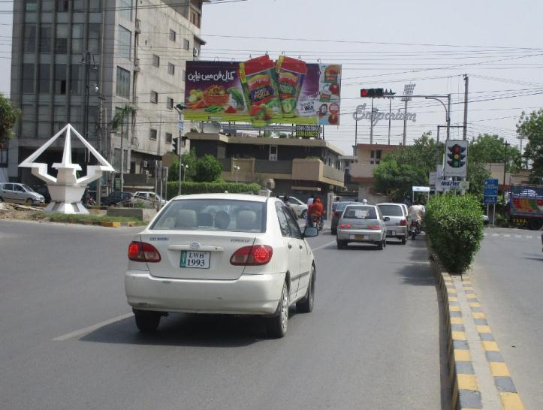
Faisalabad
Size | 56x20
Availability
Rate P/M | Rs: 350,000/-
Location | Direction
Civil Line | FTCF: Serina Road & Clock tower Towards Iqbal stadium & Jail, Sgd Road

Slide 30
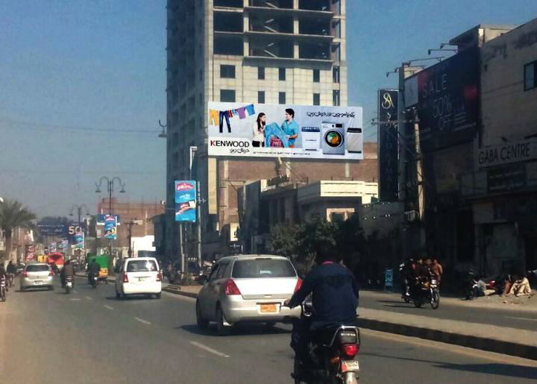
Faisalabad
Size | 56x20
Availability
Rate P/M | Rs: 350,000/-
Location | Direction
Chen one near D-Ground | FTCF: Saleemi Chowk/Satyana Road Towards D-Gruound Kohe noor

Slide 31
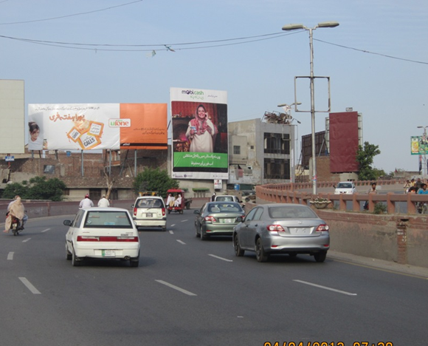
Faisalabad
Size | 30x40
Availability
Rate P/M | Rs: 350,000/-
Location | Direction
Abdullahpur Bridge | FTCF: Station Chowk Chenab club Towards Kohinoor, Susan Chowk

Slide 32
Ad Solution
TERMS & CONDITIONS
First time skin installation and removing is free.
Skin printing charges are not included in the proposed rates.
These rates are exclusive of all kinds of taxes.
If skin is damaged due to weather, changing/re-printing charges will be borne by the client.
The payment will be made 50% in advance and the remaining balance will be payable through 15 days post dated cheque, from the day, the display starts.
For locking the sites please inform us within 1-3 working days.

