Slide 1
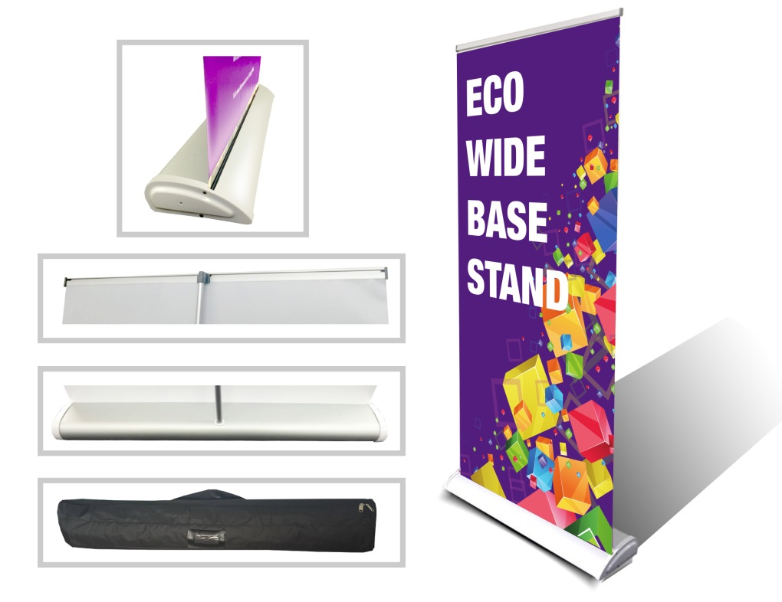
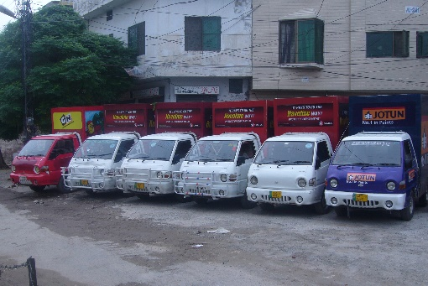
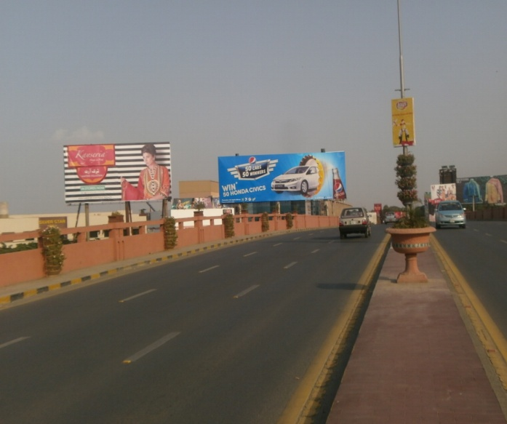
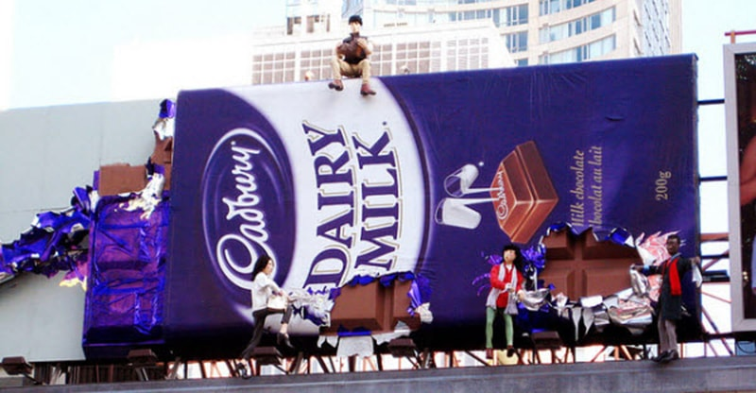
What we Do
Ad Solution
Advertising
Mobile Float
BTL Activities
Bill Boards/Hoardings
All Kinds of Pana Flex /Vinyl Printing
Offset Printing
X/Rollup Stand
Signage (New installation and Maintenance)

Slide 2
Ad Solution
Advertising
Proposal for
Billboards in Gujranwala

Slide 3
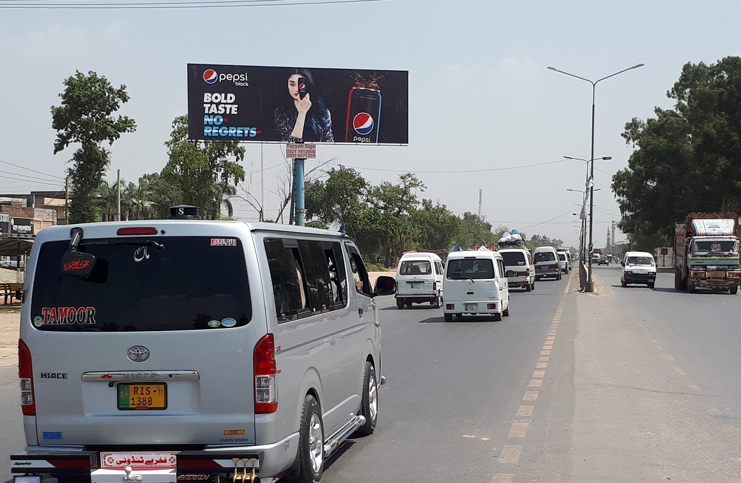
Gujranwala
Size | 60x20
Availability
Rate P/M | 250,000/=
Location | Direction
Rahwali Cantt Chenab Gate, DHA | FTCF: Wazirabad Rawalpindi Towards Gujranwala City, Lahore, Fasilabad, Sialkot

Slide 4
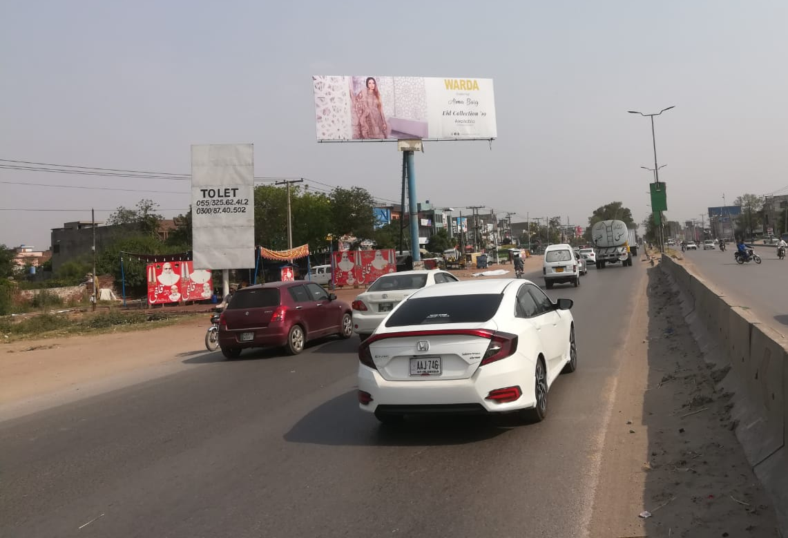
Gujranwala
Size | 60x20
Availability
Rate P/M | Rs: 250,000/=
Location | Direction
Rahwali Cantt Chenab Gate, DHA | FTCF: Fazal Center Rawalpindi Towards Gujranwala City, Lahore, Sialkot

Slide 5
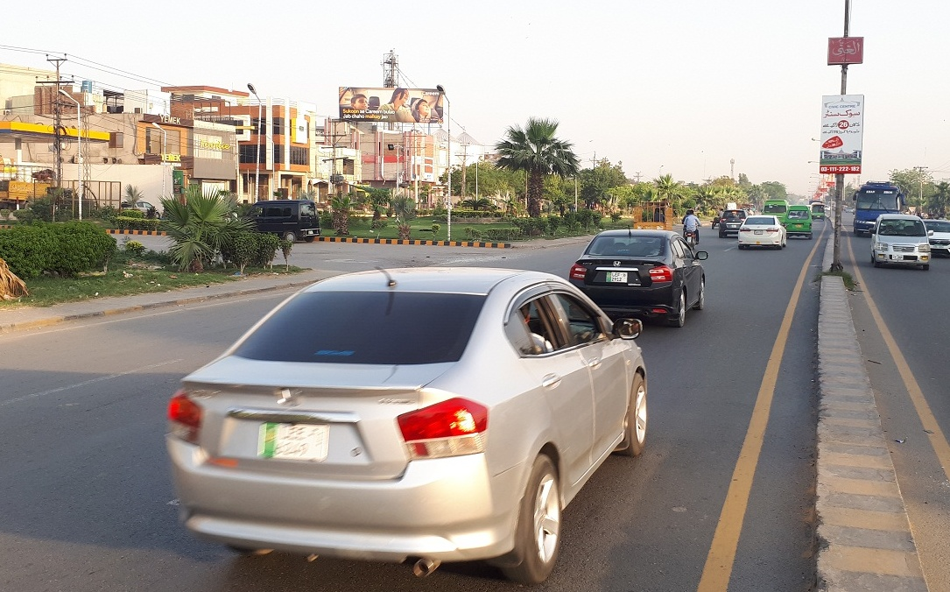
Gujranwala
Size | 60x20
Availability
Rate P/M | Rs: 200,000
Location | Direction
G.T. Road Gujranwala | FTCF: Macdonald, Pac, K.F.C, Near Electronic Market, Towards Model Town, K.F.C, Lari Ada Gujranwala Flay Over Satlite Town Markert Canda Qila

Slide 6
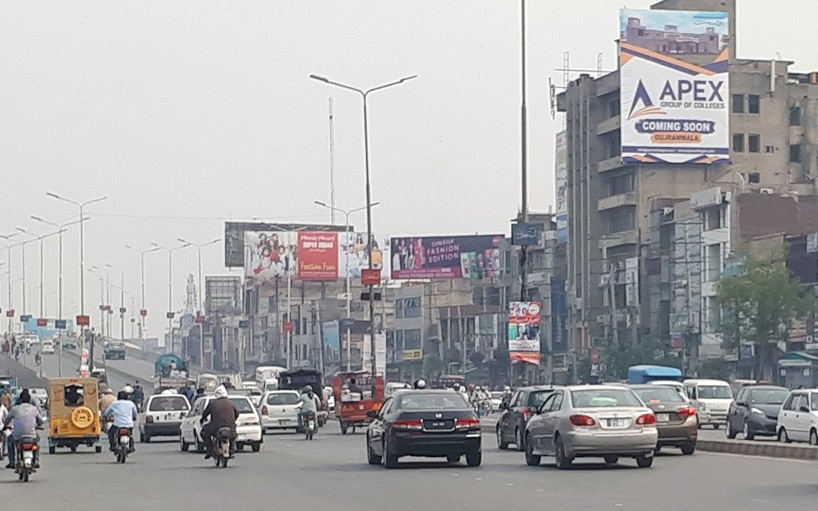
Gujranwala
Size | 30x40
Availability
Rate P/M | Rs:225,000/=
Location | Direction
G.T Road Flay Over Deen Plaza | FTCF: Iqbal High School Facing Macdonald, K.F.C, Lari Ada, Pac Towards Goundala wala Ada, Sialkti Phatak, Satilite Town Market, Katcheri Chowk

Slide 7
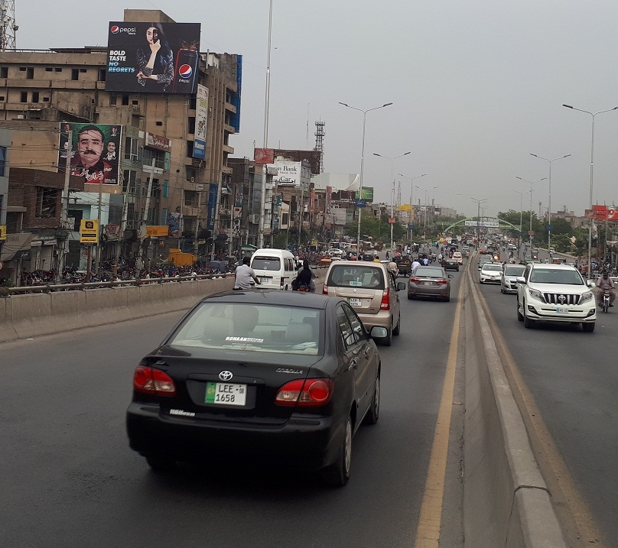
Gujranwala
Size | 40x30 Double View
Availability
Rate P/M | Rs: 225,000/=
Location | Direction
G.T Road Flay Over Deen Plaza | FTCF: Iqbal High School Facing Goundala wala Ada, Sialkti Phatak, Towoards, Satlite Town Marqeet, katcheri Chowk Macdonald, K.F.C, Lari Ada ,Pac

Slide 8
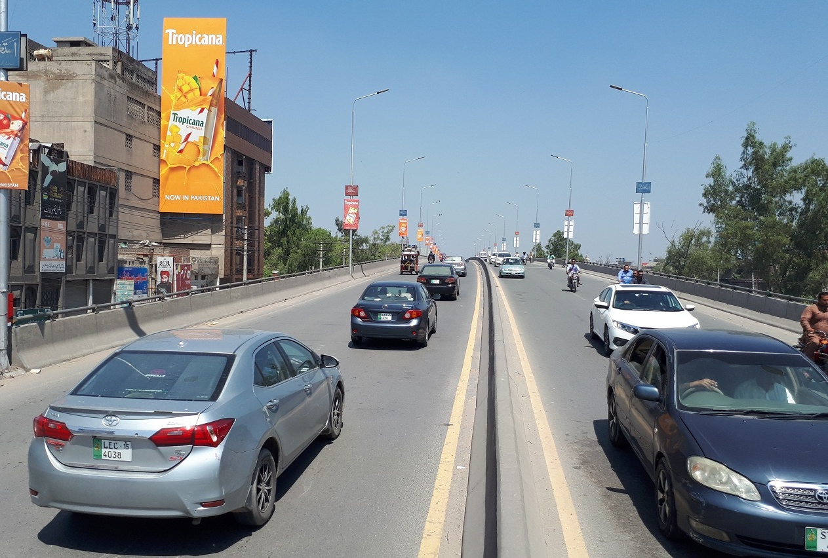
Gujranwala
Size | 20x60
Availability
Rate P/M | Rs:250,000/=
Location | Direction
G.T.Road Flayover | FTCF: Sherna wala Bagh Near Mobile Marqeet Trade Center , Amir Center,Chanda Qila Lahore Facing Towords , Goundala Wala ada ,Satlite Town , Lari Ada Trust Plaza , K.F.C , Macdonald , Pac

Slide 9
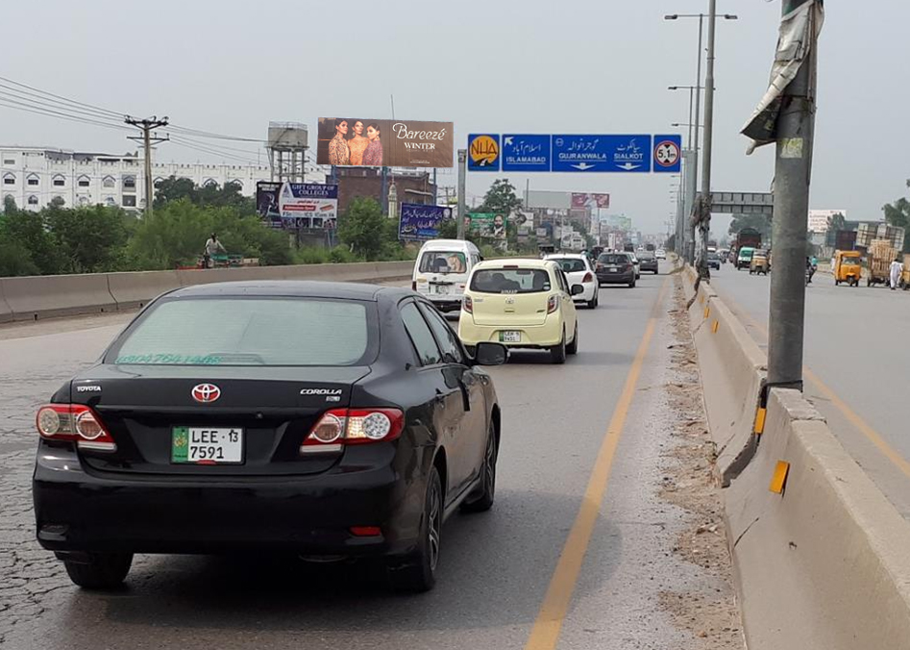
Gujranwala
Size | 60x20
Availability
Rate P/M | Rs: 225,000/=
Location | Direction
G.T.Road | FTCF: Chanda Qila Chowk Near 1122 office Facing Lahore Towards Gujranwala Entrenc , KingMall, Satlite Town Goundala wala ada , Lari ada

Slide 10
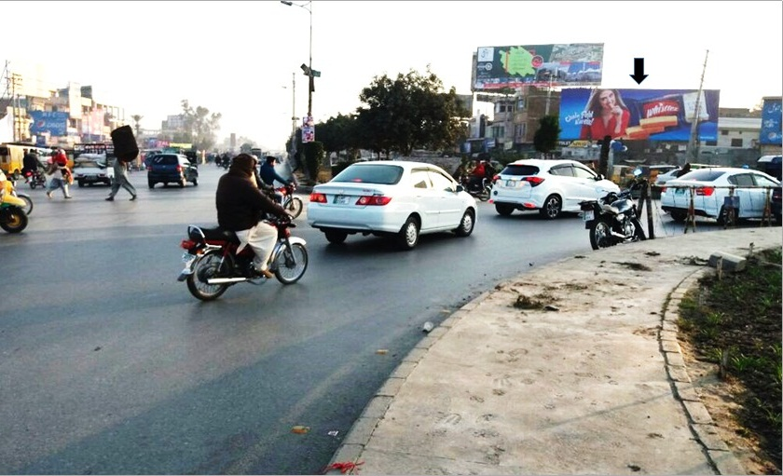
Gujranwala
Size | 60x20
Availability
Rate P/M | Rs: 225,000/=
Location | Direction
G.T.Road | FTCF: Chanda Qila Chowk , Gujranwala , Pindi By Pass , Pindi To King Mall , Lahore

Slide 11
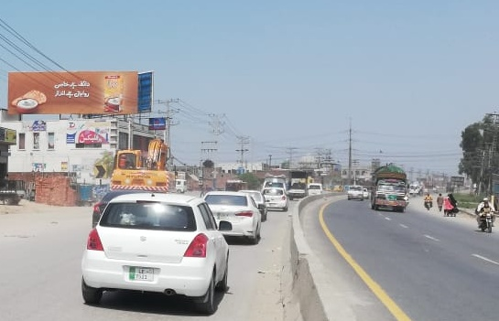
Gujranwala
Size | 60x20
Availability
Rate P/M | Rs:225,000/=
Location | Direction
Alam Chowk | FTCF: Near Police Chowki COMING FROM Lahor, Chanda Qila ,King Maal ,Hafizabad GOING TOWARDS Pindi By Pass ,Rahwali Cantt ,Sialkot,Rawalpindi

Slide 12
Gujranwala
Size | 60x20
Availability
Rate P/M | Rs:225,000/=
Location | Direction
Alam Chowk | FTCF: Near police Chowki COMING FROM Wazirabad , Rahwali Cantt , Pindi By Pass Towords Hafizabad , Wapda Town King Mall , Chanda Qila , Lahore

Slide 13
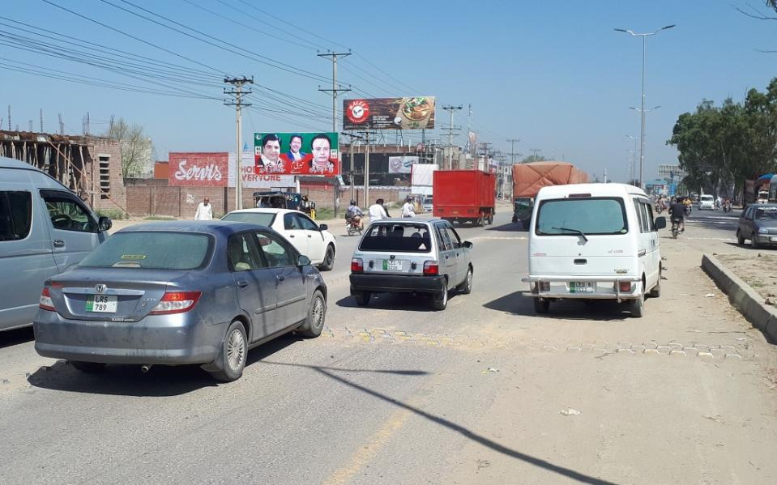
Gujranwala
Size | 60x20
Availability
Rate P/M | Rs: 200,000/-
Location | Direction
G.T Road | FTCF: Rahwali Cantt Fazal Center COMING FROM Satlite Town ,Model Town , Lahore GOING TOWARDS Gujrat , Pindi

Slide 14
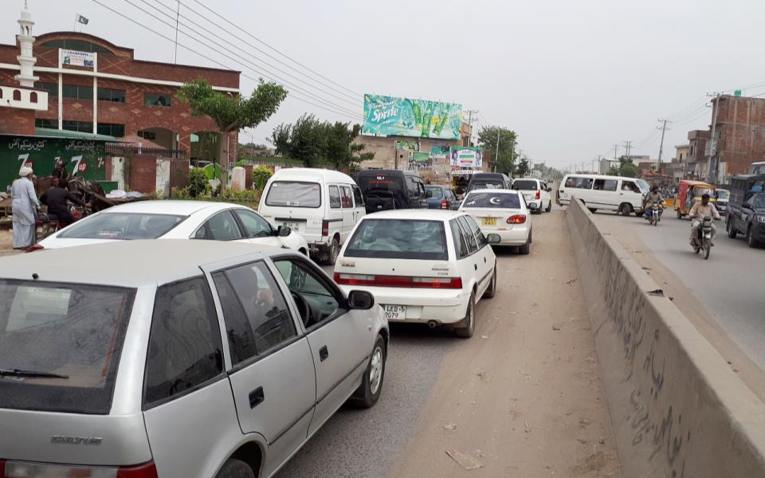
Gujranwala
Size | 60x20
Availability
Rate P/M | Rs: 200,000/-
Location | Direction
Sialkot By Pass Chowk | FTCF: Katchri Road Facing Sialkot.Daska,Rawalpindi,Pindi By Pass Towords Gujranwala City , Satlite Town. Chanda Qila

Slide 15
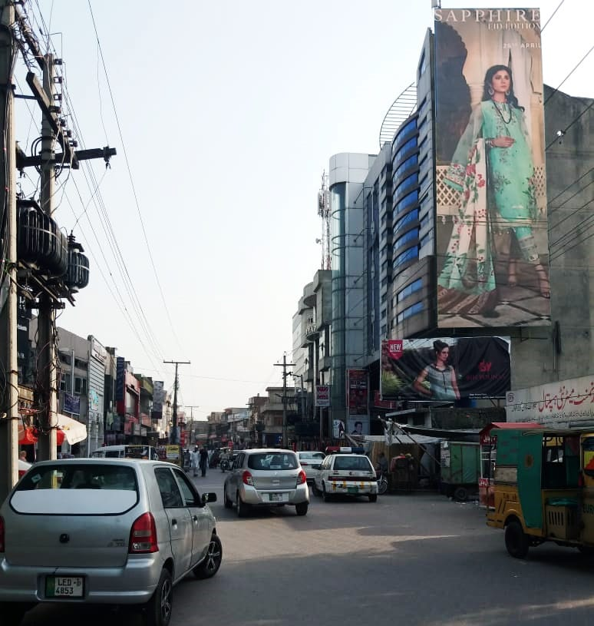
Gujranwala
Size | 20x60
Availability
Rate P/M | Rs: 200,000/=
Location | Direction
Green Center | FTCF: main marqeet Satlite Town Facing Chan One to Tipu Chowk

Slide 16
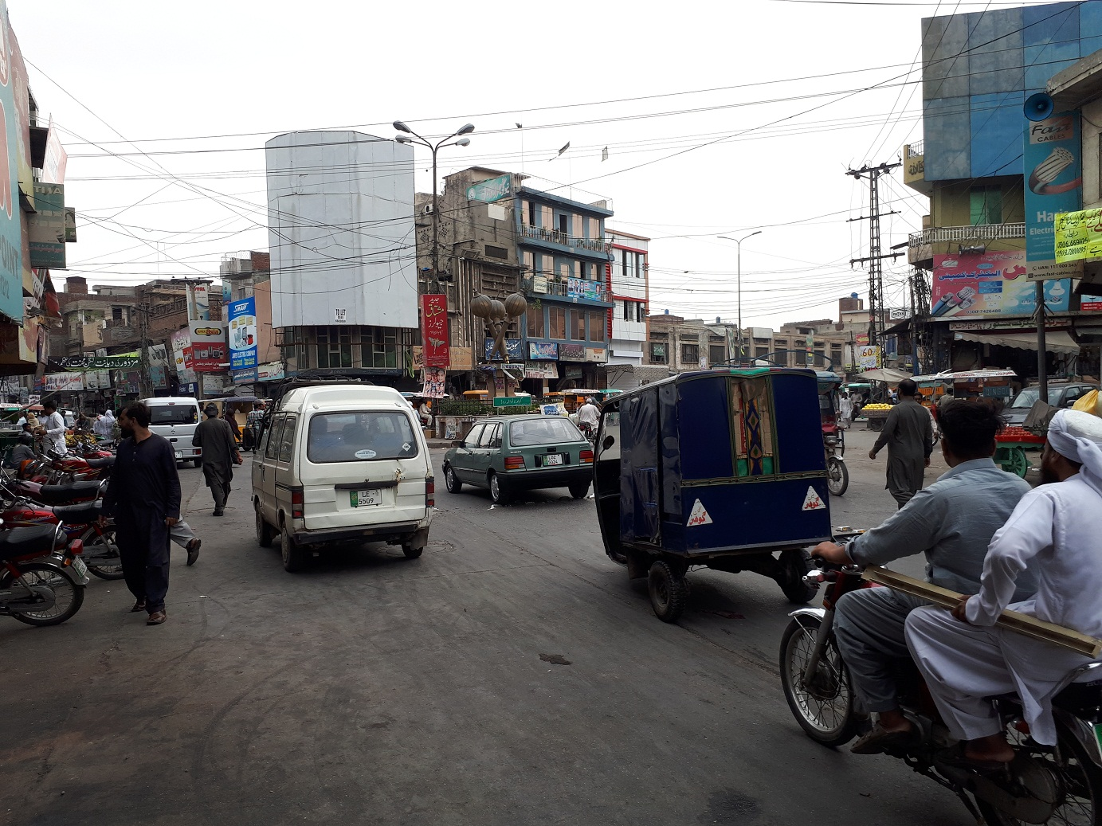
Gujranwala
Size | 60x20
Availability
Rate P/M | Rs:200,000/=
Location | Direction
Goundala Wala Ada Near Daal Bazar , Kharad Bazar , Urdu bazar

Slide 17
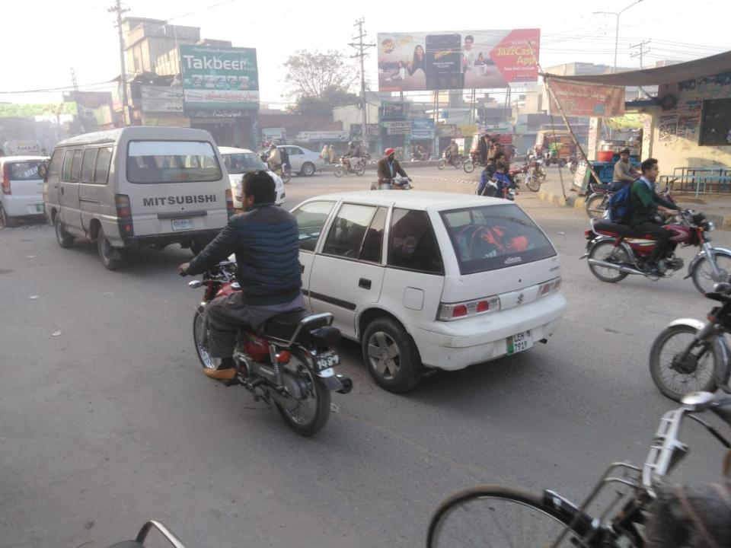
Gujranwala
Size | 60x20
Availability
Rate P/M | Rs:200,000 /=
Location | Direction
Satlite Town Markeet Pasror Road Near Peoples Coloney

Slide 18
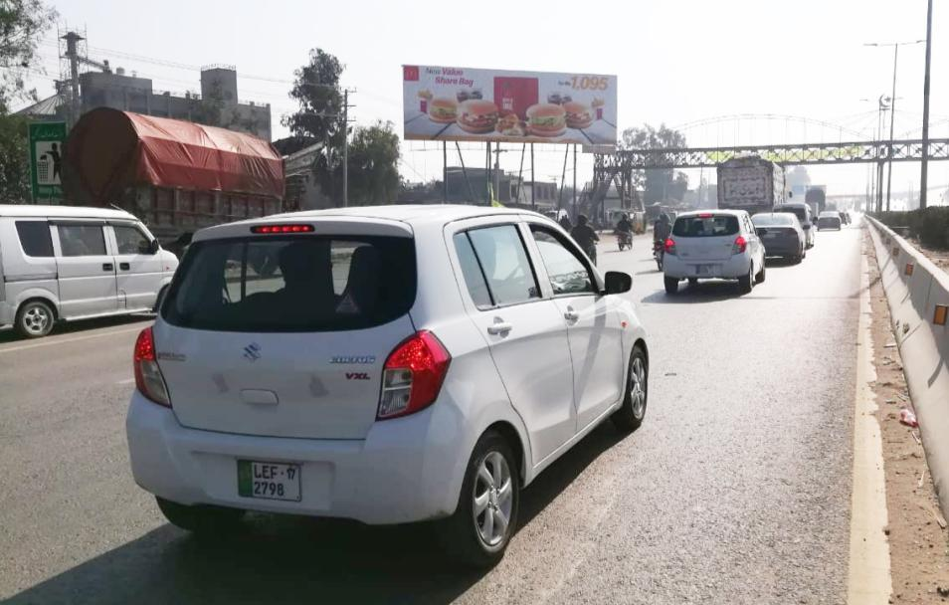
Gujranwala
Size | 60x20
Availability
Rate P/M | Rs: 200,000
Location | Direction
G.T Road | FTCF: Pindi By Pass Near Bus Stand Islamabad Stop, Facing Rahwali Cantt , Gujrat,Pindi, Towords Gujranwala City ,Model Town Satlite Town , Chanda Qila , Lahore

Slide 19
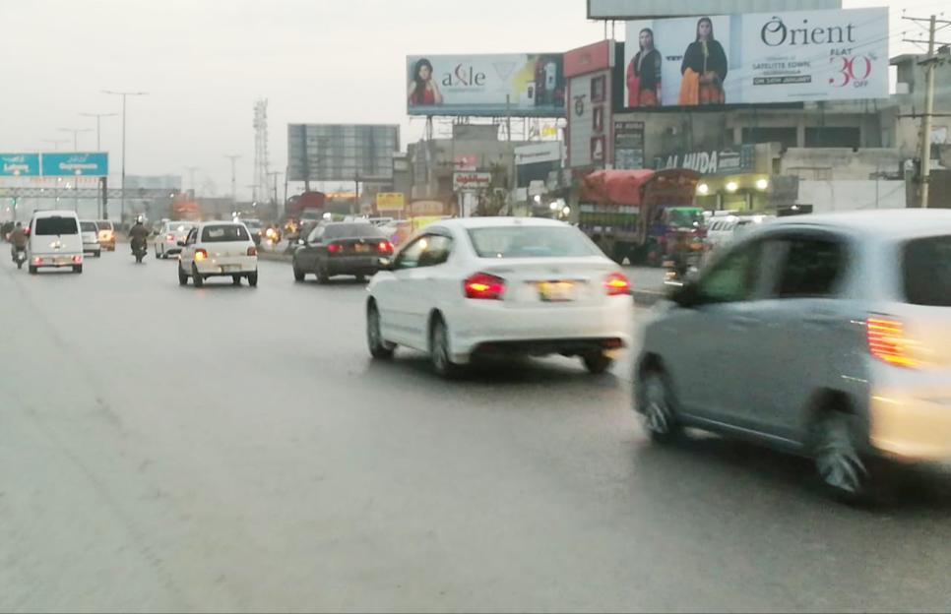
Gujranwala
Size | 60x20
Availability
Rate P/M | Rs:200,000/=
Location | Direction
G.T.Road | FTCF: Pindi By Pass Facing Rawalpindi Towords Lahore

Slide 20
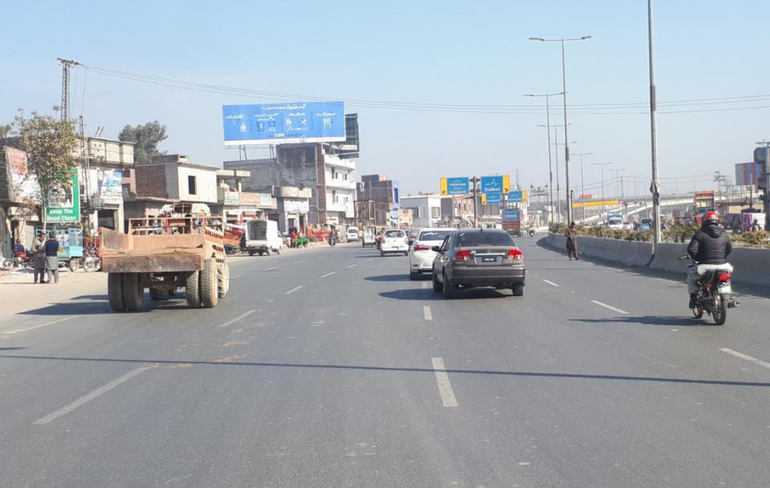
Gujranwala
Size | 60x20
Availability
Rate P/M | Rs:200,000/=
Location | Direction
Gujranwala Pindi By Pass Fly Over | FTCF: Lahore , Hafziabad Towards Rahwali Cantt , Gujranwala City ,Daska Sialkot, Rawalpindi

Slide 21
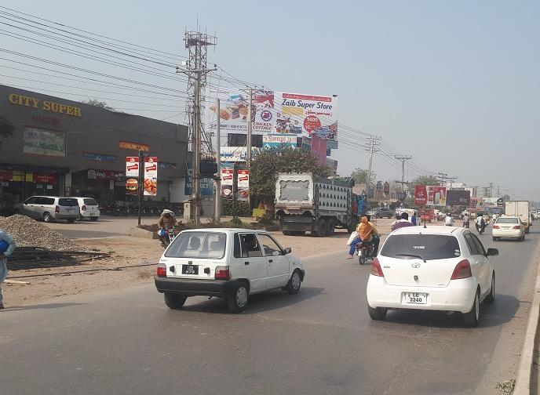
Gujranwala
Size | 60x20
Availability
Rate P/M | Rs:225,000 /-
Location | Direction
G.T.Road | FTCF: Rahwali Cantt Near Dc Coloney Phatak Facing lahore Towords Rawalpindi

Slide 22
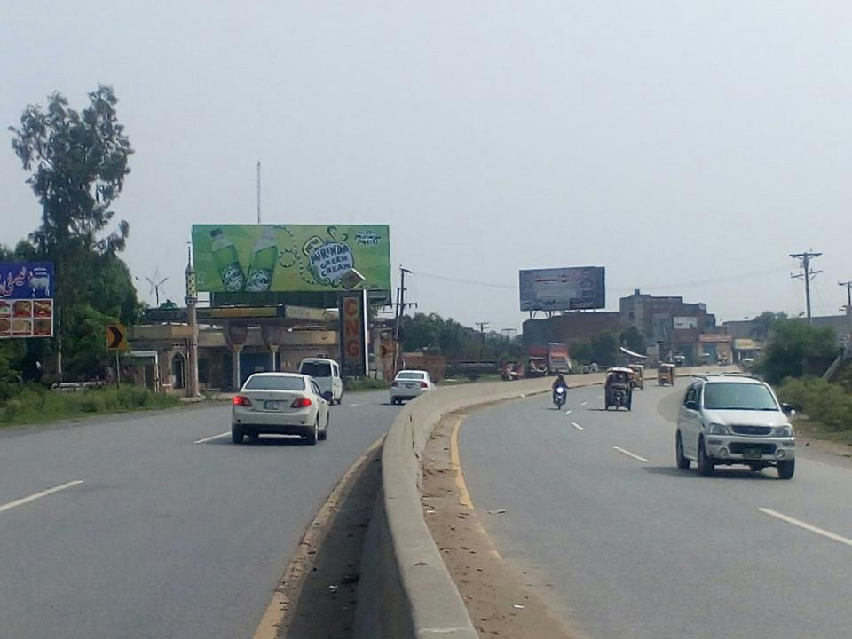
Gujranwala
Size | 60x20
Availability
Rate P/M | Rs:200,000/=
Location | Direction
G.T.Road | FTCF: kangni wala by pass Near master City Facing Sialkot ,Rahwali cant, Satlite Town ,Towords Chanda Qila , Lahore

Slide 23
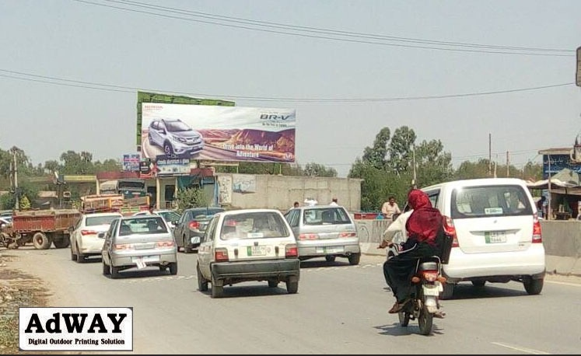
Gujranwala
Size | 60x20
Availability
Rate P/M | Rs:200,000
Location | Direction
G.T Road | FTCF: kangni wala by pass Near master City Facing Lahore Chanda Qila , Towords Satlite Town ,Sialkot Rahwali cant

Slide 24
Hafizabad

Slide 25
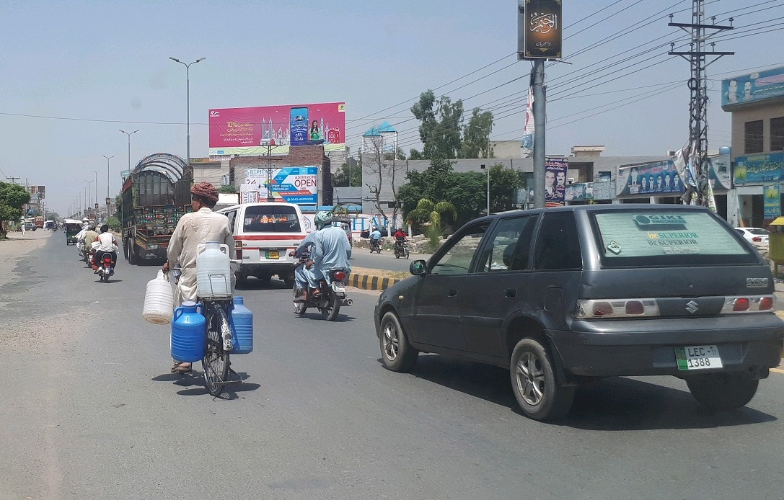
Hafizabad
Size | 60x20
Availability
Rate P/M | Rs:175,000
Location | Direction
Hafizabad | FTCF: Hafizabad Jinnah Chowk DPO Office SP Chowk Katchri Road Facing Gujranwala , Lahore Towords Hafizabad City ,Pindi Bhatian , Sargodha , Faisalabad

Slide 26
Wazirabad

Slide 27
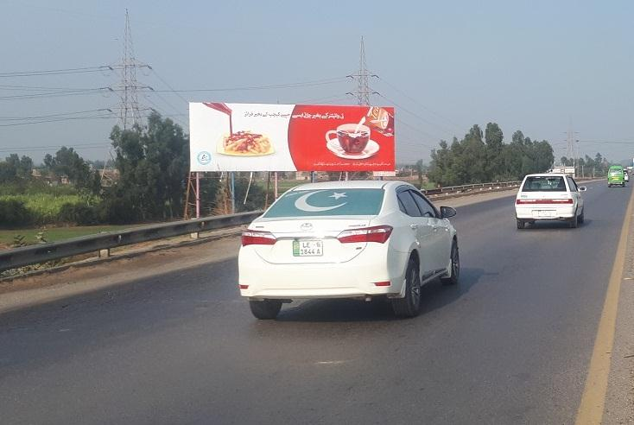
Wazirabad
Size | 90x30
Availability
Rate P/M | Rs:300,000
Location | Direction
Wazirabad | FTCF: G.T, Road Wazirabad Near Gujrat Tool Plaza Facing Lahore Towords Rawalpindi

Slide 28
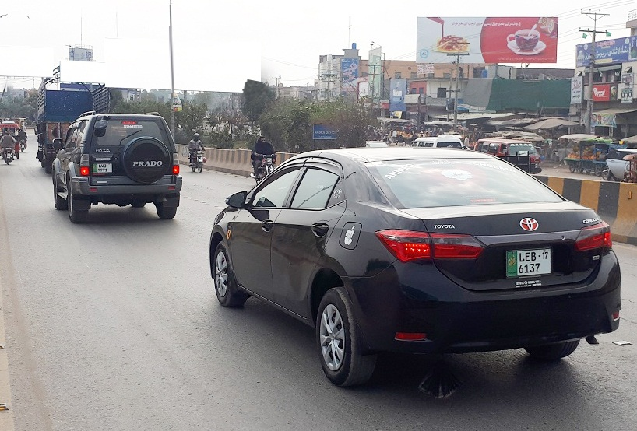
Wazirabad
Size | 60x20
Availability
Rate P/M | Rs:150,000
Location | Direction
Wazirabad | FTCF: Buss Stand Wazirabad Rail way Flay Over Near Sabzi Mandi ALLAH WALA CHOWK COMING FROM Sialkot , Sambryal , Gujrat , Pindi , Towords Gujrat,Gujranwala , Lahore

Slide 29
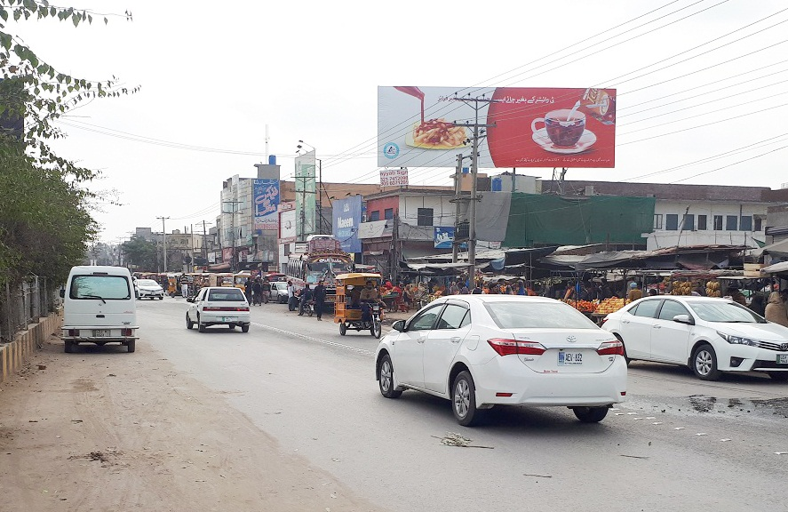
Wazirabad
Size | 60x20
Availability
Rate P/M | Rs:175,000
Location | Direction
Wazirabad | FTCF: Buss Stand Wazirabad Rail way Flay Over Near Sabzi Mandi Allah Wala Chowk Coming From, Gujrat , Pindi , Towords Sialkot , Sambryal ,Gujranwala , Lahore

Slide 30
Mandi Bahauddin

Slide 31
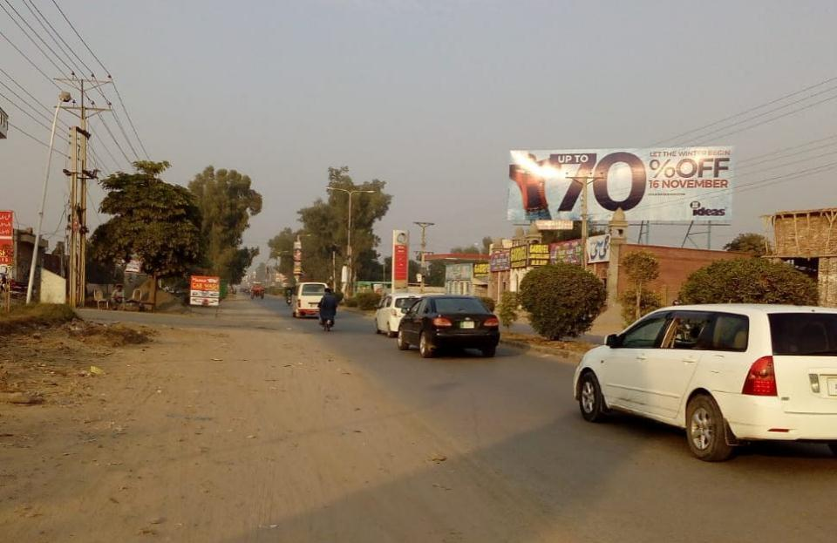
Mandi Bahauddin
Size | 60x20
Availability
Rate P/M | Rs:200,000
Location | Direction
Mandi Bahauddin | FTCF: University Town Mandibahwal Deen Phalia Road Jail Road King Morr , Ghorra Chowk facing, Gujranwala, Gujrat , Towards Cheema Chowk, Lari ada , Katchri Chowk

Slide 32
Gujrat

Slide 33
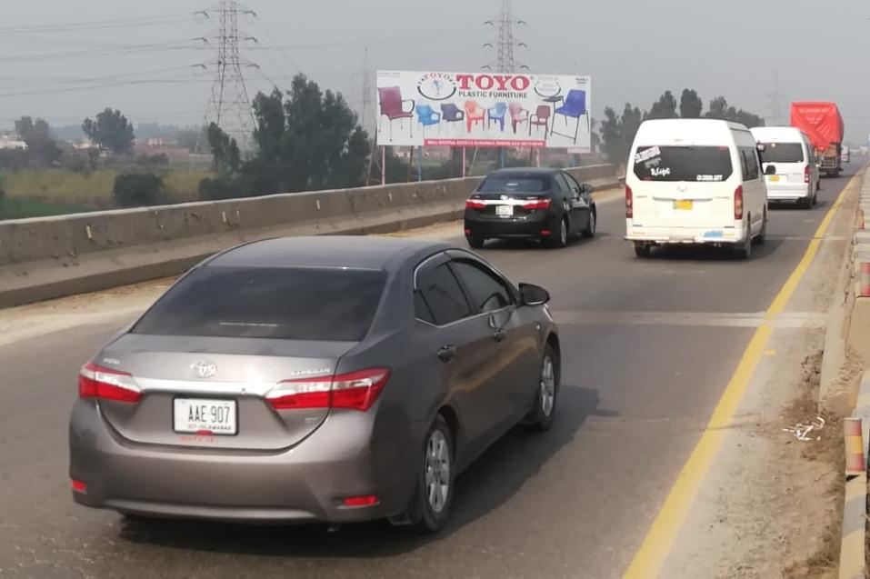
Gujrat
Size | 90x30
Availability
Rate P/M | Rs:300,000
Location | Direction
Gujrat | FTCF: G.T,Road Gujrat Near Gujrat Tool Plaza Gujrat entrance Facing Lahore Towords Rawalpindi

Slide 34
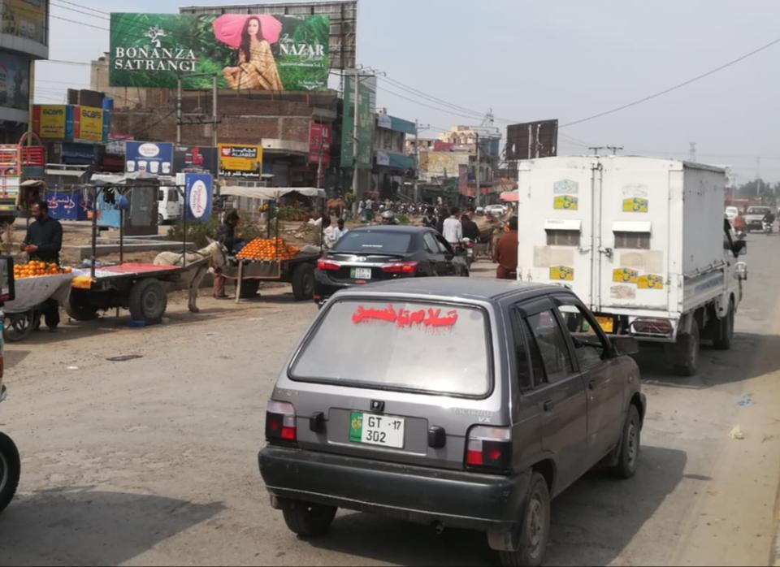
Gujrat
Size | 60x20
Availability
Rate P/M | Rs:200,000
Location | Direction
Gujrat | FTCF: G.T.Road Ramtali Chowk Gujrat Near G.T.S Chowk Katchri Road COMING FORM WAZIRABAD, GUJRANWALA, LAHORE GOING TOWARDS ,Katchri Road, G.T.S Chowk , Azeez Shaheed Road Gujrat

Slide 35
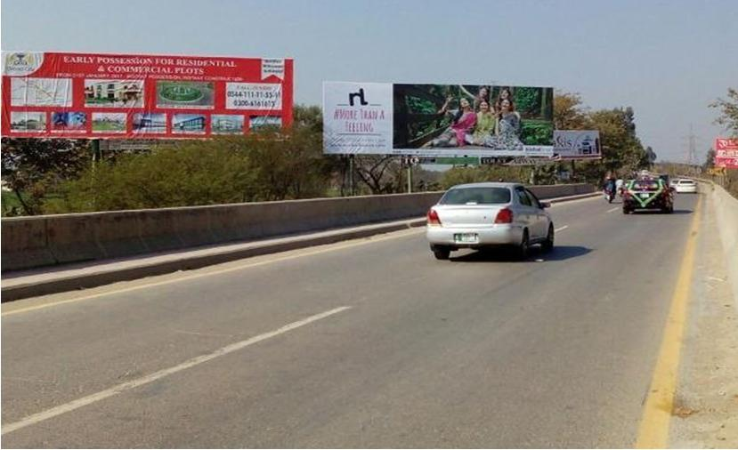
Gujrat
Size | 60x20
Availability
Rate P/M | Rs:200,000
Location | Direction
Gujrat | FTCF: G.T. Road Gujrat Rehmania Over Had Burridge Facing Lahore,Gujranwala,Wazirabad, To Lala Mussa ,Kharian , Jhelum , Pindi

Slide 36
Gujrat
Size | 60x20
Availability
Rate P/M | Rs:200,000
Location | Direction
Gujrat | FTCF: G.T. Road Gujrat Rehmania Over Had Burridge Facing Lahore,Gujranwala,Wazirabad, To Lala Mussa ,Kharian , Jhelum , Pindi

Slide 37
Sialkot

Slide 38
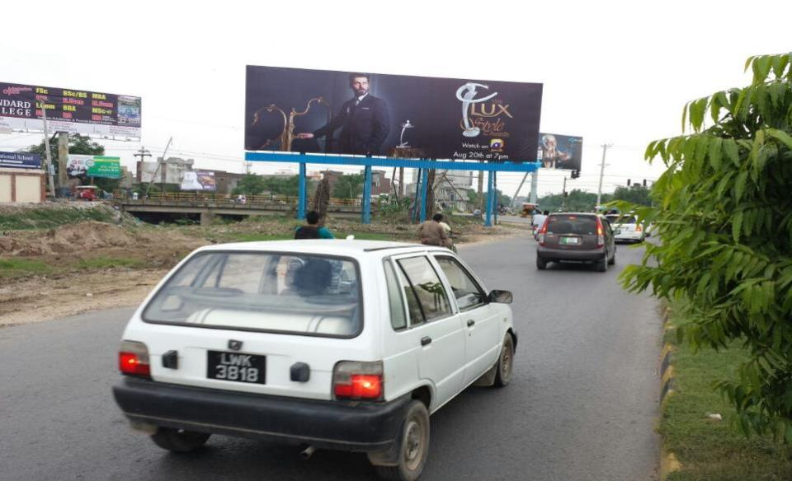
Sialkot
Size | 60x20
Availability
Rate P/M | Rs:250,000
Location | Direction
Sialkot | FTCF: Jail Pulli Cantt Coming from Shell Pump Paris rd,Going to Larri Adda, Model Town

Slide 39
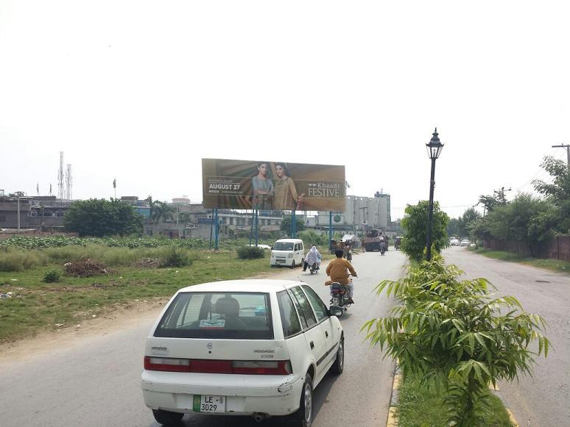
Sialkot
Size | 60x20
Availability
Rate P/M | Rs:250,000
Location | Direction
Sialkot | FTCF: Model Town Pulli Cantt Coming from Shell Pump ,Larri Adda,Going to Model Town Khadim Ali rd.

Slide 40
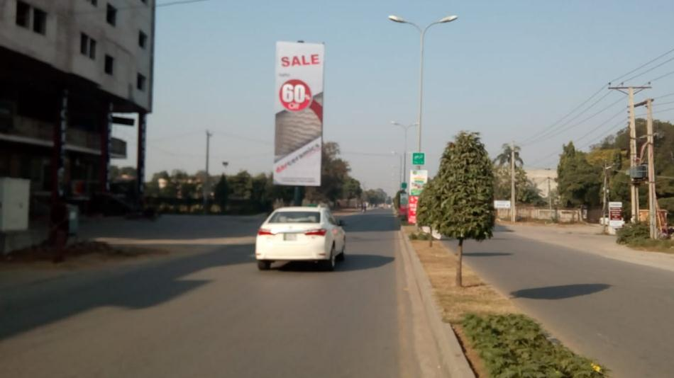
Sialkot
Size | 20x60
Availability
Rate P/M | Rs:250,000
Location | Direction
Sialkot | FTCF: Aziz Shaheed Road Pakistan Chowk Sialkot Cantt Coming Froam Ghanta Ghar Chowk Towoards Lari ada Shell Chowk

Slide 41
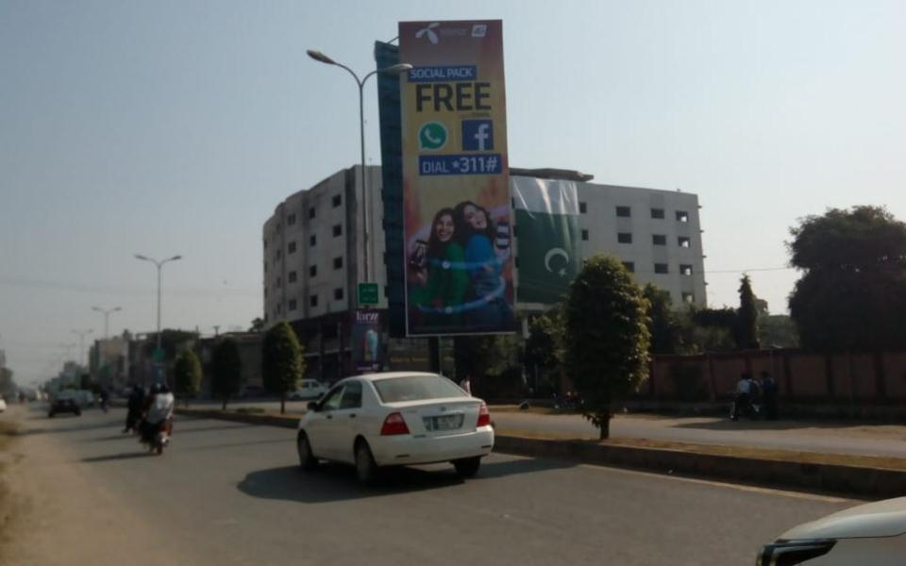
Sialkot
Size | 20x60
Availability
Rate P/M | Rs:250,000
Location | Direction
Sialkot | FTCF: Aziz Shaheed Road Pakistan Chowk Sialkot Cantt Coming Froam Lari Ada Shell Chowk Towoards Ghanta Ghar Chowk

Slide 42
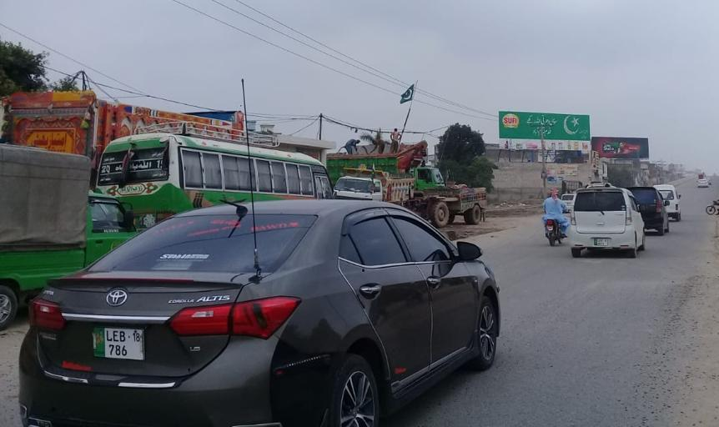
Sialkot
Size | 60x20
Availability
Rate P/M | Rs:225,000
Location | Direction
Sialkot | FTCF: Sialkot Sublime Chowk Sialkot Fly Over Coming Froam Sambryal Air Port Towoards Lari Ada Sialkot Cantt

Slide 43
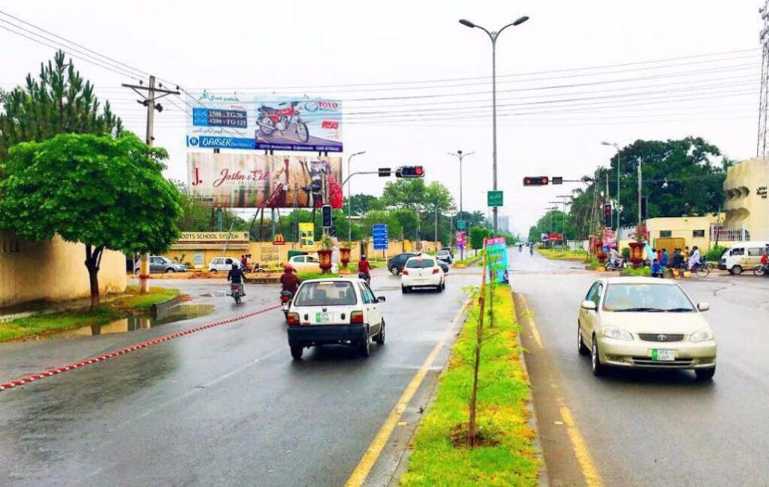
Sialkot
Size | 60x20
Availability
Rate P/M | Rs:350,000
Location | Direction
Sialkot | FTCF: Aziz Shaheed Road Pakistan Chowk Sialkot Cantt

Slide 44
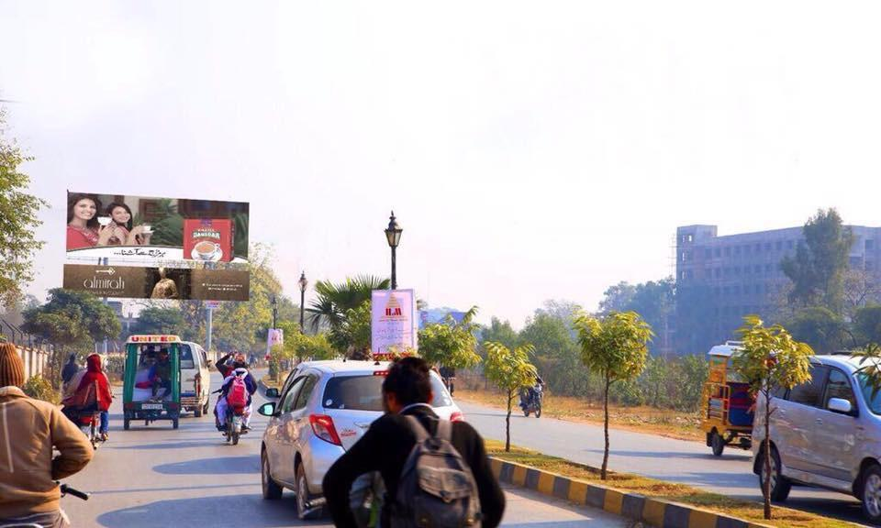
Sialkot
Size | 60x20
Availability
Rate P/M | Rs:350,000
Location | Direction
Sialkot Cantt | FTCF: Khawaja Safdar Road towards Sadar Bazar

Slide 45
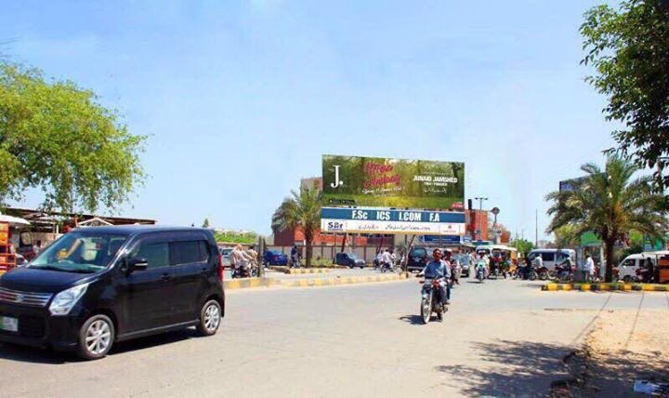
Sialkot
Size | 60x20
Availability
Rate P/M | Rs:275,000
Location | Direction
Sialkot Cantt | FTCF: Khawaja Safdar road towrads Jail road Chowk

Slide 46
Jehlam

Slide 47
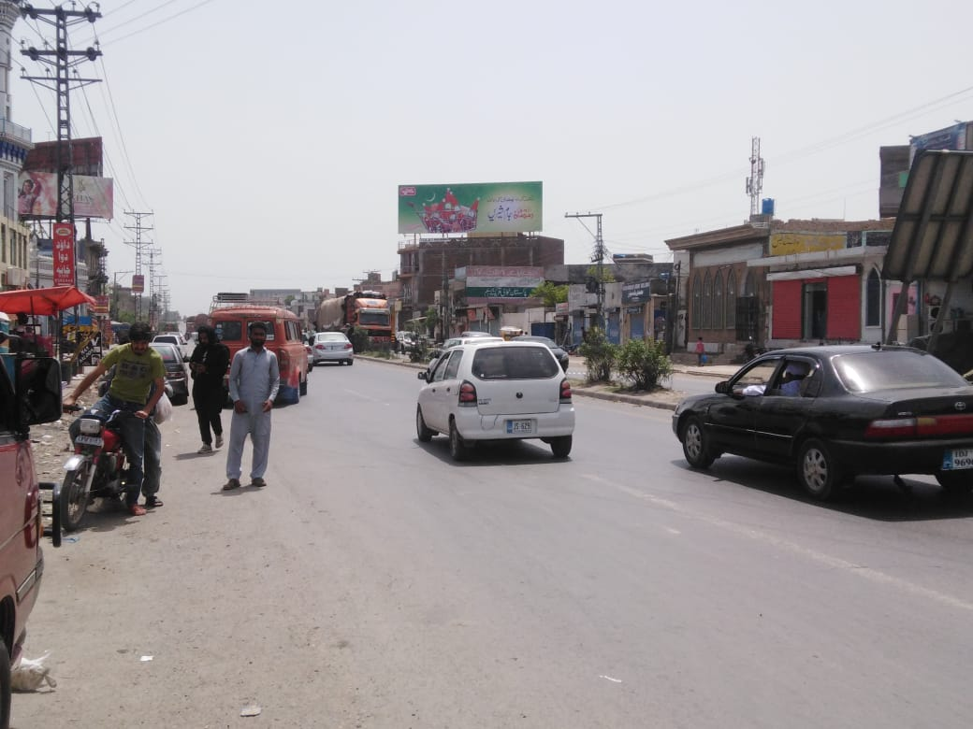
Jehlam
Size | 60x20
Availability
Rate P/M | Rs:200,000
Location | Direction
Jehlam | FTCF: G.T.Road Jhelum Near Lahore Morr Cantt Facing Jada Chowk , Deena , Pindi , Towords Kharian , Gujranwala, Lahore

Slide 48
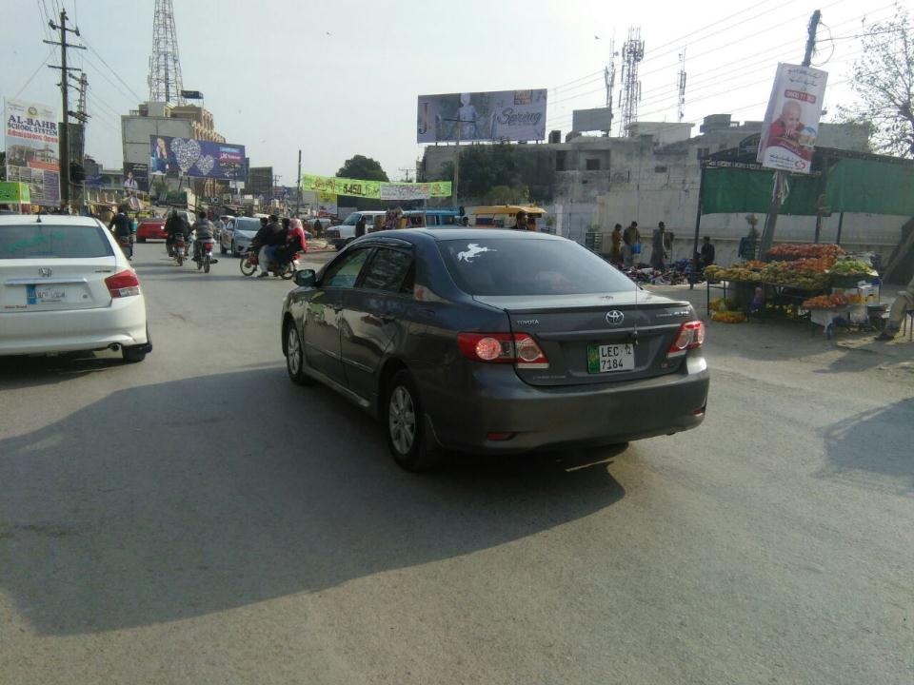
Jehlam
Size | 60x20
Availability
Rate P/M | Rs:225,000
Location | Direction
Jehlam | FTCF: Shandar Chowk Jhelum

Slide 49
Ad Solution
TERMS & CONDITIONS
First time skin installation and removing is free.
Skin printing charges are not included in the proposed rates.
These rates are exclusive of all kinds of taxes.
If skin is damaged due to weather, changing/re-printing charges will be borne by the client.
The payment will be made 50% in advance and the remaining balance will be payable through 15 days post dated cheque, from the day, the display starts.
Before locking the sites please inform us within 1-3 working days.

