Slide 1
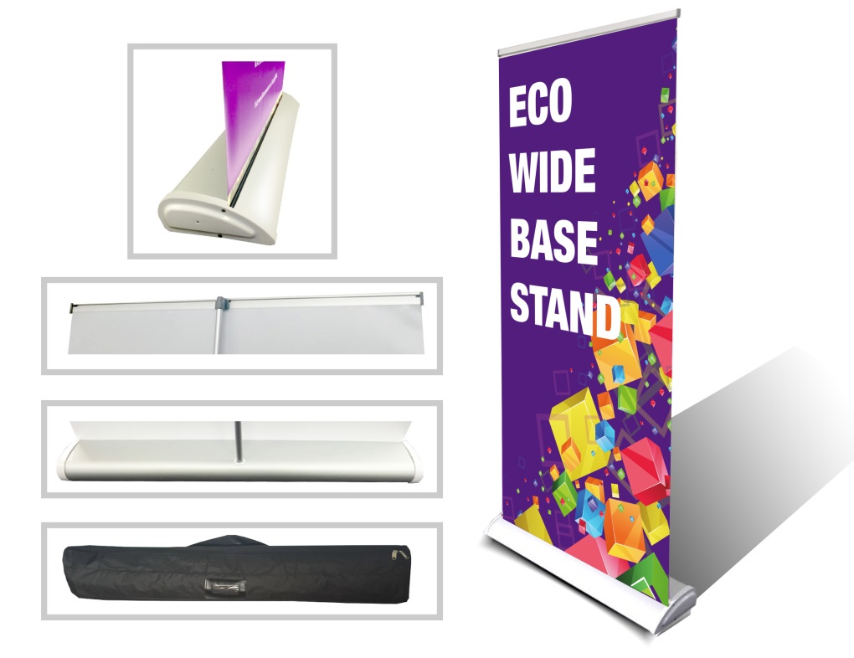
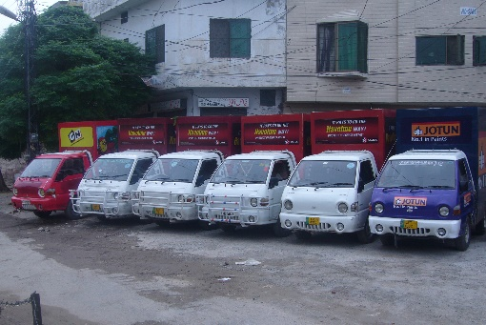
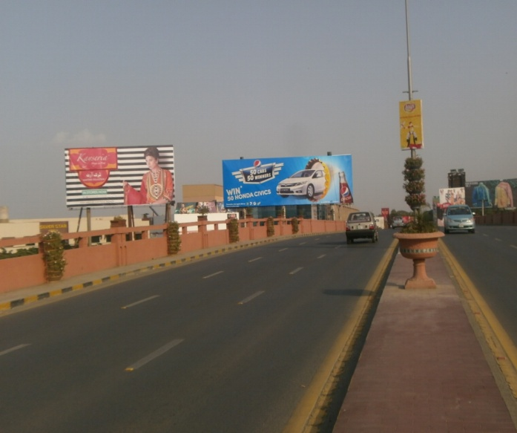
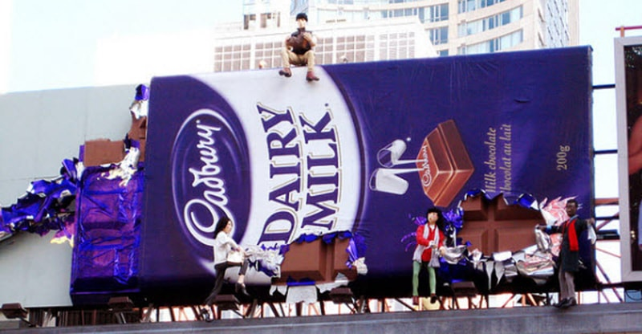
What we Do
Ad Solution
Advertising
Mobile Float
BTL Activities
Bill Boards/Hoardings
All Kinds of Pana Flex /Vinyl Printing
Offset Printing
X/Rollup Stand
Signage (New installation and Maintenance)

Slide 2
Ad Solution
Advertising
Proposal for
Billboards in Hyderabad

Slide 3
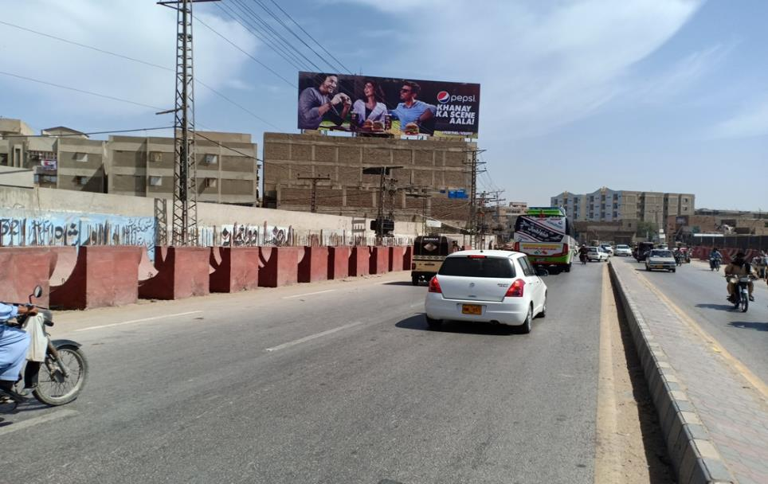
Hyderabad
Size | 90x30
Availability | Available
Rate P/M | Rs: 595,00/=
Location | Direction
Hyderabad | FTCF: Roof Top Zulfiqar Height Halanaka Qasim Chowk TFG Ayub Pump National Highway

Slide 4
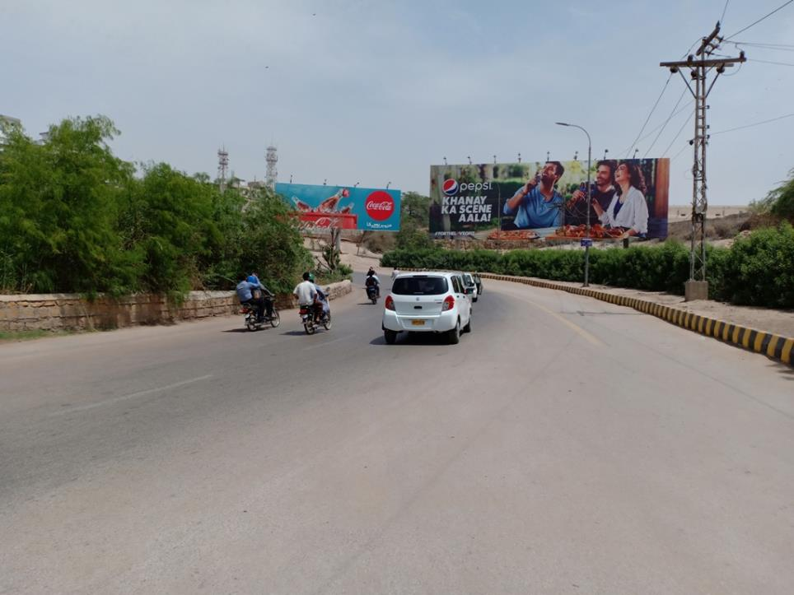
Hyderabad
Size | 90x30
Availability | Available
Rate P/M | Rs: 950,000/= With Light
Location | Direction
Hyderabad | FTCF: Hill Top Chari Latifabad towards Gymkhana

Slide 5
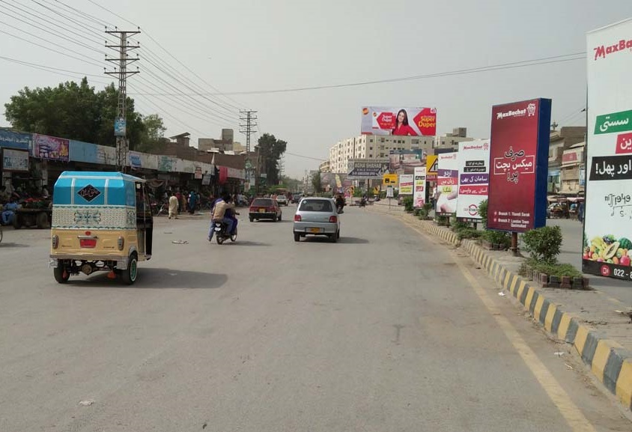
Hyderabad
Size | 90x30
Availability
Rate P/M | Rs: 800,000/=
Location | Direction
Hyderabad | FTCF:Naseem Nagar Qasmabad Thandi Sarak & Vaduwa Chowk Towards Qasimabad

Slide 6
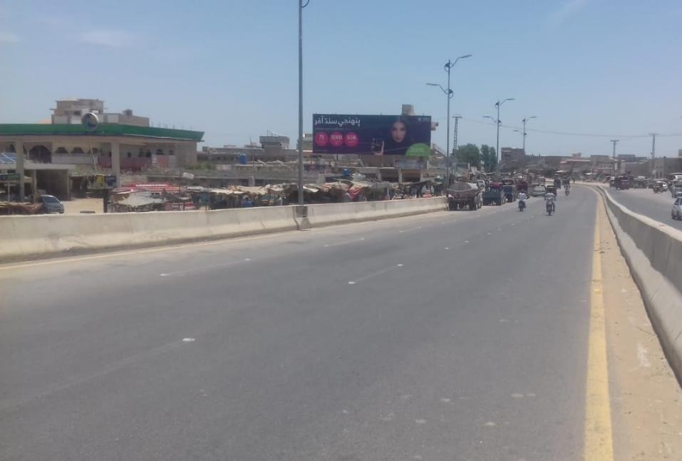
Hyderabad
Size | 60x20
Availability | Hold
Rate P/M | Rs: 250,000/=
Location | Direction
Jamshror | FTCF: Main Jamsohoro Chowk Lums University TFG Hydearbad

Slide 7
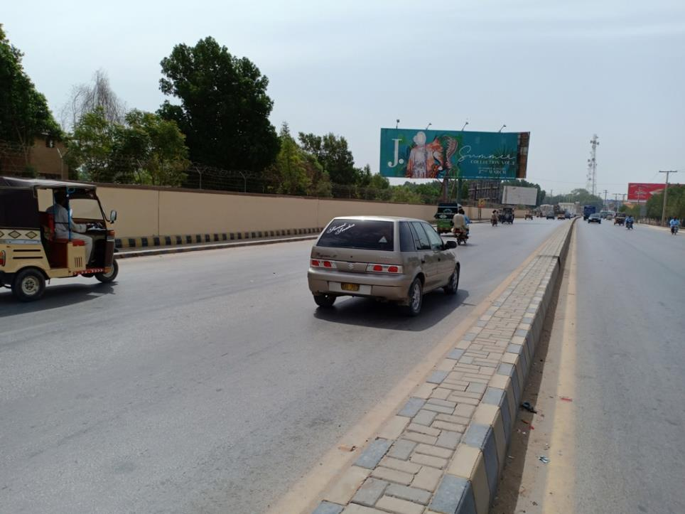
Hyderabad
Size | 60x20
Availability | 26/7/209 + Hold
Rate P/M | Rs: 495,000/=
Location | Direction
Hyderabad | FTCF: Opp: Qasam Banquet Qasam Chowk, Karachi, Jamshoro & Rajputana TFG Qasam Chowk & City

Slide 8
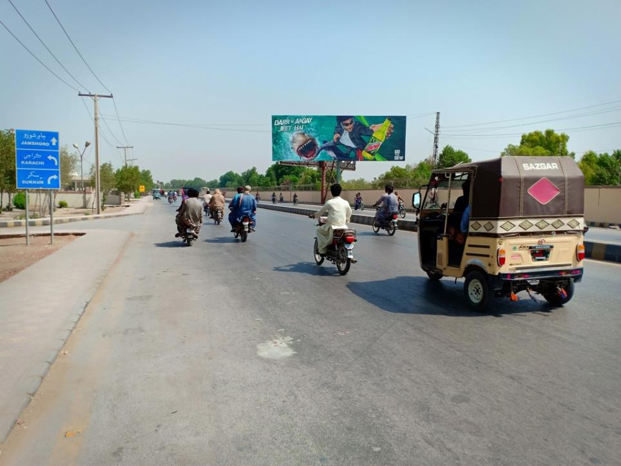
Hyderabad
Size | 60x20
Availability | Available
Rate P/M | Rs: 495,000/=
Location | Direction
Hyderabad | FTCF: Opp: Qasam Banquet Qasam Chowk City TFG Qasam Chowk, Jamshoro & Karachi

Slide 9
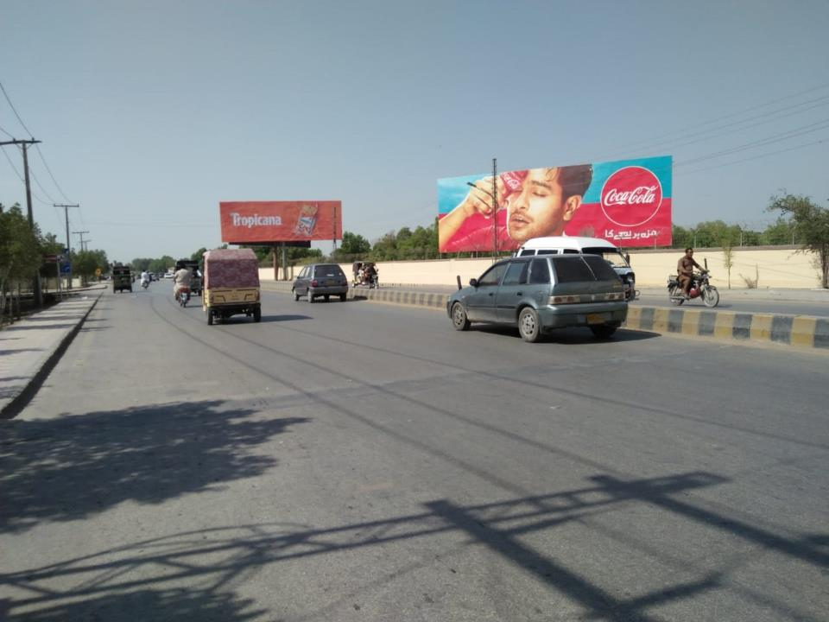
Hyderabad
Size | 60x20
Availability | Available
Rate P/M | Rs: 495,000/=
Location | Direction
Hyderabad | FTCF: Opp: Qasam Banquet Qasam Chowk City TFG Qasam Chowk, Jamshoro & Karachi

Slide 10
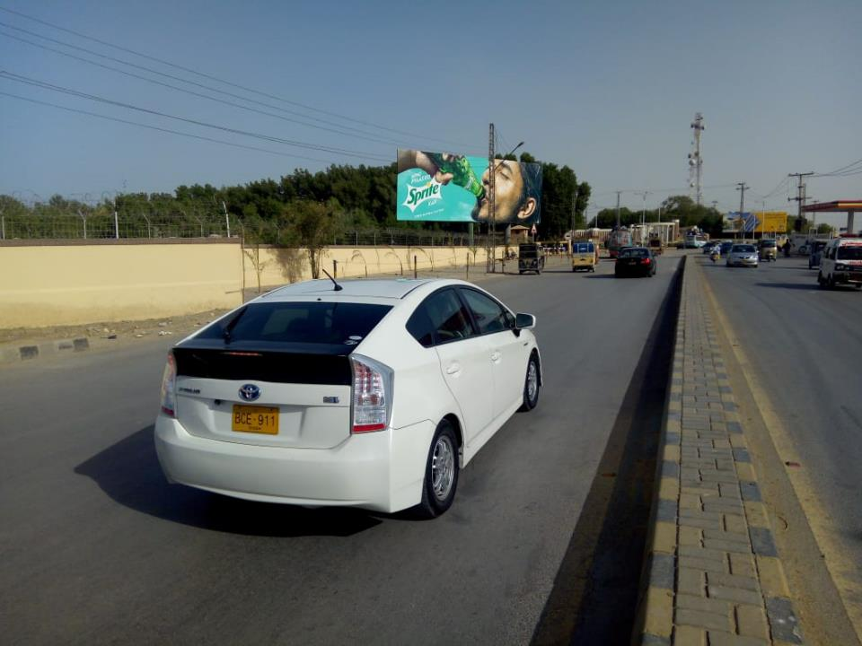
Hyderabad
Size | 60x20
Availability | Available
Rate P/M | Rs: 495,000/=
Location | Direction
Hyderabad | FTCF: Opp: Qasam Banquet Qasam Chowk, Karachi, Jamshoro & Rajputana TFG Qasam Chowk & City

Slide 11
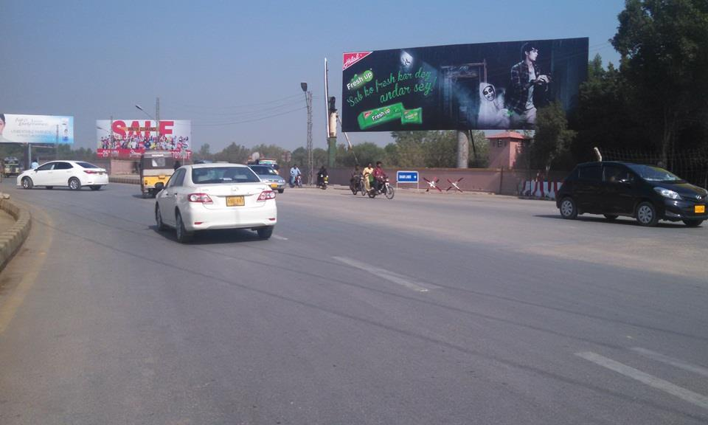
Hyderabad
Size | 60x20
Availability | Available
Rate P/M | Rs: 495,000/=
Location | Direction
Hyderabad | FTCF: Shami Line Qasam ChowkTFC City TFG Qasam Chowk, Jamshoro & Karachi

Slide 12
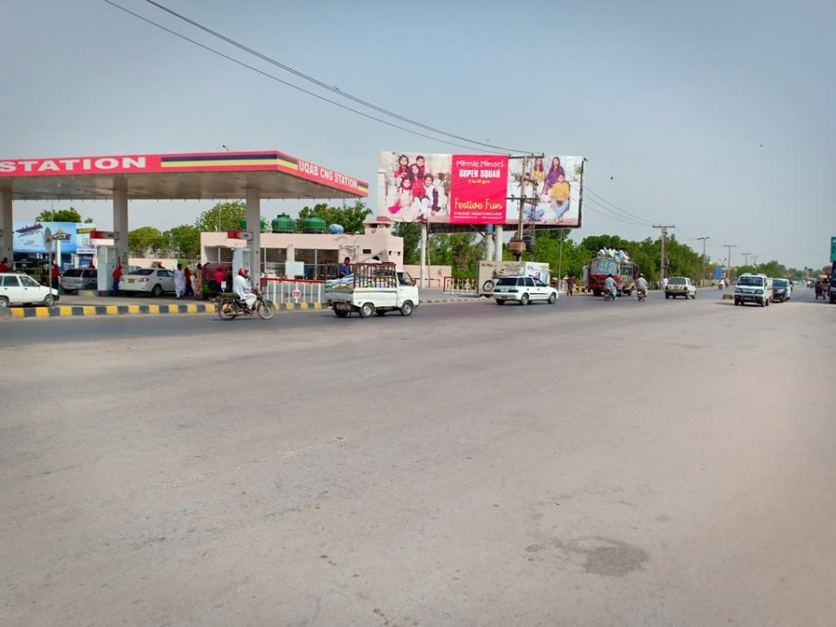
Hyderabad
Size | 60x20
Availability | 9/7/2019
Rate P/M | Rs: 495,000/=
Location | Direction
Hyderabad | FTCF: Near Askari Cng Qasam Chowk City TFG Qasam Chowk

Slide 13
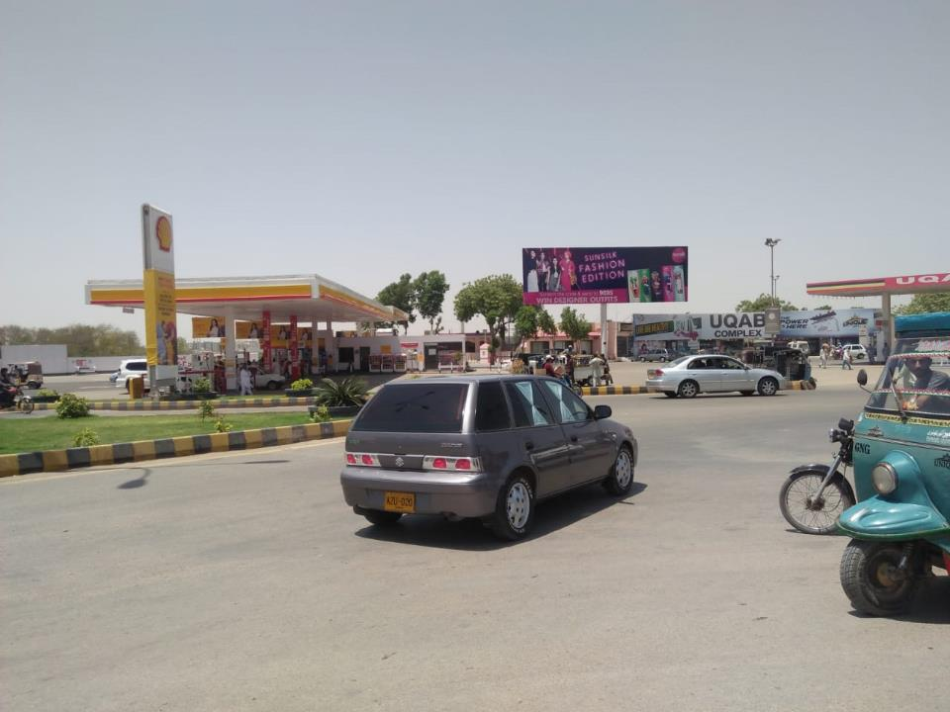
Hyderabad
Size | 60x20
Availability | Hold
Rate P/M | Rs: 495,000/=
Location | Direction
Hyderabad | FTCF: Near Near Aksari Mart Qasam Chowk C.M.H,City Gate & Vaduhwa TFG Qasam Chowk

Slide 14
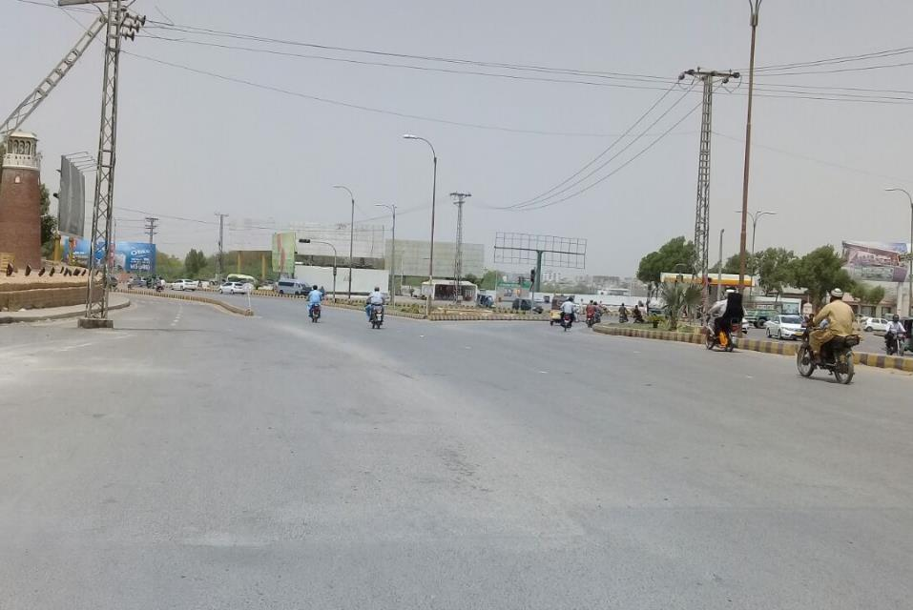
Hyderabad
Size | 60x20
Availability | Available
Rate P/M | Rs: 495,000/=
Location | Direction
Hyderabad | FTCF: Near Shell Pump Qasam Chowk C.M.H,City Gate & Vaduhwa TFG Qasam Chowk

Slide 15
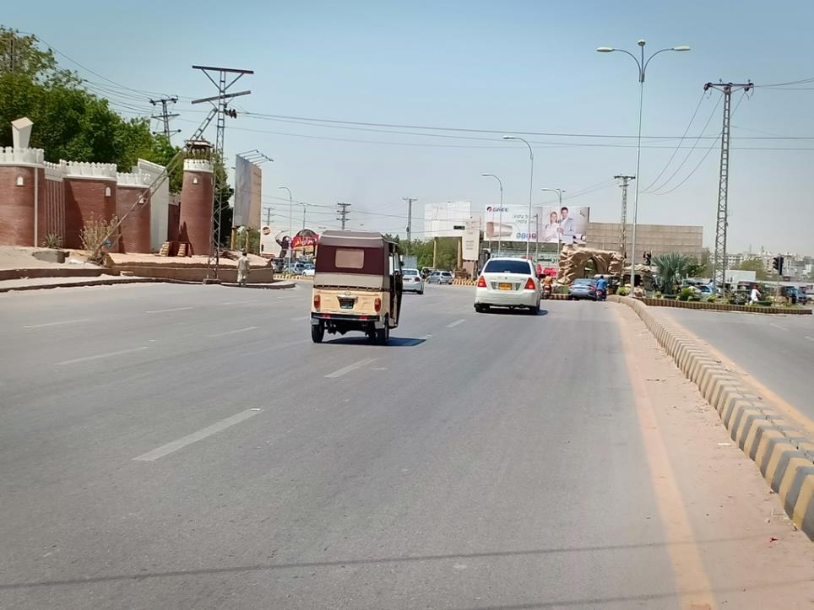
Hyderabad
Size | 60x20
Availability | Available
Rate P/M | Rs: 495,000/=
Location | Direction
Hyderabad | FTCF: Near Shell Pump Qasam Chowk C.M.H,City Gate & Vaduhwa TFG Qasam Chowk

Slide 16
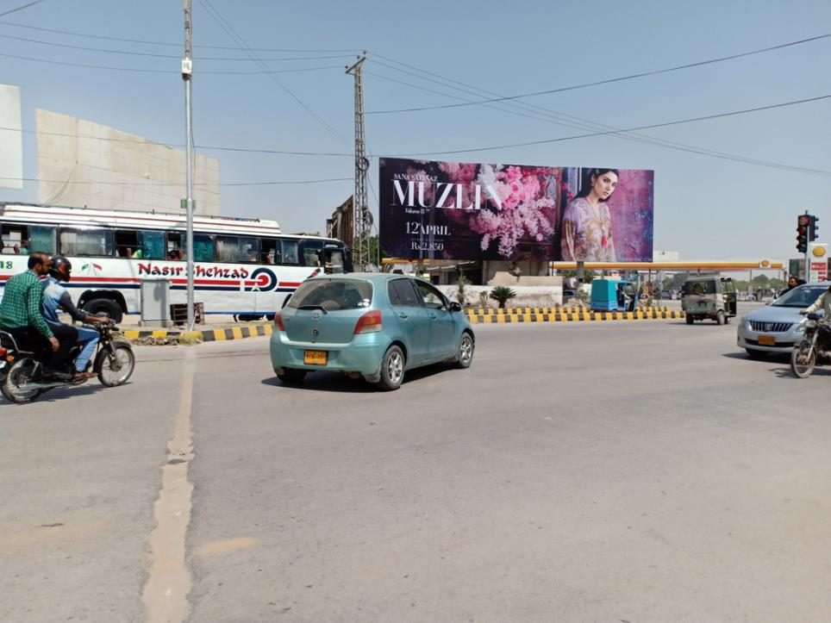
Hyderabad
Size | 60x20
Availability | Hold
Rate P/M | Rs: 495,000/=
Location | Direction
Hyderabad | FTCF: Qasam Chowk C.M.H,City Gate & Vaduhwa TFG Qasam Chowk

Slide 17
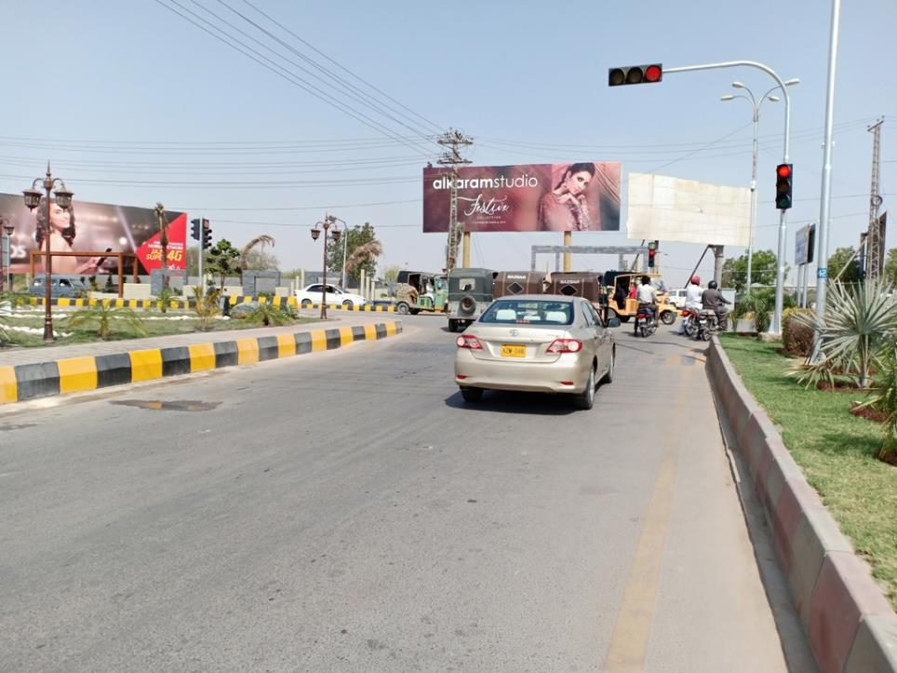
Hyderabad
Size | 60x20
Availability | 17/6/2019
Rate P/M | Rs: 495,000/=
Location | Direction
Hyderabad | FTCF: Qasam Chowk C.M.H,City Gate & Vaduhwa TFG Qasam Chowk

Slide 18
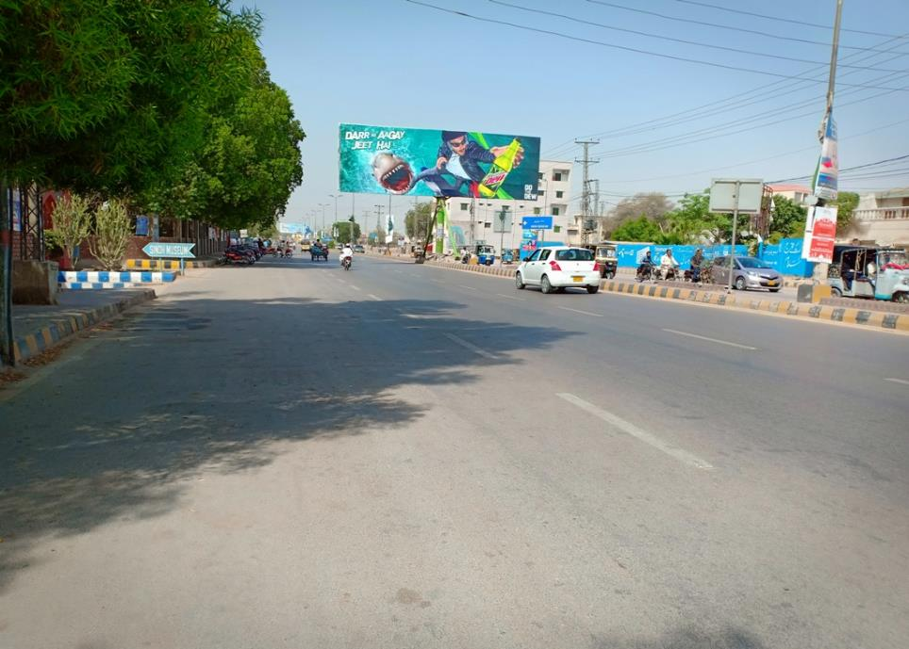
Hyderabad
Size | 45x15
Availability | Available
Rate P/M | Rs: 225,000/=
Location | Direction
Hyderabad | FTCF: Eidgha Centre Belt Qasam Chowk TFG Auto Bhan Road

Slide 19
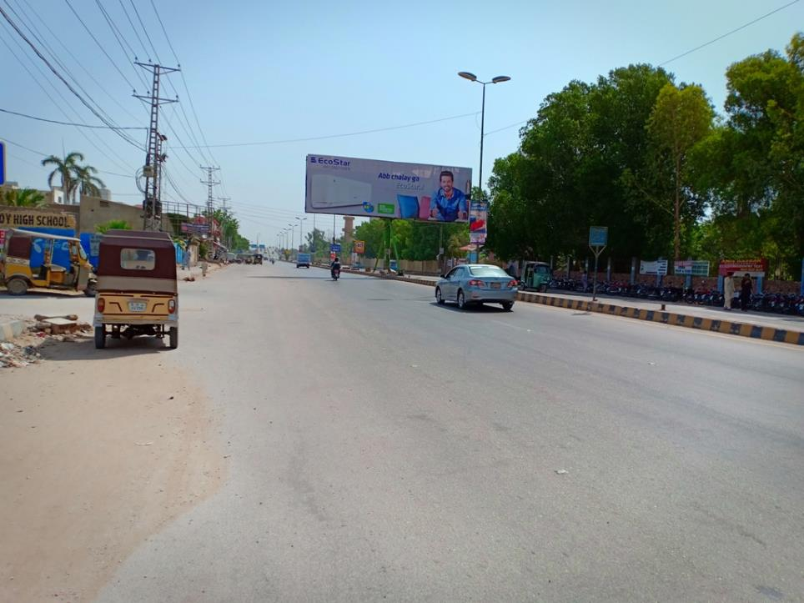
Hyderabad
Size | 45x15
Availability | Available
Rate P/M | Rs: 225,000/=
Location | Direction
Hyderabad | FTCF: Eidgha Centre Belt Auto Bhan Road TFG Qasam Chowk

Slide 20
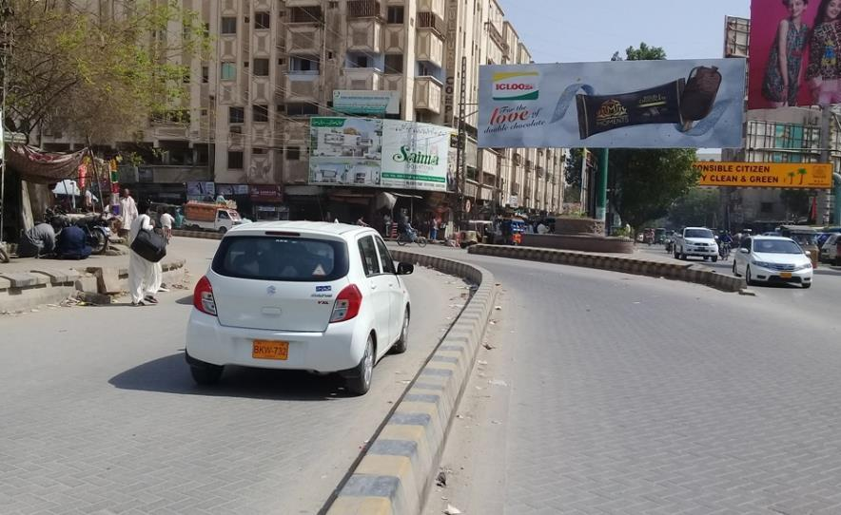
Hyderabad
Size | 45x15
Availability | 15 /12/2019
Rate P/M | Rs: 225,000
Location | Direction
Hyderabad | FTCF: Agriculture Complex Main Giddu Chowk Auto Ban TFG Thandi Sarak

Slide 21
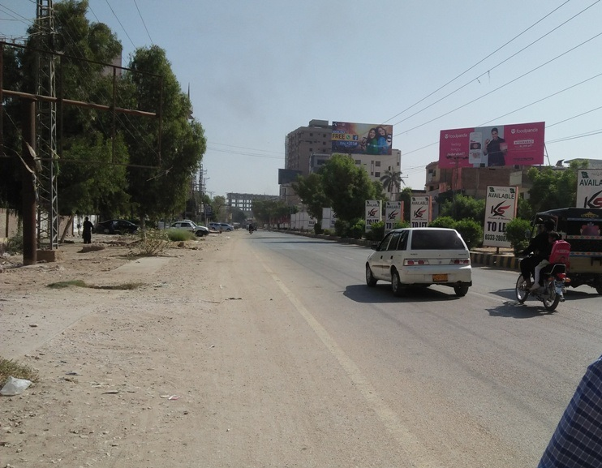
Hyderabad
Size | 60x30
Availability | Available
Rate P/M | Rs: 350,000/=
Location | Direction
Hyderabad | FTCF: Opp : Lal Qila Resturant Main Auto Bhan Road Thandi Sarak & Giddu Chowk TFG Latifabad

Slide 22
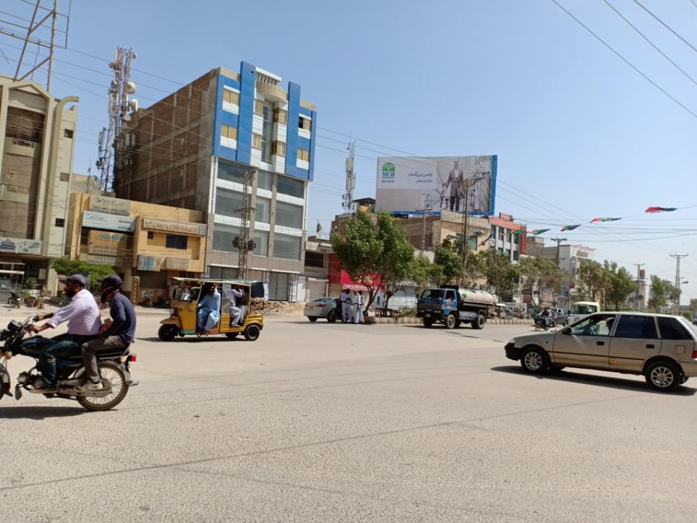
Hyderabad
Size | 60x30
Availability | Available
Rate P/M | Rs: 300,000/=
Location | Direction
Hyderabad | FTCF: Opp : Mehmood Garden Main Auto Bhan Road Auto Bhan & Giddu Chowk TFG Latifabad TFC Latifabad TFG Auto Bhan & Giddu Chowk

Slide 23
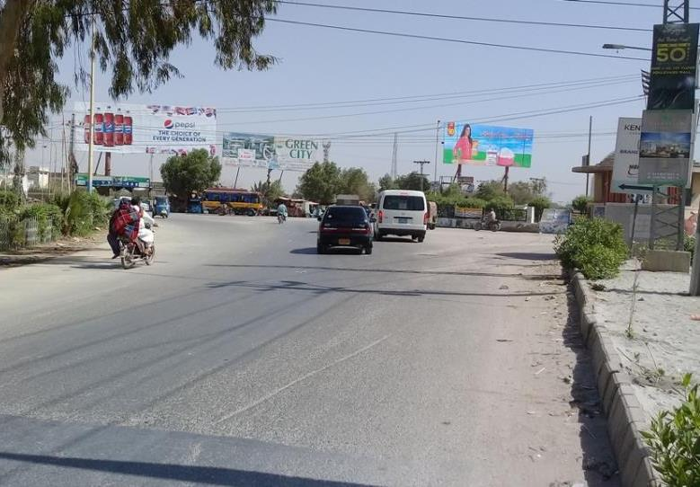
Hyderabad
Size | 60x20
Availability | Available
Rate P/M | Rs: 300,000/=
Location | Direction
Hyderabad | FTCF: Fateh Chowk Auto Bhan, Latifabad & Boulevard Mall TFG Fateh Chowk

Slide 24
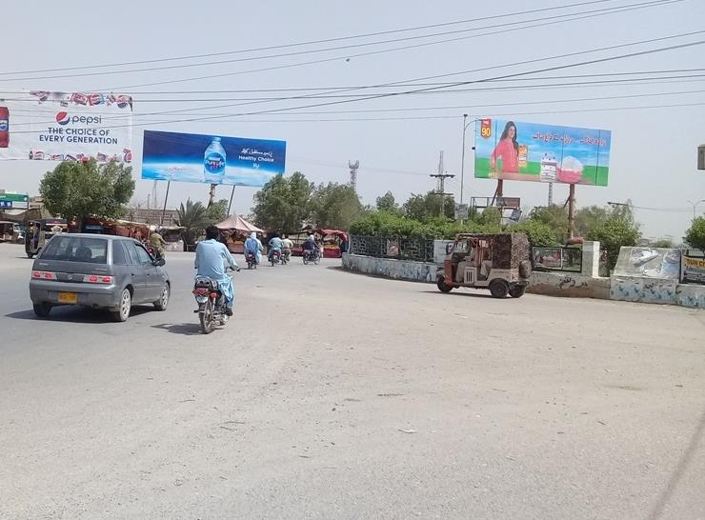
Hyderabad
Size | 45x15
Availability | Available
Rate P/M | Rs: 225,000/=
Location | Direction
Hyderabad | FTCF: Fateh Chowk Auto Bhan, Latifabad & Boulevard Mall TFG Fateh Chowk

Slide 25
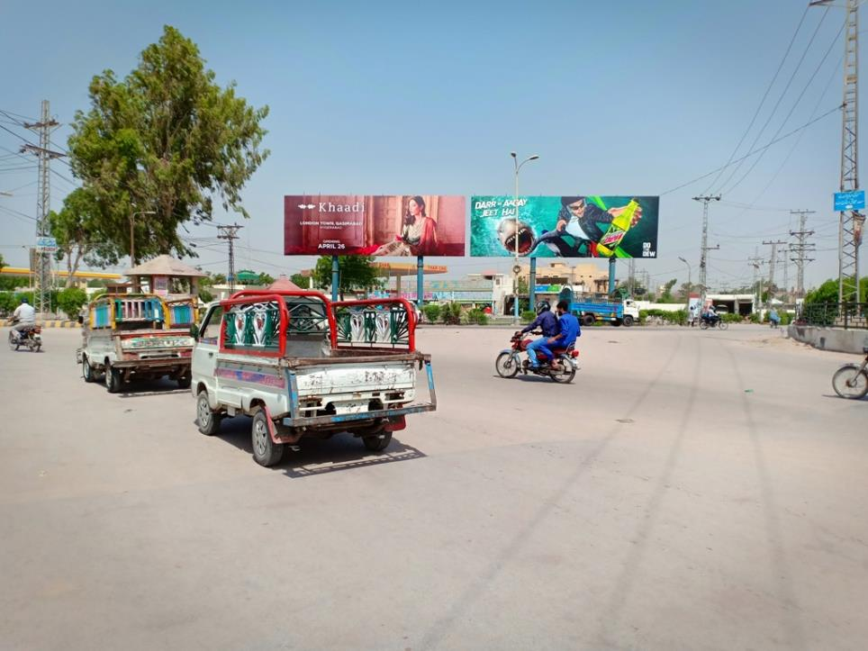
Hyderabad
Size | 60x20
Availability | Hold
Rate P/M | Rs: 350,000/=
Location | Direction
Hyderabad | FTCF: Fateh Chowk Fateh Chowk TFG Boulevard Mall & Latifabad

Slide 26
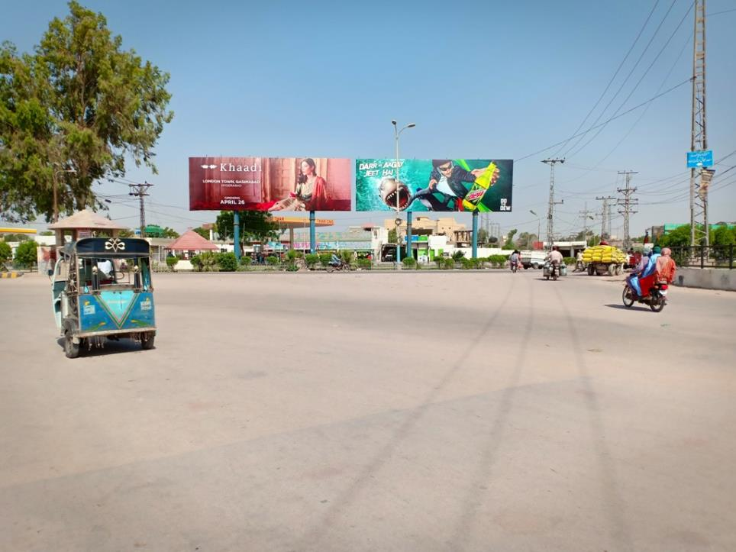
Hyderabad
Size | 60x20
Availability | Available
Rate P/M | Rs: 350,000/=
Location | Direction
Hyderabad | FTCF: Fateh Chowk Fateh Chowk TFG Boulevard Mall & Latifabad

Slide 27
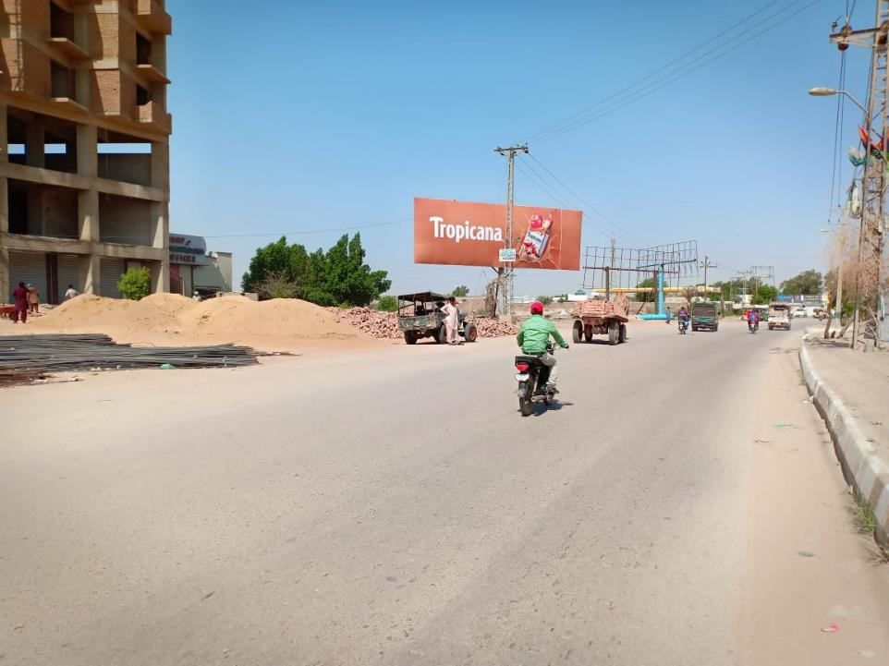
Hyderabad
Size | 60x20
Availability | Available
Rate P/M | Rs: 300,000/=
Location | Direction
Hyderabad | FTCF: Near Boulevard Mall Auto Bhan Road Fateh Chowk Fateh Chowk TFG Auto Bhan & Latifabad

Slide 28
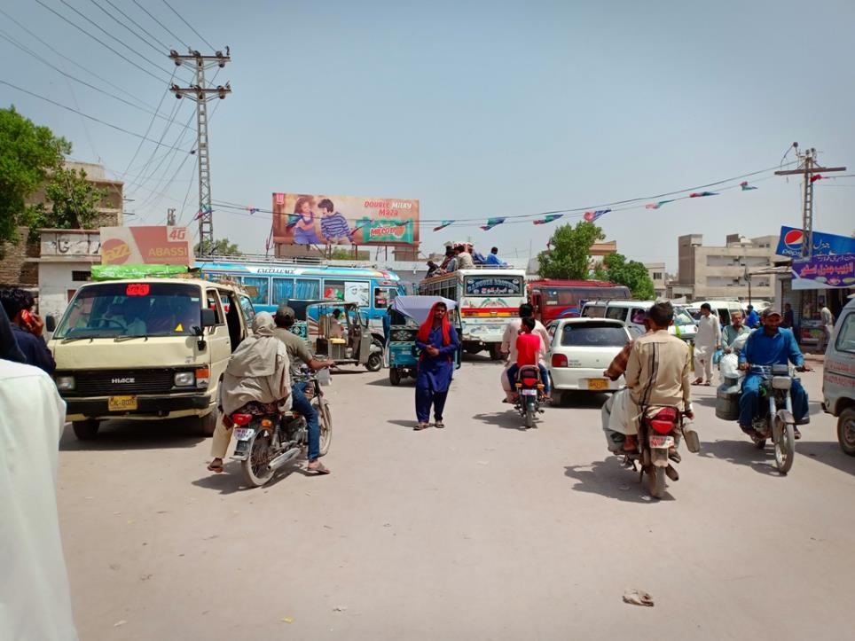
Hyderabad
Size | 60x20
Availability | Available
Rate P/M | Rs: 300,000/=
Location | Direction
Hyderabad | FTCF: Badin Stop Fateh Chowk TFG Badin Stop & City

Slide 29
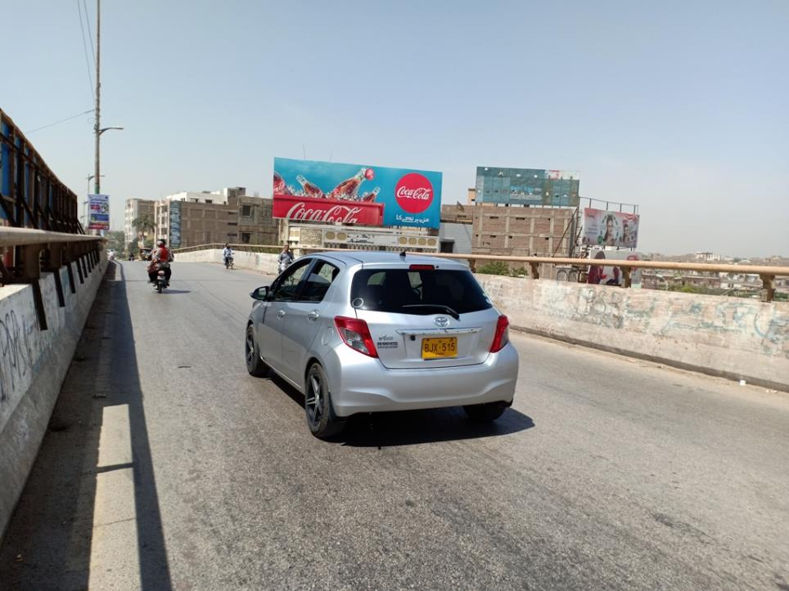
Hyderabad
Size | 60x21
Availability | Available
Rate P/M | Rs: 300,000/=
Location | Direction
Hyderabad | FTCF: Roof of Bus Terminal Latifabad No.7 Hill Top TFG Latifabad Fly over

Slide 30
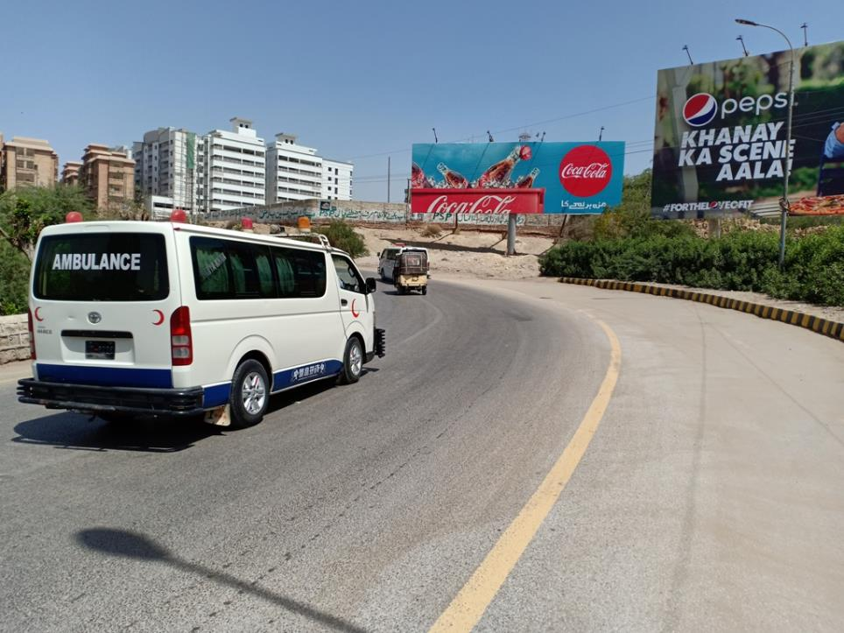
Hyderabad
Size | 60x20
Availability | Available
Rate P/M | Rs: 400,000/= With Lights
Location | Direction
Hyderabad | FTCF: Hill Top Chari Latifabad TFG Gymkhana

Slide 31
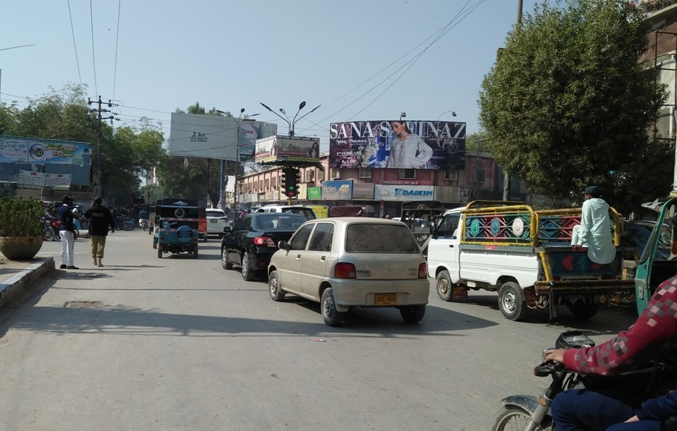
Hyderabad
Size | 45x15
Availability | 18/7/2019
Rate P/M | Rs: 300,000/=
Location | Direction
Hyderabad | FTCF: Gull Centre Gymkhana Chowk Latifabad & Hyder Chowk TFG Gymkhana & Thandi Sarak.

Slide 32
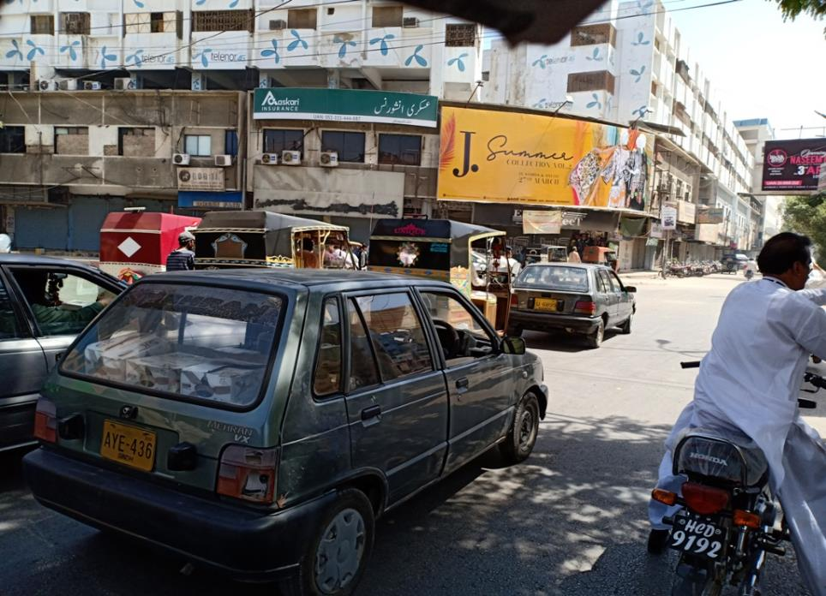
Hyderabad
Size | 45x15
Availability | 26/7/2019
Rate P/M | Rs: 300,000/=
Location | Direction
Hyderabad | FTCF: Gull Centre Gymkhana Chowk Latifabad & Thandi Sark TFG Gymkhana & Hyder Chowk

Slide 33
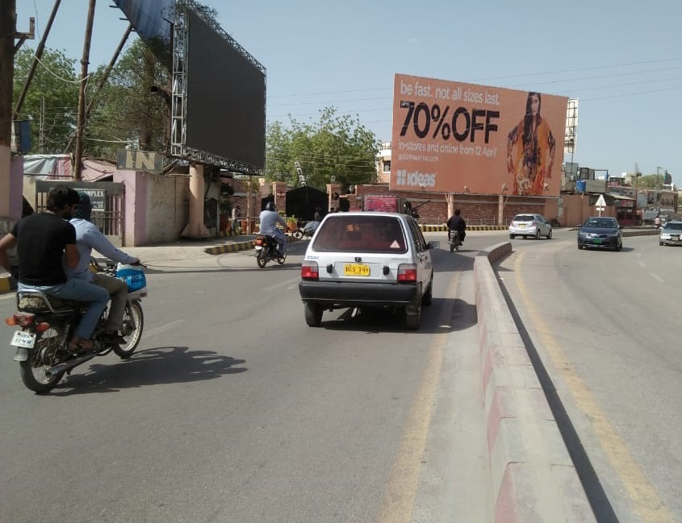
Hyderabad
Size | 60x30
Availability | 01 Aug -2019 Hold
Rate P/M | Rs: 1 Million With Light
Location | Direction
Hyderabad | FTCF: Station Head Quarter Gymkhana TFG Chandni Market

Slide 34
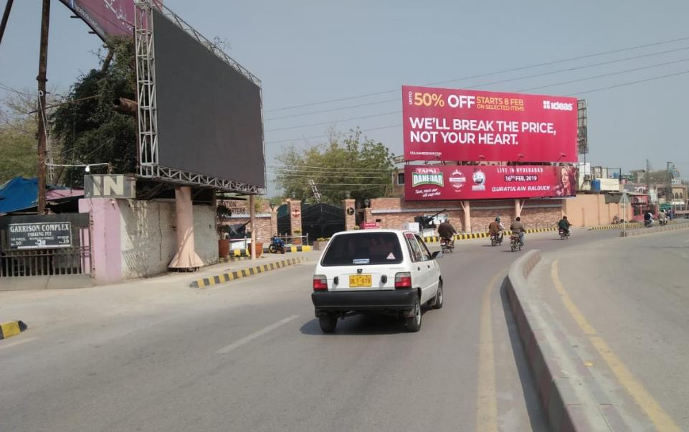
Hyderabad
Size | 60x10
Availability | Available
Rate P/M | Rs: 300,000 With Light
Location | Direction
Hyderabad | FTCF: Station Head Quarter Gymkhana TFG Chandni

Slide 35
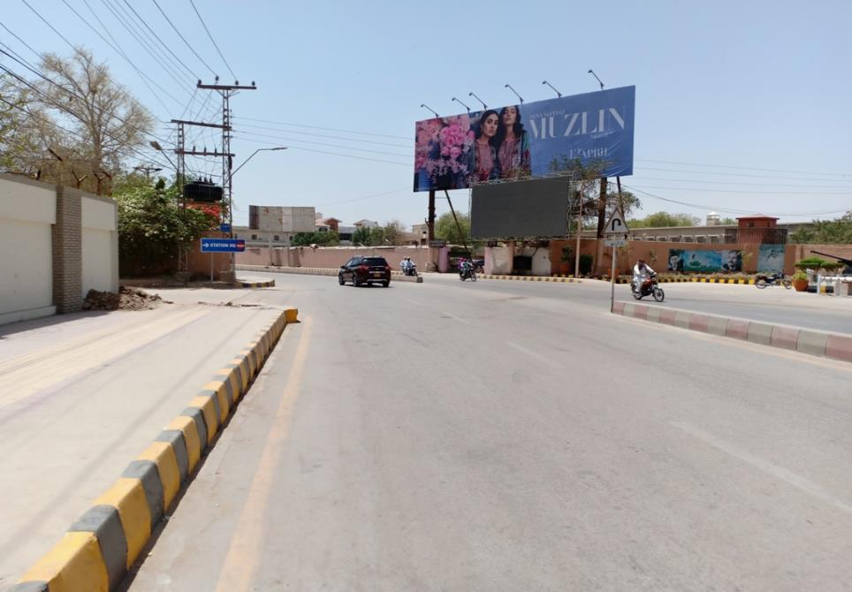
Hyderabad
Size | 60x20
Availability | Available
Rate P/M | Rs: 650,000
Location | Direction
Hyderabad | FTCF: Station Head Quarter Chandni TFG Gymkhana

Slide 36
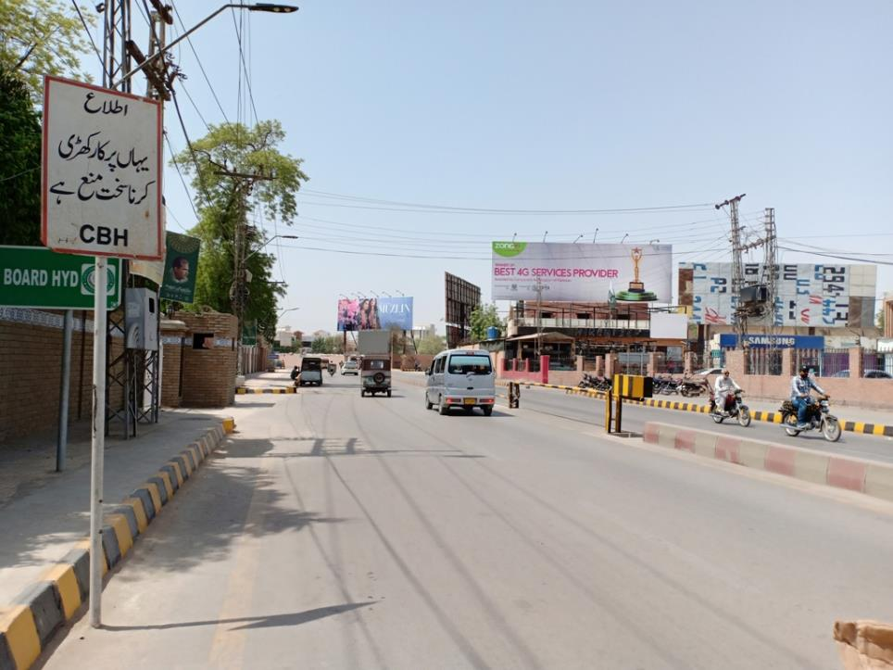
Hyderabad
Size | 60x20
Availability | 1-Jan-20 + Hold
Rate P/M | Rs: 650,000 Whit Lights
Location | Direction
Hyderabad | FTCF: Garrison Bakery Chandni TFG Gymkhana

Slide 37
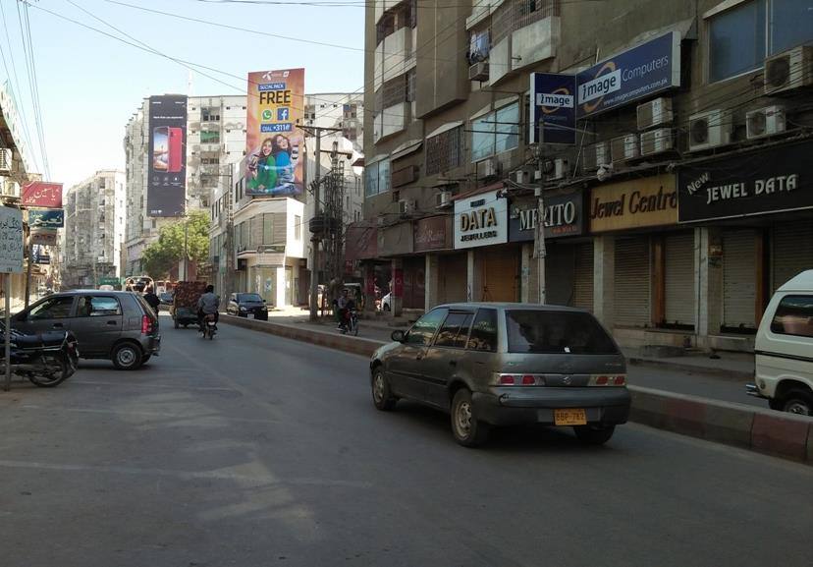
Hyderabad
Size | 15x30
Availability | Available
Rate P/M | Rs: 250,000
Location | Direction
Hyderabad | FTCF: Chandni Mobile Market Gymkhana TFG Chandni

Slide 38
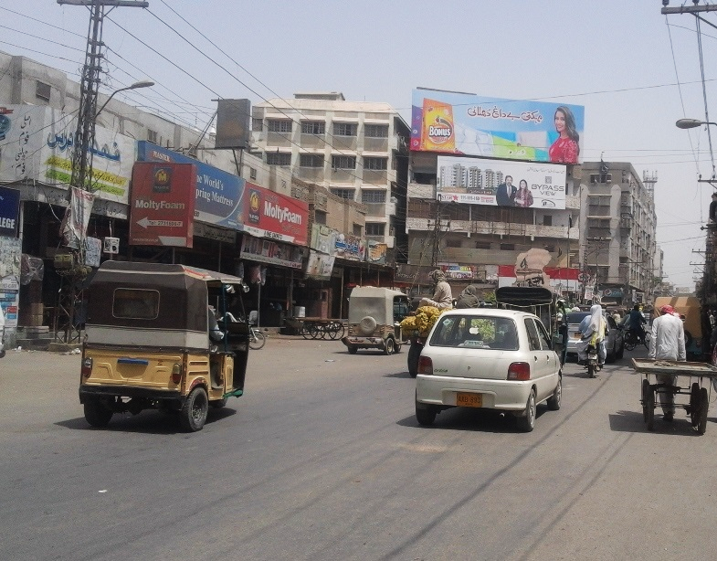
Hyderabad
Size | 60x20
Availability | Hold
Rate P/M | Rs: 380,000
Location | Direction
Hyderabad | FTCF: Roof Top Hotel Ritz Near Hyder Chowk Hyder Chowk TFG Saddar

Slide 39
Hyderabad
Size | 45x15
Availability | Available
Rate P/M | Rs: 190,000
Location | Direction
Hyderabad | FTCF: Roof Top Hotel Ritz Near Hyder Chowk Hyder Chowk TFG Saddar

Slide 40
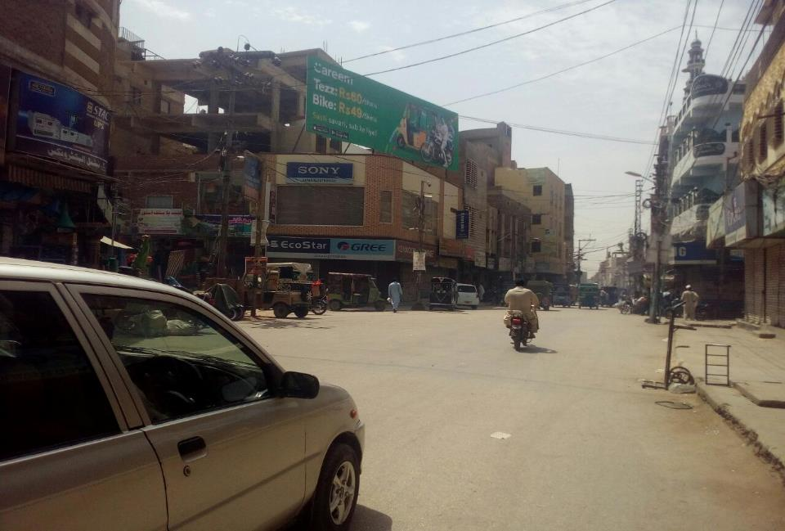
Hyderabad
Size | 45x15
Availability | 05-Jul-19
Rate P/M | Rs: 175,000
Location | Direction
Hyderabad | FTCF: Saddar Electronic Market Market & Electronic Market TFG Resham Bazar & Kohinoor Chowk

Slide 41
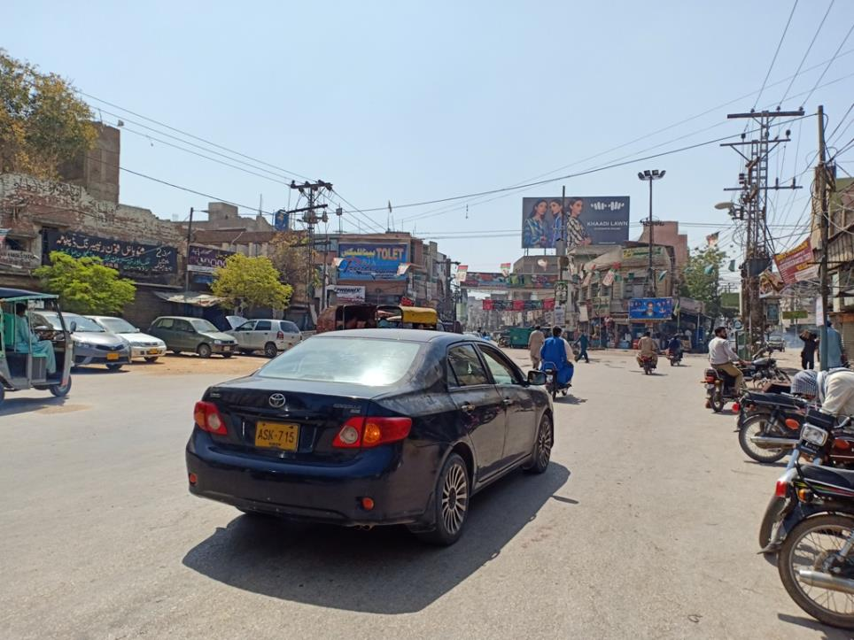
Hyderabad
Size | 60x30
Availability | Hold
Rate P/M | Rs: 400,000
Location | Direction
Hyderabad | FTCF: Near Resham Bazar Kohinoor Chowk Tilak In Line & Electronic Market TFG Resham Bazar & Kohinoor Chowk

Slide 42
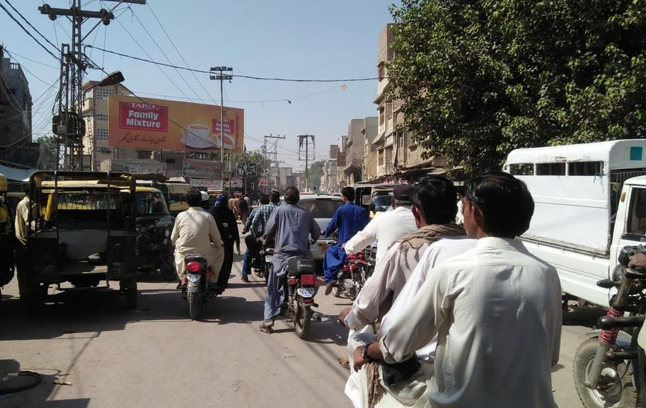
Hyderabad
Size | 45x15
Availability | 15-Dec-19
Rate P/M | Rs: 175,000
Location | Direction
Hyderabad | FTCF: Phuleli Tanga Stand Phuleli TFG City

Slide 43
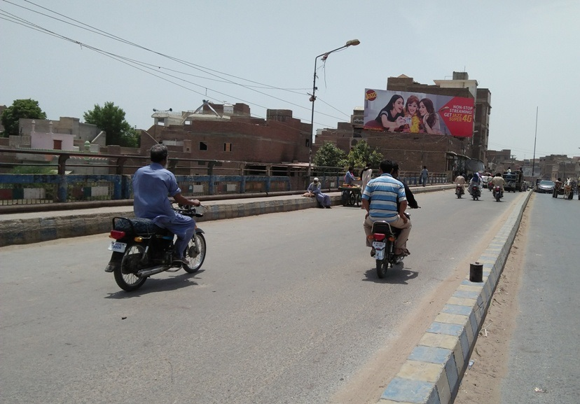
Hyderabad
Size | 45x15
Availability | 10-Dec-19
Rate P/M | Rs: 175,000
Location | Direction
Hyderabad | FTCF: Phuleli Tanga Stand Phuleli TFG City

Slide 44
Larkana

Slide 45
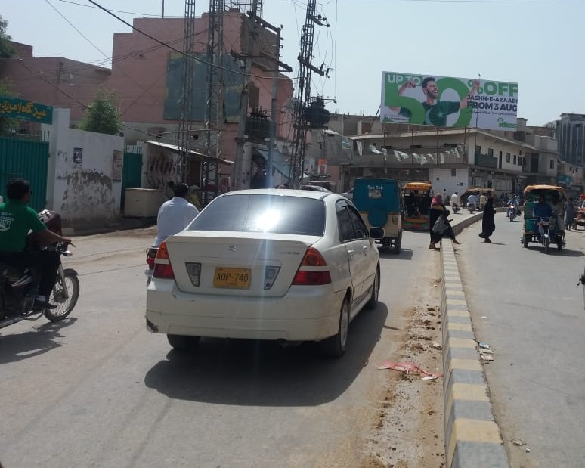
Larkana
Size | 45x15
Availability | Available
Rate P/M | Rs: 250,000
Location | Direction
Larkana | FTCF: Lahori Mohalla Royal Chowk TFG Station & Vip Flyover

Slide 46
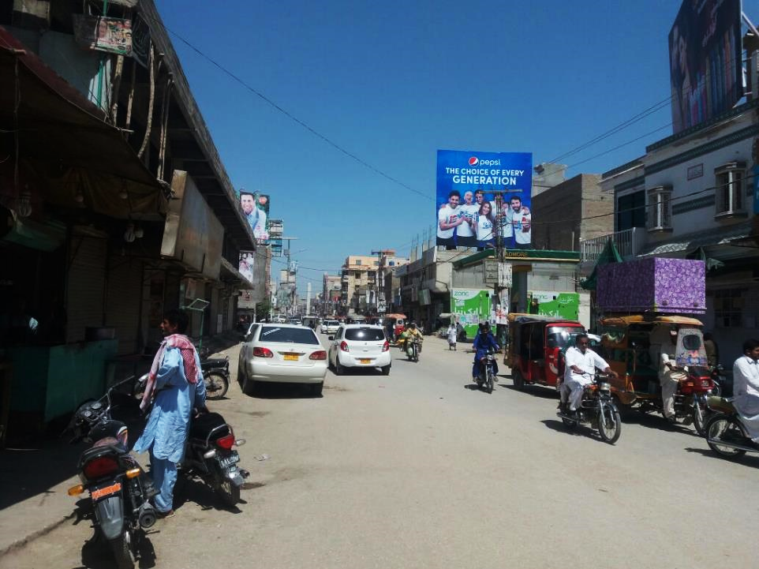
Larkana
Size | 30x30
Availability | Available
Rate P/M | Rs: 175,000
Location | Direction
Larkana | FTCF: Lahori Mohalla Royal Chowk TFG Station & Vip Flyover

Slide 47
Ad Solution
TERMS & CONDITIONS
First time skin installation and removing is free.
Skin printing charges are not included in the proposed rates.
These rates are exclusive of all kinds of taxes.
If skin is damaged due to weather, changing/re-printing charges will be borne by the client.
The payment will be made 50% in advance and the remaining balance will be payable through 15 days post dated cheque, from the day, the display starts.
For locking the sites please inform us within 1-3 working days.

