Slide 1
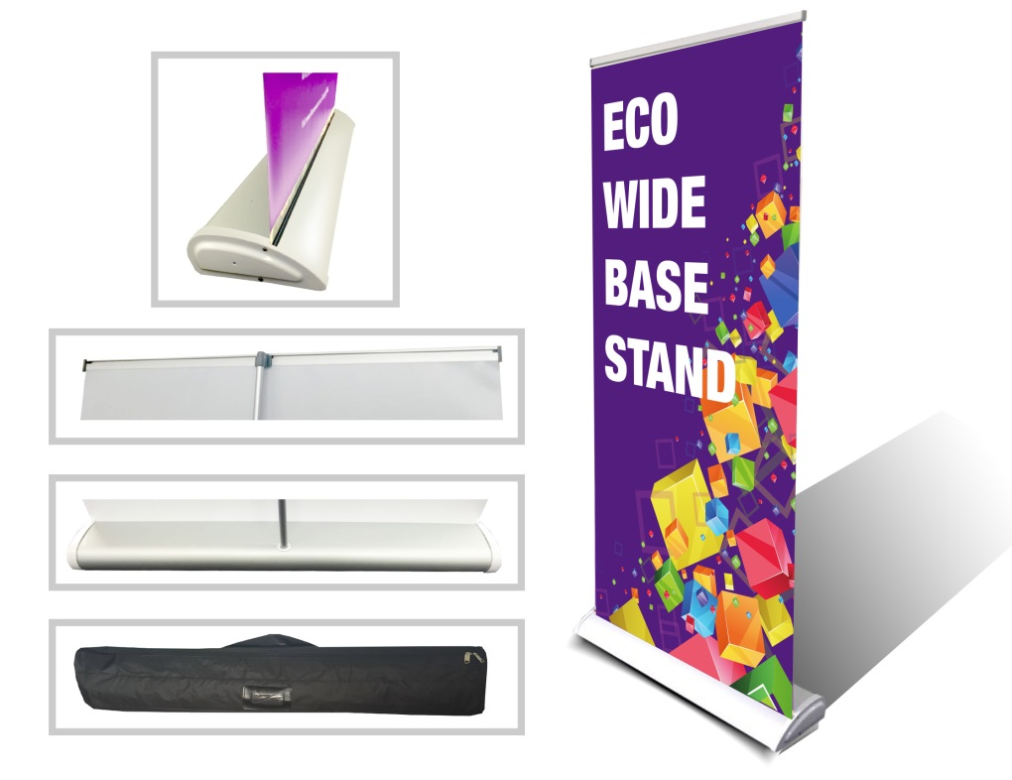
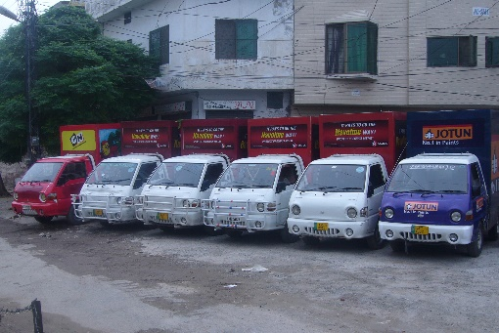
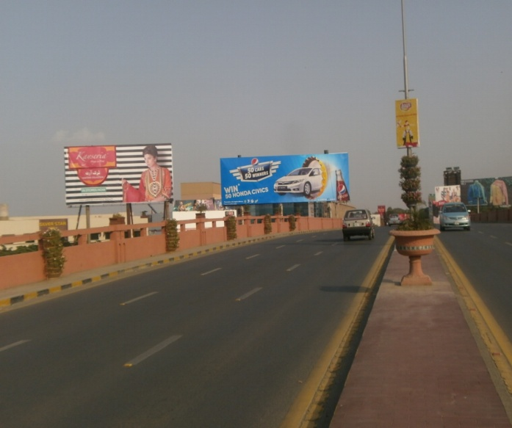
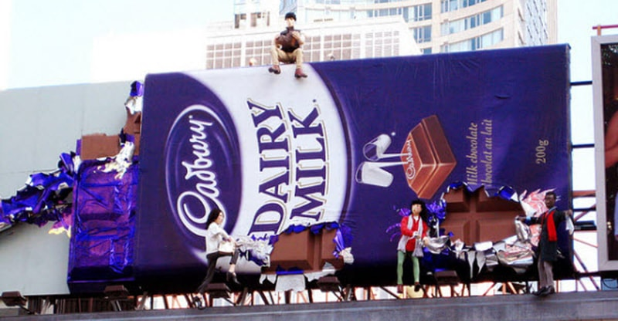
What we Do
Ad Solution
Advertising
Mobile Float
BTL Activities
Bill Boards/Hoardings
All Kinds of Pana Flex /Vinyl Printing
Offset Printing
X/Rollup Stand
Signage (New installation and Maintenance)

Slide 2
Ad Solution
Advertising
Proposal for
Larkana

Slide 3
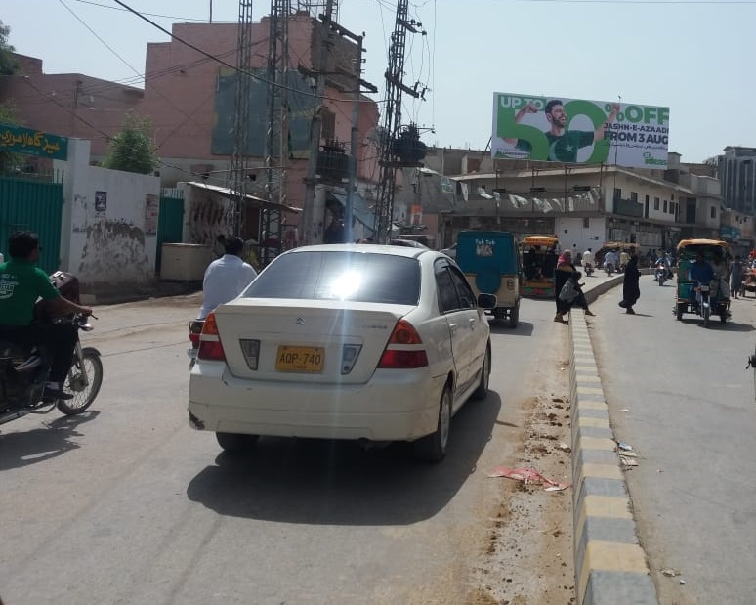
Larkana
Size | 45x15
Availability
Rate P/M | Rs: 250,000
Location | Direction
Larkana | FTCF: Lahori Mohalla Royal Chowk TFG Station & Vip Flyover

Slide 4
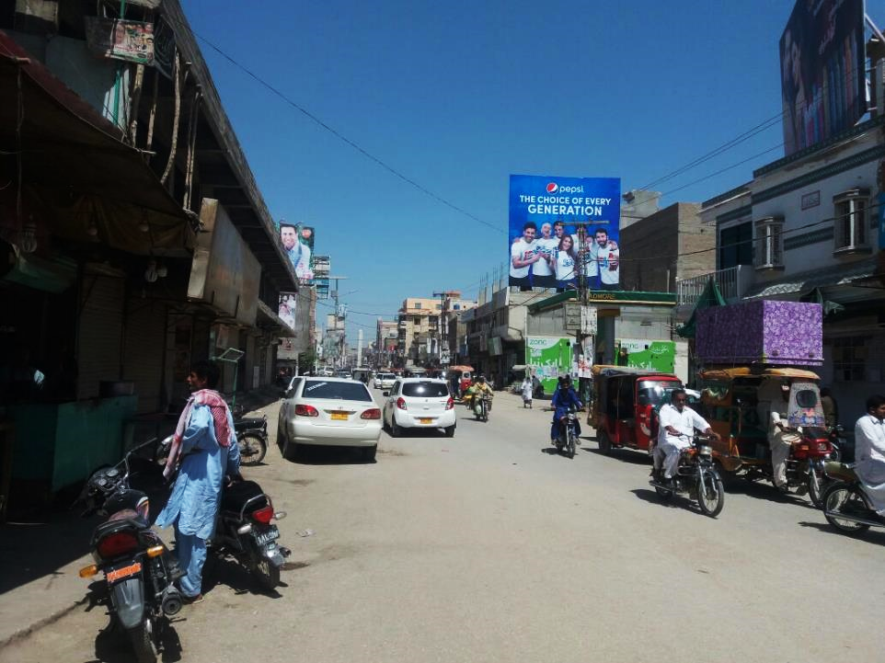
Larkana
Size | 30x30
Availability
Rate P/M | Rs: 175,000
Location | Direction
Larkana | FTCF: Lahori Mohalla Royal Chowk TFG Station & Vip Flyover

Slide 5
Ad Solution
TERMS & CONDITIONS
First time skin installation and removing is free.
Skin printing charges are not included in the proposed rates.
These rates are exclusive of all kinds of taxes.
If skin is damaged due to weather, changing/re-printing charges will be borne by the client.
The payment will be made 50% in advance and the remaining balance will be payable through 15 days post dated cheque, from the day, the display starts.
For locking the sites please inform us within 1-3 working days.

