Slide 1
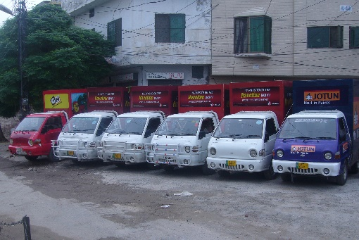
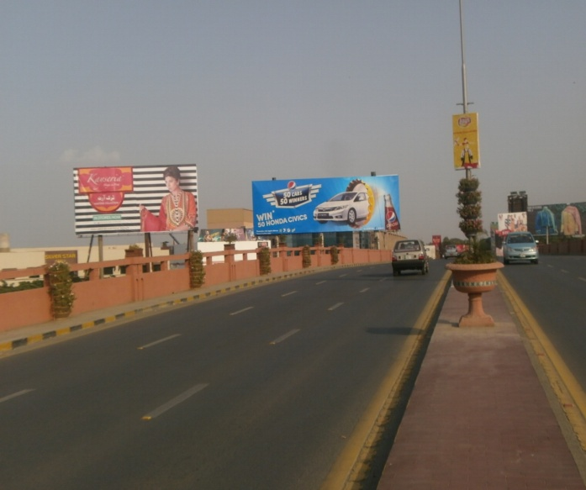
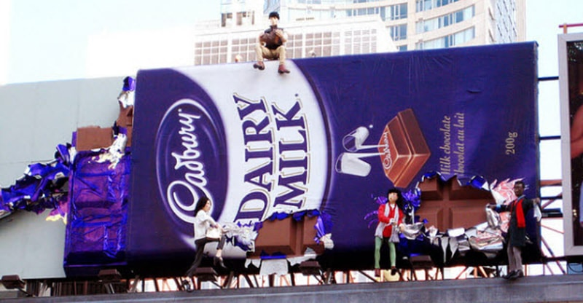
What we Do
Ad Solution
Advertising
Mobile Float
BTL Activities
Bill Boards/Hoardings
All Kinds of Pana Flex /Vinyl Printing
Offset Printing
X/Rollup Stand
Signage (New installation and Maintenance)

Slide 2
MIRPUR

Slide 3
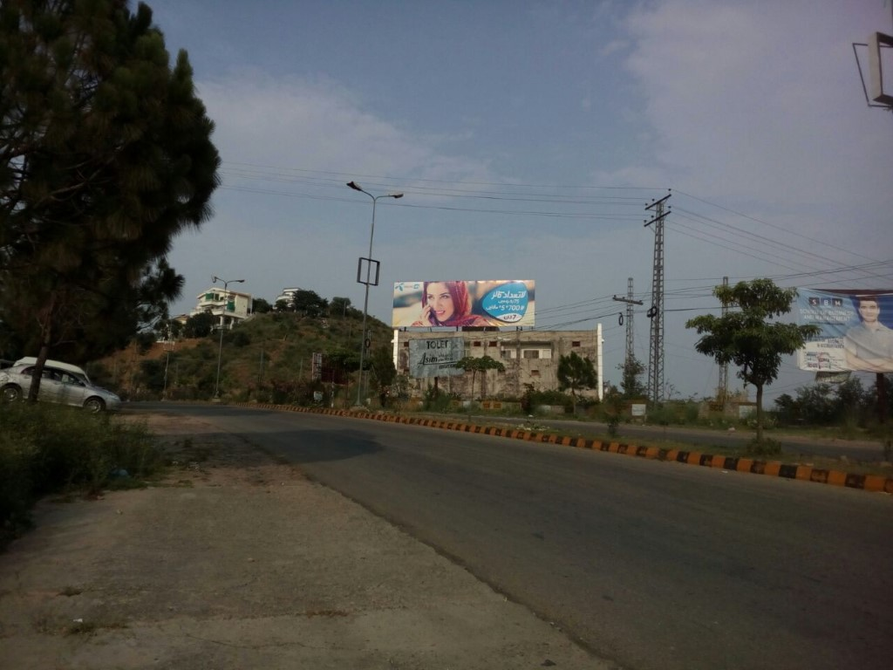
Mirpur
Size | 60x20
Availability
Rate P/M | Rs: 150,000
Location | Direction
Y Cross | FTCF: Mangla Towards Mairpur

Slide 4
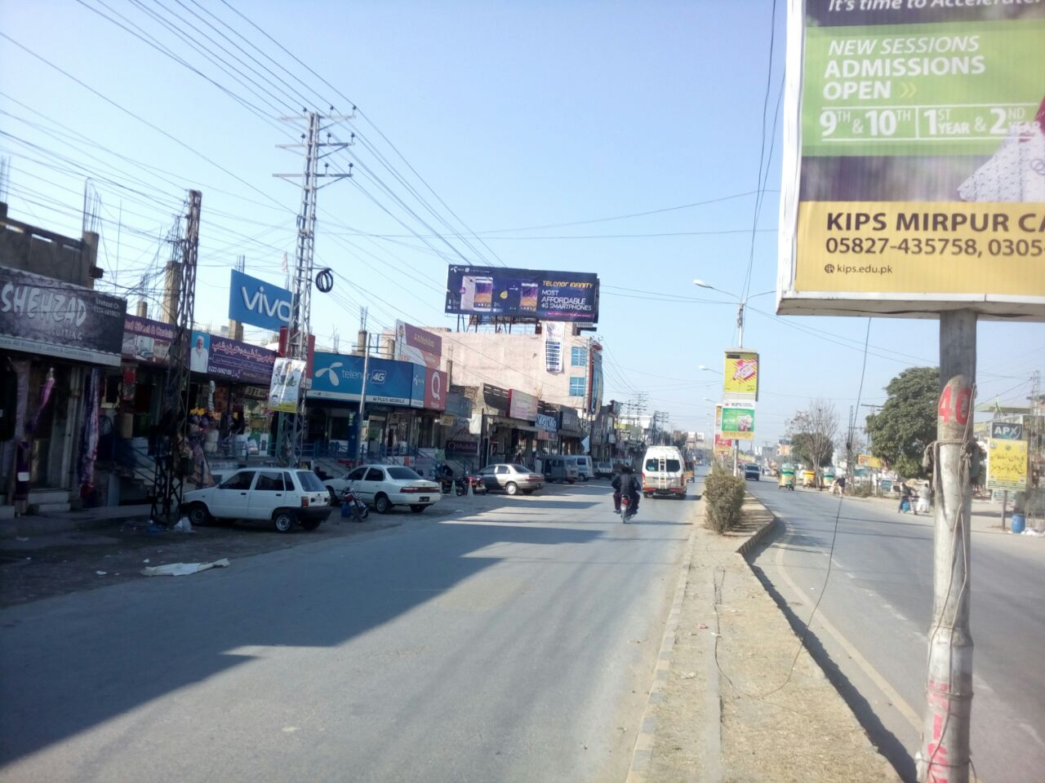
Mirpur
Size | 60x20
Availability
Rate P/M | Rs: 150,000
Location | Direction
Nangi Chowk Mirpur | FTCF: Chowk Shaheedan Near Nangi Chowk Towards Khalyal Chowk Mirpur

Slide 5
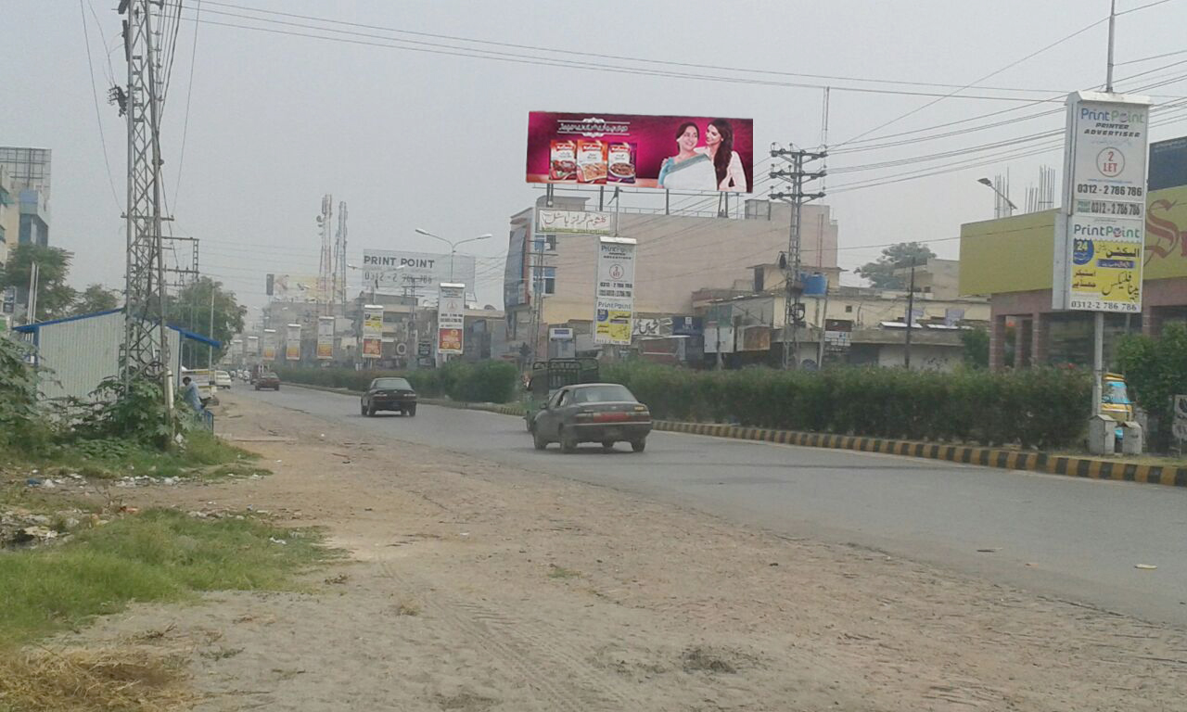
Mirpur
Size | 60x20
Availability
Rate P/M | Rs: 150,000
Location | Direction
Allama Iqbal Road | FTCF: Khalyal Chowk Towards Chowk Shaheedan Adjecant Select D Sane Mirpur

Slide 6
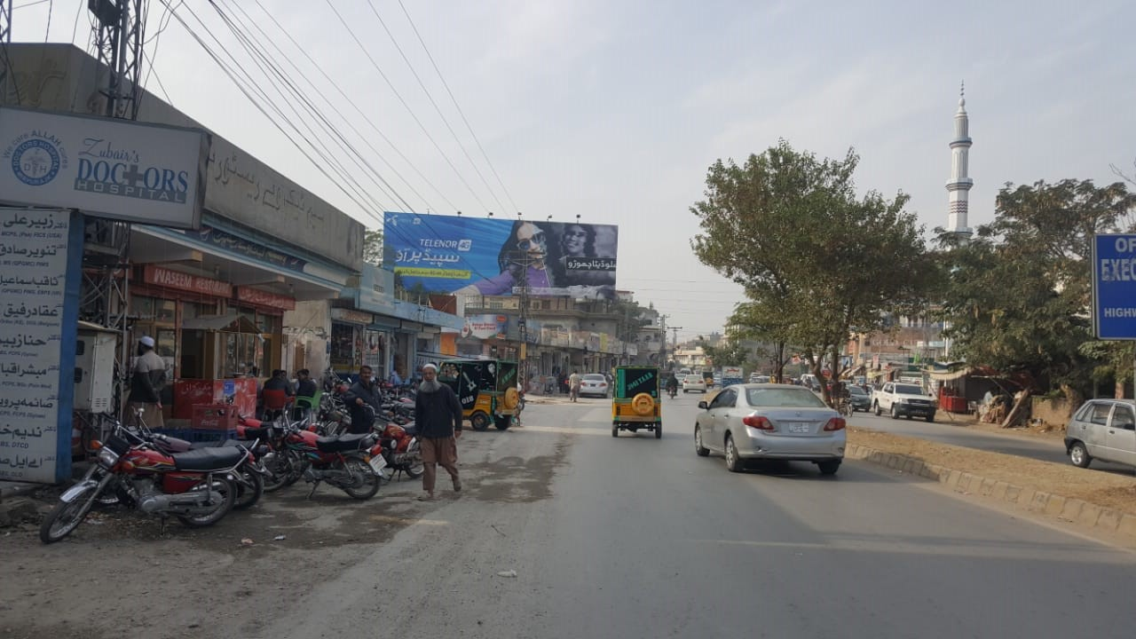
Mirpur
Size | 90x30
Availability
Rate P/M | Rs: 375,000
Location | Direction
Goal Mall Kotli Road Sector F1 Mairpur AJK | FTCF: Chowk Shahadeen Towards Mirpur Stadium ,Sector F1 Mirpur AK.

Slide 7
ChKSWARI

Slide 8
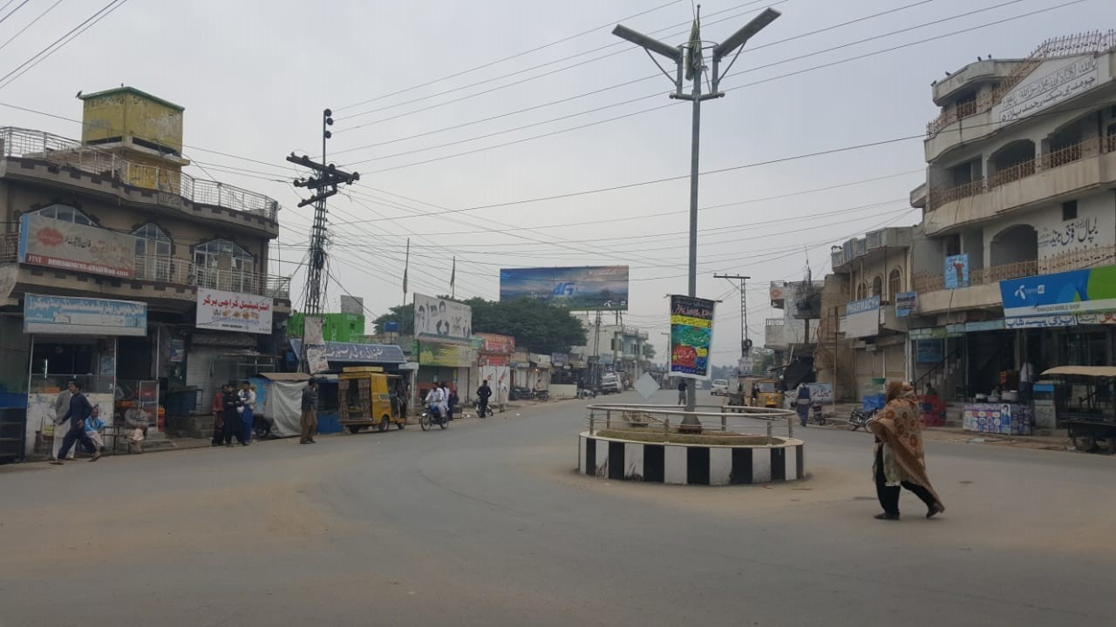
Chakswari
Size | 60x20
Availability
Rate P/M | Rs: 140,000
Location | Direction
Main Bazar Chakswari | FTCF: Kotli Towards Mairpur

Slide 9
ISLAM GHAR AJK

Slide 10
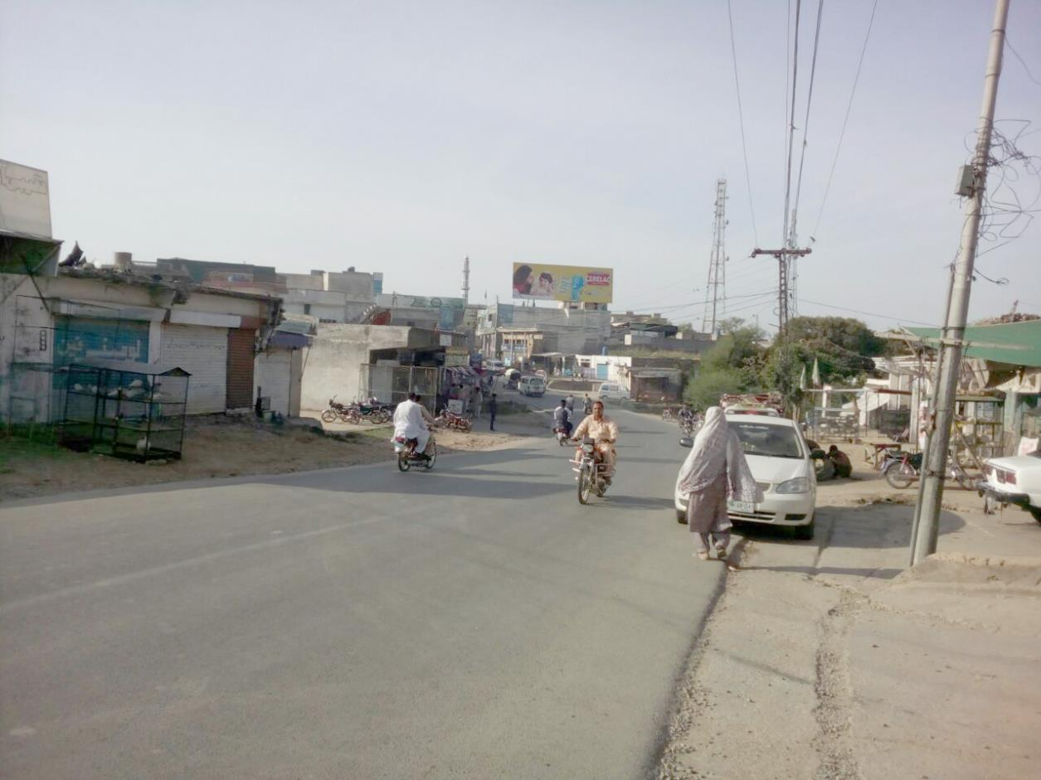
Islamghar AJK
Size | 60x20
Availability
Rate P/M | Rs: 150,000
Location | Direction
Islam Garh Mirpur AJK | FTCF: Chowk Shahadeen Towards Mirpur Stadium ,Sector Islam Gar Mirpur AK.

Slide 11
HARIPUR

Slide 12
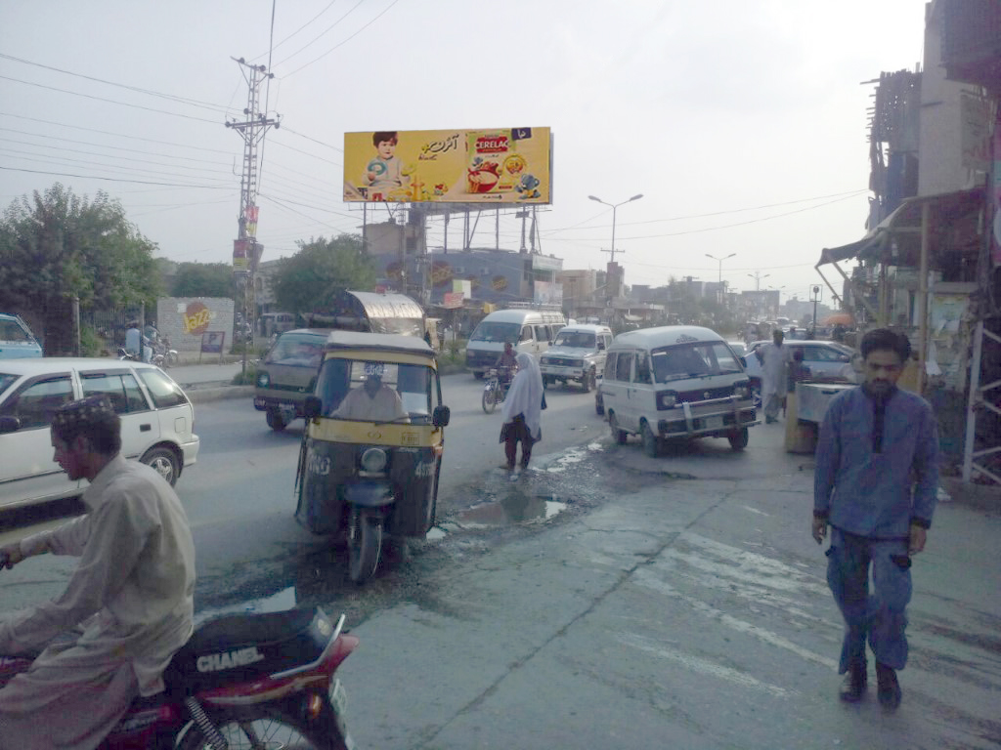
Haripur
Size | 60x20
Availability
Rate P/M | Rs: 150,000
Location | Direction
Rehana Plaza | FTCF: Abbottabad Towards Hassanabdaal, Wah cantt & Islamabad

Slide 13
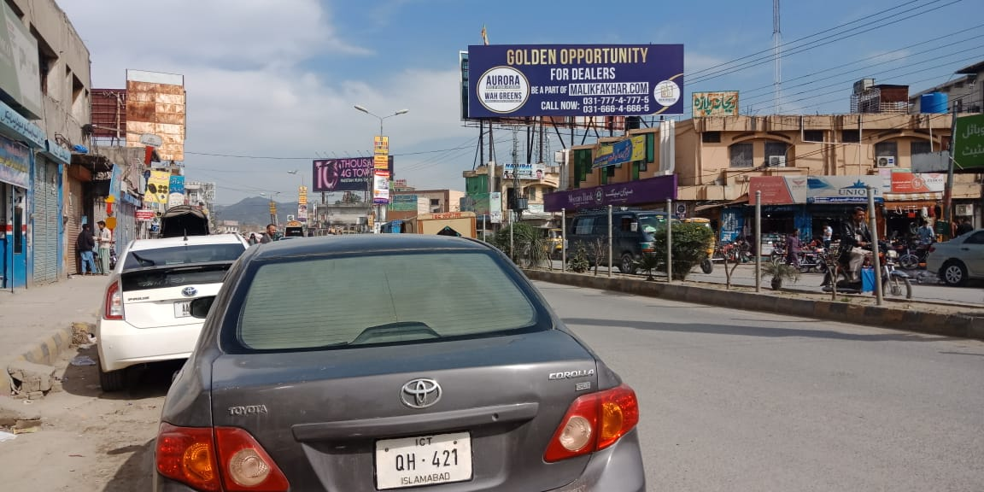
Haripur
Size | 60x20
Availability
Rate P/M | Rs: 150,000
Location | Direction
Rehana Plaza | FTCF: Islamabad, Wah Cantt & Hassanabdaal, Towards PSO Filling Station Abbottabad

Slide 14
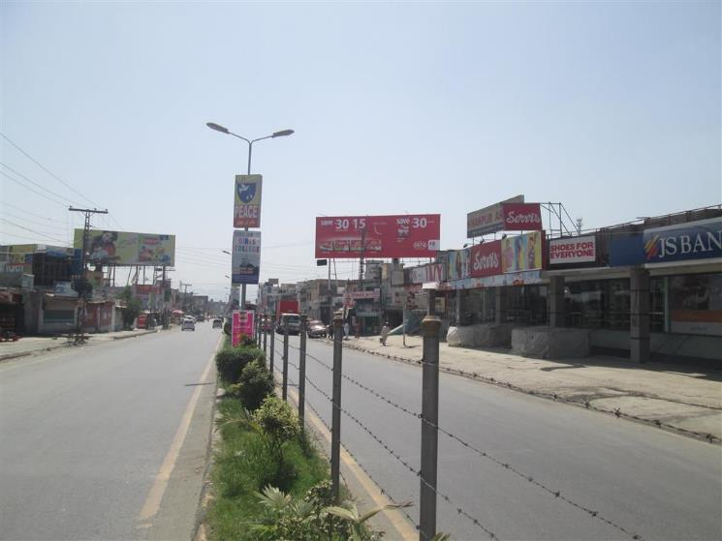
Haripur
Size | 60x20
Availability
Rate P/M | Rs: 150,000
Location | Direction
Al-Hamra Plaza | FTCF: Abbottabad, PSO Filling Station Towards Hassanabdaal, Wah Cantt & Islamabad

Slide 15
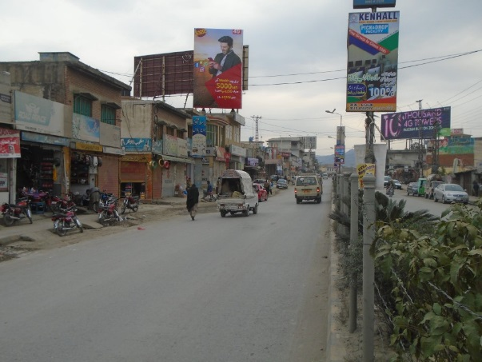
Haripur
Size | 35x20
Availability
Rate P/M | Rs: 90,000
Location | Direction
Al-Hamra Plaza | FTCF: Hassanabdaal, Wah Cantt & Islamabad Towards Havalian, Abbottabad.

Slide 16
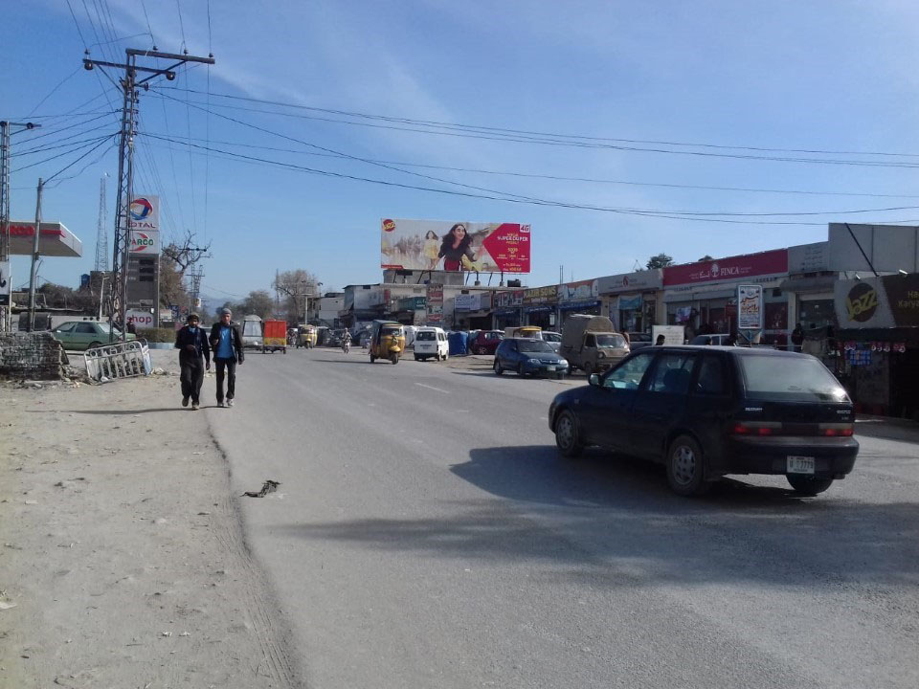
Haripur
Size | 60x20
Availability
Rate P/M | Rs: 150,000
Location | Direction
Main GT Road | FTCF: Islamabad, Wah Cantt & Hassanabdaal Towards Abbottabad

Slide 17
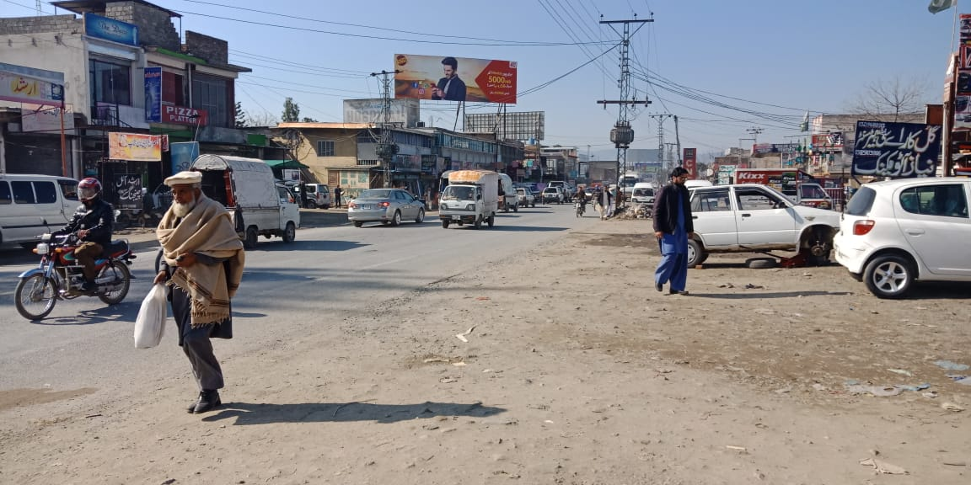
Haripur
Size | 60x20
Availability
Rate P/M | Rs: 150,000
Location | Direction
Opposite Daewoo Terninal Hirpur | FTCF: Abbottabad Towards Hassanabdaal, Wah Cantt & Islamabad

Slide 18
HAVALIAN

Slide 19
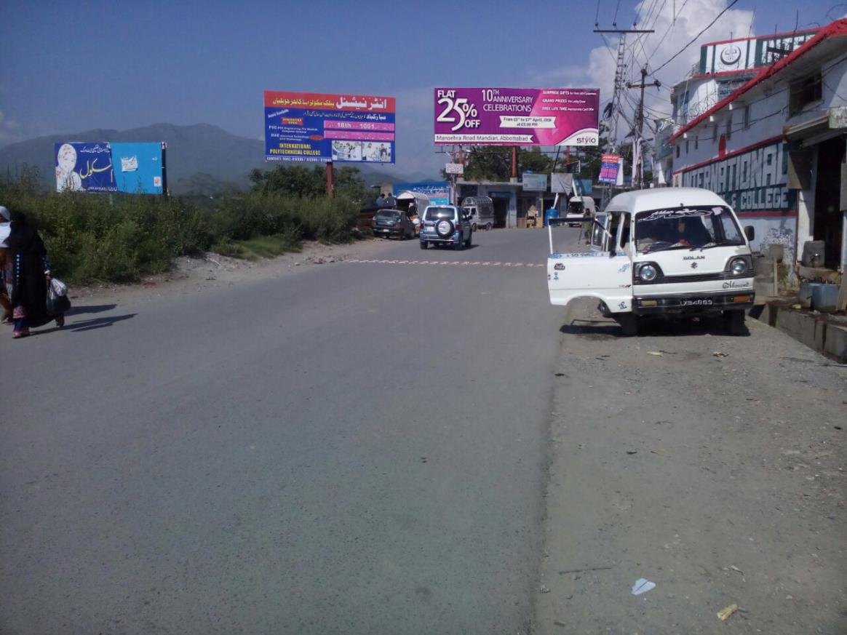
Havalian
Size | 60x20
Availability
Rate P/M | Rs: 125,000/=
Location | Direction
Rizvi Masjid Havalian Road | FTCF: Islamabad, Wah Cantt & Hassanabdaal Towards Abbottabad

Slide 20
ABBOTTABAD

Slide 21
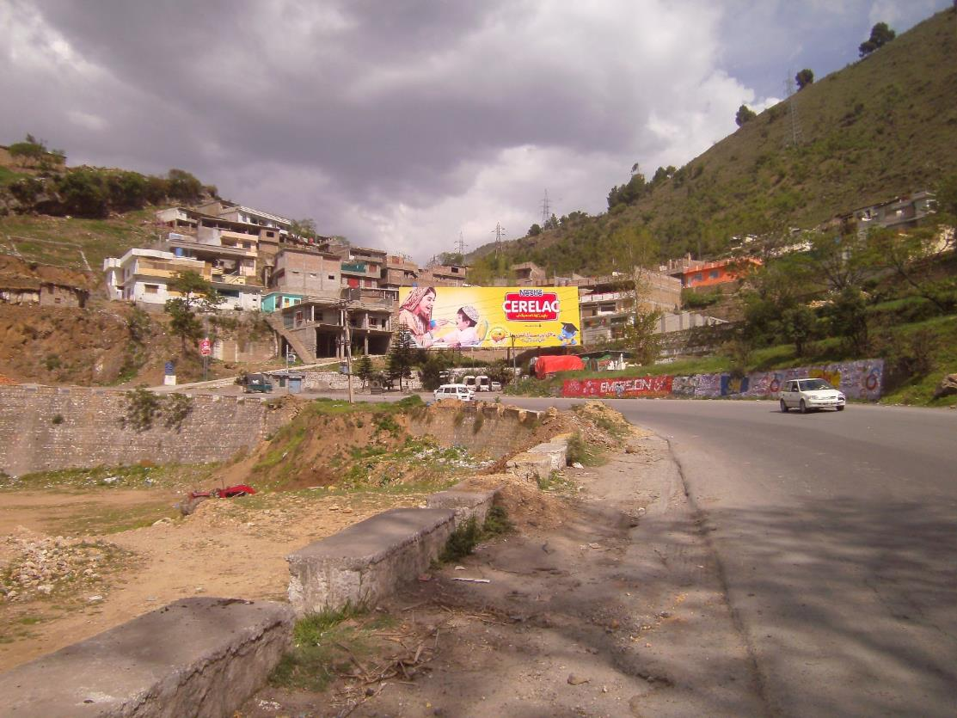
Abbottabad
Size | 90x30
Availability
Rate P/M | Rs: 325,000/=
Location | Direction
Saihad Near PSO Pump | FTCF: Islamabad, Haripur, Havailian Towards City and Mansehra

Slide 22
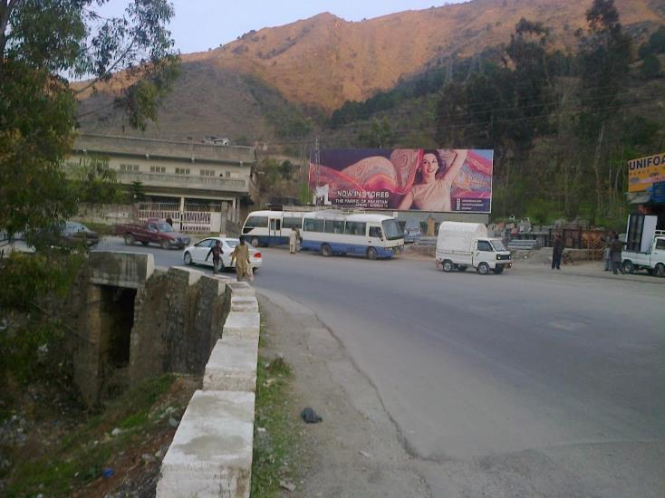
Abbottabad
Size | 60x20
Availability
Rate P/M | Rs: 150,000/=
Location | Direction
Saihad Near Block Factory | FTCF: Islamabad, Haripur, Havailian Towards City and Mansehra

Slide 23
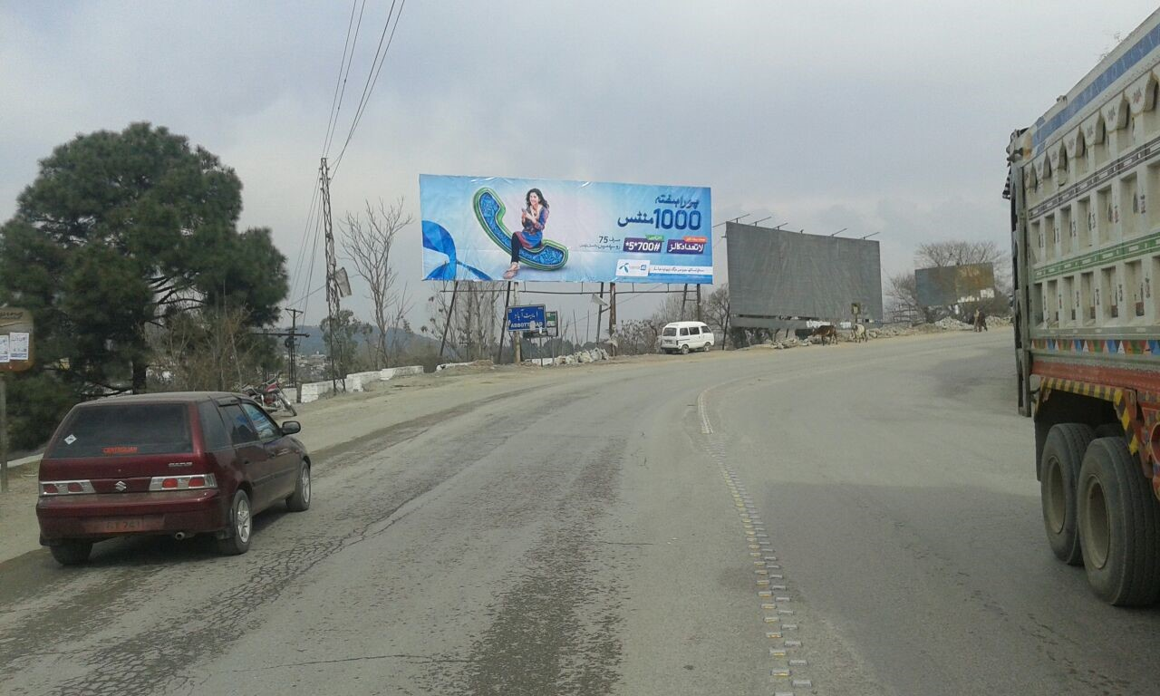
Abbottabad
Size | 60x20
Availability
Rate P/M | Rs: 150,000/=
Location | Direction
Pari Mor Salhad, Near new Sabzi mandi | FTCF: Islamabad, Haripur, Havailian Towards City and Mansehra

Slide 24
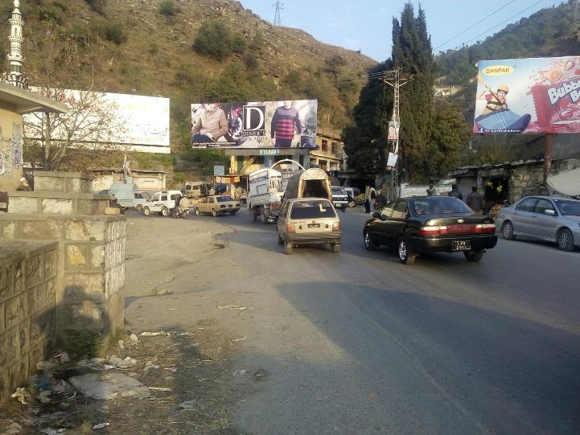
Abbottabad
Size | 45x15
Availability
Rate P/M | Rs: 115,000/=
Location | Direction
Sabzi Mandi Turn (Double Side View). | FTCF: Islamabad, Haripur & Salhad Towards Fawara Chowk, City, Mandian and Mansehra

Slide 25
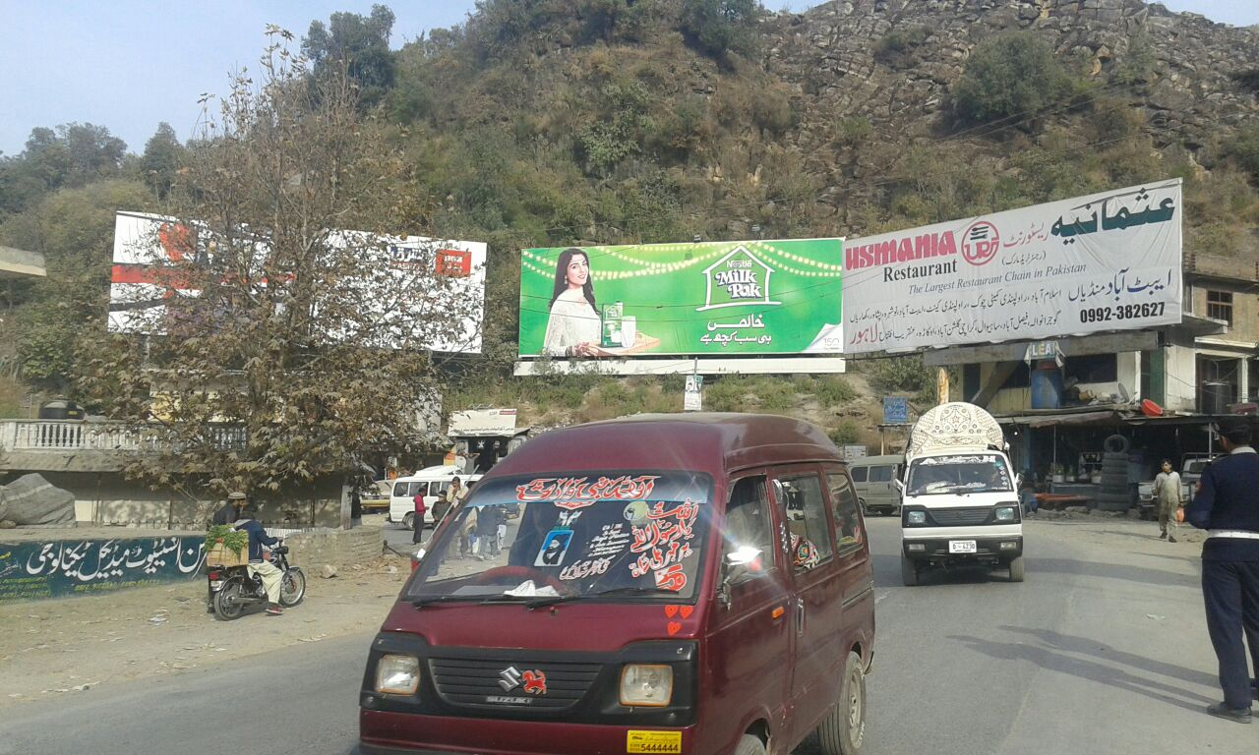
Abbottabad
Size | 60x20
Availability
Rate P/M | Rs: 150,000/=
Location | Direction
New Sabzi Mandi Turn | FTCF: Islamabad, Haripur & Salhad Towards Fawara Chowk, City, Mandian and Mansehra

Slide 26
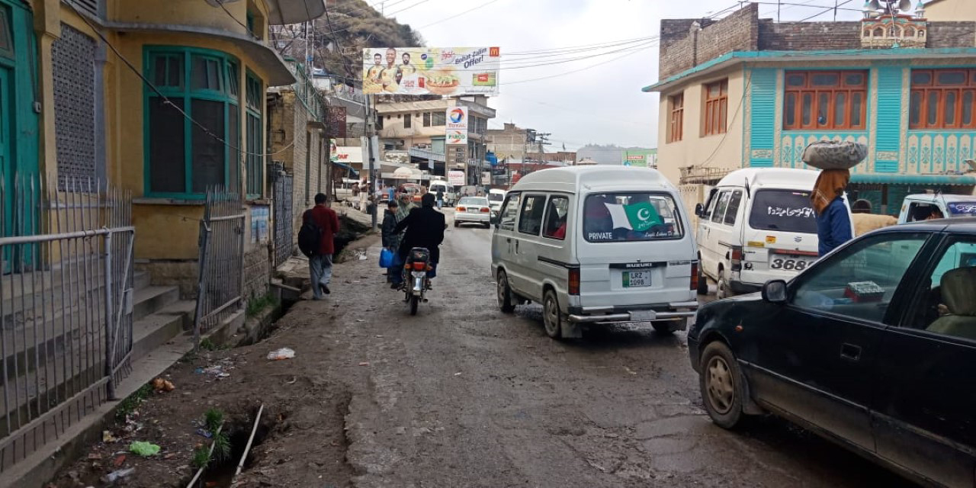
Abbottabad
Size | 60x20
Availability
Rate P/M | Rs: 150,000/=
Location | Direction
Saad Plaza Lari Adda Fawara Chowk Near Total Pump & Shell Pump | FTCF: Norhtern Areas, Mansehra, Ayub Medical Complex, Mandian & Murree, Nawanshehr, City Towards Havailian, Haripur, Hassanabdal, Peshawar & Islamabad, Rawalpindi

Slide 27
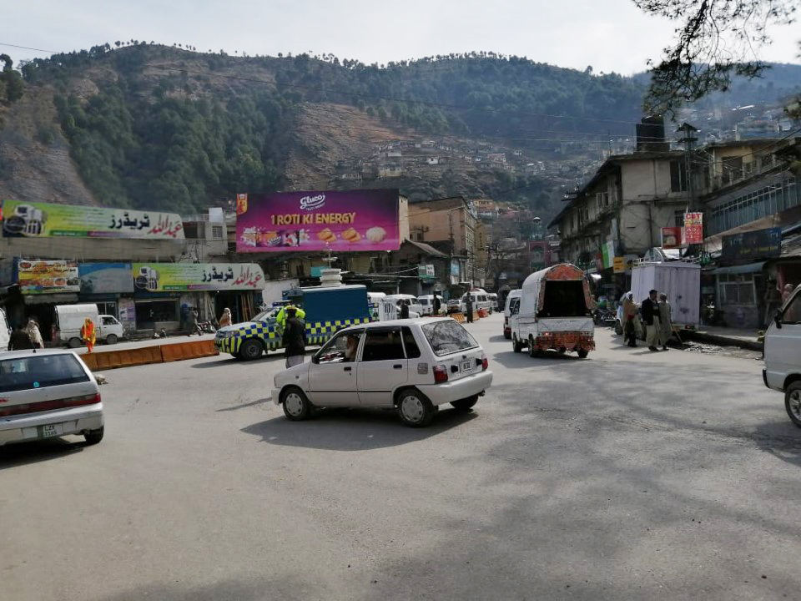
Abbottabad
Size | 60x20
Availability
Rate P/M | Rs: 150,000/=
Location | Direction
Fawara Chowk Near Pakistan Railway Reservation Office | FTCF: Jinnahabad, Mandian, Sarban Chowk Towards Lari adda, Haripur & Islamabad

Slide 28
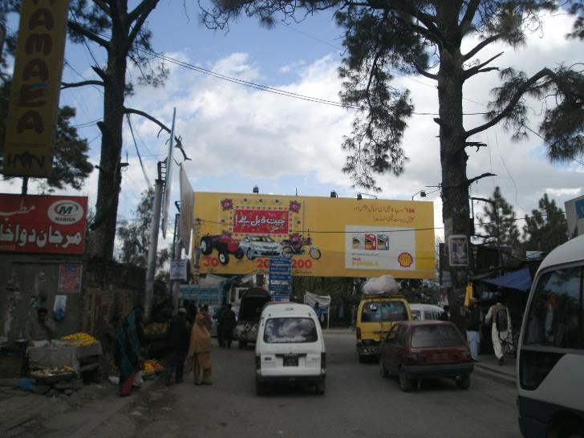
Abbottabad
Size | 60x20
Availability
Rate P/M | Rs: 150,000/=
Location | Direction
Fawara Chowk adjacent with Bar Club | FTCF: Islamabad, Haripur, Salhad & Lari Add Towards City, Sarban Chowk, Mandian, Manserhra & Nothern Areas

Slide 29
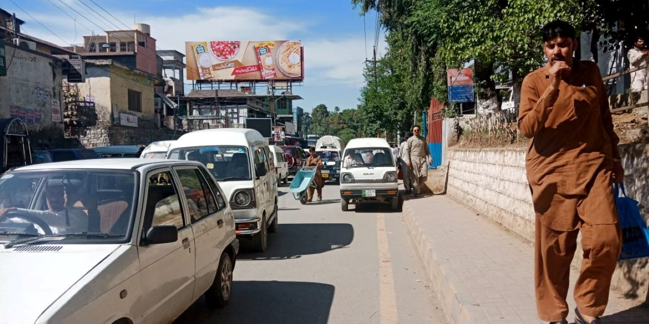
Abbottabad
Size | 60x20
Availability
Rate P/M | Rs: 150,000/=
Location | Direction
Main Jinnah Chowk, Near Station Head Quaters (Cantt) | FTCF: Fawara Chowk, Kuchehry, MCB Chowk Towards Public park, CMH and Mandian

Slide 30
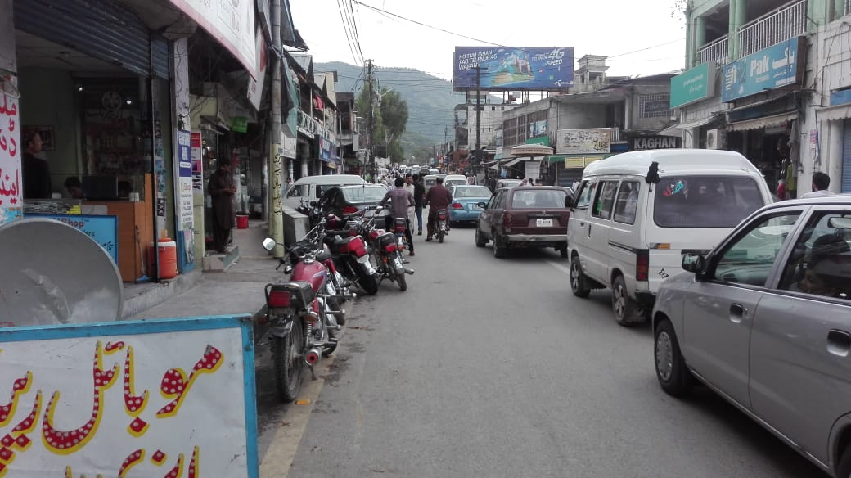
Abbottabad
Size | 60x20
Availability
Rate P/M | Rs: 150,000/=
Location | Direction
Main Jinnah Chowk, (Cantt). | FTCF: Mandian, PC Hotel, CMH Towards Fawara chowk & Cantt Chowk

Slide 31
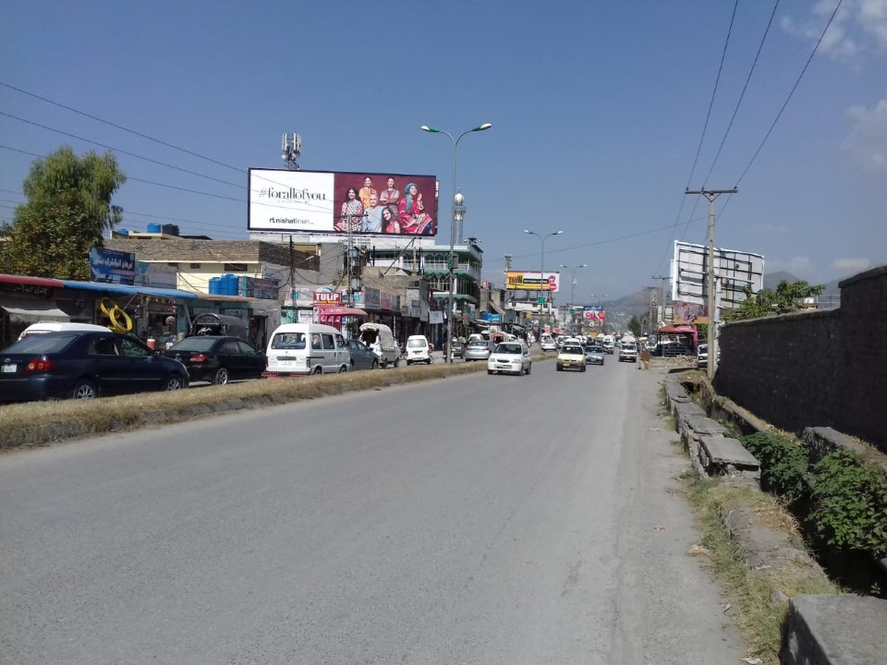
Abbottabad
Size | 60x20
Availability
Rate P/M | Rs: 150,000/=
Location | Direction
Near PMA Chowk, Supply | FTCF: Main City, CMH, Towards PC Hotel, Daewoo Terminal, Mandian, Medical Complex & Manserhra

Slide 32
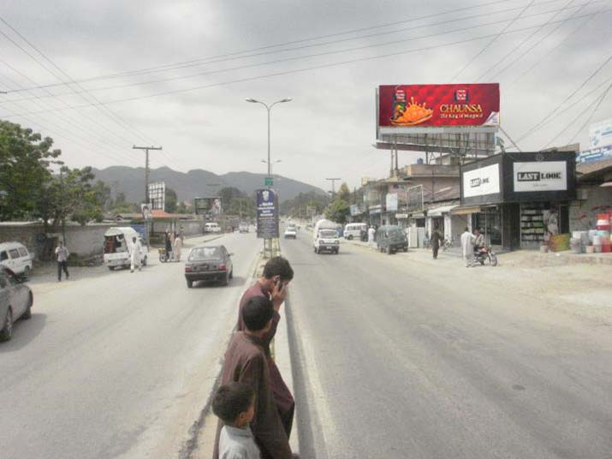
Abbottabad
Size | 45x15
Availability
Rate P/M | Rs: 110,000/=
Location | Direction
Main Supply Bazar, Near PMA Chowk | FTCF: Mansehra, Ayub Medical Complex, Mesil Chowk Mandian, Jinnah Abad, Towards CMH, City & Fawara Chowk

Slide 33
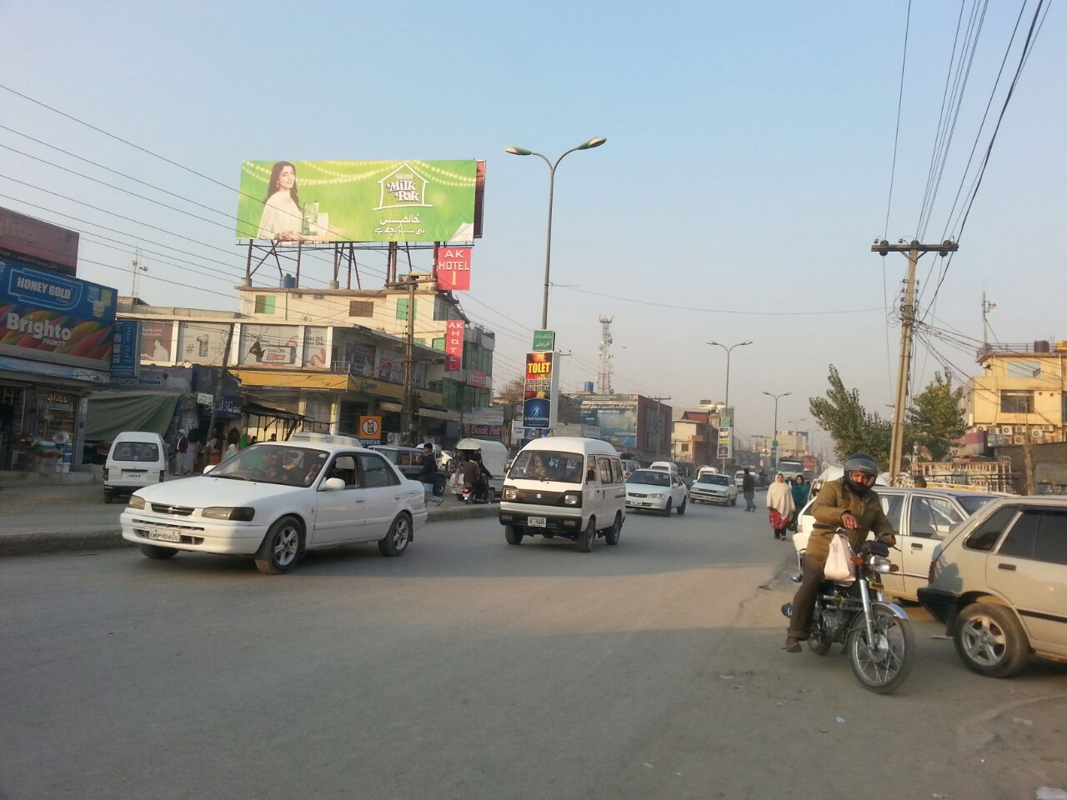
Abbottabad
Size | 60x20
Availability
Rate P/M | Rs: 140,000/=
Location | Direction
JS Bank, Opp Punjab Bank Near Rehmat Hospital | FTCF: Main City, CMH Towards PC Hotel, Daewoo Terminal, Mandian, Medical Complex & Manserhra

Slide 34
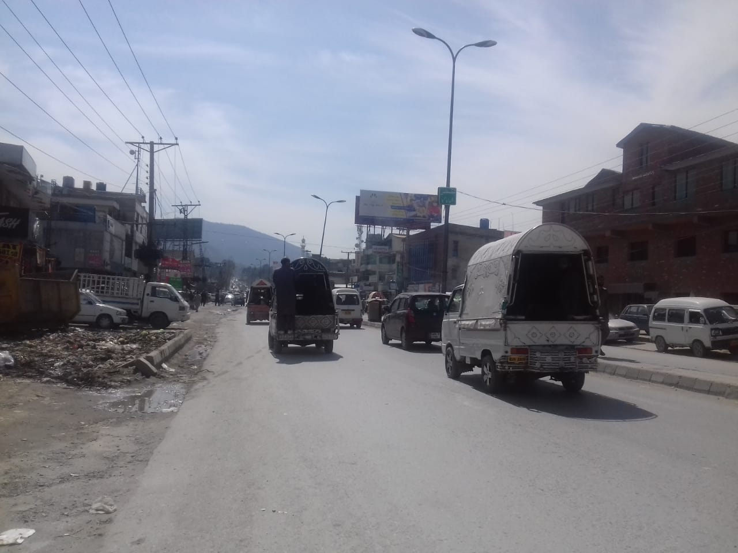
Abbottabad
Size | 60x20
Availability
Rate P/M | Rs: 175,000/=
Location | Direction
JS Bank, Opp Punjab Bank Near Rehmat Hospital | FTCF: Mansehra, Medical Complex, Mandian Towards CMH, Main City, Fawara Chowk & Islamabad

Slide 35
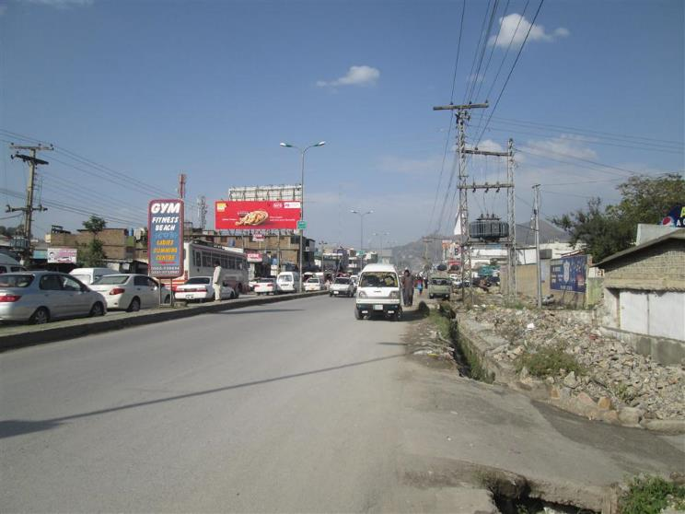
Abbottabad
Size | 60x20
Availability
Rate P/M | Rs: 175,000/=
Location | Direction
Imran Plaza, Near Bata, Opp Gul Ahmed & Radio Station | FTCF: Main City, CMH, PC Hotel Towards Daewoo Terminal, Mandian, Medical Complex & Manserhra

Slide 36
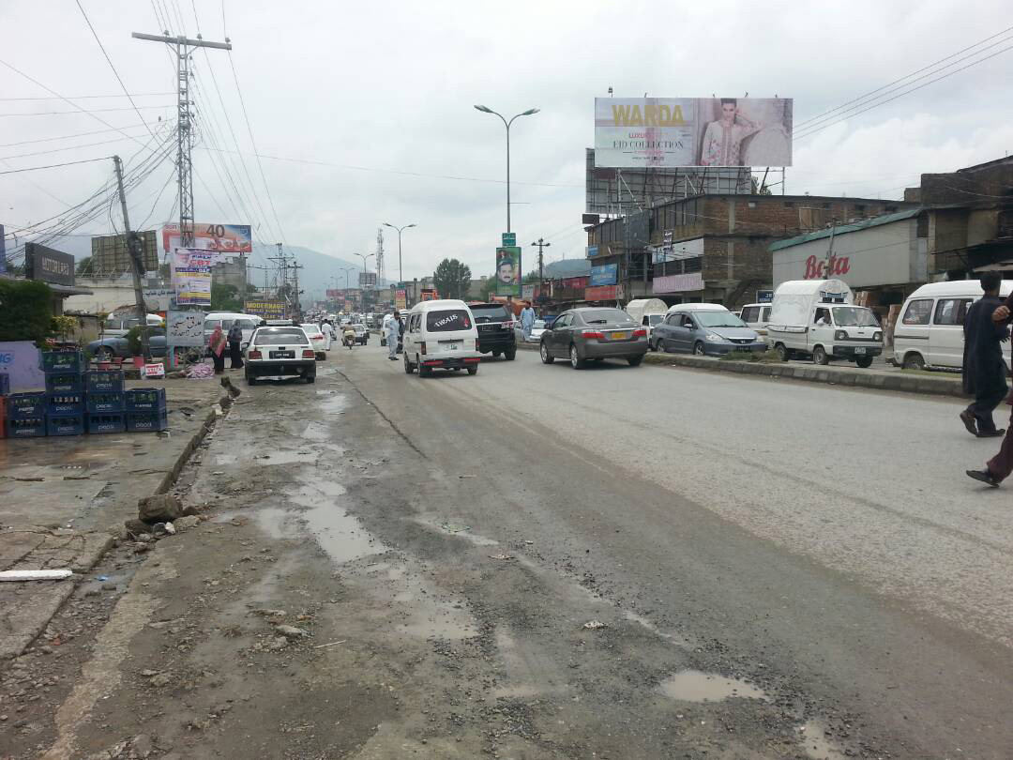
Abbottabad
Size | 60x20
Availability
Rate P/M | Rs: 175,000/=
Location | Direction
Imran Plaza, Opp Gul Ahmed, Near Radio Pakistan and Sethi Masjid | FTCF: Mansehra, Medical Complex, Mandian Towards CMH, Main City, Fawara Chowk & Islamabad

Slide 37
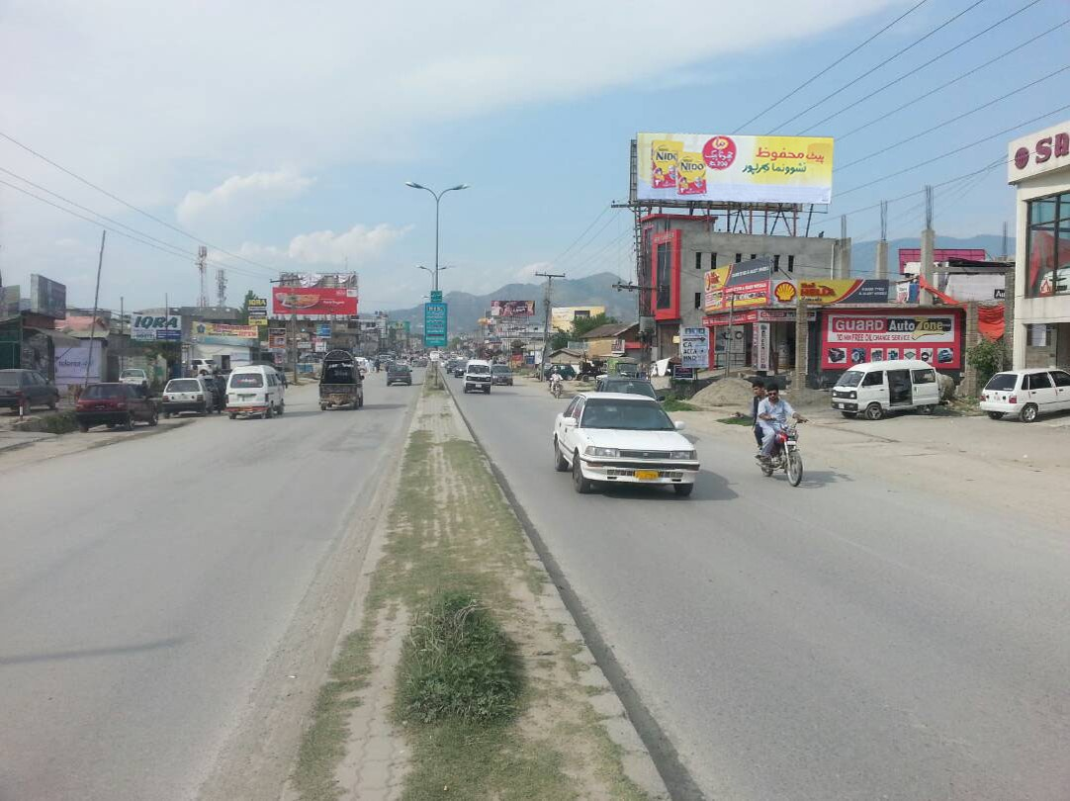
Abbottabad
Size | 60x20
Availability
Rate P/M | Rs: 175,000/=
Location | Direction
GM Plaza Abbottabad | FTCF: Manserhra Towards Medical complex ,Daeweoo terminal PC Hotel ,CMH & Main city

Slide 38
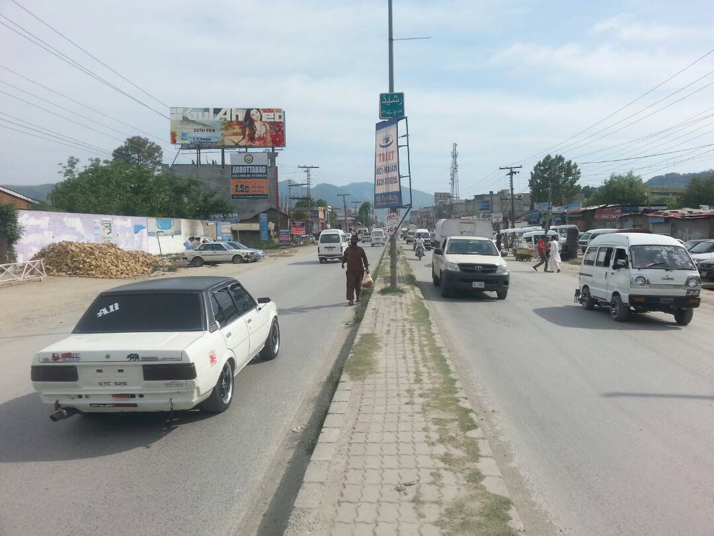
Abbottabad
Size | 60x20
Availability
Rate P/M | Rs: 175,000/=
Location | Direction
GM Plaza Abbottabad | FTCF: Manserhra Towards Medical complex ,Daeweoo terminal PC Hotel ,CMH & Main city

Slide 39
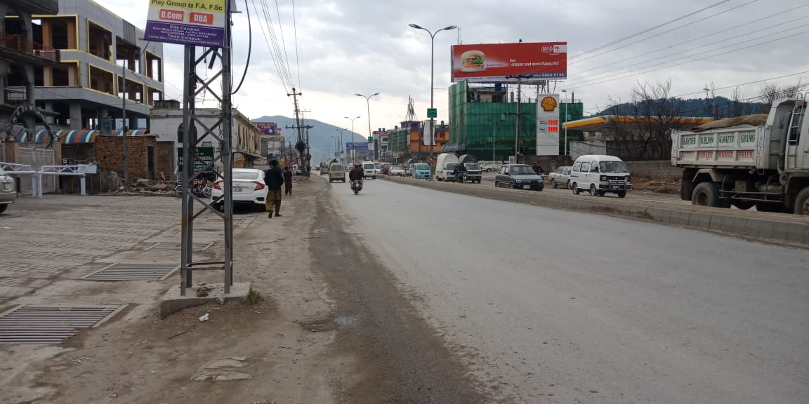
Abbottabad
Size | 60x20
Availability
Rate P/M | Rs: 175,000/=
Location | Direction
Ayaz Plaza, opp PC Hotel, near to Pakistan Radio Station, Jhangi | FTCF: Mansehra, Jadoon Plaz, Jinnahabad, Mandian and Complex Towards CMH, Fawara Chowk City, Havalien & Haripur

Slide 40
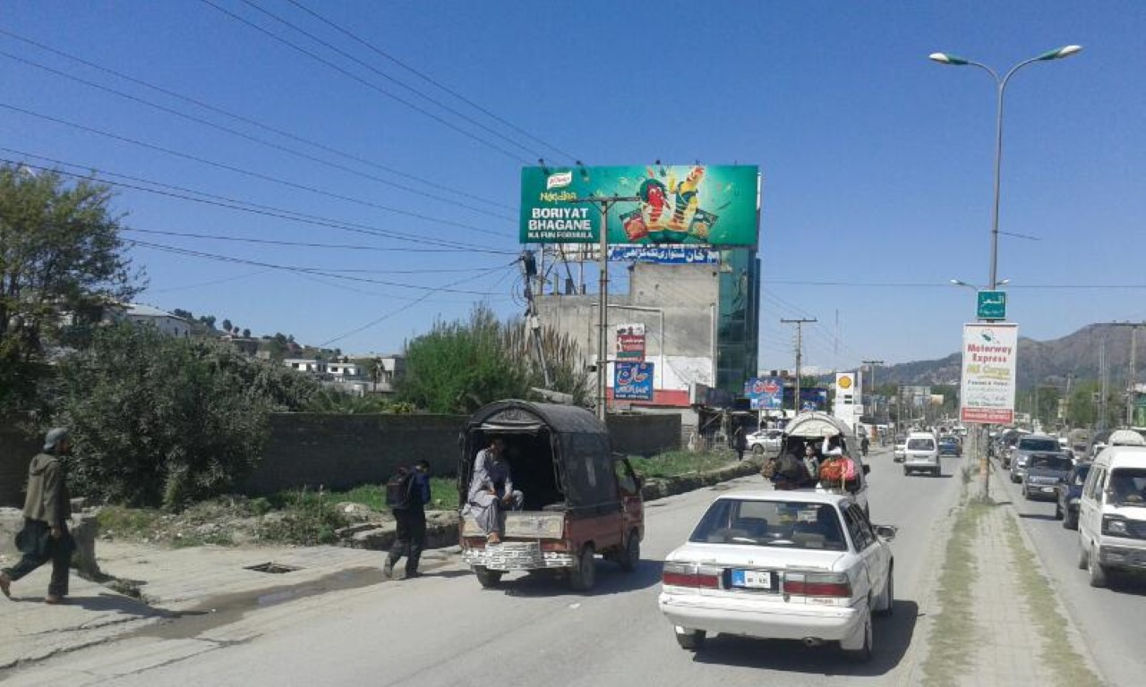
Abbottabad
Size | 60x20
Availability
Rate P/M | Rs: 175,000/=
Location | Direction
Ayaz Plaza, opp PC Hotel, Near to Pakistan Radio Station, Jhangi | FTCF: Fawara Chowk, City, CMH Towards Jadoon Plaz, Jinnahabad, Mandian and Complex

Slide 41
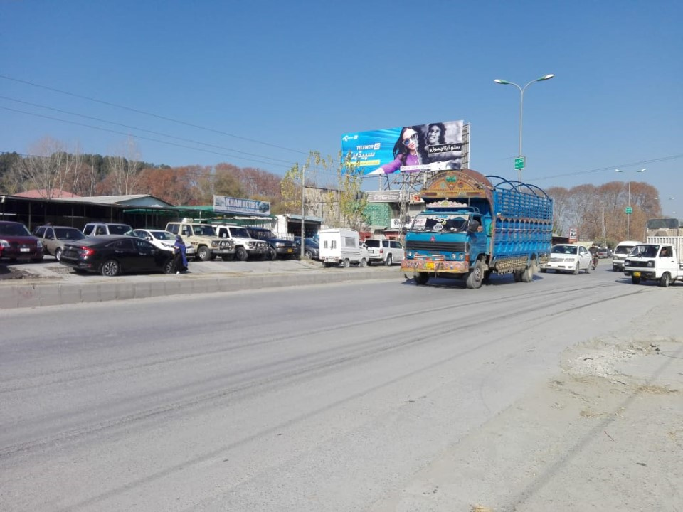
Abbottabad
Size | 60x20
Availability
Rate P/M | Rs: 175,000/=
Location | Direction
Hairdri Plaza, Opp Jadoon Plaza and Adjacent with Army Burn Hall College for Boys | FTCF: Fawara Chowk, City, CMH Towards Jadoon Plaz, Jinnahabad, Mandian and Complex

Slide 42
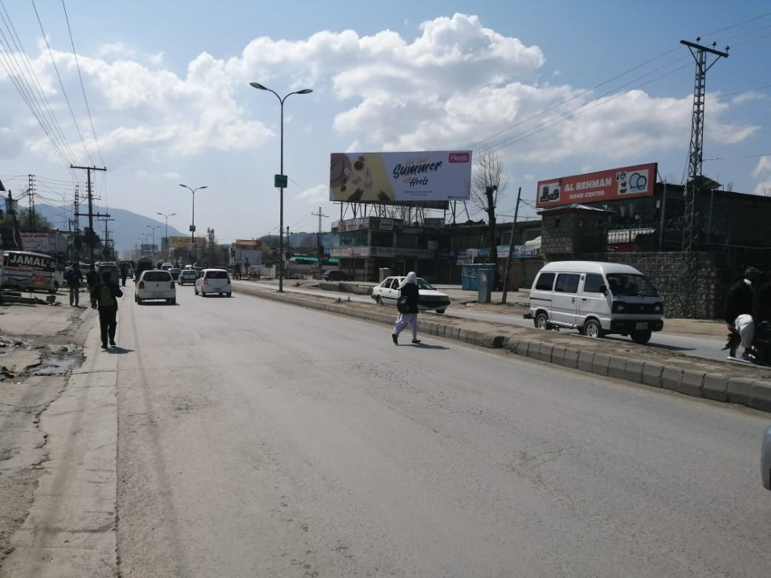
Abbottabad
Size | 60x20
Availability
Rate P/M | Rs: 175,000/=
Location | Direction
Haidri Plaza Near Army Burn Hall College (Senior Section) & Jadoon Plaza | FTCF: Mansehra, Medical Complex, Mandian Towards CMH, Main City, Fawara Chowk & Islamabad

Slide 43
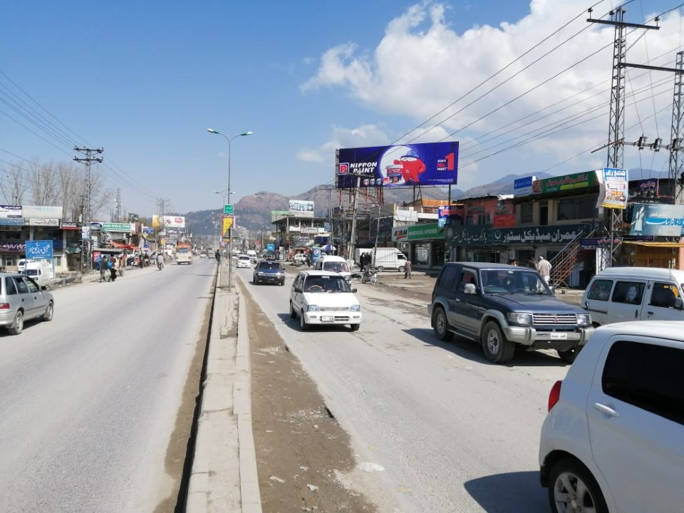
Abbottabad
Size | 60x20
Availability
Rate P/M | Rs: 175,000/=
Location | Direction
Awan Plaza, Near Mesile Chowk Opp Shafique Plaza | FTCF: Fawara Chowk, City, CMH, Jadoon Plaz, Jinnahabad & Mandian Towards Small Industrial Estate, Medical Complex and Mansehra City

Slide 44
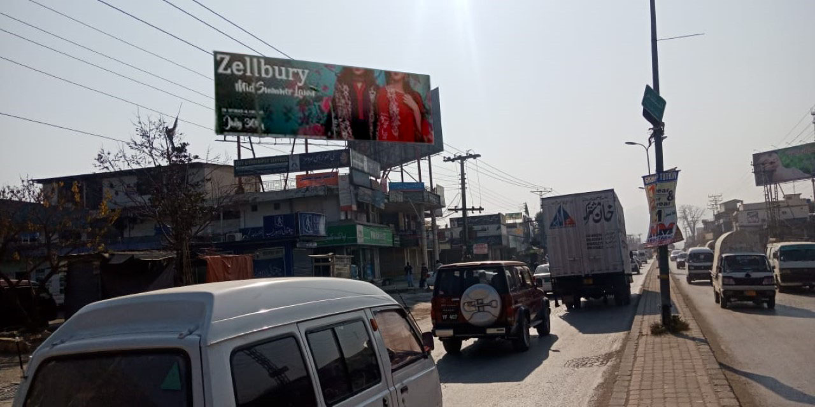
Abbottabad
Size | 60x20
Availability
Rate P/M | Rs: 175,000/=
Location | Direction
Awan Plaza, Mezile Chowk near Ayub Mediacal Complex | FTCF: Mansehra, Ayub Medical Complex Towards Mesile Chowk, Mandian, Jinnah Abad, CMH, City and Fawara Chowk

Slide 45
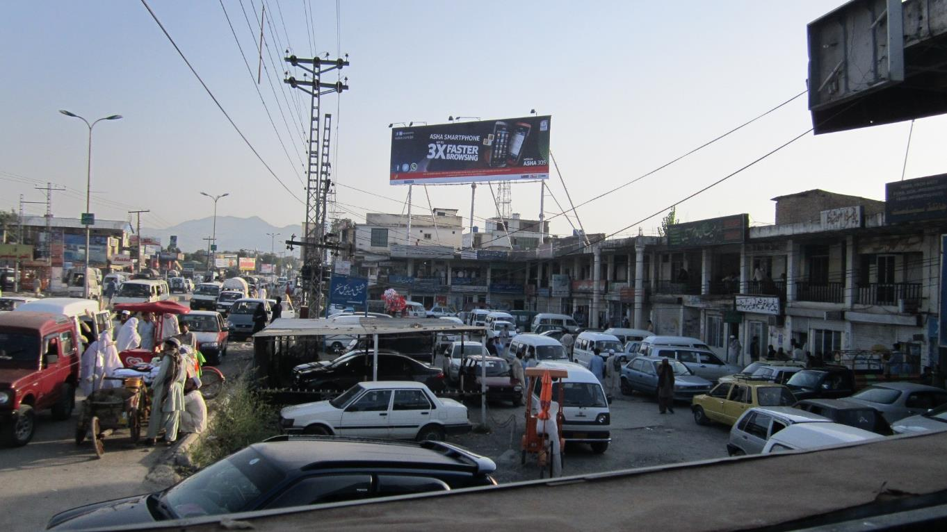
Abbottabad
Size | 60x20
Availability
Rate P/M | Rs: 175,000/=
Location | Direction
Shafique Plaza, Mezile Chowk | FTCF: Mansehra, Ayub Medical Complex Towards Mesile chowk, Mandian, Jinnah Abad, CMH, City and Fawara Chowk

Slide 46
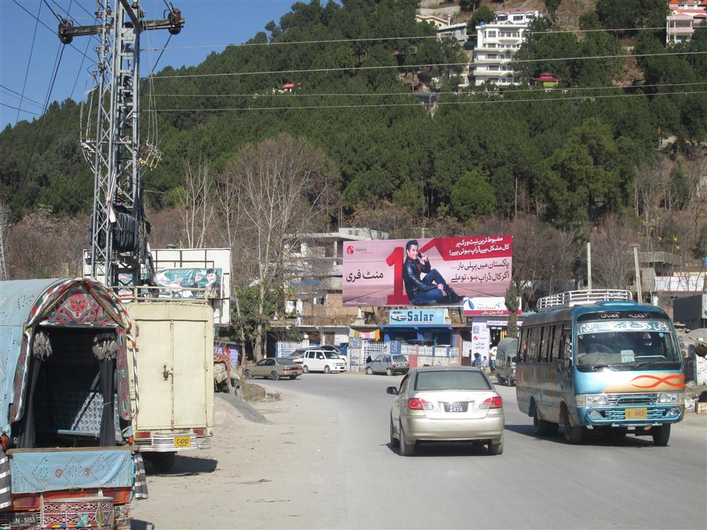
Abbottabad
Size | 60x20
Availability
Rate P/M | Rs: 175,000/=
Location | Direction
Mirpur forest check post (Silk Route). | FTCF: Fawara Chowk, City, CMH, Jadoon Plaz, Jinnahabad, Mandian and Complex Towards APS School, Toyota Showroom, Qalandarabad, Mansehra and Northern Areas

Slide 47
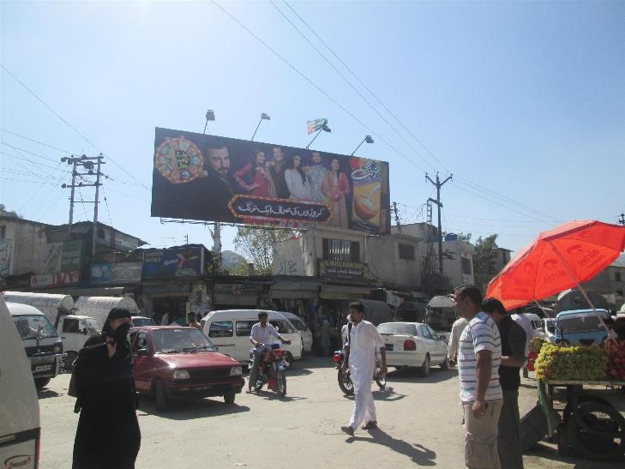
Abbottabad
Size | 45x15
Availability
Rate P/M | Rs: 110,000/=
Location | Direction
Main Band Khu | FTCF: Murree Road, Boys Degree College, Girls Degree College, Lots of Schools & Shopping Area Towards Sarban Chowk, Fawara Chowk, City & Mandian, Mansehra.

Slide 48
MURREE

Slide 49
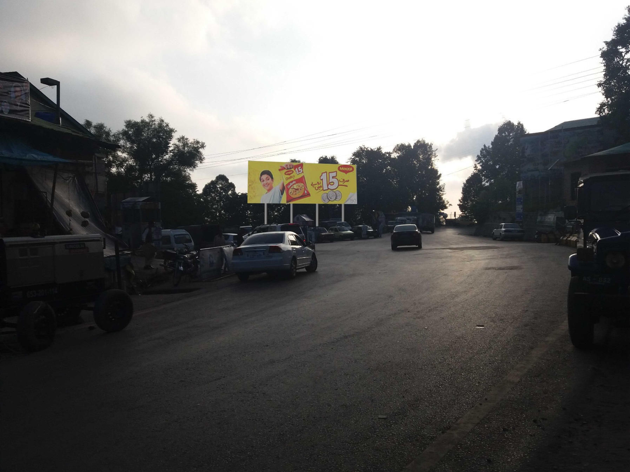
Murree
Size | 60x20
Availability
Rate P/M | Rs: 180,000/=
Location | Direction
Kuldanna near Muree Main Bazar | FTCF: Mall Road, Rawalpindi, Islamabad Towards Bhurban, Ayubia and Abbottabad

Slide 50
MANSEHRA

Slide 51
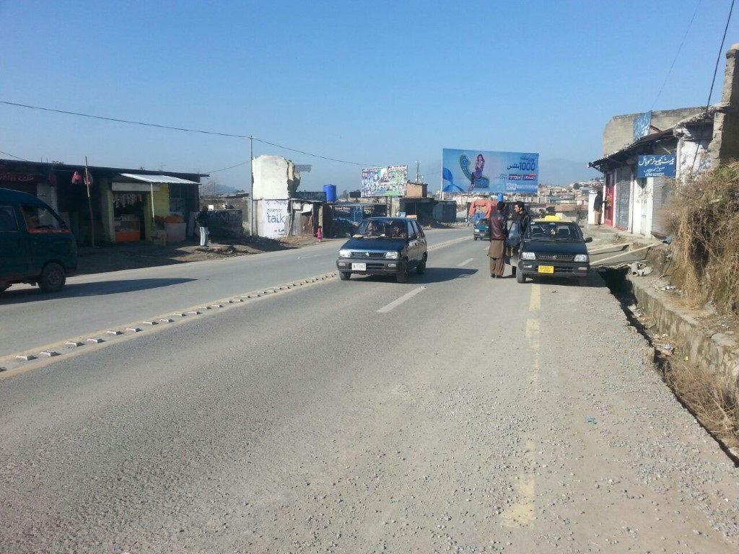
Mansehra
Size | 60x20
Availability
Rate P/M | Rs: 175,000/=
Location | Direction
Ghazi Kot Township | FTCF: Abbottabad, Ghazi Kot Township Towards Inner City and Lari adda & Northern Areas

Slide 52
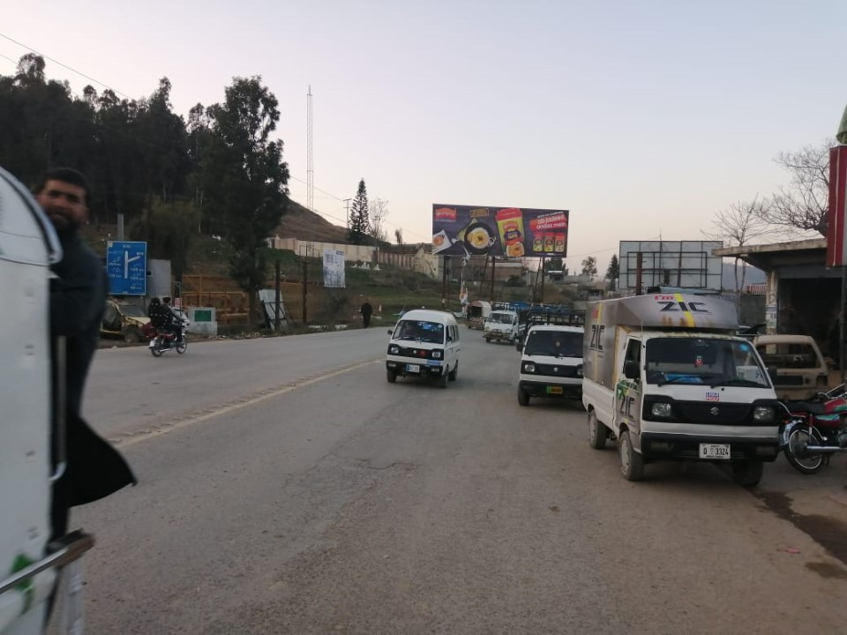
Mansehra
Size | 60x20
Availability
Rate P/M | Rs: 175,000/=
Location | Direction
Ghazi Kot Township | FTCF: Abbottabad, Ghazi Kot Township Towards Inner City and Lari adda & Northern Areas

Slide 53
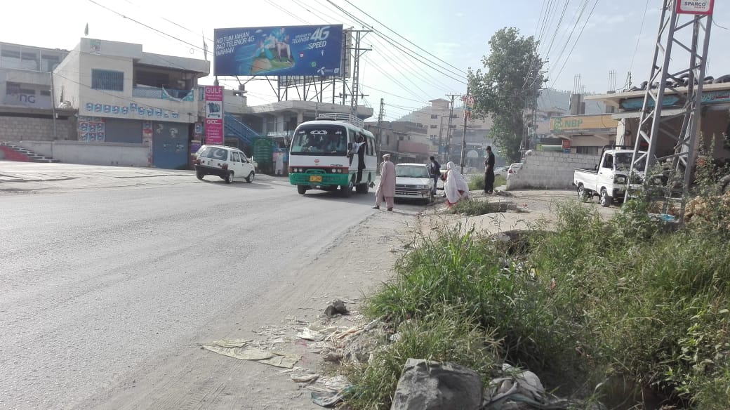
Mansehra
Size | 60x20
Availability
Rate P/M | Rs: 175,000/=
Location | Direction
Awan Plaza | FTCF: Abbottabd, Qalandarabad, Ghazikot Township Towards Butt Pull, Naran Bypass & Lariadda

Slide 54
Mansehra
Size | 60x20
Availability
Rate P/M | Rs: 175,000/=
Location | Direction
Awan Plaza | FTCF: Abbottabd, Qalandarabad, Ghazikot Township Towards Butt Pull, Naran Bypass & Lariadda

Slide 55
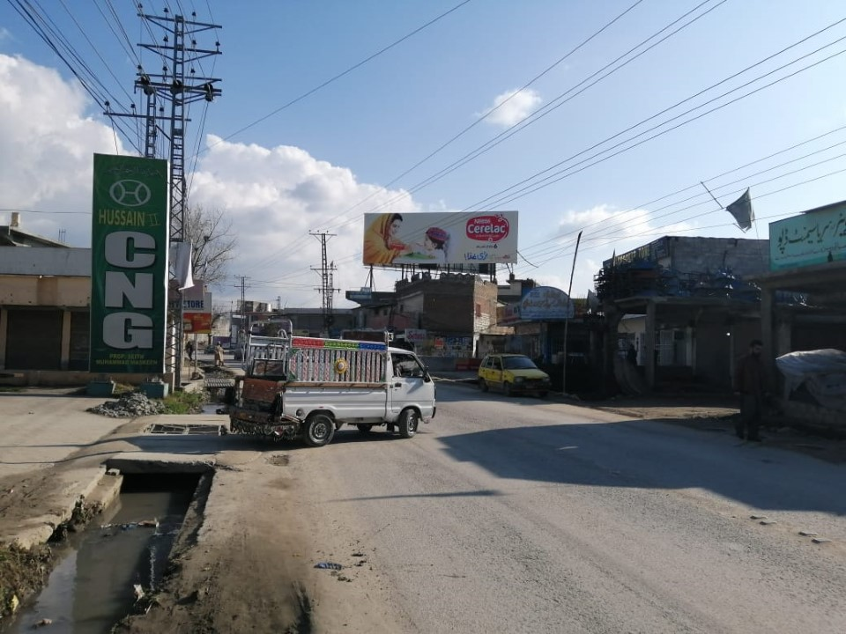
Mansehra
Size | 60x20
Availability
Rate P/M | Rs: 175,000/=
Location | Direction
Awan Plaza | FTCF: Lari Adda, Naran Bypass Butt Pull Towards Ghazi Kot Township & Abbottabad

Slide 56
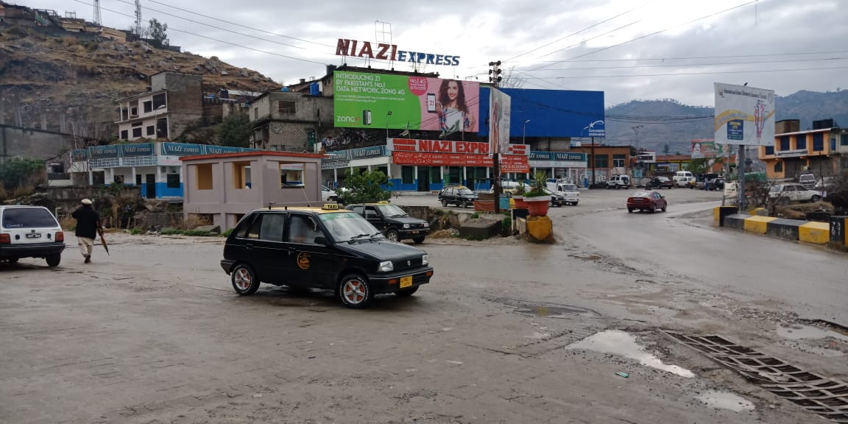
Mansehra
Size | 60x20
Availability
Rate P/M | Rs: 150,000/=
Location | Direction
Niazi Adda, Shahnawaz Chowk | FTCF: Northern Areas, Naran, Muzaffarabad Towards Butt pull, Ghazikot Township & Abbottabad

Slide 57
BALAKOT

Slide 58
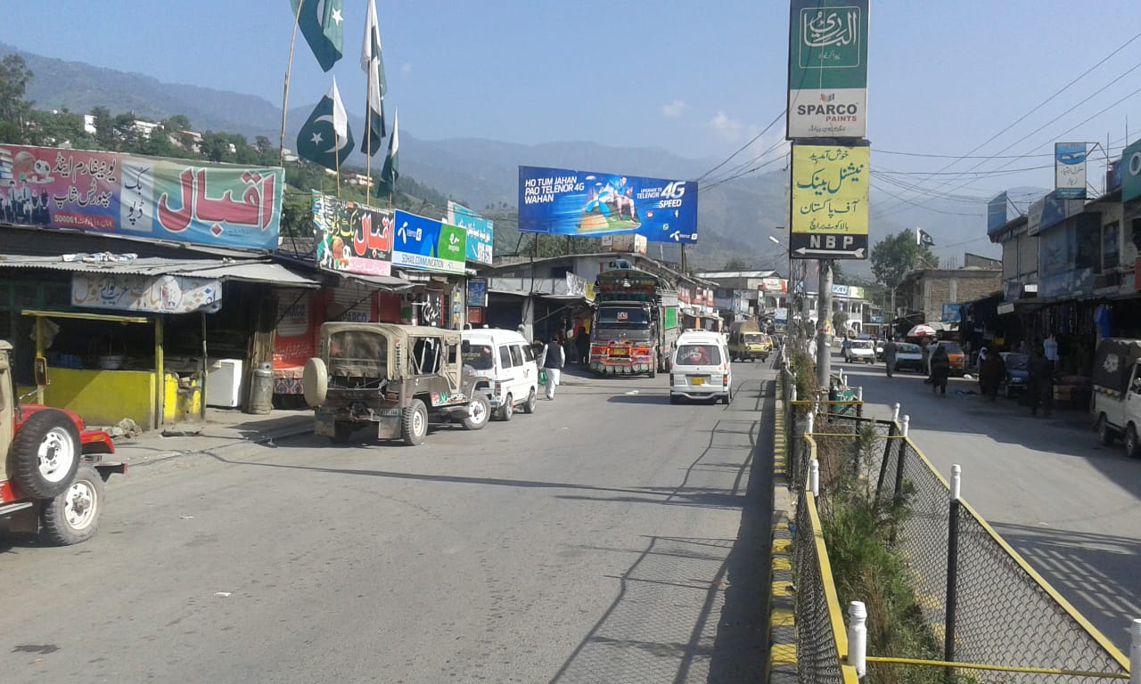
Balakot
Size | 60x20
Availability
Rate P/M | Rs: 175,000/=
Location | Direction
Main Bazar Kaghan Road Balakot | FTCF: Mansehra Towards Abbottabad

Slide 59
BATTAGARAM

Slide 60
Battagram
Size | 60x20
Availability
Rate P/M | Rs: 175,000/=
Location | Direction
Mohsin Market Kuchary Chowk Battagaram Pull | FTCF: Thakot Towards Mansehra

Slide 61
ATTOCK

Slide 62
Attock
Size | 90x30
Availability
Rate P/M | Rs: 375,000
Location | Direction
Toll Plaza, Kamra Attock | FTCF: Islamabad, Wah Cantt, Taxila Towards Kamra, Attock and Peshawar

Slide 63
Attock
Size | 60x20
Availability
Rate P/M | Rs: 150,000/=
Location | Direction
Lalazar Ground Muncipal Plaza Roof Top (Mid of city) | FTCF: Kuchehry Towards Fawara Chowk

Slide 64
Attock
Size | 60x20
Availability
Rate P/M | Rs: 150,000/=
Location | Direction
Malik Nawazish Plza, Kamra Road Attock | FTCF: Attock City, Towards Kamra

Slide 65
Attock
Size | 60x20
Availability
Rate P/M | Rs: 150,000/=
Location | Direction
Malik Nawazish Plza, Kamra Road Attock | FTCF: Kamra Towards Attock City

Slide 66
NOWSHEHRA

Slide 67
Nowshehra
Size | 60x20
Availability
Rate P/M | Rs: 150,000/=
Location | Direction
Jhangira Najeeb Plaza Khairabad | FTCF: Islamabad Towards Peshawar

Slide 68
KOHAT

Slide 69
Kohat
Size | 60x20
Availability
Rate P/M | Rs: 120,000/=
Location | Direction
Kuchehry Chowk | FTCF: Main Kuchehry Chowk

Slide 70
Kohat
Size | 60x20
Availability
Rate P/M | Rs: 125,000/=
Location | Direction
Kuchehry Chowk | FTCF: Kuchehry Chowk Towards Hungu

Slide 71
Kohat
Size | 60x20
Availability
Rate P/M | Rs: 140,000/=
Location | Direction
Hungu Chowk | FTCF: Hungu Towards Kuchehry Chowk

Slide 72
Kohat
Size | 60x20
Availability
Rate P/M | Rs: 140,000/=
Location | Direction
Maaz Plaza Bannu Road Kohat | FTCF: DI Khan, Bannu Towards Kohat

Slide 73
RAWALAKOT

Slide 74
Rawlakot
Size | 60x20
Availability
Rate P/M | Rs: 120,000/=
Location | Direction
City Barha Market Rawlakot | FTCF: Mang Road Towards City

Slide 75
Rawlakot
Size | 60x20
Availability
Rate P/M | Rs: 120,000/=
Location | Direction
Main Bazar Bank Road Rawlakot | FTCF: Mang Road Towards City

Slide 76
Rawlakot
Size | 60x20
Availability
Rate P/M | Rs: 125,000/=
Location | Direction
Mang Road | FTCF: Rawalakot Towards Islamabad

Slide 77
Rawlakot
Size | 60x20
Availability
Rate P/M | Rs: 125,000/=
Location | Direction
Adjacent 15 Office Mang Road | FTCF: Chandini Chowk Towards Bank Road

Slide 78
KOTLI

Slide 79
Kotli
Size | 60x20
Availability
Rate P/M | Rs: 125,000/=
Location | Direction
Pangpeeran Chowk | FTCF: Pindi Bypass Towards Lariadda

Slide 80
Kotli
Size | 60x20
Availability
Rate P/M | Rs: 125,000/=
Location | Direction
General Bus Stand (Entrance) | FTCF: Main City Area

Slide 81
Kotli
Size | 60x20
Availability
Rate P/M | Rs: 125,000/=
Location | Direction
Abshar Chowk | FTCF: Kuchehry Towards Lari Adda

Slide 82
Kotli
Size | 30x40
Availability
Rate P/M | Rs: 110,000/=
Location | Direction
Abshar Chowk | FTCF: Lari Ada Towards Kuchery

Slide 83
BAGH AJK

Slide 84
Bagh
Size | 60x20
Availability
Rate P/M | Rs: 120,000/=
Location | Direction
Bagh Bridge | FTCF: Bagh Towards Rawlakot, Mirpur & Kotli

Slide 85
Bagh
Size | 60x20
Availability
Rate P/M | Rs: 120,000/=
Location | Direction
Bagh Bridge | FTCF: Bagh Towards Rawlakot, Mirpur & Kotli

Slide 86
Bagh
Size | 60x20
Availability
Rate P/M | Rs: 120,000/=
Location | Direction
Police Lines | FTCF: Mirpur, Kotli, Rawlakot Towards Bagh City

Slide 87
Bagh
Size | 45x15
Availability
Rate P/M | Rs: 100,000/=
Location | Direction
Noman Pura | FTCF: Bagh Towards Rawlakot, Mirpur & Kotli

Slide 88
MUZAFFARABAD

Slide 89
Muzaffarabad
Size | 60x20
Availability
Rate P/M | Rs: 125,000/=
Location | Direction
Hattian Bala | FTCF: Muzaffarabad Towards Chakothi

Slide 90
Muzaffarabad
Size | 60x20
Availability
Rate P/M | Rs: 135,000/=
Location | Direction
Garhi Dopatta | FTCF: Entrance Towards Garhi Dopatta

Slide 91
Muzaffarabad
Size | 60x20
Availability
Rate P/M | Rs: 115,000/=
Location | Direction
Lari Ada | FTCF: Abbottabad, Mansehra Towards Muzaffarabad and Rawlapindi

Slide 92
Muzaffarabad
Size | 60x20
Availability
Rate P/M | Rs: 150,000/=
Location | Direction
Sathra More | FTCF: Rawalpindi, Sectrait to Neelum Road, CMH and Abbottabad

Slide 93
Muzaffarabad
Size | 60x20
Availability
Rate P/M | Rs: 140,000/=
Location | Direction
Quaid-e-Azam Bridge | FTCF: Lari Adda, Saheli Sarkar, PM House Towards Secretairiat, Supreme Court Assembly Hall and Rawalpindi

Slide 94
Muzaffarabad
Size | 60x20 Qty_2
Availability
Rate P/M | Rs: 140,000/=
Location | Direction
Kohala Bridge | FTCF: Muzaffarabad Towards Murree & Islamabad

Slide 95
BHIMBER

Slide 96
Bhimber
Size | 60x20
Availability
Rate P/M | Rs: 145,000/=
Location | Direction
Zong Office Bhimber | FTCF: Gujrat Towards Bhimber

Slide 97
SWAT MINGORA

Slide 98
Swat Mingora
Size | 60x20
Availability
Rate P/M | Rs: 130,000/=
Location | Direction
Raheema Abad Police Station | FTCF: Mardan to Mingora entrance

Slide 99
Swat Mingora
Size | 60x20
Availability
Rate P/M | Rs: 130,000/=
Location | Direction
Near Sohrab Chowk Zeeshan Hotel | FTCF: Lari Adda Towards sohrab chowk

Slide 100
Swat Mingora
Size | 40x15
Availability
Rate P/M | Rs: 110,000/=
Location | Direction
Watke Chowk Mingora | FTCF: Madin ,Kalam ,Bagh Towards Swat

Slide 101
Swat Mingora
Size | 60x20
Availability
Rate P/M | Rs: 130,000/=
Location | Direction
GT Road Raheema Abad Entrance Mingora | FTCF: Mardan Towards Mingora entrance

Slide 102
DI KHAN

Slide 103
DI Khan
Size | 60x20
Availability
Rate P/M | Rs: 130,000/=
Location | Direction
Sheikh Yousef Adda Peshawar road | FTCF: Peshawar Towards Entrance DI Khan

Slide 104
DI Khan
Size | 60x20
Availability
Rate P/M | Rs: 130,000/=
Location | Direction
Opp Rehamini Hospital Rehamani Chowk | FTCF: Lahore Karachi Towards DI Khan City Entrance

Slide 105
DI Khan
Size | 60x20
Availability
Rate P/M | Rs: 130,000/=
Location | Direction
New Sabzi Mandi Chowk near Saddar Thana Peshawar Road Dikhan | FTCF: Peshawar Towards DI Khan

Slide 106
MARDAN

Slide 107
Mardan
Size | 60x20
Availability
Rate P/M | Rs: 140,000/=
Location | Direction
Rashakai Motorway Interchange(Junction) | FTCF: Peshawar , Nosehra Towards Mardan & Swat

Slide 108
Mardan
Size | 60x20
Availability
Rate P/M | Rs: 140,000/=
Location | Direction
Rashakai Motorway Interchange (Junction) | FTCF: Mardan Towards Noeshara & Lahore

Slide 109
Mardan
Size | 60x20
Availability
Rate P/M | Rs: 125,000/=
Location | Direction
Main Charsadda Chowk | FTCF: Pindi, Noeshara Towards New Adda, Swat, Dir Etc

Slide 110
Mardan
Size | 60x20
Availability
Rate P/M | Rs: 135,000/=
Location | Direction
Sheikh Maltoon Town Chowk Opp Mardan Medical Center (MMC) | FTCF: Nowshehra, Sheikh Maltoon Chowk towards Mardan City

Slide 111
Mardan
Size | 60x20
Availability
Rate P/M | Rs: 140,000/=
Location | Direction
Kalpani Bridge | FTCF: Pakistan Chowk Towards Parhoti Chowk

Slide 112
Mardan
Size | 60x20
Availability
Rate P/M | Rs: 150,000/=
Location | Direction
Bank Road | FTCF: Katchary Chowk Towards Pakistan Chowk

Slide 113
Mardan
Size | 60x20
Availability
Rate P/M | Rs: 135,000/=
Location | Direction
College Chowk Opp Bilal Masjid | FTCF: Noweshara & Peshawar Towards Mardan

Slide 114
Mardan
Size | 60x20
Availability
Rate P/M | Rs: 135,000/=
Location | Direction
College Chowk Near Bata Showroom | FTCF: College Chowk Towards Peshawar , Noeshara ,Lahore

Slide 115
KARAK

Slide 116
Karak
Size | 60x20
Availability
Rate P/M | Rs: 115,000/=
Location | Direction
Hak Behu Plaza | FTCF: City Towards Bannu

Slide 117
Karak
Size | 60x20
Availability
Rate P/M | Rs: 150,000/=
Location | Direction
Gt Road | FTCF: Bannu Towards Karak Near DCO

Slide 118
BANNU

Slide 119
Bannu
Size | 60x20
Availability
Rate P/M | Rs: 140,000/=
Location | Direction
Allah Wala Chowk | FTCF: Kohat Towards DI Khan

Slide 120
Bannu
Size | 60x20
Availability
Rate P/M | Rs: 140,000/=
Location | Direction
Hayat Plaza Allah wala Chowk | FTCF: DI khan, Taranorang Towards Lari Adda ,Kohat,karak & Peshawar

Slide 121
Bannu
Size | 60x20
Availability
Rate P/M | Rs: 140,000/=
Location | Direction
Hayat Plaza Allah wala Chowk | FTCF: DI khan, Taranorang Towards Lari Adda ,Kohat,karak & Peshawar

Slide 122
TALAGUNG

Slide 123
Talagang
Size | 50x20
Availability
Rate P/M | Rs: 100,000/=
Location | Direction
Al Qamar Hospital | FTCF: Talangang Towards Chakwal

Slide 124
CHAKWAL

Slide 125
Chakwal
Size | 60x20
Availability
Rate P/M | Rs: 125,000/=
Location | Direction
Al Qamar Hospital | FTCF: Talangang Towards Chakwal

Slide 126
TIMEGARA

Slide 127
Timegara
Size | 60x20
Availability
Rate P/M | Rs: 150,000/=
Location | Direction
Timegara | FTCF: Dir Towards Chakdar

Slide 128
DIR

Slide 129
DIR
Size | 60x20
Availability
Rate P/M | Rs: 130,000/=
Location | Direction
DIR | FTCF: Chakdar Towards Dir

Slide 130
GILGIT

Slide 131
Gilgit
Size | 60x20
Availability
Rate P/M | Rs: 120,000/=
Location | Direction
Opp Karakorum Chamber Of Commerce | FTCF: Islamabad Air port Towards Gilgit

Slide 132
PESHAWAR

Slide 133
Peshawar
Size | 45x15
Availability
Rate P/M | Rs: 90,000/=
Location | Direction
Babu Hafeez plaza Wersak Road Ghari Chowk | FTCF: Fata Sectariate Towards Ring road Junction

Slide 134
Ad Solution
TERMS & CONDITIONS
First time skin installation and removing is free.
Skin printing charges are not included in the proposed rates.
These rates are exclusive of all kinds of taxes.
If skin is damaged due to weather, changing/re-printing charges will be borne by the client.
The payment will be made 50% in advance and the remaining balance will be payable through 15 days post dated cheque, from the day, the display starts.
For locking the sites please inform us within 1-3 working days.

