Slide 1
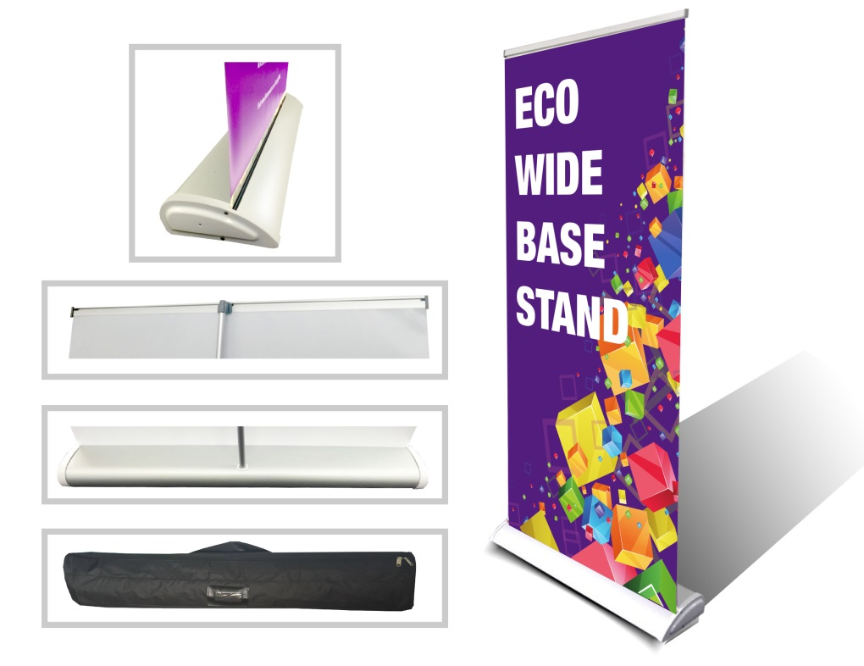
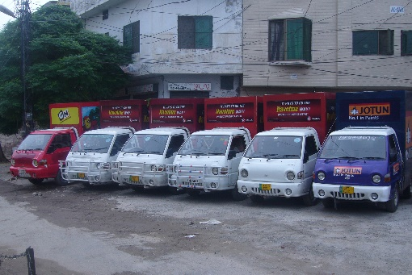
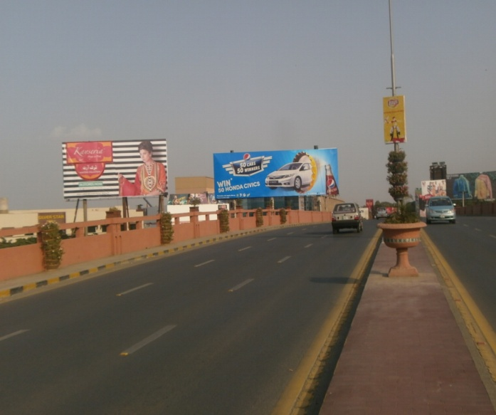
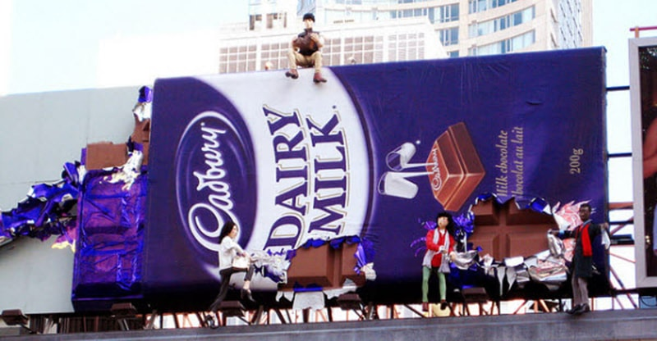
What we Do
Ad Solution
Advertising
Mobile Float
BTL Activities
Bill Boards/Hoardings
All Kinds of Pana Flex /Vinyl Printing
Offset Printing
X/Rollup Stand
Signage (New installation and Maintenance)

Slide 2
Ad Solution
Advertising
Proposal for
Billboards in Peshawar

Slide 3
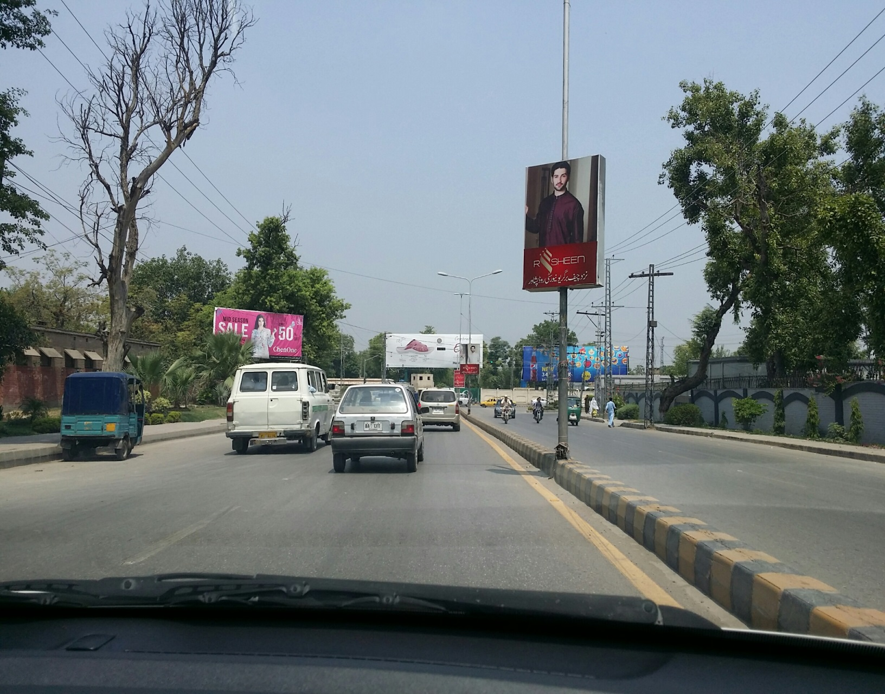
Peshawar
Size | 10x20
Availability
Rate | Rs:85,000/-
Location | Direction
 | FTCF:CSD Tanks buster Chowk

Slide 4
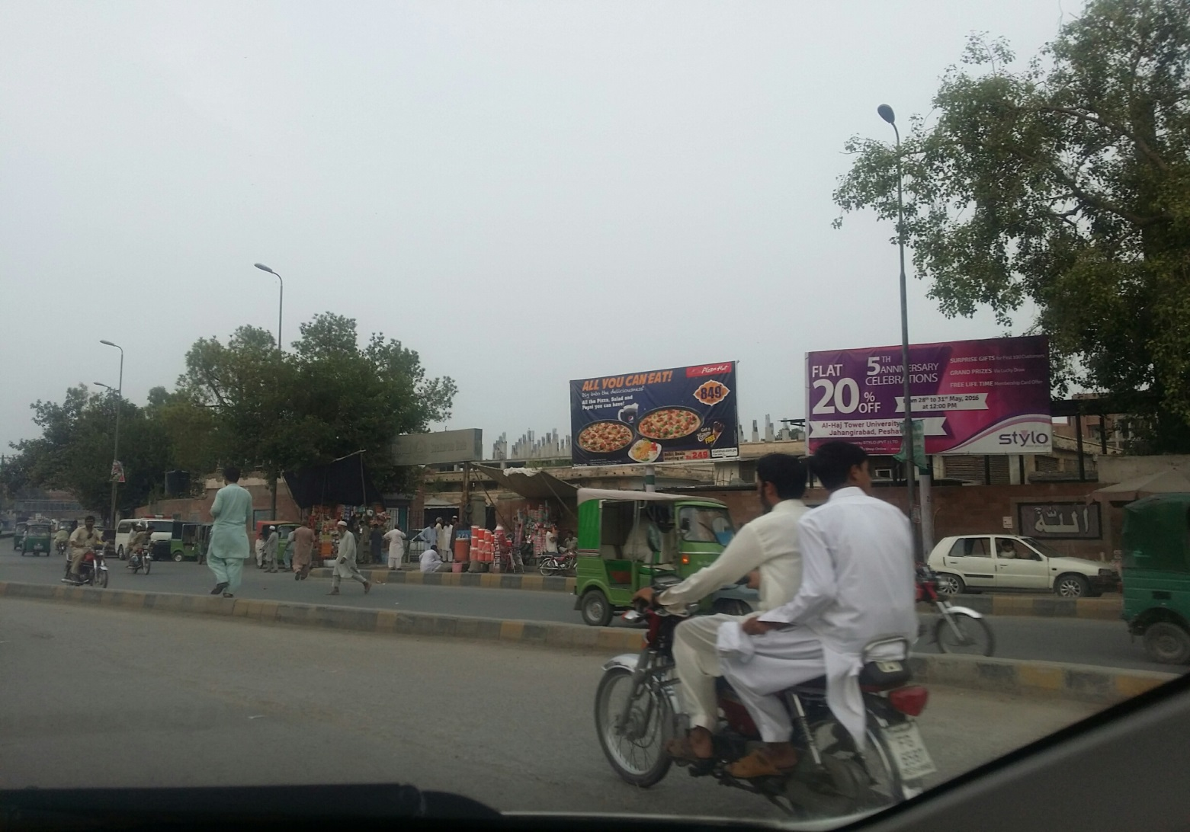
Peshawar
Size | 10x20
Availability
Rate | Rs:75,000/-
Location | Direction
 | FTCF:Kyber Bazar

Slide 5
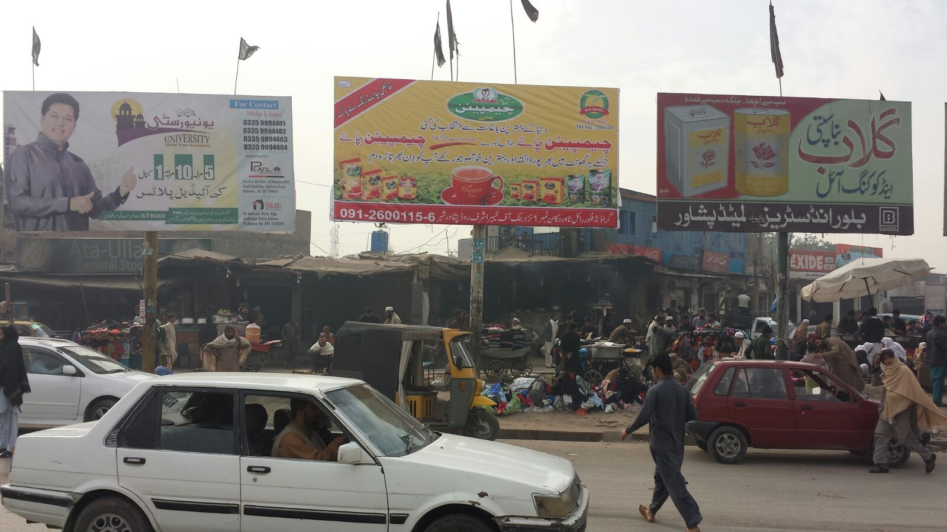
Peshawar
Size | 10x20
Availability
Rate | Rs:75,000/-
Location | Direction
 | FTCF:Kyber Bazar

Slide 6
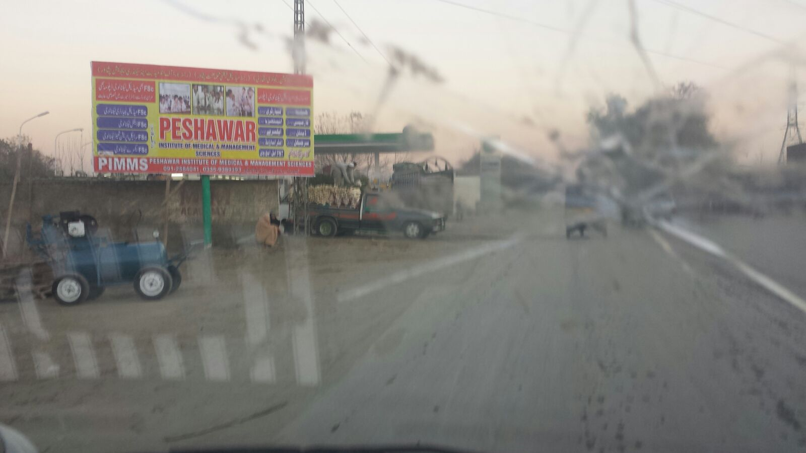
Peshawar
Size | 10x20
Availability
Rate | Rs:75,000
Location | Direction
 | FTCF:Kyber Bazar

Slide 7
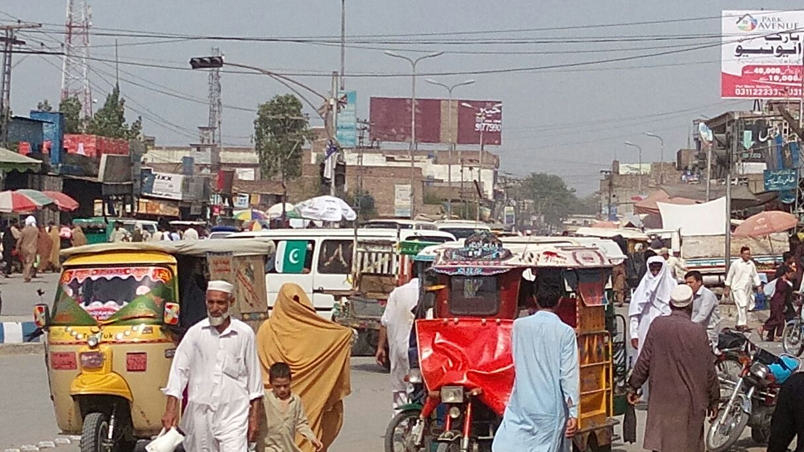
Peshawar
Size | 10x20
Availability
Rate | Rs:75,000/-
Location | Direction
 | FTCF:Kyber Bazar

Slide 8
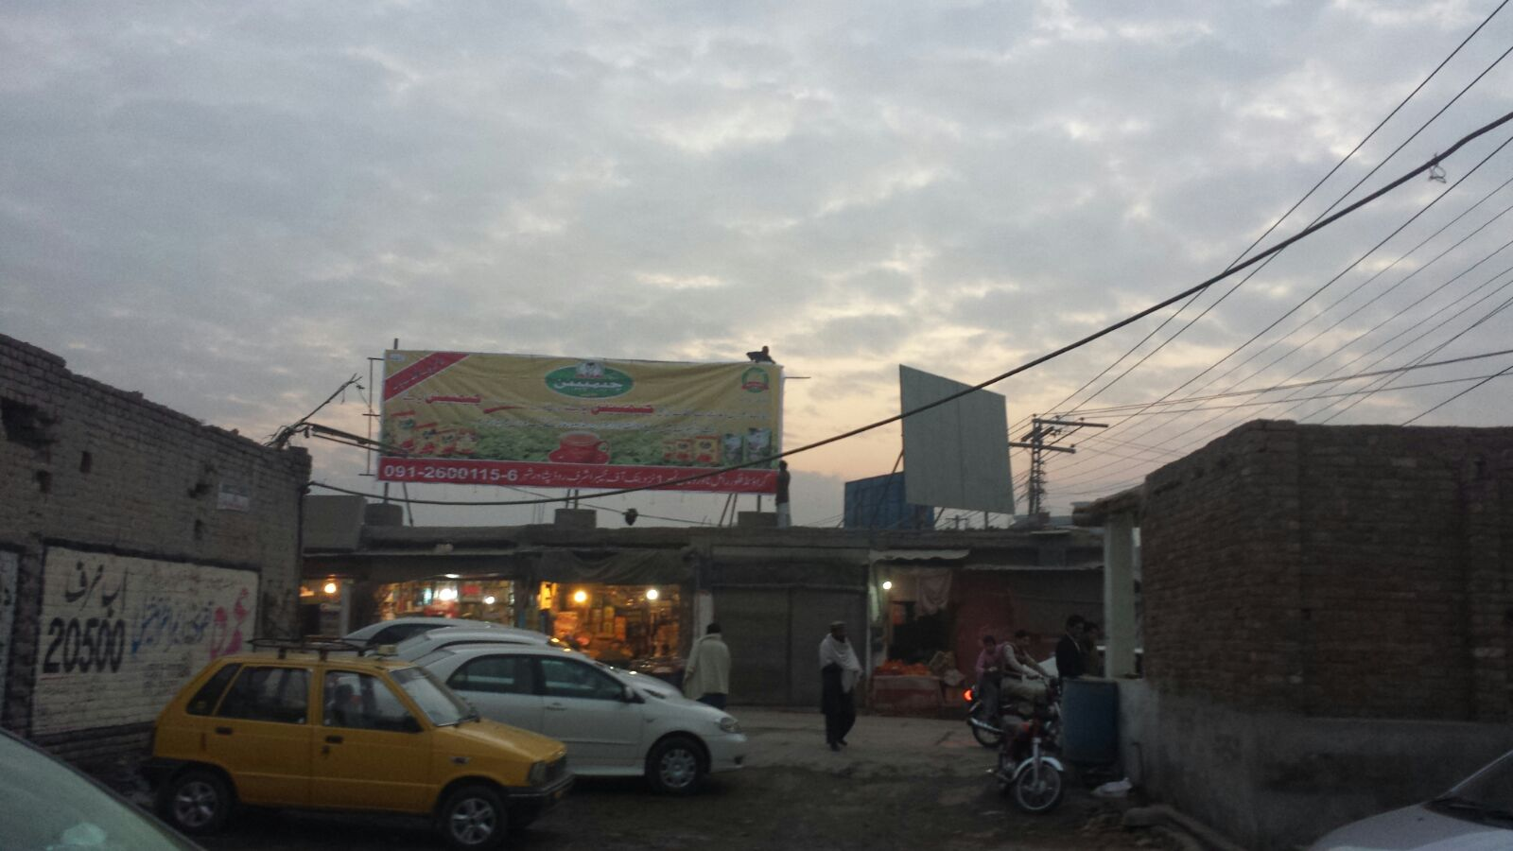
Peshawar
Size | 10x20
Availability
Rate | Rs:75,000/-
Location | Direction
 | FTCF:Kyber Bazar

Slide 9
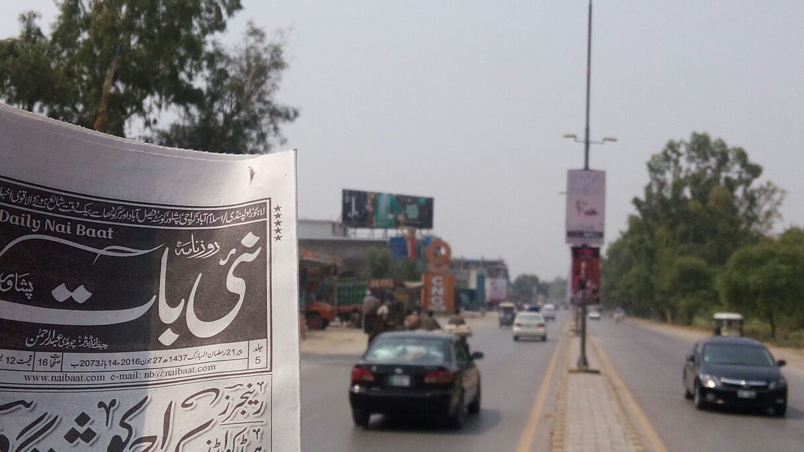
Peshawar
Size | 10x20
Availability
Rate | Rs:75,000/-
Location | Direction
 | FTCF:Kyber Bazar

Slide 10
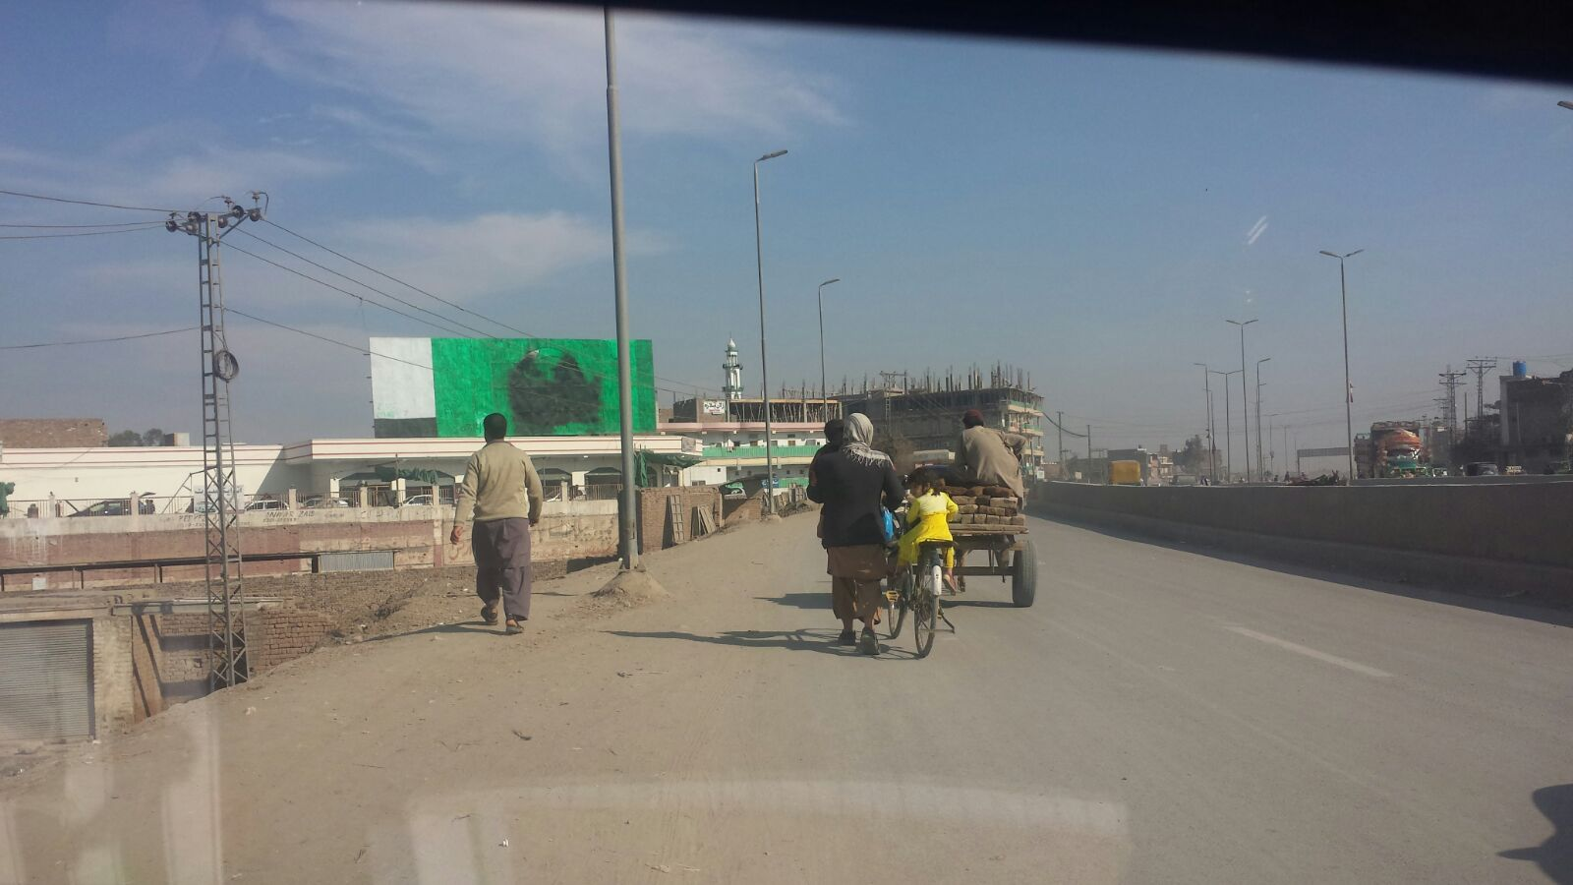
Peshawar
Size | 10x20
Availability
Rate | Rs:75,000/-
Location | Direction
 | FTCF:Kyber Bazar

Slide 11
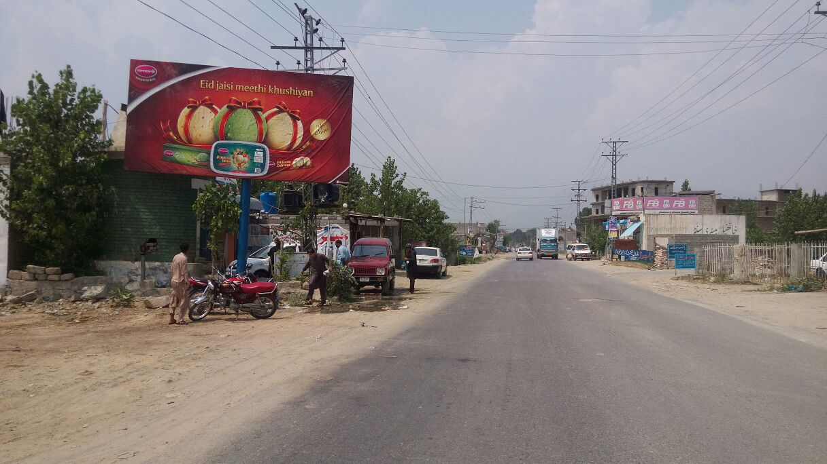
Peshawar
Size | 10x20
Availability
Rate | Rs:75,000/-
Location | Direction
 | FTCF:Kyber Bazar

Slide 12
Peshawar
Size | 60x20
Availability
Rate | Rs:
Location | Direction
Peshawar City | FTCF:Gubahar Flyover on roof of Al Fatah tower

Slide 13
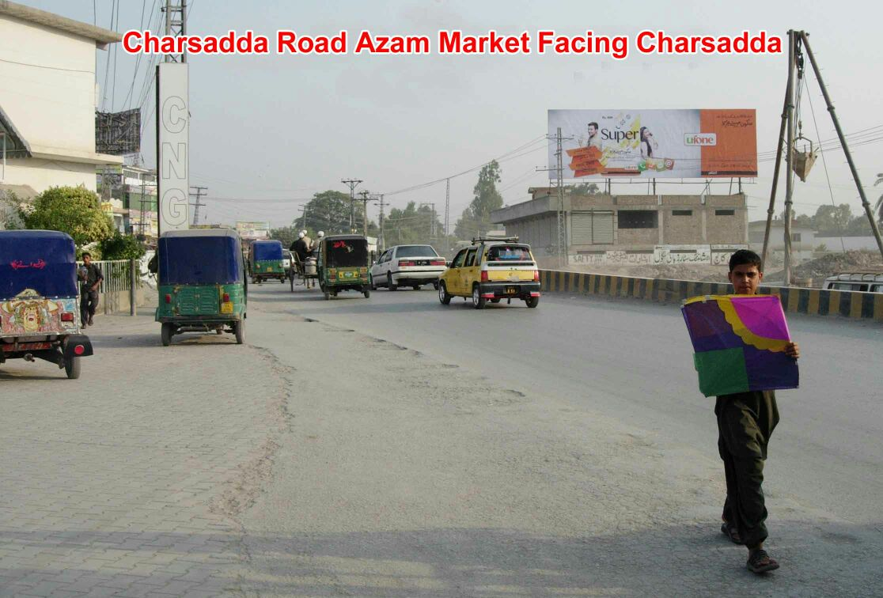
Peshawar
Size | 60x20
Availability
Rate | Rs:
Location | Direction
Azam Market | FTCF:Facing traffic going towards Charsada

Slide 14
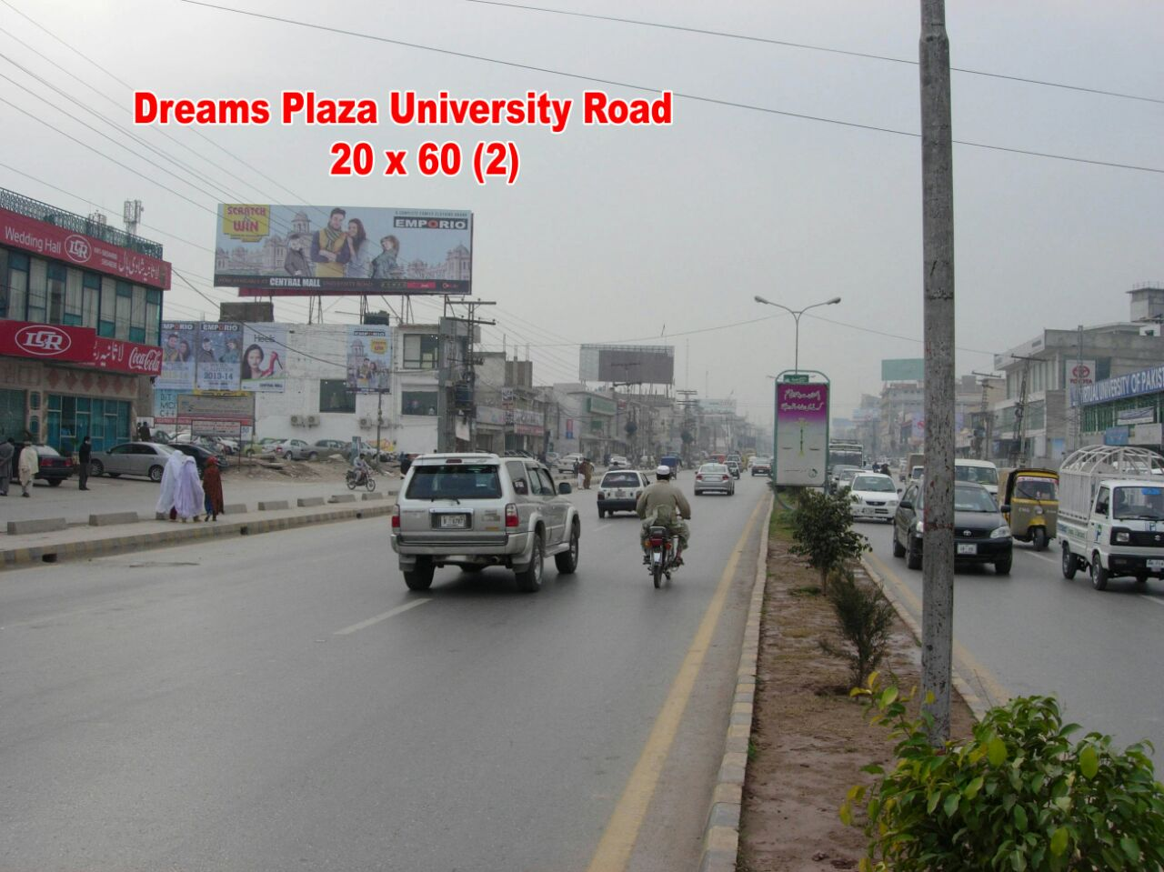
Peshawar
Size | 60x20
Availability
Rate | Rs:
Location | Direction
Dreams Plaza | FTCF:University Road

Slide 15
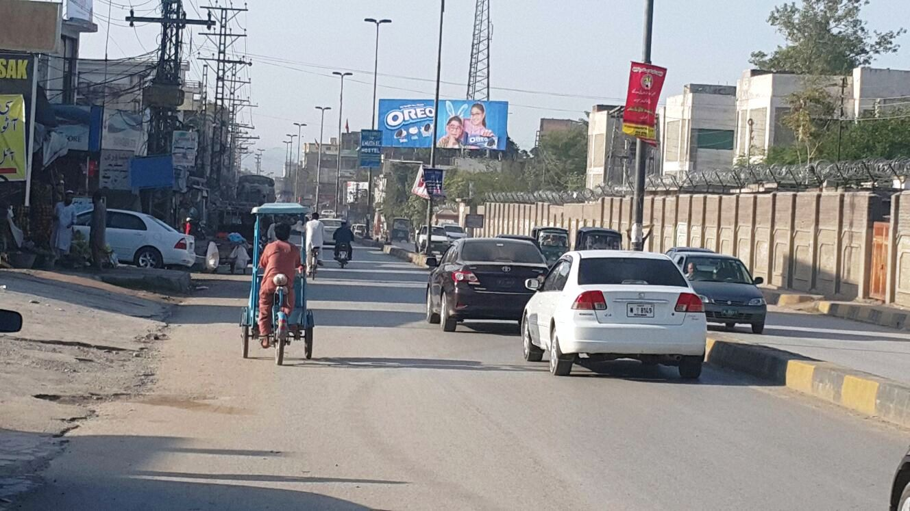
Peshawar
Size | 60x20
Availability
Rate | Rs:250,000/-
Location | Direction
Warsak Road Cantt | FTCF:TFCF Aman Chowk/City and going towards Warsak Dam

Slide 16
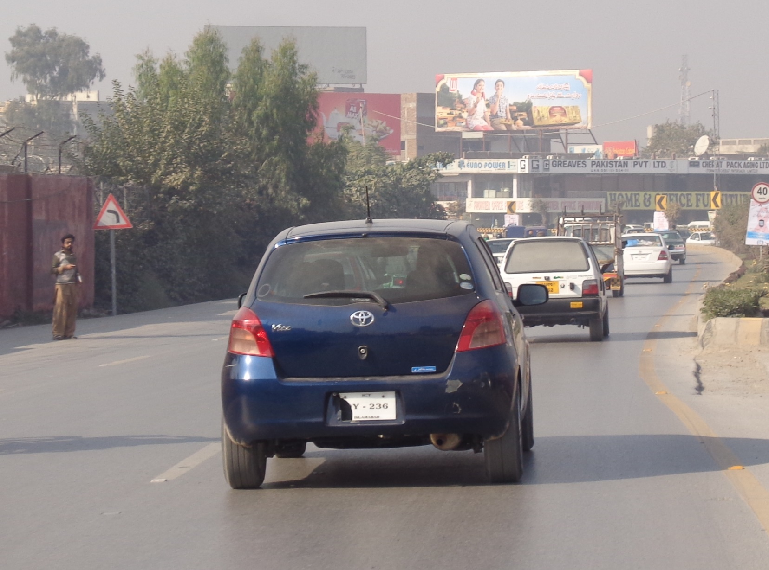
Peshawar
Size | 60x20
Availability
Rate | Rs:250,000/-
Location | Direction
University Road Tambwano Turn | FTCF:TFCF Saddar and going towards Hayatabad

Slide 17
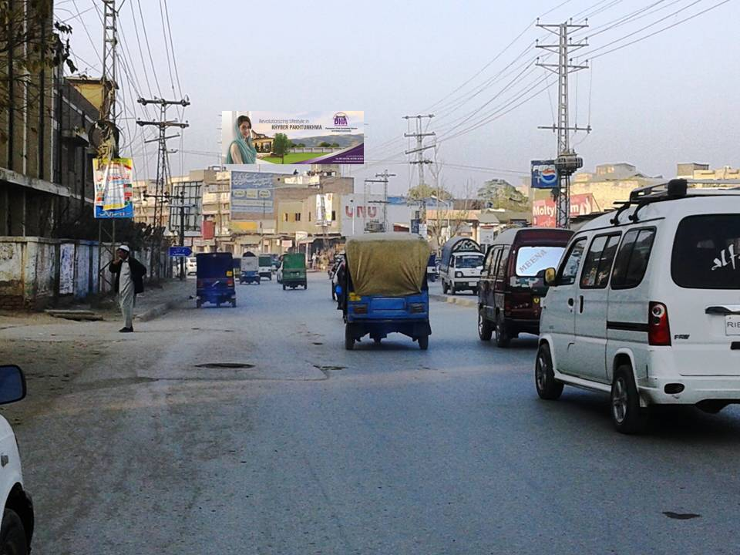
Peshawar
Size | 60x20
Availability
Rate | Rs:250,000/-
Location | Direction
Kohat Road Peshawar City | FTCF:TFCF Kohat/Ring road and going towards Khyber Bazar/Saddar/Deanz etc

Slide 18
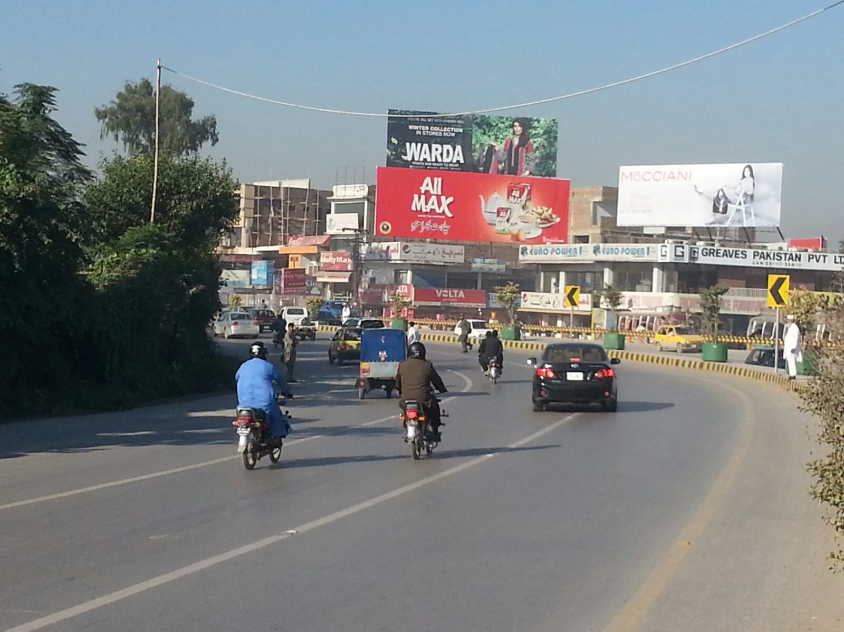
Peshawar
Size | 60x20
Availability
Rate | Rs:275,000/-
Location | Direction
University Road at Tambwano Turn 2 | FTCF:TFCF Saddar and going towards Hayatabad

Slide 19
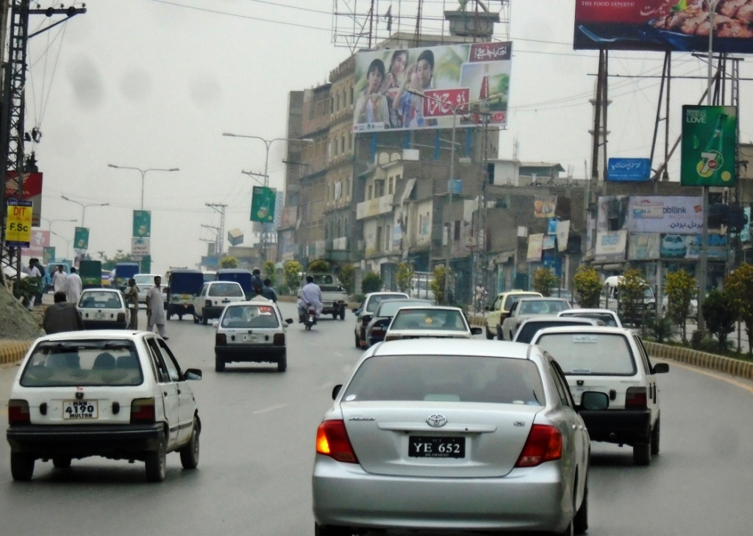
Peshawar
Size | 60X20
Availability
Rate | Rs: 250,000/-
Location | Direction
University Road at Near KFC | FTCF:TFCF Saddar and going towards Hayatabad

Slide 20
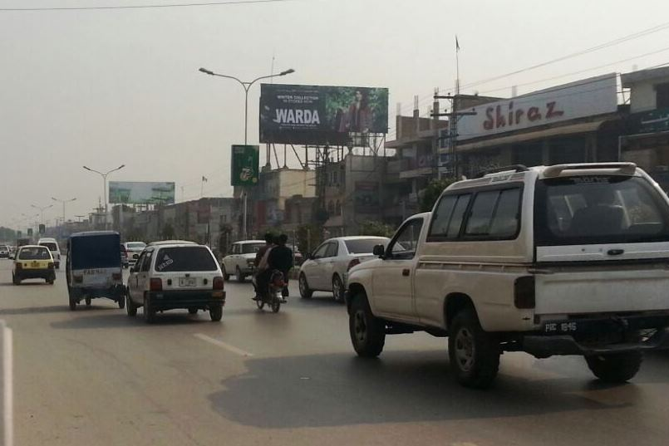
Peshawar
Size | 60X20
Availability
Rate | Rs:250,000/-
Location | Direction
University Road near Shiraz Restaurant | FTCF:TFCF Hayat Abad and going towards Saddar Cantt/Peshawar City

Slide 21
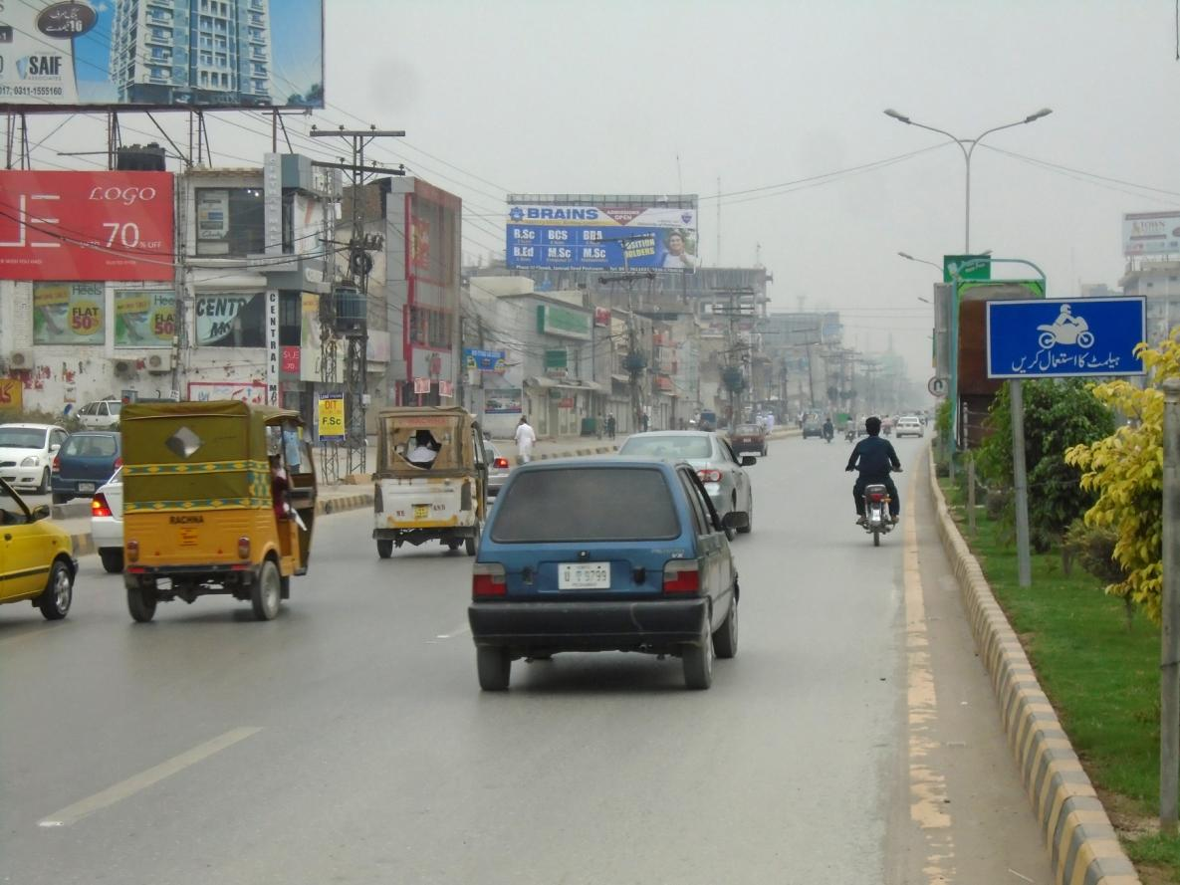
Peshawar
Size | 60X20
Availability
Rate | Rs:200,000/-
Location | Direction
University Road Near Ufone Office | FTCF:TFCF Saddar and going towards Hayatabad

Slide 22
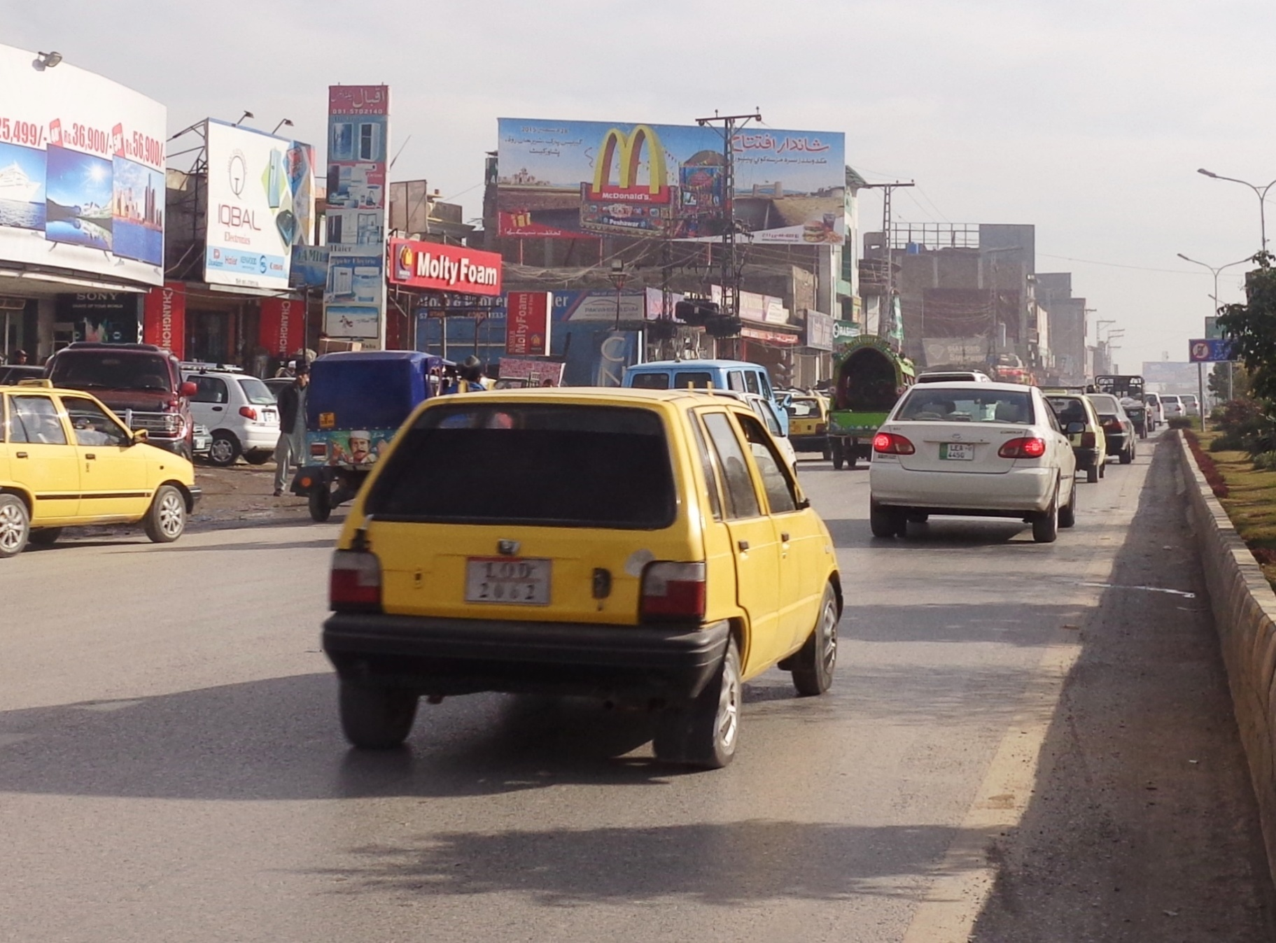
Peshawar
Size | 60X20
Availability
Rate | Rs:250,000/-
Location | Direction
University Road Opp Runway | FTCF:TFCF Hayatabad and going towards Saddar/City

Slide 23
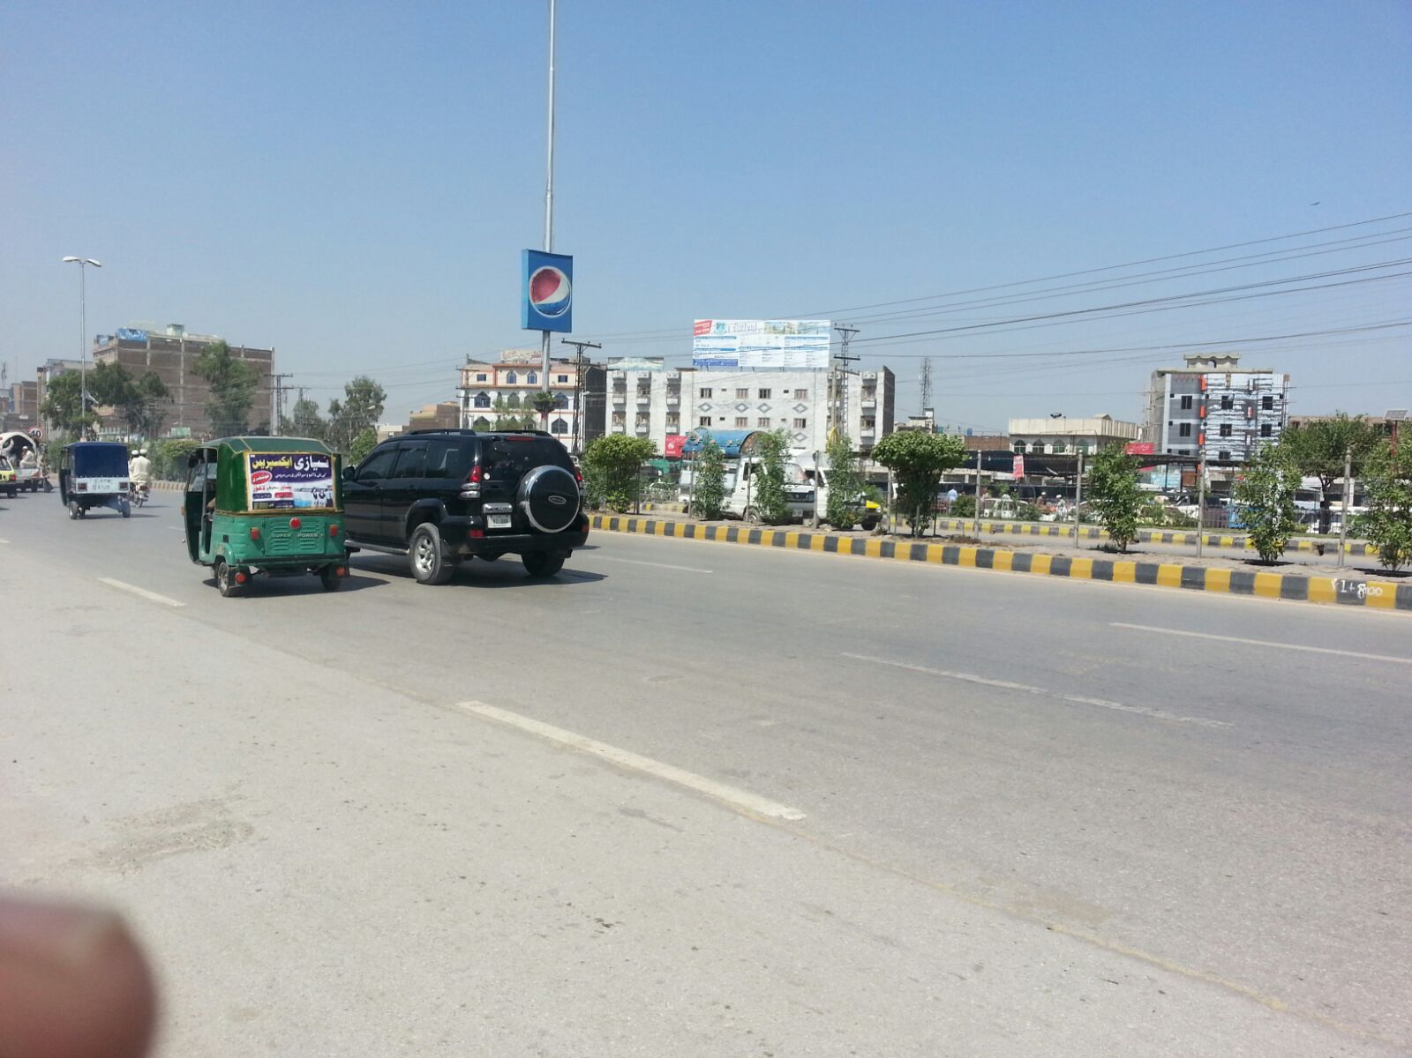
Peshawar
Size | 60X20
Availability
Rate | Rs:250,000/-
Location | Direction
Bus Termina | FTCF:TFCF Ring road and going towards Qilla Bala Hisar

Slide 24
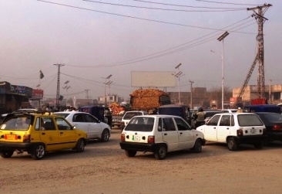
Peshawar
Size | 60X20
Availability
Rate | Rs:250,000/-
Location | Direction
Jameel Chowk Ring Road | FTCF:TFCF GT/Motorway /Phandu Road and going towards Hayatabad/Industrial Estate

Slide 25
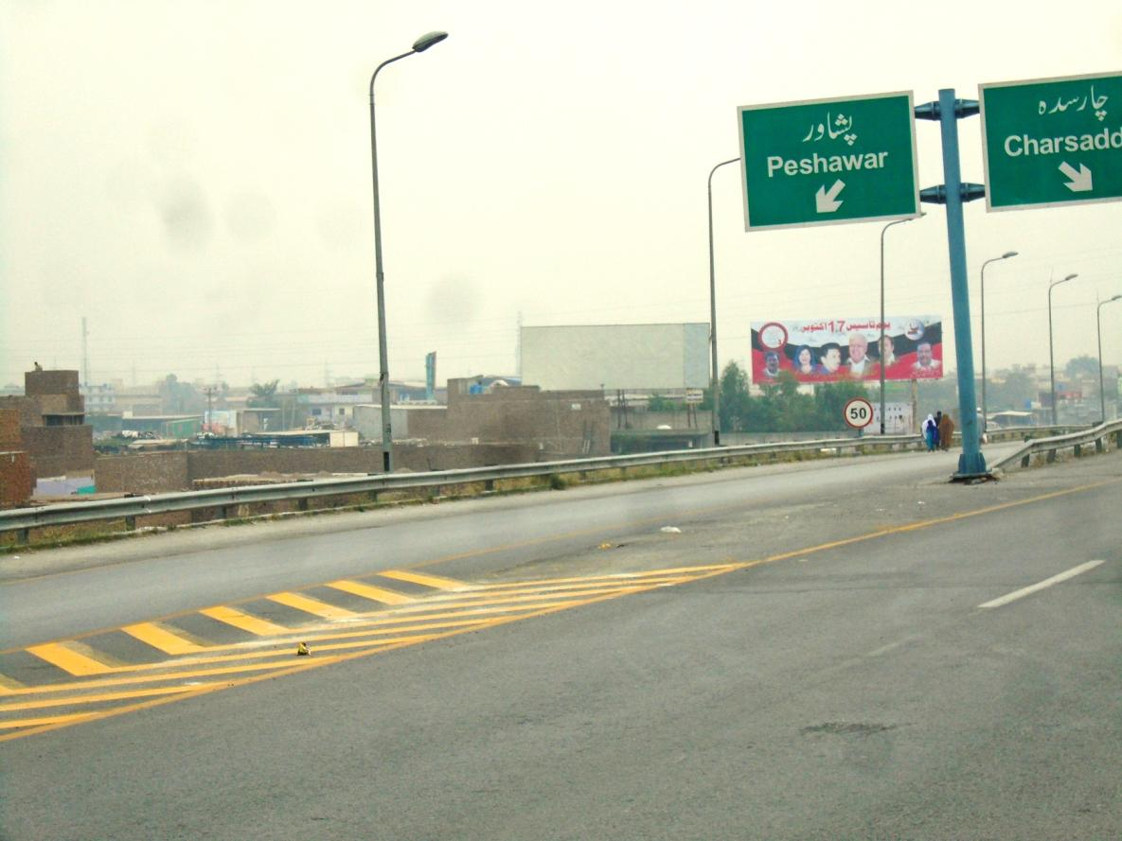
Peshawar
Size | 60X20
Availability
Rate | Rs:250,000/-
Location | Direction
Motorway Exit / City Entrance | FTCF:TFCF Motorway and going towards Peshawar City

Slide 26
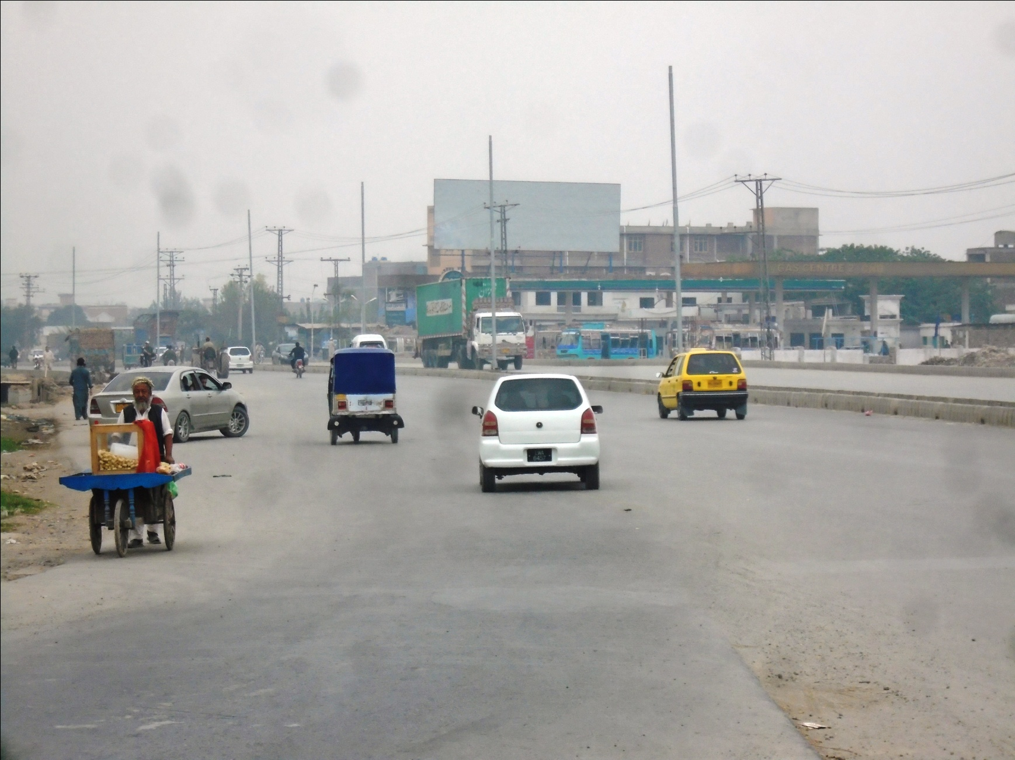
Peshawar
Size | 60X20
Availability
Rate | Rs:250,000/-
Location | Direction
Motorway Exit / Ring Road | FTCF:TFCF Motorway and going towards Charsadda Road

Slide 27
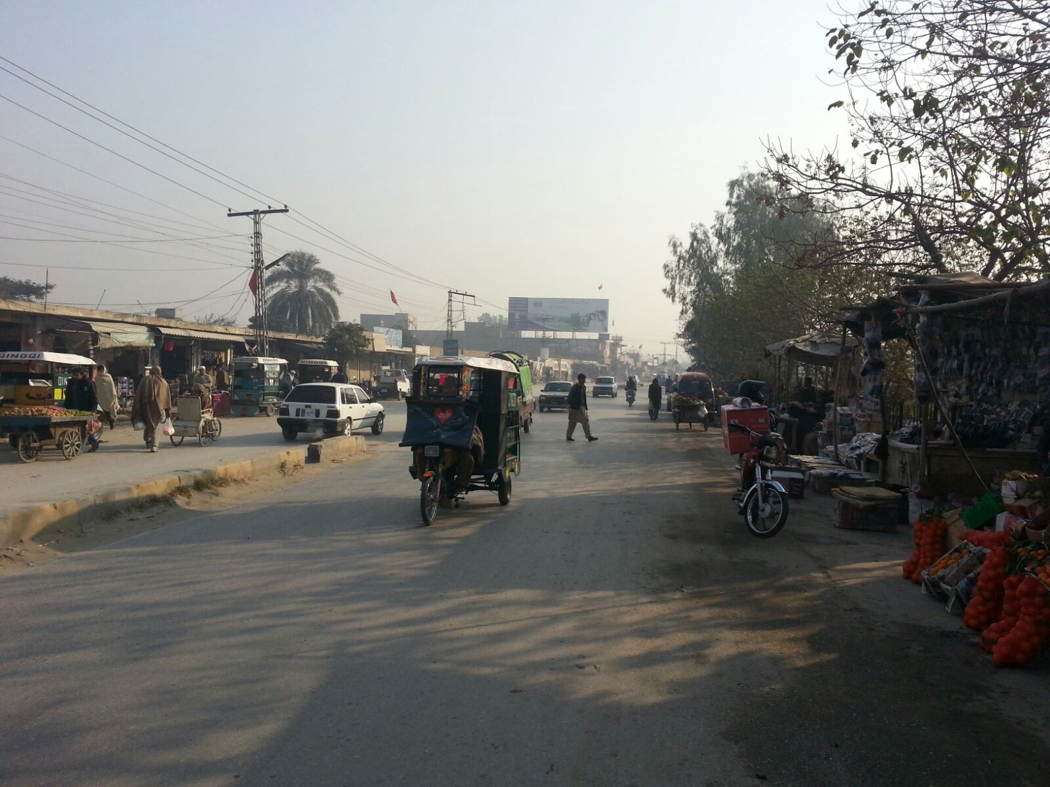
Peshawar
Size | 60X20
Availability
Rate | Rs:175,000/-
Location | Direction
Main Bazar | FTCF:TFCF Peshawar and going towards Mardan

Slide 28
Ad Solution
TERMS & CONDITIONS
First time skin installation and removing is free.
Skin printing charges are not included in the proposed rates.
These rates are exclusive of all kinds of taxes.
If skin is damaged due to weather, changing/re-printing charges will be borne by the client.
The payment will be made 50% in advance and the remaining balance will be payable through 15 days post dated cheque, from the day, the display starts.
For locking the sites please inform us within 1-3 working days.

