Slide 1
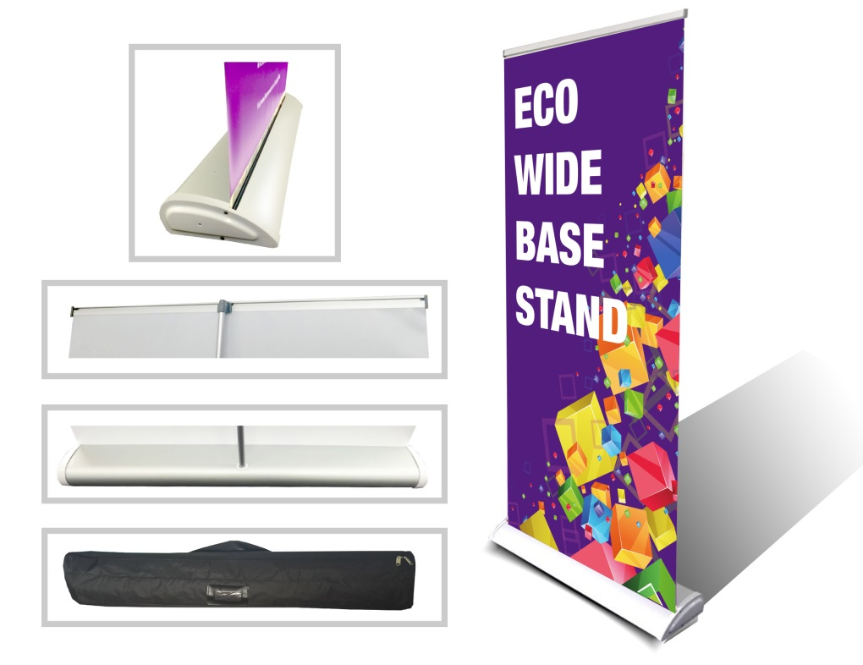
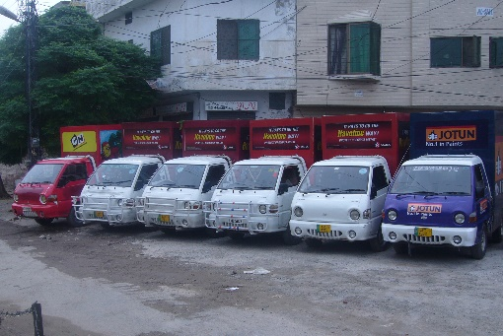
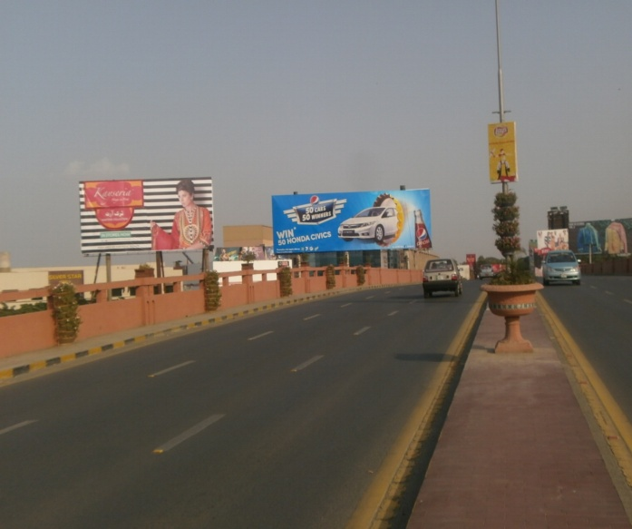
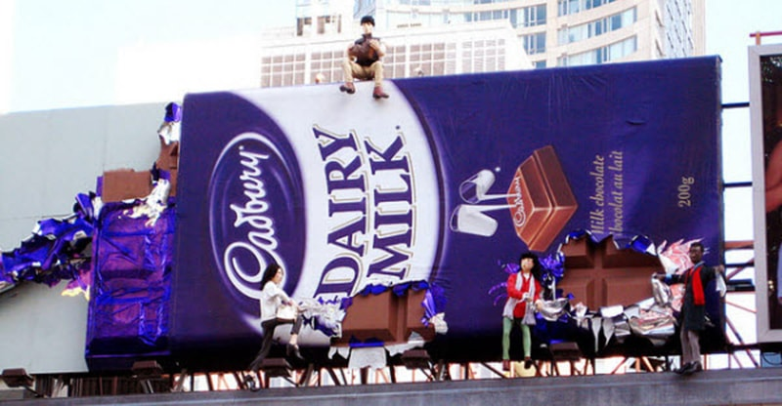
What we Do
Ad Solution
Advertising
Mobile Float
BTL Activities
Bill Boards/Hoardings
All Kinds of Pana Flex /Vinyl Printing
Offset Printing
X/Rollup Stand
Signage (New installation and Maintenance)

Slide 2
Ad Solution
Advertising
Proposal for
Billboards in Sargodha

Slide 3
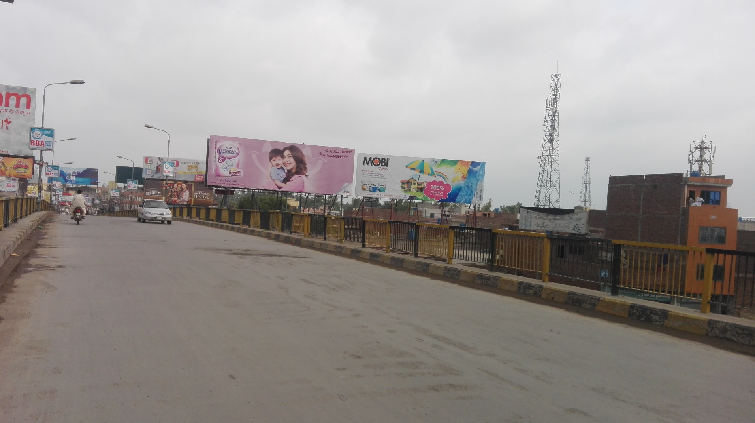
Sargodha
Size | 60X20
Availability
Rate P/M | Rs:200,000/-
Location | Direction
Khayyam bridge | FTCF:Traffic coming from city going toward university road and Shama chowk

Slide 4
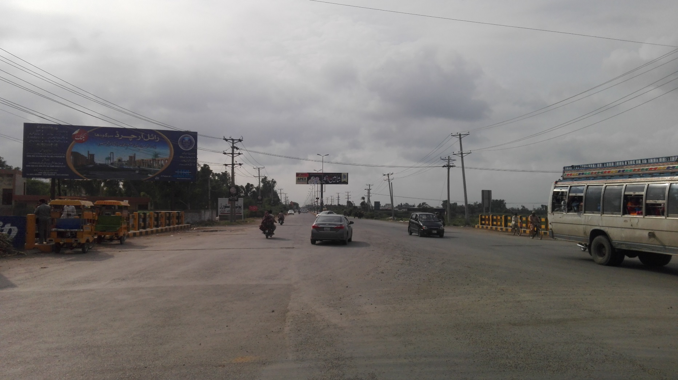
Sargodha
Size | 60X20
Availability
Rate P/M | Rs:175,000/-
Location | Direction
Lahore road Site | FTCF:Traffic coming from Lahore going towards university road and city

Slide 5
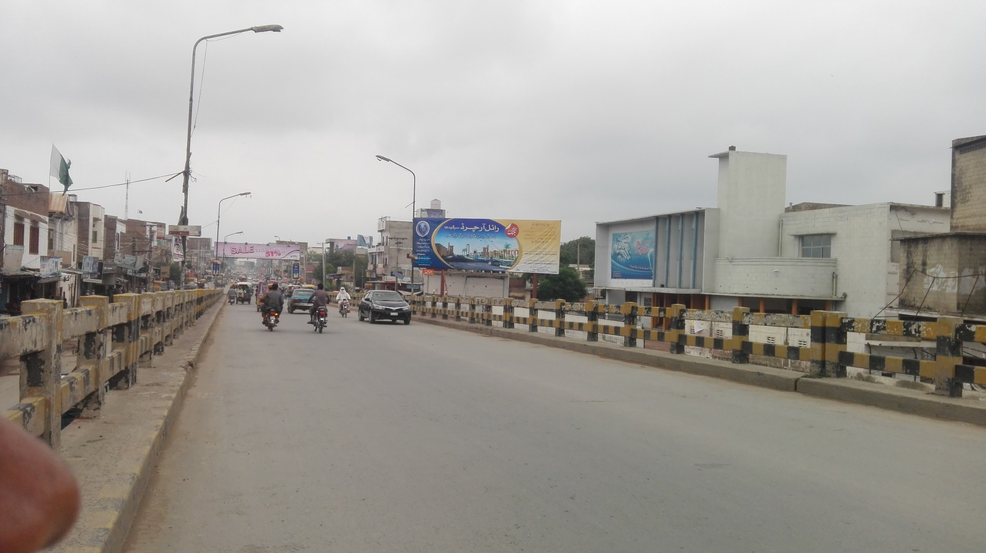
Sargodha
Size | 60X20
Availability
Rate P/M | Rs:200,000/-
Location | Direction
Old Bridge Rex Marriage Hall | FTCF:Traffic coming from city and going towards qenchi mor and Lahore

Slide 6
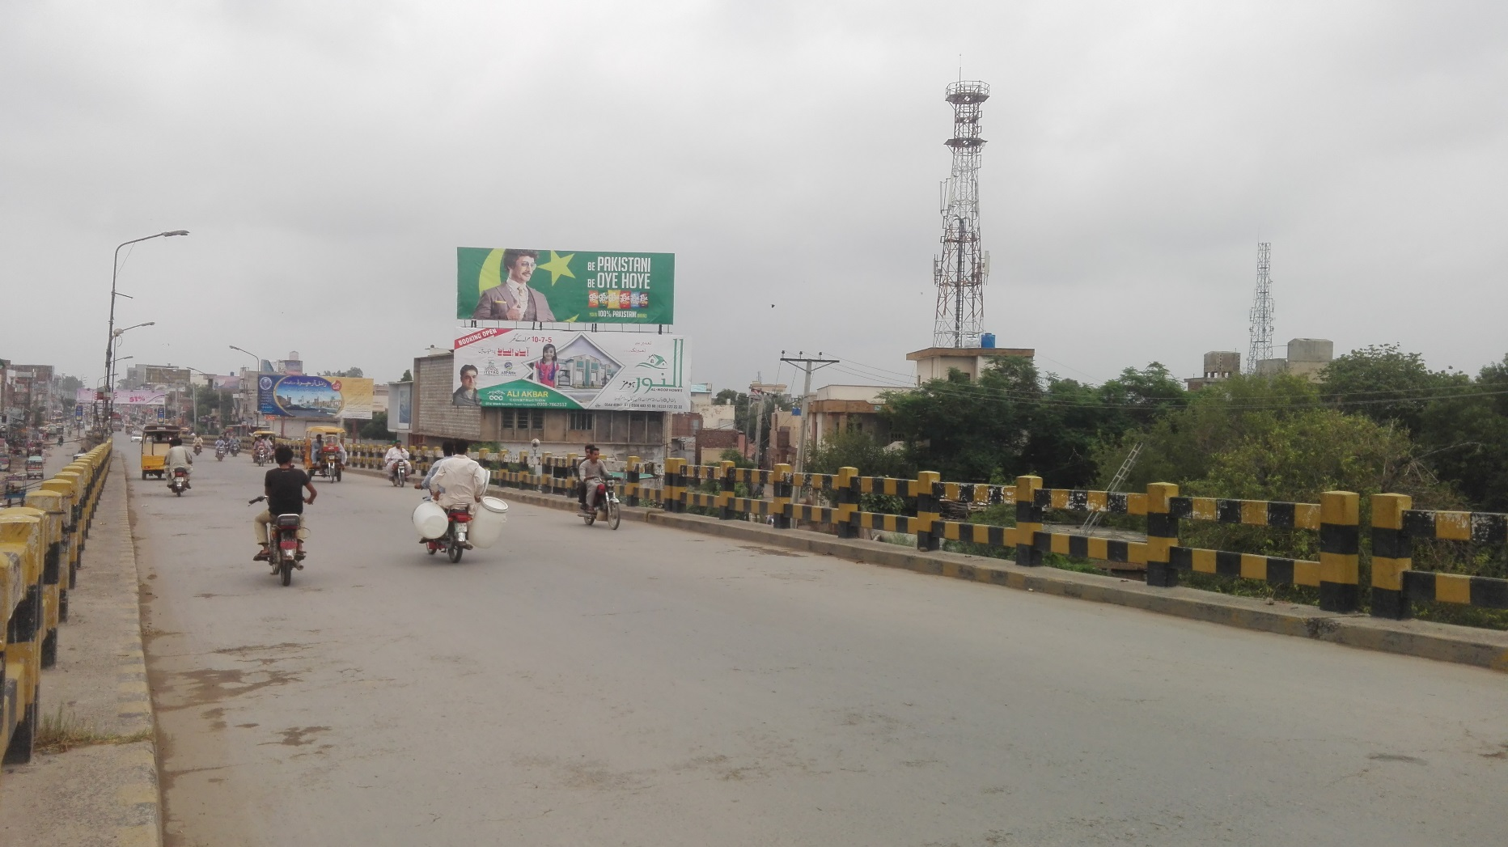
Sargodha
Size | 60X20
Availability
Rate P/M | Rs:200,000/-
Location | Direction
Old Bridge Neelam Cinema | FTCF:Traffic coming from city and going towards qenchi mor and Lahore

Slide 7
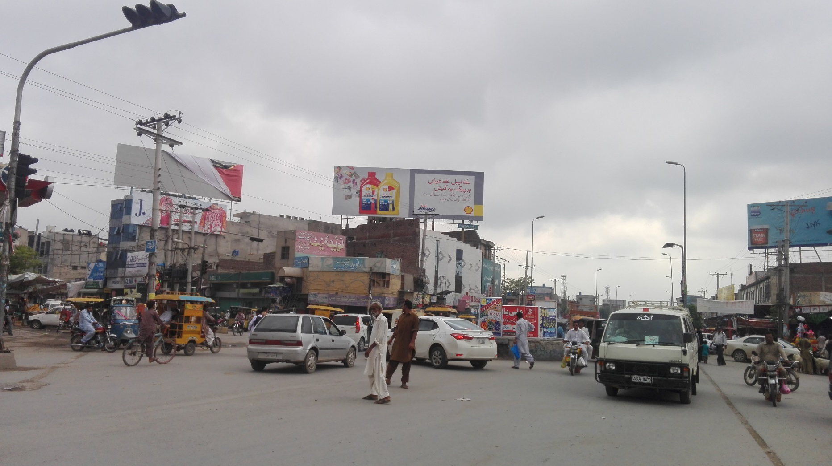
Sargodha
Size | 60X20
Availability
Rate P/M | Rs:200,000/-
Location | Direction
Satellite town chock | FTCF:Traffic coming from Chungi # 9 and going towards city Sargodha

Slide 8
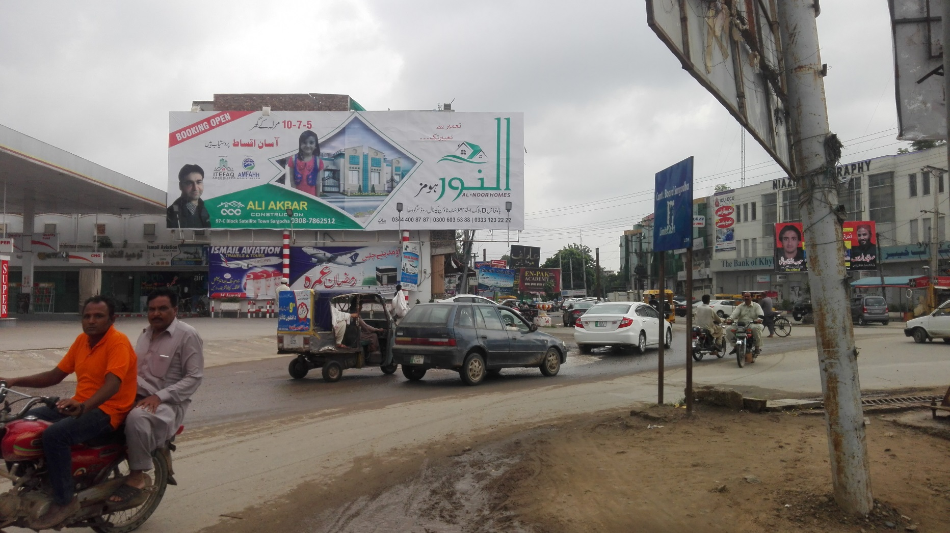
Sargodha
Size | 60X20
Availability
Rate P/M | Rs:200,000/-
Location | Direction
Main Shama chowk Site | FTCF: Shama chowk roundabout

Slide 9
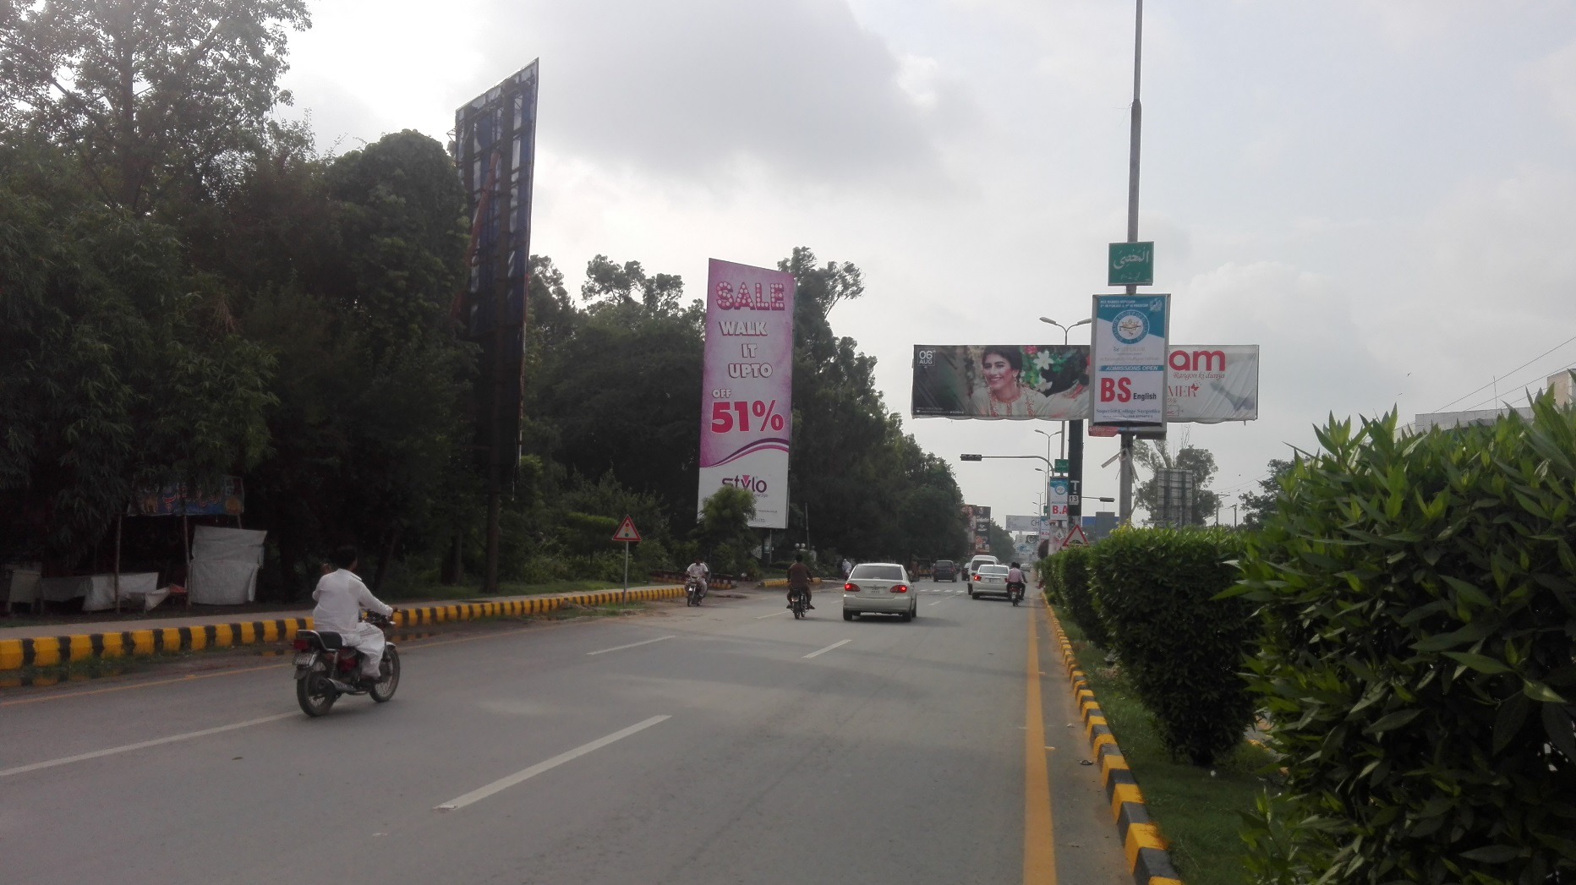
Sargodha
Size | 60X20
Availability
Rate P/M | Rs:200,000/-
Location | Direction
University road opposite Rahman Plaza | FTCF:Traffic coming from 47 pull going towards Khayyam chock

Slide 10
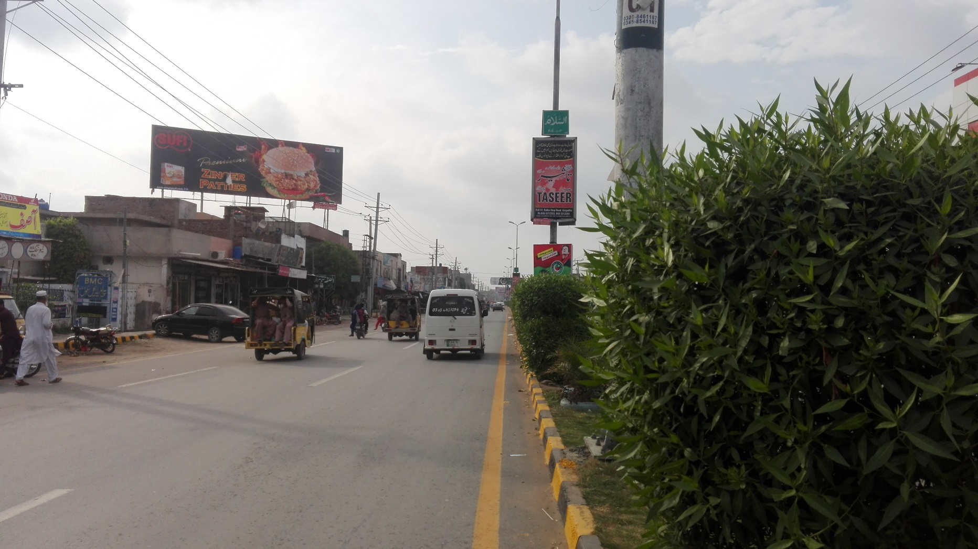
Sargodha
Size | 60X20
Availability
Rate P/M | Rs:200,000/-
Location | Direction
University road site opposite Daewoo terminal | FTCF:Traffic coming from 47 pull and going towards Sargodha university

Slide 11
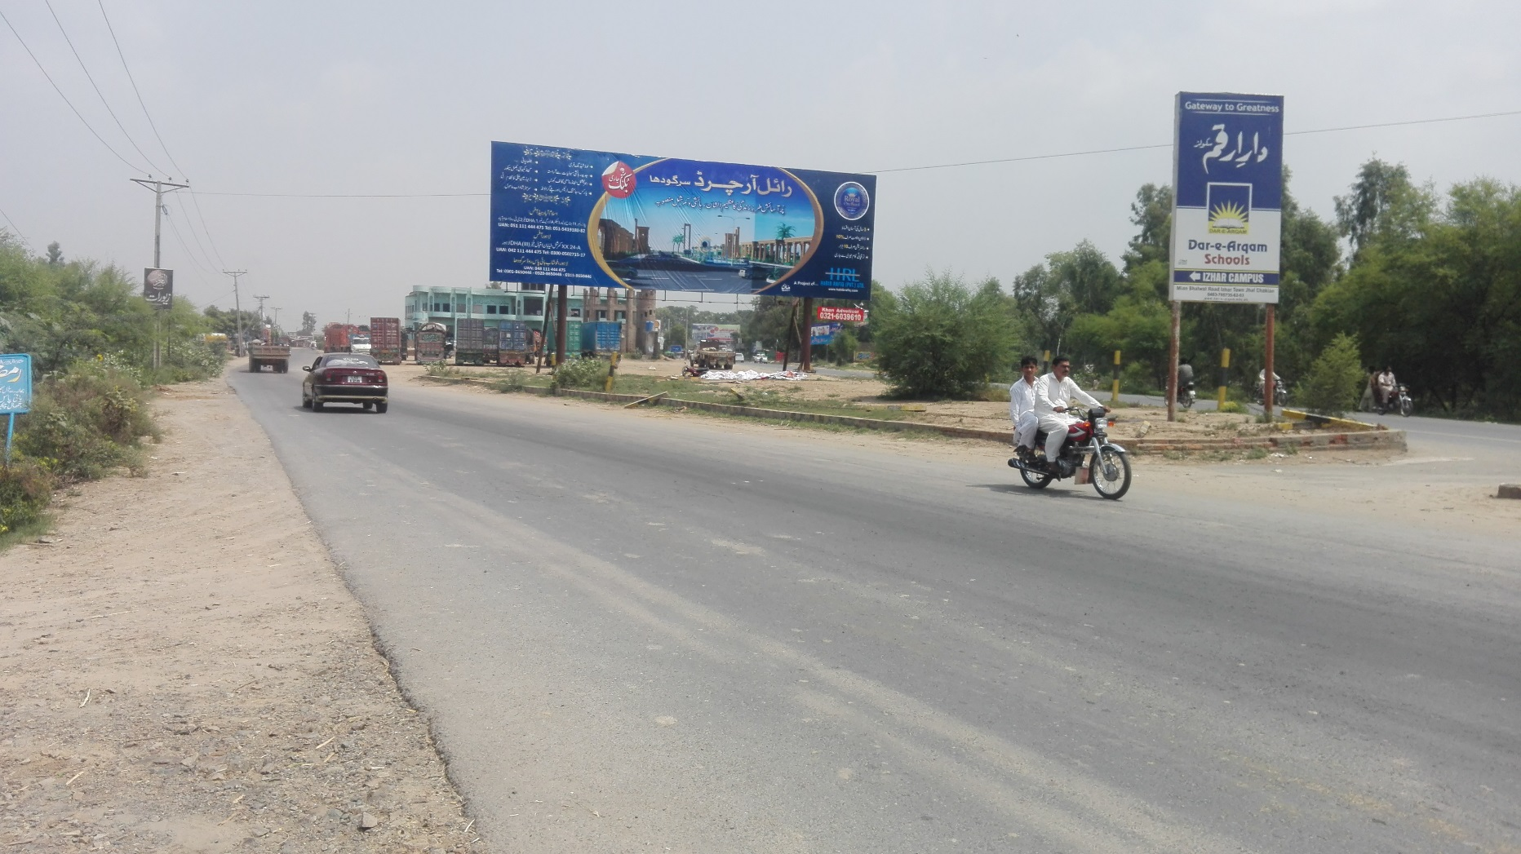
Sargodha
Size | 60X20
Availability
Rate P/M | Rs:200,000/-
Location | Direction
ChakiyanTraffic coming from khushab | FTCF:Mianwali going towards Sargodha city

Slide 12
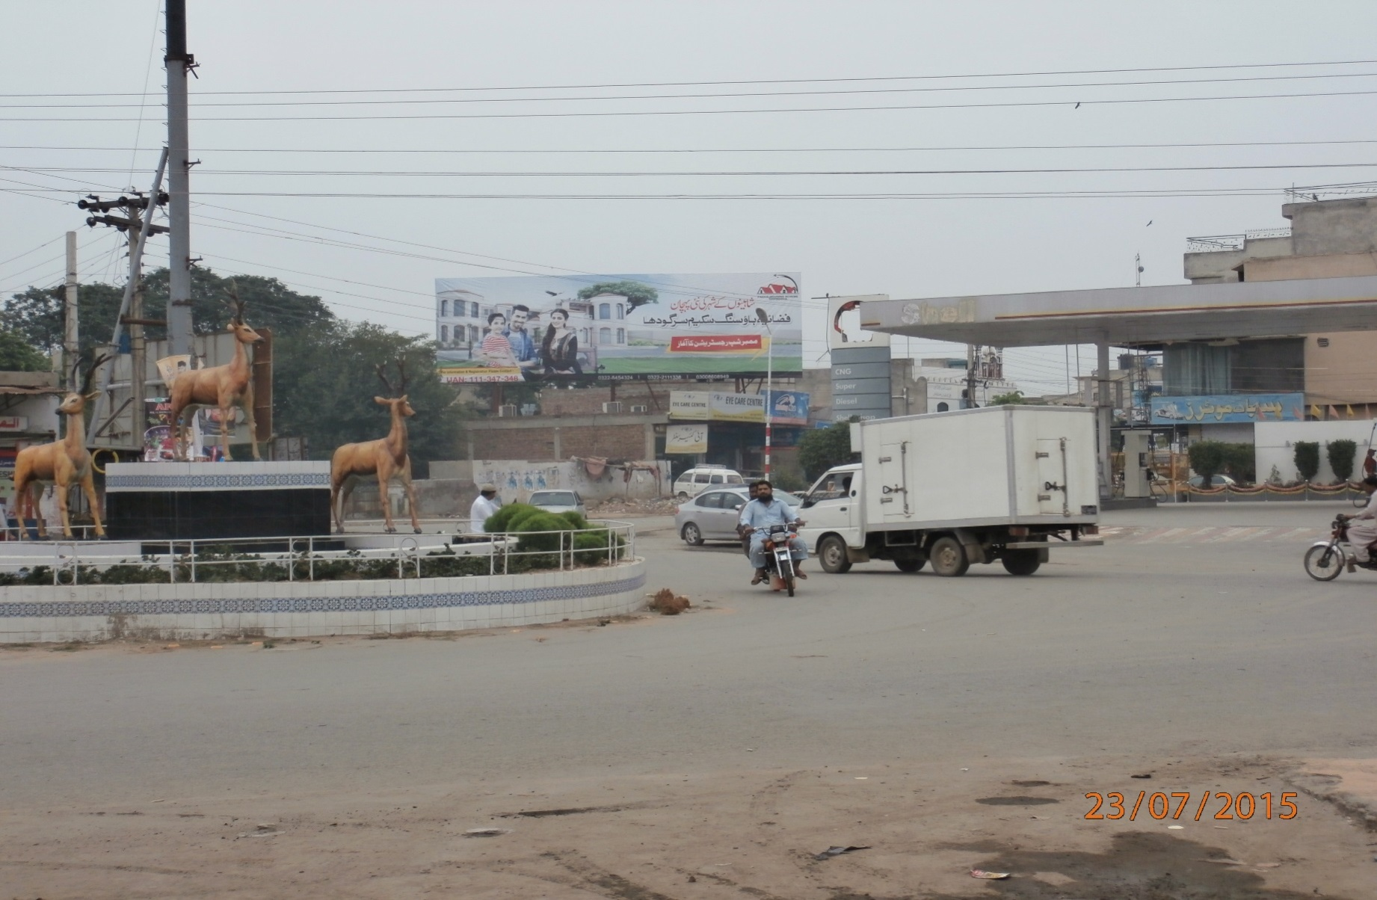
Sargodha
Size | 60X20
Availability
Rate P/M | Rs:200,000/-
Location | Direction
Main Shama Chowk | FTCF: shama chowk roundabot

Slide 13
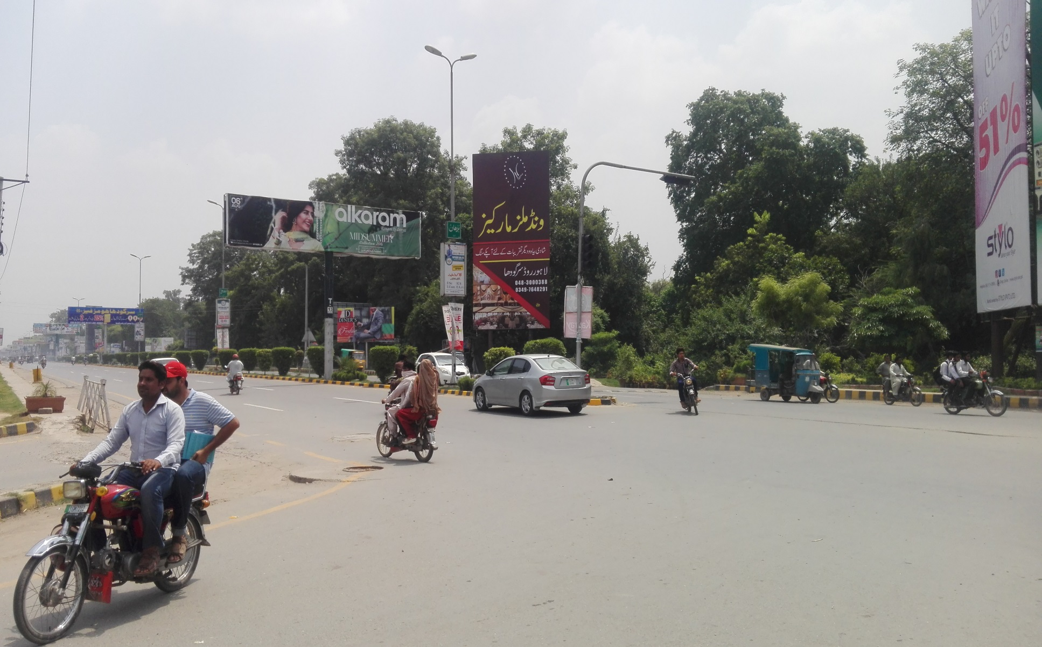
Sargodha
Size | 60X20
Availability
Rate P/M | Rs:200,000/-
Location | Direction
Khayyam chowk | FTCF:Facing Khayyam chowk Opposite Rahman Plaza university road

Slide 14
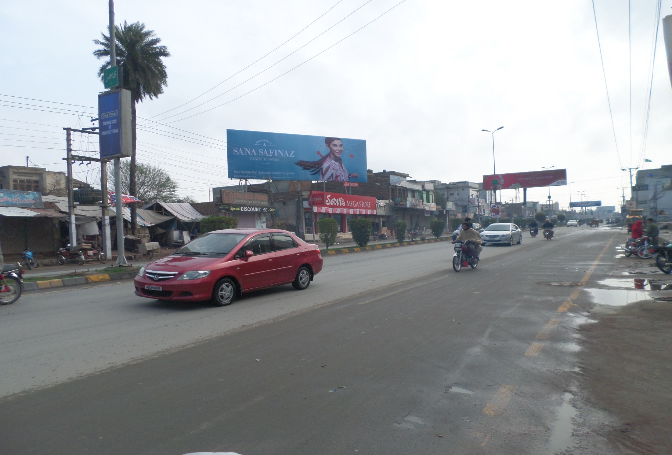
Sargodha
Size | 60X20
Availability
Rate P/M | Rs:200,000/-
Location | Direction
University road | FTCF: University Road Opposite Chen One Tower

Slide 15
Ad Solution
TERMS & CONDITIONS
First time skin installation and removing is free.
Skin printing charges are not included in the proposed rates.
These rates are exclusive of all kinds of taxes.
If skin is damaged due to weather, changing/re-printing charges will be borne by the client.
The payment will be made 50% in advance and the remaining balance will be payable through 15 days post dated cheque, from the day, the display starts.
For locking the sites please inform us within 1-3 working days.

