Slide 1
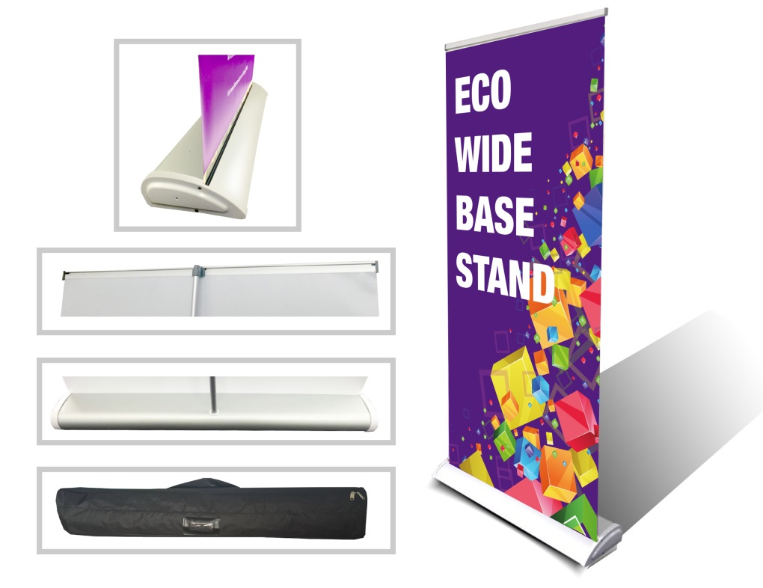
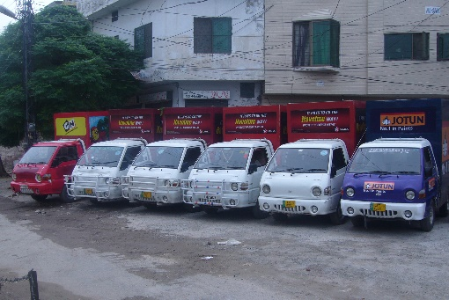
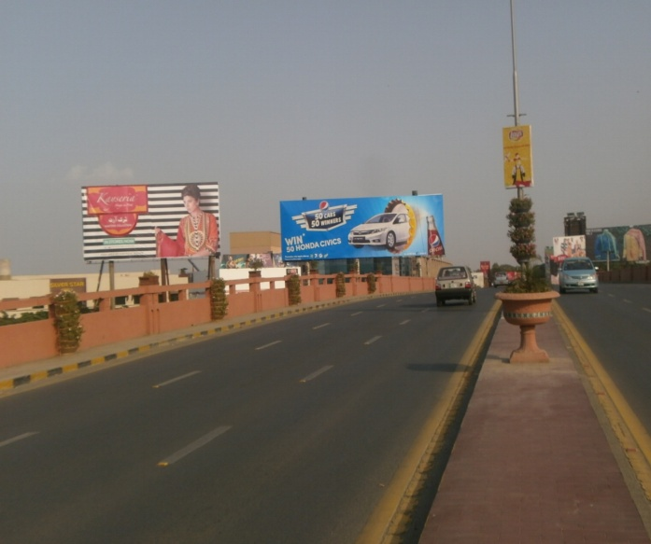
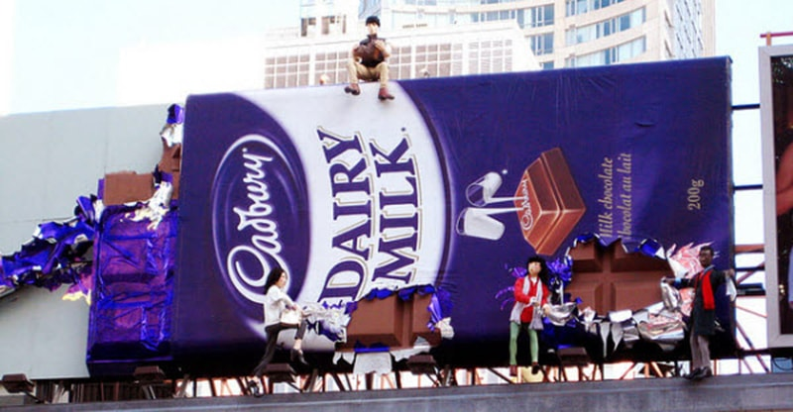
What we Do
Ad Solution
Advertising
Mobile Float
BTL Activities
Bill Boards/Hoardings
All Kinds of Pana Flex /Vinyl Printing
Offset Printing
X/Rollup Stand
Signage (New installation and Maintenance)

Slide 2
Ad Solution
Advertising
Proposal for
Billboards in Sialkot

Slide 3
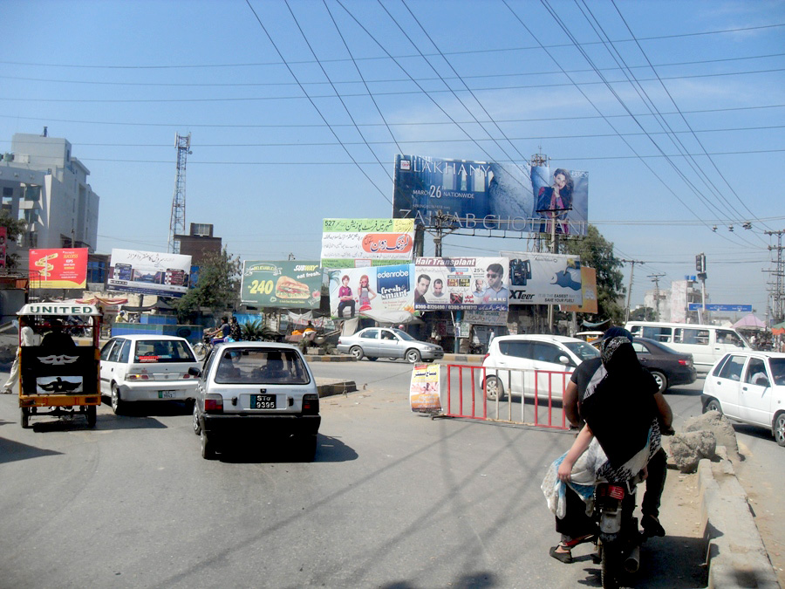
Sialkot
Size | 60x20
Availability
Rate P/M | Rs:250,000/-
Location | Direction
Sialkot cantt | FTCF:Sublime Chowk Sialkot Facing traffic coming from Daska,Gujranwala,Lahore

Slide 4
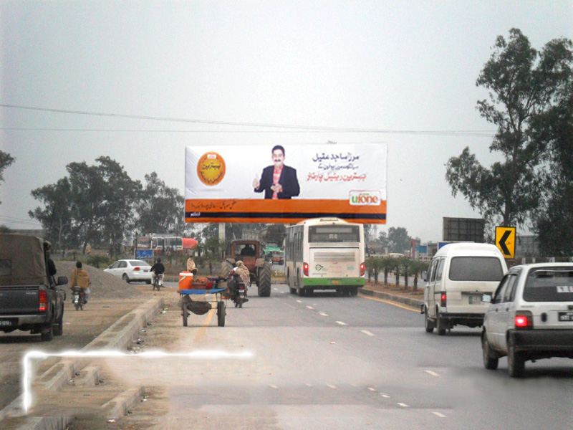
Sialkot
Size | 90x30
Availability
Rate P/M | Rs:450,000/-
Location | Direction
Sialkot cantt | FTCF:Airport Chowk Wazirabad Road(Near Dryport) Facing traffic coming from Islamabad, Wazirabad, jehlum

Slide 5
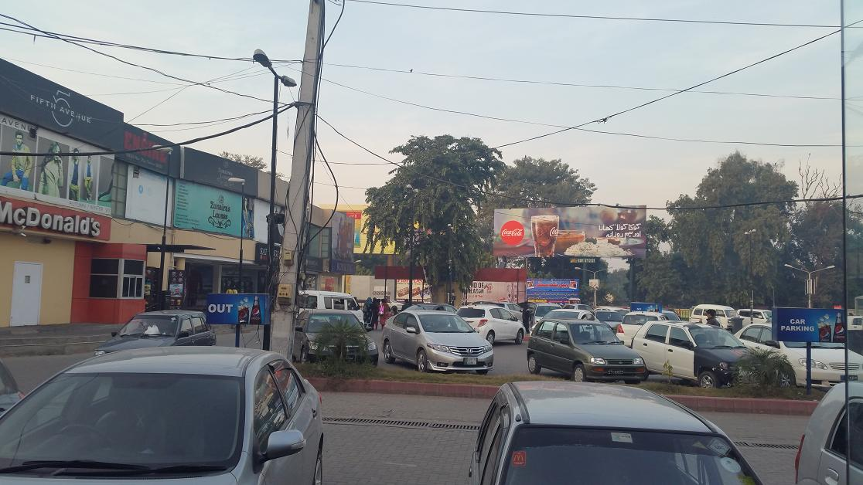
Sialkot
Size | 60x20
Availability
Rate P/M | Rs:325,000/-
Location | Direction
Sialkot cantt | FTCF:8 Division Clover Plaza Welfare Shops Cantt with Dual Visibility. Mahmood Ghaznvi road. Coming From Cantt and City MARKET site

Slide 6
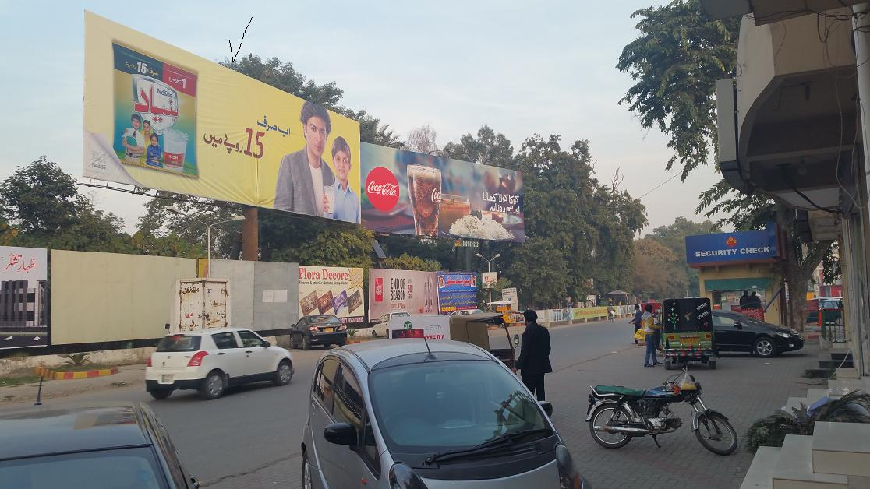
Sialkot
Size | 60x20
Availability
Rate P/M | Rs:300,000/-
Location | Direction
Sialkot cantt | FTCF:Clover Plaza 8 Div Welfare Shops Cantt Nestle Bunyad Ghazi road Cantt Coming From Mahmood Ghazanvi Road Cantt and City

Slide 7
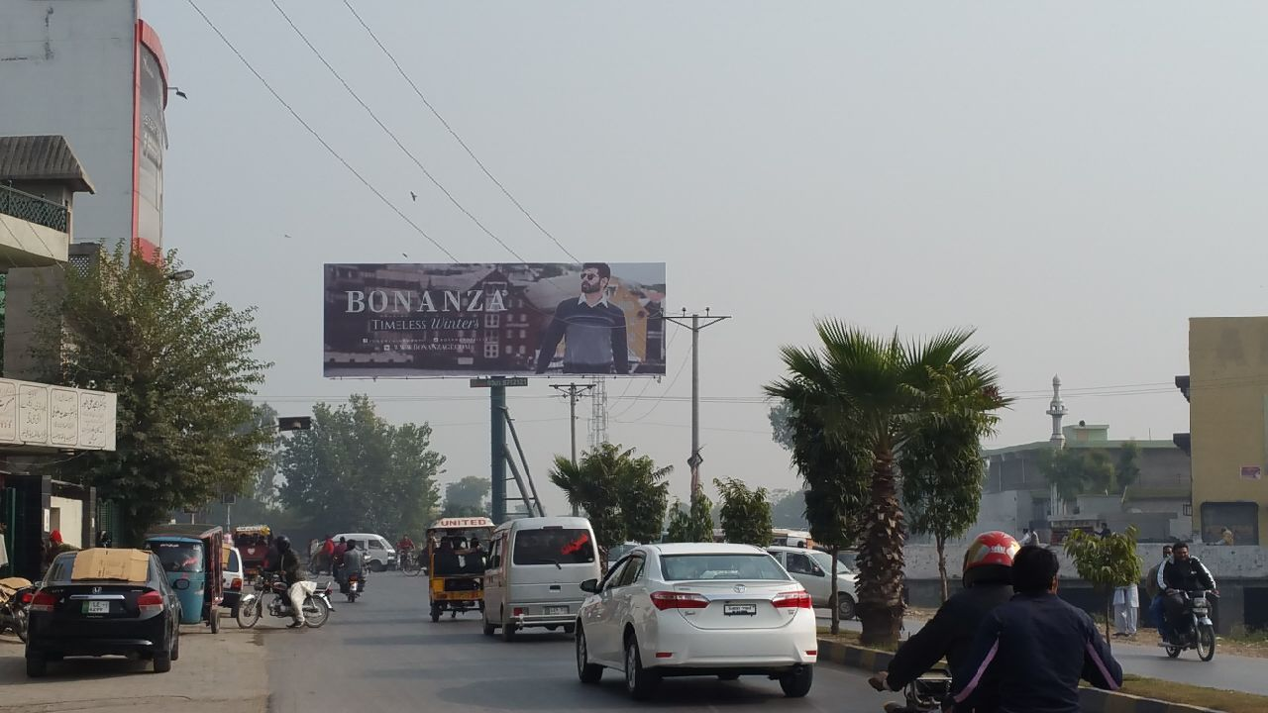
Sialkot
Size | 60x20
Availability
Rate P/M | Rs:300,000/-
Location | Direction
Sialkot cantt | FTCF:Saddar Bazar Bhed Pulli Cantt Coming From Kh.Safdar Road Cantt Going to Aziz Shaheed Road cantt V Mall, Saddar Bazar , Clover Plaza

Slide 8
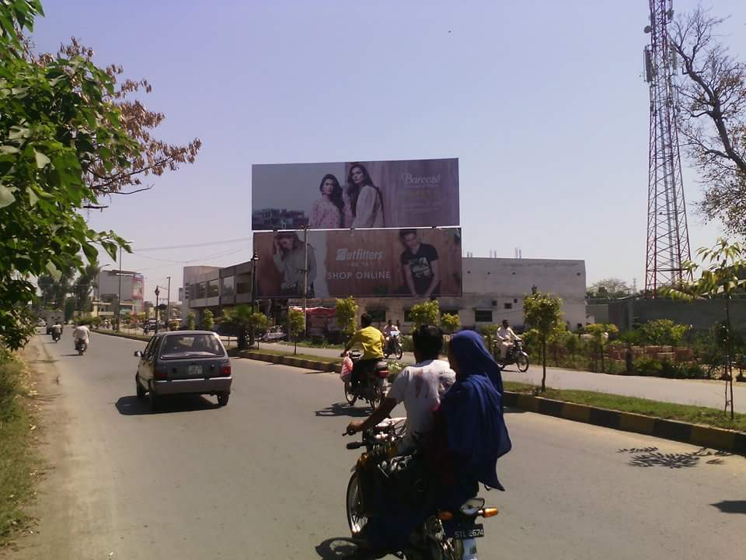
Sialkot
Size | 60x20
Availability
Rate P/M | Rs:250,000/-
Location | Direction
Sialkot cantt | FTCF:Kh.Safdar Road Near Bhed Pulli Coming From Commissioner road. Going to Bhed pulli Saddar Bazar Ghanta Ghar V Mall.

Slide 9
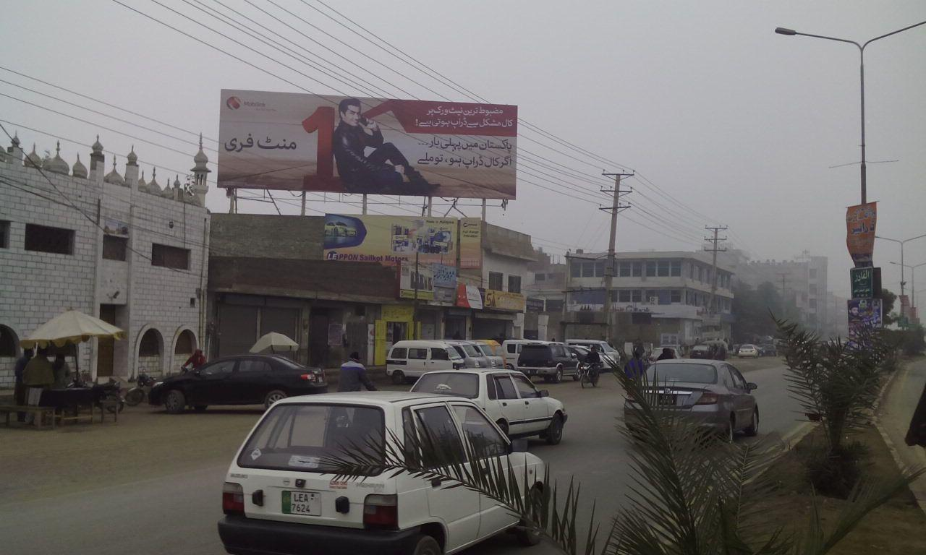
Sialkot
Size | 60x20
Availability
Rate P/M | Rs:200,000/-
Location | Direction
Sialkot city | FTCF:Sublime Chowk,CHINA CHOWK / KASHMIR ROAD FTCF :Waziranabad,AIR PORT DEFENCE ROAD GOING TOWARDS G.BUS STAND AND KFC AZIZ SHAHEED CANNT

Slide 10
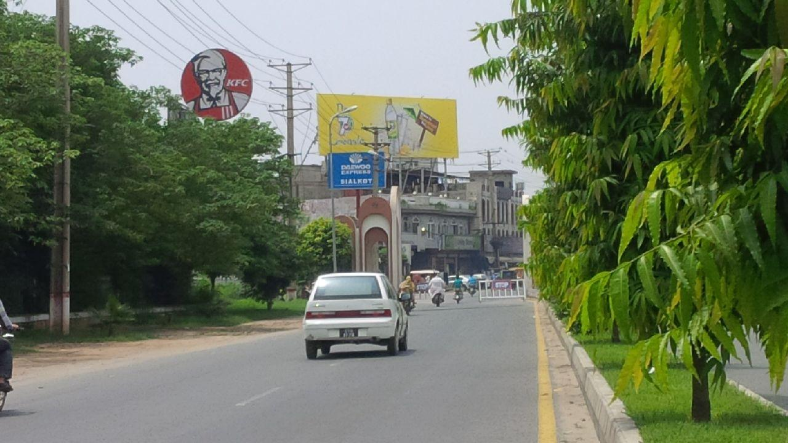
Sialkot
Size | 60x20
Availability
Rate P/M | Rs:200,000/-
Location | Direction
Sialkot city | FTCF:Aziz Shaheed Road Larri AddaComing From. Saddar Bazar. Going to Kashmir road, Larri Adda

Slide 11
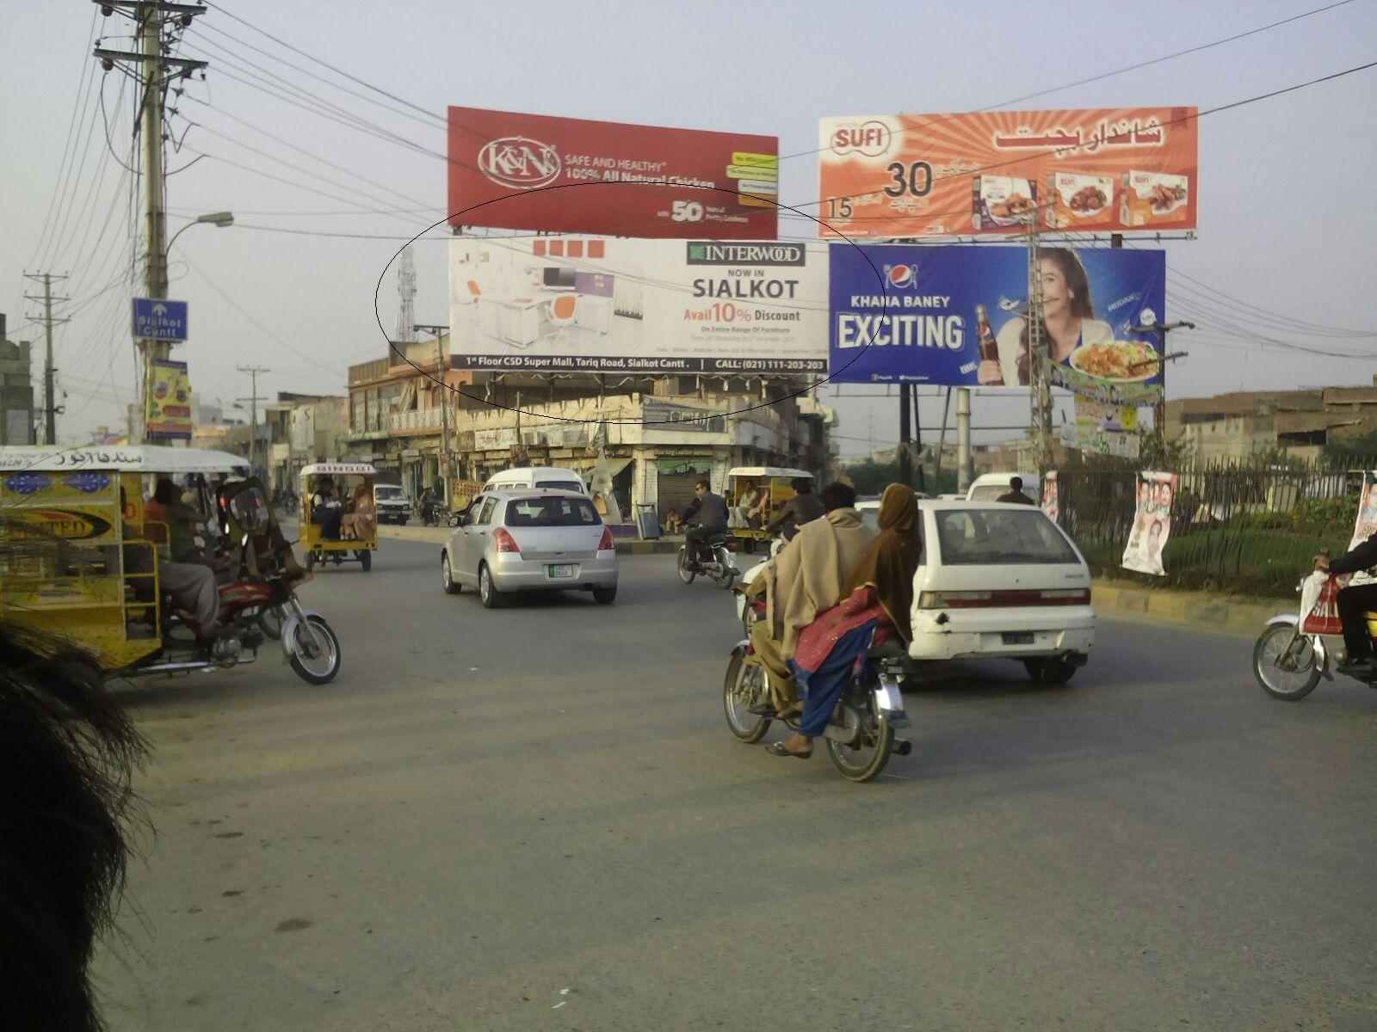
Sialkot
Size | 60x20
Availability
Rate P/M | Rs:225,000/-
Location | Direction
Silkot city | FTCF:City Enterance from DaskaComing From. Daska Going to Defence road,Kashmir road, Larri Adda, Aziz Shaheed

Slide 12
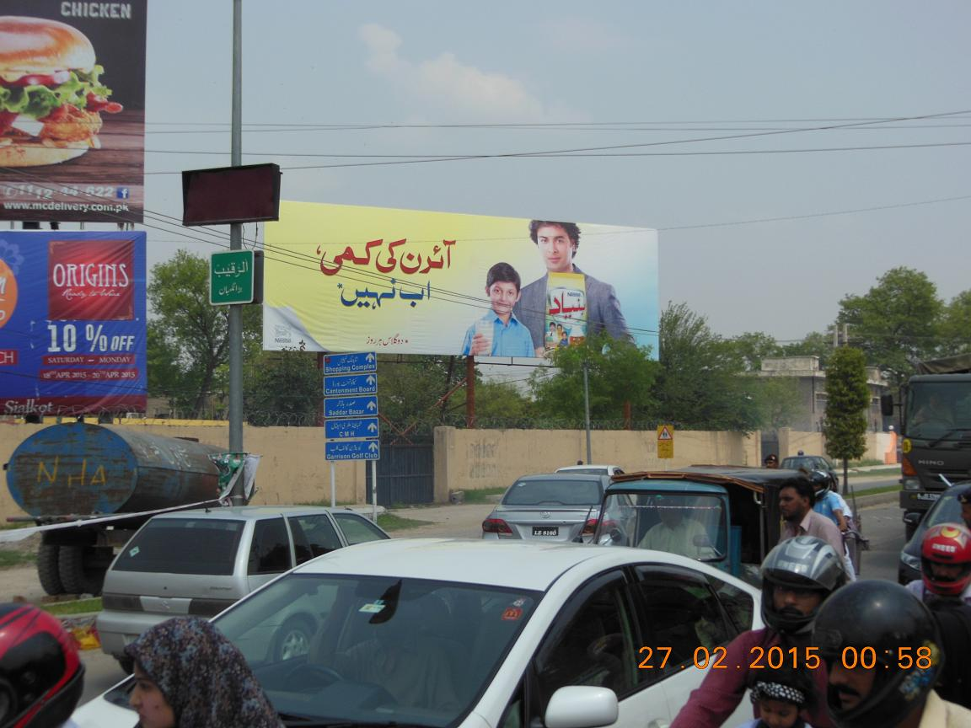
Sialkot
Size | 60x20
Availability
Rate P/M | Rs:250,000/-
Location | Direction
Silkot cantt | FTCF:Pakistan chowk Aziz Shaheed Road Cantt( Ptcl)Coming from. Larri Adda , Mahmood Ghaznvi Road Going to Ghanta Ghar Chowk, V Mall Ghalib Road cantt

Slide 13
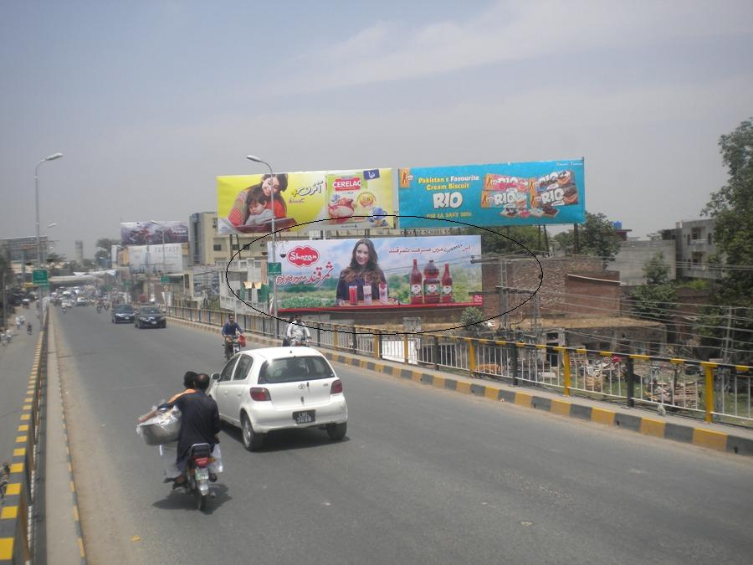
Sialkot
Size | 60x20
Availability
Rate P/M | Rs:200,000/-
Location | Direction
Silkot cantt | FTCF:Jinnah Brdige Coming from Circular road.Going saddar Bazar Cantt,Aziz Shaheed road Cantt,Kh.Safdar road

Slide 14
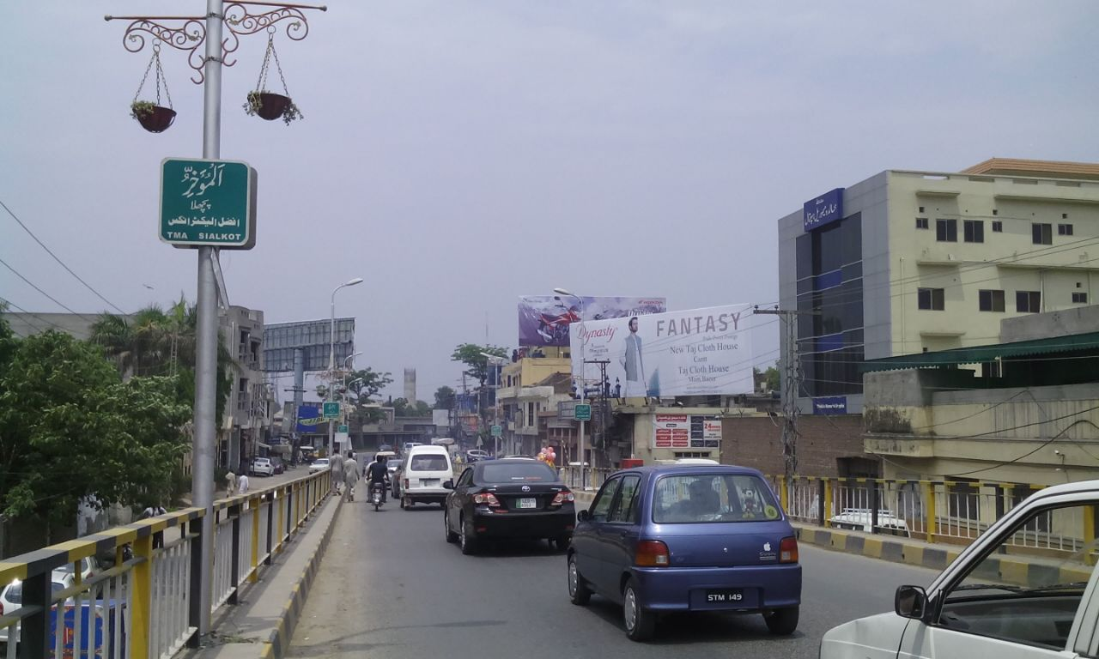
Sialkot
Size | 60x20
Availability
Rate P/M | Rs:200,000/-
Location | Direction
Silkot cantt | FTCF:Jinnah Bridge Coming from Circular road.Going saddar Bazar Cantt,Aziz Shaheed road Cantt,Kh.Safdar road

Slide 15
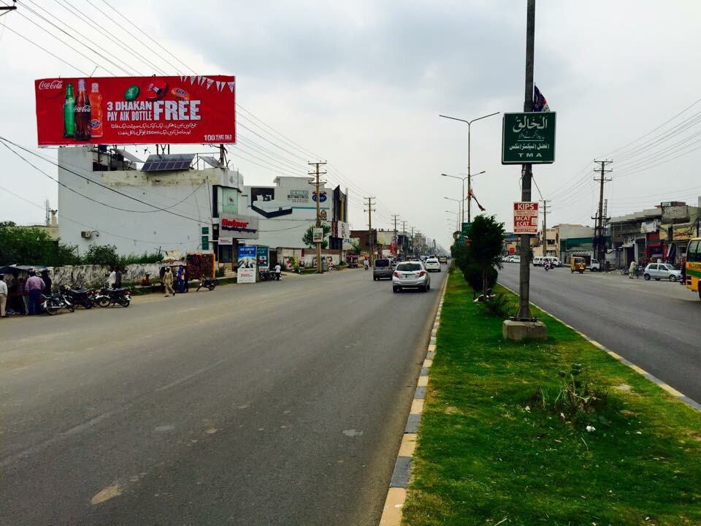
Sialkot
Size | 60x20
Availability
Rate P/M | Rs:200,000/-
Location | Direction
Silkot city | FTCF:Kashmir Road Coming From. Daska Going to Aziz Shaheed Road Cantt, Clover Plaza, Paris Road, Kh.Safdar Road

Slide 16
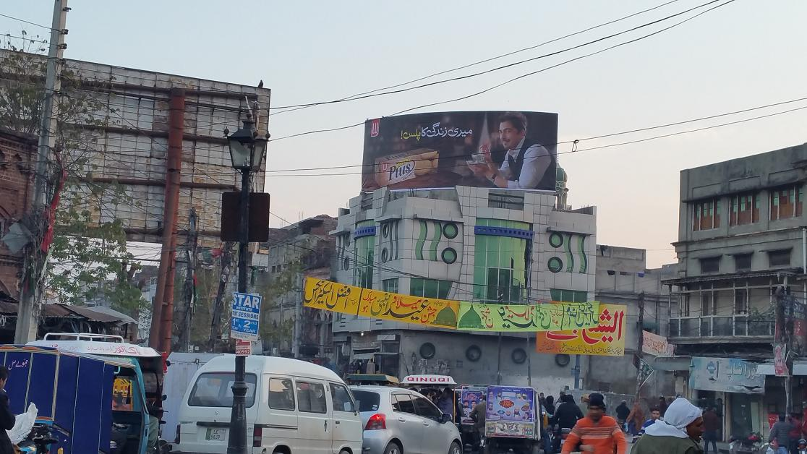
Sialkot
Size | 47x16
Availability
Rate P/M | Rs:150,000/-
Location | Direction
Silkot city | FTCF:Drama Wala Chowk / Alama Iqbal Chowk. From PARISTripple View Site. Coimng from Paris rd Going to Railway rd, Jinah Bridge, Ramtalai, Mujahid rd , Lh Bazar

Slide 17
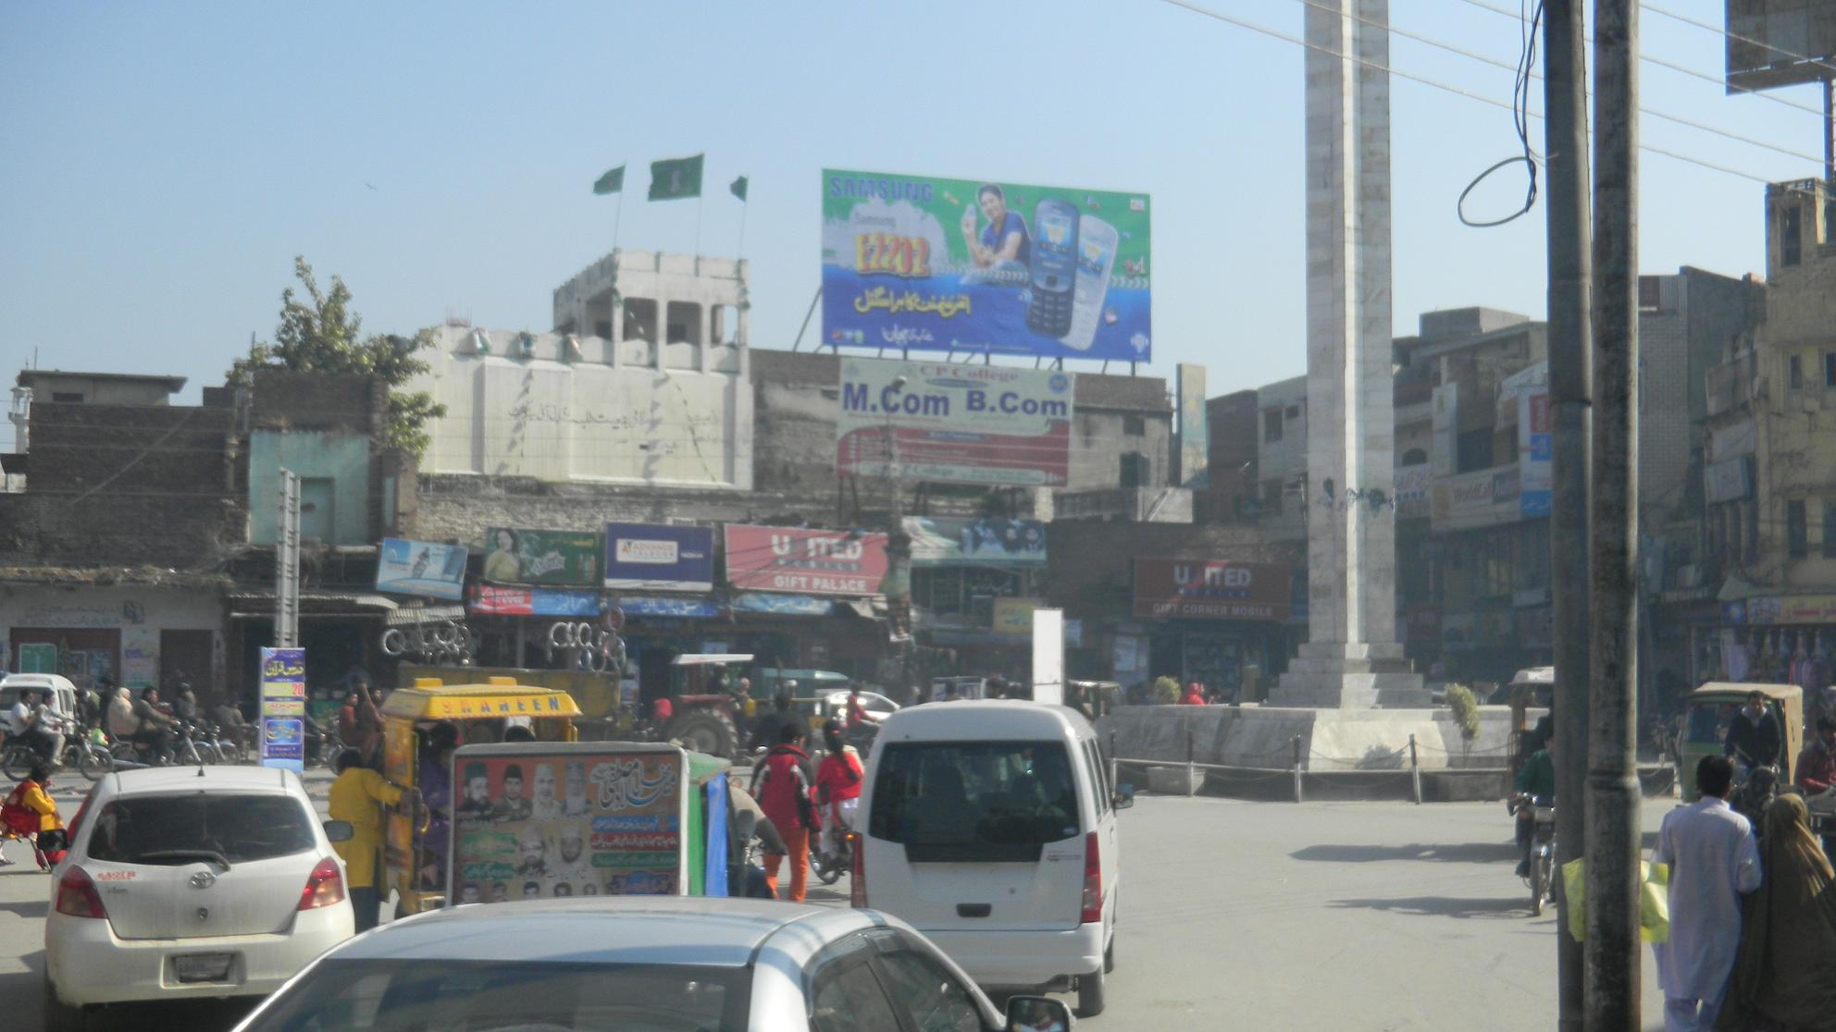
Sialkot
Size | 40x20
Availability
Rate P/M | Rs:150,000/-
Location | Direction
Silkot city | FTCF:Drama Wala Chowk / Alama Iqbal Chowk. From PARISCoimng from Paris rd Going to Railway rd, Jinah Bridge, Ramtalai, Mujahid rd , Lh Bazar

Slide 18
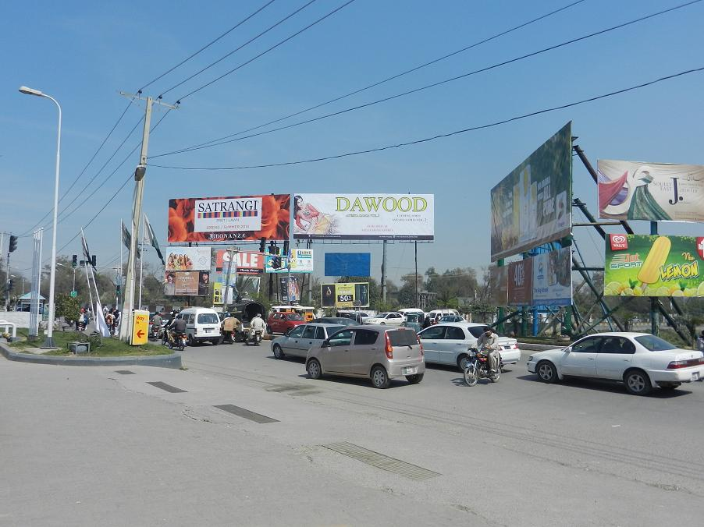
Sialkot
Size | 60x20
Availability
Rate P/M | Rs:300,000/-
Location | Direction
Silkot cantt | FTCF:Shell Pump Chowk Cantt Dawood Double view Coming from Paris Road Going to Mahmood Ghaznavi rdAllama Iqbal rd, Fatima Jinah Park, Model Town Khadim Ali rd, Aziz Shaheed

Slide 19
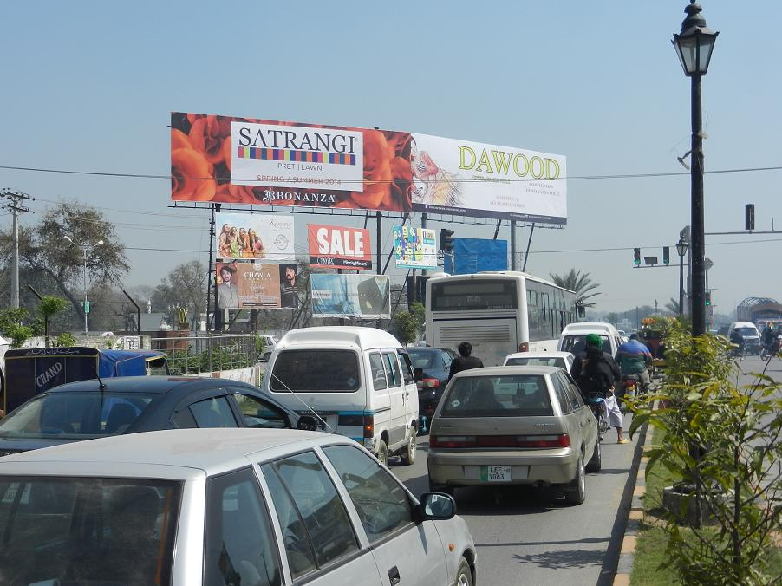
Sialkot
Size | 60x20
Availability
Rate P/M | Rs:300,000/-
Location | Direction
Silkot cantt | FTCF:Shell Pump Chowk Cantt SATRANGI Coming from Larri Adda Fatima Jinah Park , Going to Mahmood Ghaznavi rd,Aziz Shaheed, Paris Raod,Allama Iqbal road Bhed Pulli Cantt

Slide 20
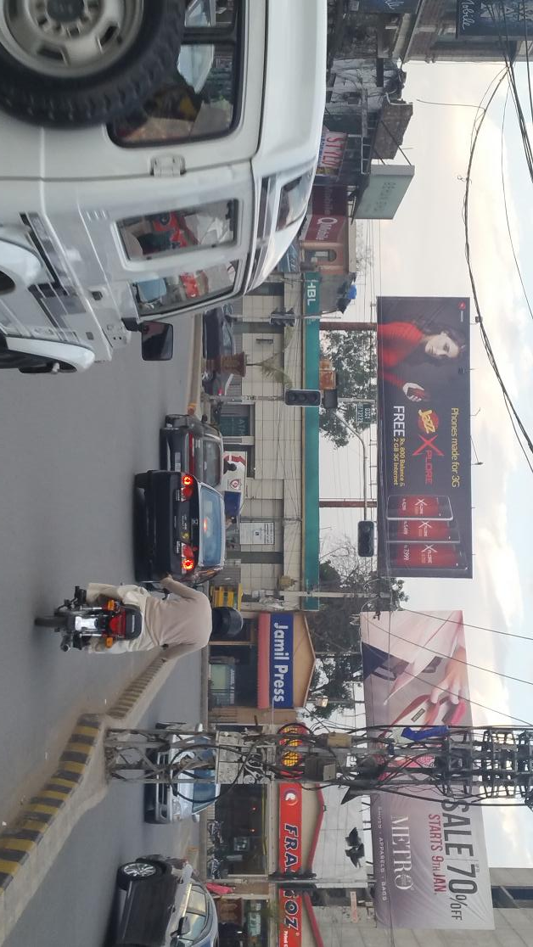
Sialkot
Size | 60x20
Availability
Rate P/M | Rs:375,000/-
Location | Direction
Silkot cantt | FTCF:Ghanta Ghar Chowk Aziz Shaheed rd Coming from Jinnah Bridge Saddar Bazar, Kh.Safdar Going to Covering Shoping Mall Main Markets 15 Div V Mall,Clover Plaza 8 Div , Aziz Shaheed

Slide 21
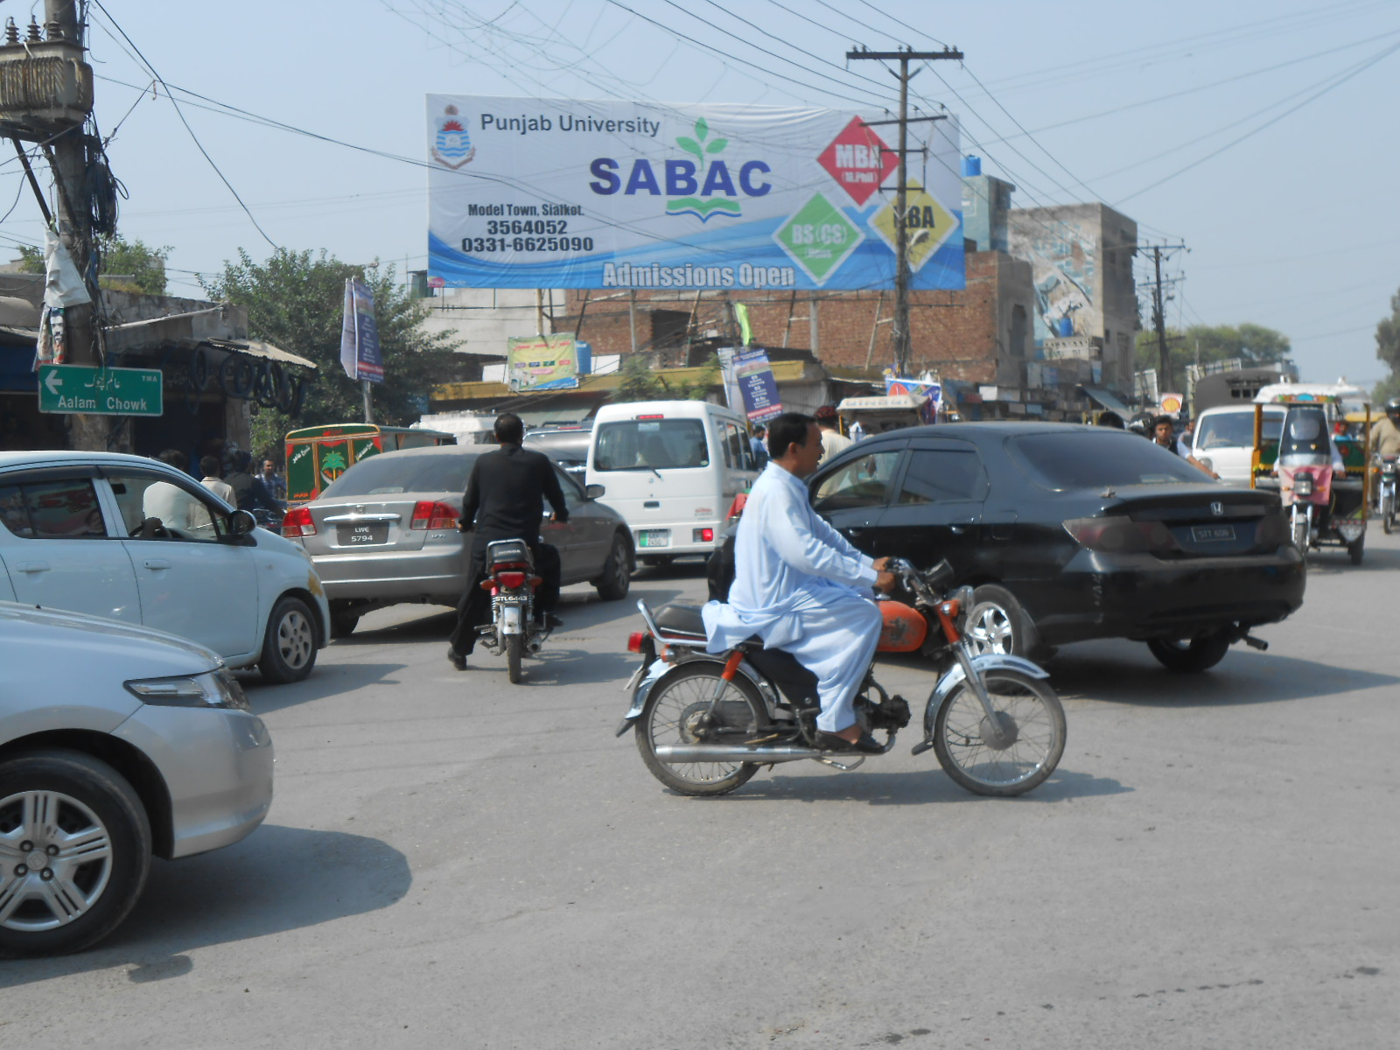
Sialkot
Size | 60x20
Availability
Rate P/M | Rs:225,000/-
Location | Direction
Silkotcity | FTCF:Khadim Ali road Mandi Phatik Coming from : Aalam Chowk Shahab pura road Going to : Model town , khawaja safdar road, Kashmir road

Slide 22
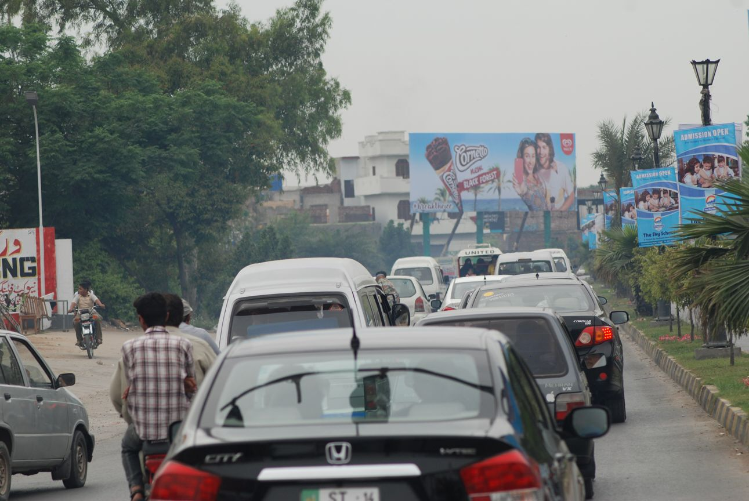
Sialkot
Size | 60x20
Availability
Rate P/M | Rs:300,000/-
Location | Direction
Silkot cantt | FTCF:Shell Pump Chowk Cantt Coming from Paris Road Allama Iqbal Civil Chowk Going to Kashmir road, Larri Adda, Fatima Jinah Park, Model Town Khadim Ali rd, Aziz Shaheed

Slide 23
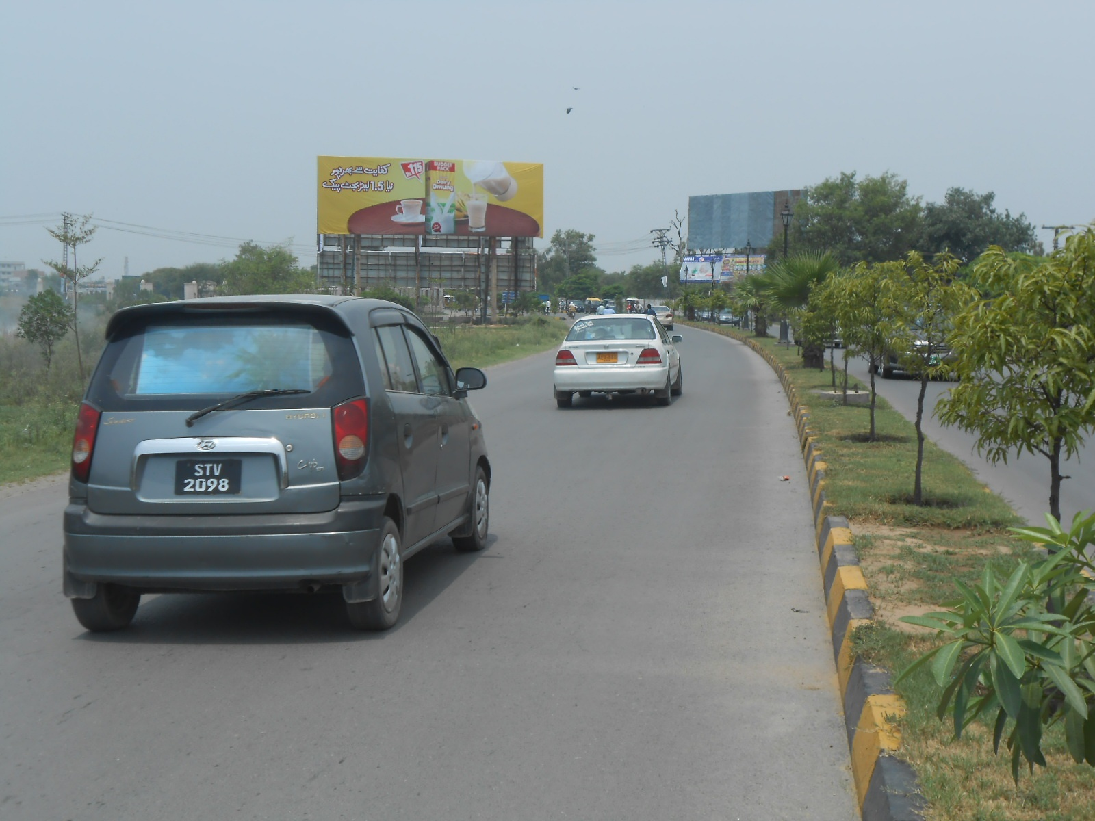
Sialkot
Size | 60x30
Availability
Rate P/M | Rs:300,000/-
Location | Direction
Silkot cantt | FTCF:Civil Hospital Chowk Cantt Coming from Bhed Pulii Saddar Bazar.Going to Paris rd shell pump,Kashmir road, Larri Adda, Fatima Jinah Park, Model Town Khadim Ali rd

Slide 24
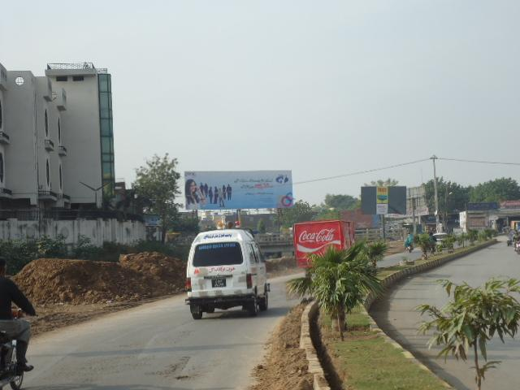
Sialkot
Size | 60x20
Availability
Rate P/M | Rs:225,00/-
Location | Direction
Silkot cantt | FTCF:Model Town Pulli Coming from Paris Road Allama Iqbal Civil Chowk Going to Kashmir road, Model Town Khadim Ali

Slide 25
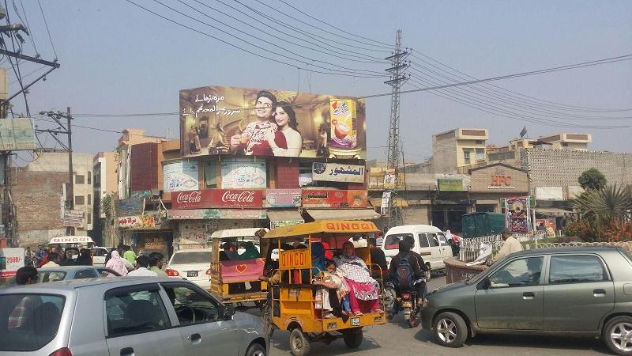
Sialkot
Size | 45x15
Availability
Rate P/M | Rs:175,000/-
Location | Direction
Silkot cantt | FTCF:Aalam ChowkComing from Factory Area Shahab roadGoing to Drama wala chowk, Kashmir road, Model Town Khadim Ali

Slide 26
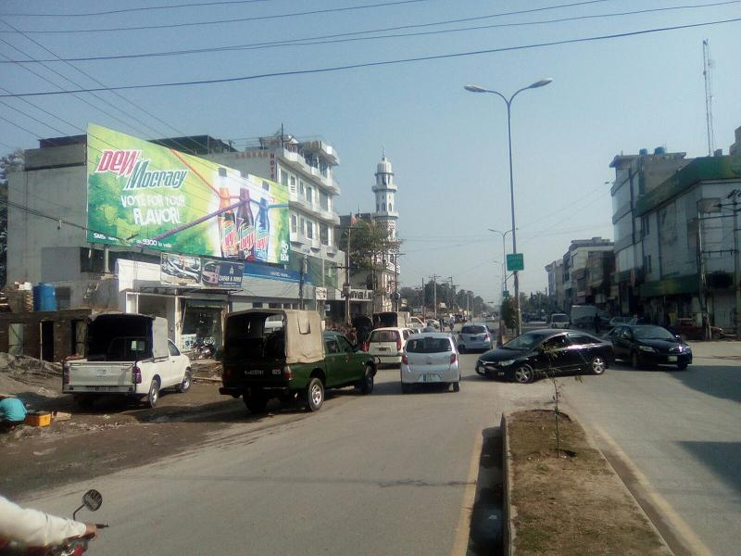
Sialkot
Size | 60x20
Availability
Rate P/M | Rs:250,000/-
Location | Direction
Silkot cantt | FTCF:Aziz Shaheed rd Ghanta Ghar ChowkComing from Jinnah Bridge Saddar Bazar, Kh.Safdar Going to Covering Shoping Mall Main Markets 15 Div V Mall,Clover Plaza 8 Div , Aziz Shaheed

Slide 27
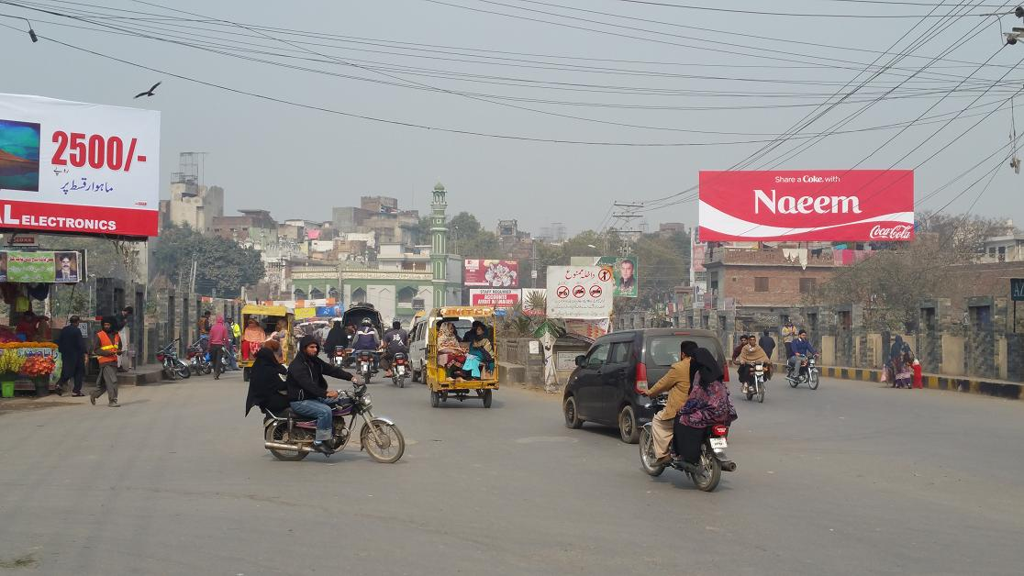
Sialkot
Size | 60x20
Availability
Rate P/M | Rs:200,000/-
Location | Direction
Silkot cantt | FTCF:City Entrance from Pasrur,Narowal Coming from Pasrur,Narowal,Aymanabad road, Gulshan park Going Circular road,Jinnah Bridge,saddar Bazar Cantt,Aziz Shaheed road Cantt,Kh.Safdar road

Slide 28
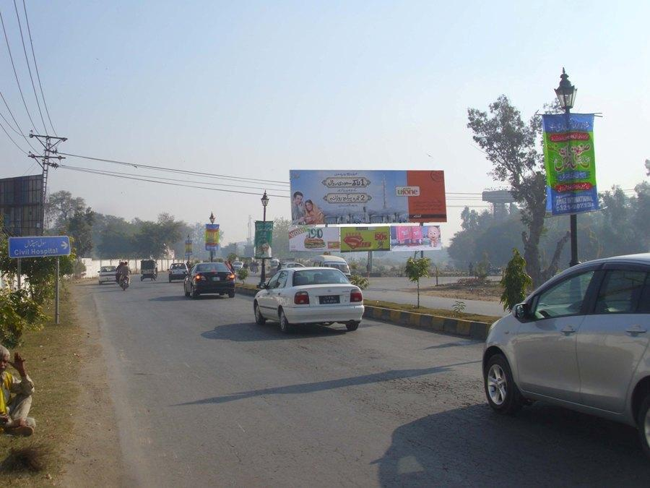
Sialkot
Size | 60x20
Availability
Rate P/M | Rs:275,000/-
Location | Direction
Silkot cantt | FTCF:Civil chowk Cantt Coming from Paris road,Going to Saddar Bazar,Aziz Shaheed rd cantt, Jinnah Bridge, Comissioner Road

Slide 29
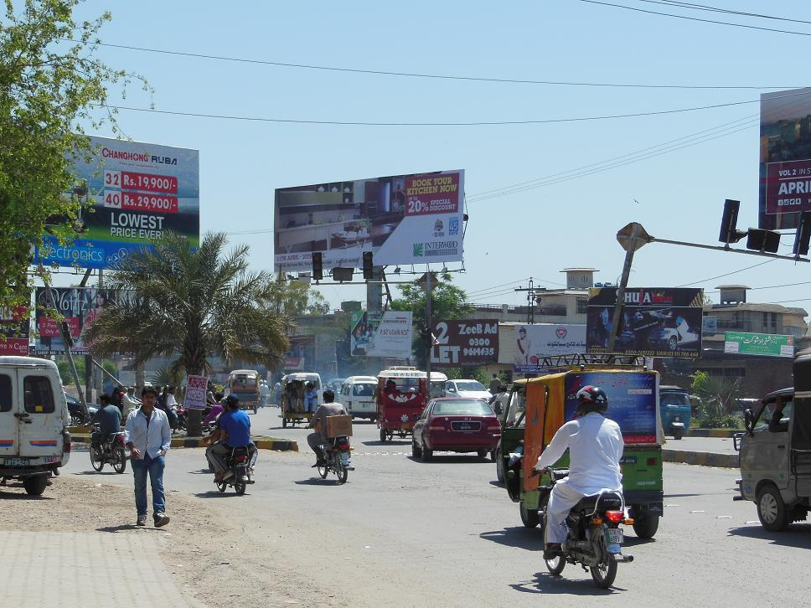
Sialkot
Size | 60x20
Availability
Rate P/M | Rs:225,000/-
Location | Direction
Silkot cantt | FTCF:Jail Chowk Bus Stand Coming from Larri Addad Kashmir Road,Going to Jail road Kutchery Chowk, Drama Wala chowk

Slide 30
Ad Solution
TERMS & CONDITIONS
First time skin installation and removing is free.
Skin printing charges are not included in the proposed rates.
These rates are exclusive of all kinds of taxes.
If skin is damaged due to weather, changing/re-printing charges will be borne by the client.
The payment will be made 50% in advance and the remaining balance will be payable through 15 days post dated cheque, from the day, the display starts.
For locking the sites please inform us within 1-3 working days.

